Slide 1
CONERSIONS IN ORACLE APPS

Slide 2
CONVERSION
Conversion: Conversions are data migration program used to migrate data from Legacy system to Oracle System.
It is one time process.
Let us suppose client is using some legacy system and now moving to oracle Apps. So, whatever data is present in existing legacy system must also be present in oracle Apps Tables. ‘Conversion’ Program can be developed to load the data into Oracle Apps tables

Slide 3
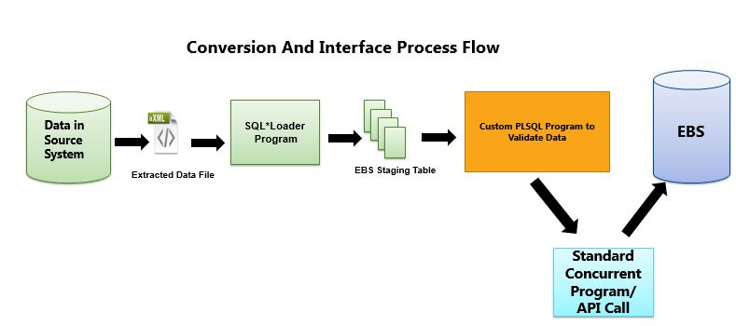
Conversion Process Flow

Slide 4
STEPS IN CONVERSION
:
Get the Item Flat files from the customer. File types could be .csv, .xls, .txt, .xml
Create Staging table same as Item flat file columns.
Create SQL Loader (Control file – .ctl file) to load Data into staging table from flat file.
Register SQL Loader program as Concurrent Program in Oracle Apps.
Run The program to insert data into staging table. Below are the files used while working on SQL Loader Program.
Control file .ctl = to transfer the data from flat file to staging table.

Slide 5
STEPS IN CONVERSION
Flat file .csv = raw data file which we will receive from legacy system
Log file .log = It will display the execution of the program.
Bad file .bad = These records could have been rejected by SQL*Loader
Discard file .dis = It will contain records that didn’t meet the criteria.
Create PL/SQL Package to validate data in Staging Table before transferring into standard table
The item interface table contains every column in the Oracle Inventory item master table, The columns in the item interface correspond directly to those in the item master table

Slide 6
If the record is validated then status_flag should be updated with ‘V’. If the record is error out then status_flag should be updated with ‘E’ and the record should be inserted into custom error table.
PLSQL Program will pick the valid records from staging table and insert into standard staging table
RUN the Standard Concurrent Program to populate data into standard Item table.
Standard Concurrent Program can be called from Package itself using fnd_request.submit_request and after this no need to run same program separately using front end screen.

Slide 7
Usage Of API:
API: The Application Programmatic Interface or API is a standard PL/SQL packaged procedure provided by Oracle Apps that can be used as an alternative to insert and update data in Oracle Applications. There are some benefit of using API
It is an Oracle Predefined PL/SQL Package
Used to do built-in functionality
Using API’s we will reduce the code
We use API’s to update, retrive, Insert data from/to Database

Slide 8
We also use them to write messages into the log, output files
Using API’s we interact with other software programs
The name Interface in API stands for Inbound/Outbound Interface in Oracle Applications.
So using API’s we can load data from/to legacy systems to/from Oracle Apps Database. Some examples are:

Slide 9
THANK YOU

