Slide 1
Safe Harbor Statements
The following is intended to outline our general product direction. It is intended for information purposes only, and may not be incorporated into any contract. It is not a commitment to deliver any material, code, or functionality, and should not be relied upon in making purchasing decisions.
The development, release, and timing of any features or functionality described for Oracle’s products remains at the sole discretion of Oracle.

Slide 2

Fusion HCM Cloud Integration File Based Loader ( Rel 5) Prabu Iyer ,Timm Hannula –Fusion HCM Development

Slide 3

Oracle Fusion Integration Framework
The “Big Picture”
File Based Loader - Simplified high volume data loading based on CSV , XML, DAT
Spreadsheet Loader – Simplified Low volume data loading via spreadsheets
Specialized Loaders -
Payroll Batch Element Entries Benefits, Talent
HCM Extract - Extract, Transform and format large amounts of complex data
BI Publisher - Extract data from HCM Business Object repository in a preformatted template
OTBI - Extract data from HCM Business Object repository to provide real-time operational reporting & file creation
Staging Area
Core HR
HCM Extract
Benefits
Performance Management
Web
Services
Goal Management
Fusion Analytics
Web services – Programmatic data exchange with external systems
Talent
Compensation

Slide 4
Agenda
FBL Overview
Demo - Load /Update Scenarios
Q/A

Slide 5
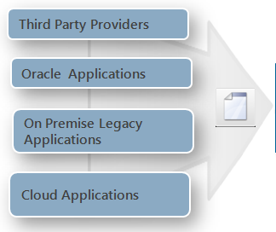

File Based Loader
Overview
Load HR data from your source system to Fusion HCM
Flat file based data upload utility
Validates and loads the data
Support for Error Correction
Supports complex data objects with full date effective history
Supports multiple data sources
Load data from any source via Flat Files in Fusion Object Shape
Notes:
Load data in Fusion Object shape via Flat files in a CSV form for specific Business Objects
Supports Initial data creation and ongoing updates
Suited for Large volumes, hierarchical data
Supports any source to Fusion HCM integration scenarios
Benefits
Allows customer to leverage existing on-premise investments
Integration allows you to migrate to the cloud – no need to rip and replace your functioning on-premise system

Slide 6
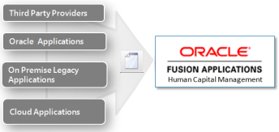




File Based Loader
Process Flow
csv datafile
Bulk Data Load
CSV format
Data Conversion
Initial & On going
Fusion HCM
Load data to Interface Tables
Validate/
Correct Errors
Load data to Fusion
csv datafile
Multiple
Source Systems
Notes:
File-Based Loader enables you to bulk-load data to Oracle Fusion HCM from any external source.
Customers use any ETL tool e.g. ODI Studio to extract data conforming to Fusion object shape in to CSV files from one or more source systems. These files are uploaded to Fusion HCM Cloud . These files will be processed using scheduled background jobs which load the file data into staging tables, and then asynchronously process staging data to the Fusion HCM transactional tables. The processing allows for error-correction and generation of cross-reference information if needed for new records.
Key Features:
Allows multiple source systems to import data into Fusion HCM.
Simplify data conversion by loading data using standard flat file.
Supports Creation of new LBO instances only.
Data can be loaded incrementally.
Supports Date Effective history enabled objects.
Leverages current Data Loader services and UI.
Better performance due to PLSQL BULK/caching capabilities

Slide 7
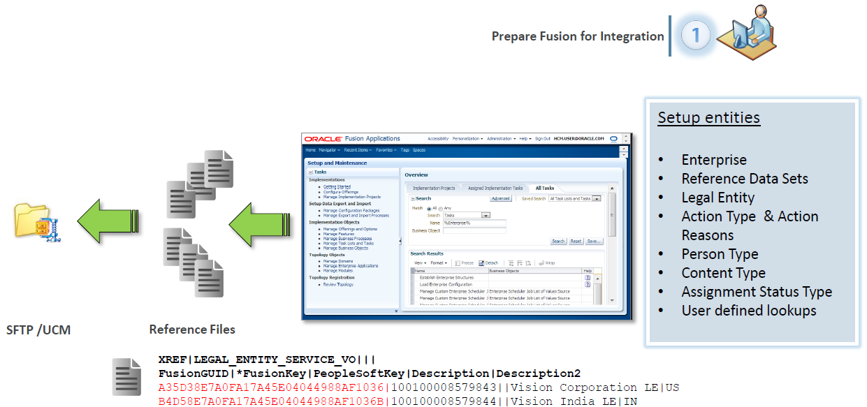
Process Flow
1. Prepare Fusion for Integration

Slide 8
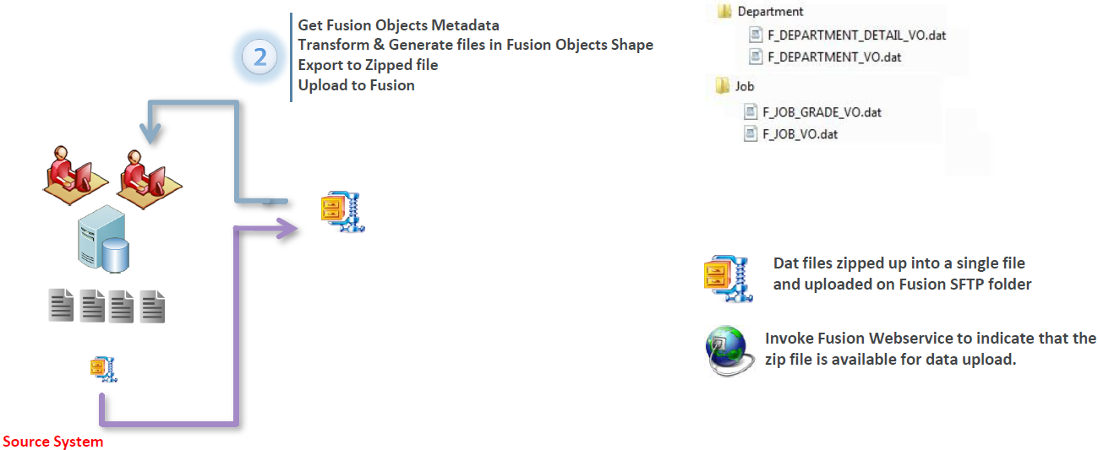
Process Flow
2. Transform and Generate Data Files

Slide 9
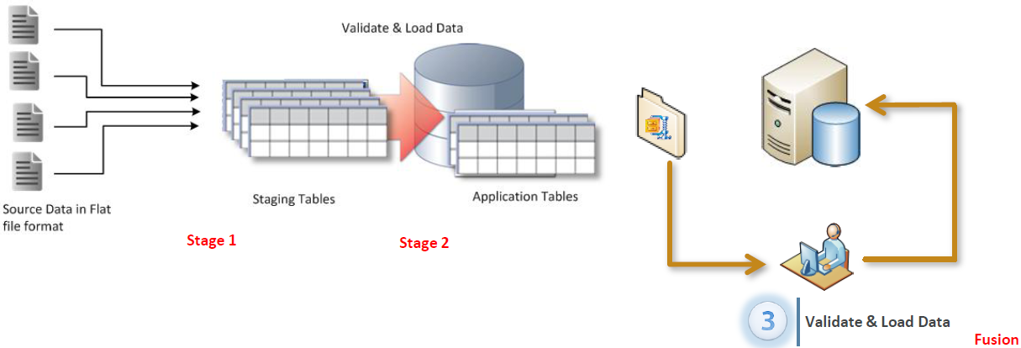
Process Flow
3. Validate and Load Data

Slide 10
File Based Loader Who does what..
Customer/Partner Activity
Perform Schema Gap analysis
Compare the fields from source data with the available fields in Fusion HCM object schema
Map source data fields to Fusion HCM object
Prepare Source data
Cleanse the source data
Import data to Fusion HCM schema
Import data to Fusion HCM schema
Create Files and transfer files via SFTP
Import Files to Fusion HCM stage area
Validate data
Create the files in Fusion HCM format
Import the files in to Fusion HCM staging tables via Data Exchange
Transfer the files to Fusion HCM via Secure FTP
Verify the imported data
Fix import errors and re-import if necessary
Observe correct order of the importing objects
Transform the source data
Write Extraction routines
Delivered Functionality

Slide 11
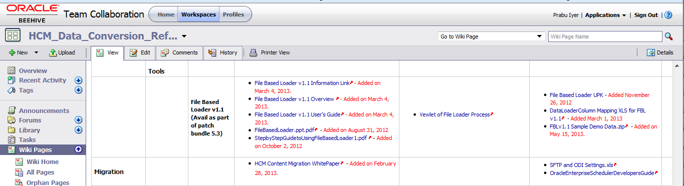
FBL Documents /References
Integrations Library:
The Data Conversion Reference Library provides customers and partners with timely data conversion related information specific to their Fusion HCM implementation..
Email Timm.Hannula@oracle.com for access with you email address .
https://beehiveonline.oracle.com/teamcollab/overview/HCM_Data_Conversion_Reference_Library_Workspace

Slide 12
File Based Loader Supported Business Objects
Work Structures
Location
Organizations
Business Unit
HR Org as Departments
Job Family
Job
Position
Grade
Talent
Competencies
Qualification
Rating Scales & Levels
Schools & Colleges
Employment
Person
Person Name
Person National Identifier
Person Address
Person Legislative
Person Phone
Person Email
Person Documentation
Person Type Usage
Assignment
Assignment Work Measure
Assignment Supervisor
Work Term
Work Relationship
Person Profile
Person Profile Items
Compensation
Salary Basis
Salary, Salary Components
Element Entries (Bonus, Allowances)

Slide 13
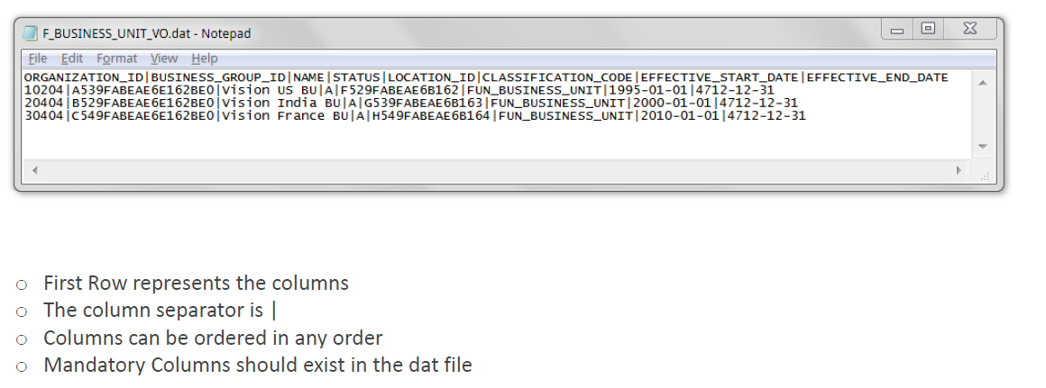
File Based Loader
Dat File Structure

Slide 14
File Based Loader Data Loading Sequence
Action
ActionReasons
Location
BusinessUnit
Grade
GradeRate
JobFamily
Job
SalaryBasis
Establishment
Rating Model
ContentItem
ContentItemRelationship
Person
PersonDocumentation
Department
Position
WorkRelationship
Salary
Element Entry
Profile

Slide 15
File Based Loader Objects Filenames
Object Name | Data-File Name
Person | F_PERSON_ADDRESS_VO.dat
 | F_PERSON_EMAIL_VO.dat
 | F_PERSON_ETHNICITY_VO.dat
 | F_PERSON_LEGISLATIVE_DATA_VO.dat
 | F_PERSON_NAME_VO.dat
 | F_PERSON_NATIONAL_IDENTIFIER_VO.dat
 | F_PERSON_PHONE_VO.dat
 | F_PERSON_VO.dat
Profile | F_PROFILE_ITEM_VO.dat
 | F_PROFILE_RELATION_VO.dat
 | F_PROFILE_VO.dat
RatingModel | F_RATING_LEVEL_VO.dat
 | F_RATING_MODEL_VO.dat
Salary | F_SALARY_COMPONENT_VO.dat
 | F_SALARY_VO.dat
SalaryBasis | F_SALARY_BASIS_VO.dat
WorkRelationship | F_ASSIGNMENT_SUPERVISOR_VO.dat
 | F_ASSIGNMENT_VO.dat
 | F_ASSIGNMENT_WORK_MEASURE_VO.dat
 | F_WORK_RELATIONSHIP_VO.dat
 | F_WORK_TERMS_VO.dat
Object namE | Data-File Name
BusinessUnit | F_BUSINESS_UNIT_VO.dat
ContentItem | F_CONTENT_ITEM_RATING_DESCRIPTION_VO.dat
 | F_CONTENT_ITEM_VO.dat
Department | F_DEPARTMENT_DETAIL_VO.dat
 | F_DEPARTMENT_VO.dat
ElementEntry | F_ELEMENT_ENTRY_VALUE_VO.dat
 | F_ELEMENT_ENTRY_VO.dat
Establishment | F_ESTABLISHMENT_VO.dat
Grade | F_GRADE_VO.dat
GradeRate | F_GRADE_RATE_VALUE_VO.dat
 | F_GRADE_RATE_VO.dat
Job | F_JOB_GRADE_VO.dat
 | F_JOB_VO.dat
Location | F_LOCATION_VO.dat
Position | F_POSITION_GRADE_VO.dat
 | F_POSITION_VO.dat
Sample Data https://beehiveonline.oracle.com/content/dav/Oracle/HCM_Data_Conversion_Reference_Library_Workspace/Documents/4.%20Load/1.%20Tools/2.%20File%20Based%20Loader/3.%20References/Sample%20Load%20ZIP%20File(s)/FBLv11SampleDemoData.zip

Slide 16
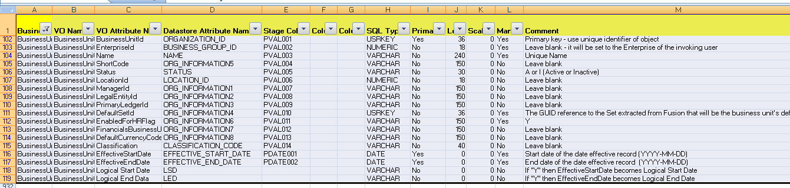
File Based Loader Mapping
DataLoaderColumnsV3.xlsx

Slide 17
Enterprise setup vs Conversion Objects
Data you setup online in Fusion | Data you should not setup online, instead convert using FBL
Enterprise Level Setup | Work structure & Employee Data
This is the basic setup in every project irrespective of conversion approach.
Once you configure following objects in Fusion Application, extract the GUIDs using cross reference process and use it in the input files for mapping. | There is no GUID extract required for data converted using FBL. You will specify IDs (JOBID, Location ID, Person ID ..etc) as part of your data file. FBL will use those IDs to build the key map internally.
Objects you configure online: • ACTION • ACTION_REASON • ACTION_REASON_USAGE • ACTION_TYPE • ASSIGNMENT_STATUS_TYPE • ENTERPRISE • LEGAL_ENTITY • LEGISLATIVE_DATA_GROUP • PERSON_TYPE • SETID • PAY_ELEMENT_TYPE_STD • PAY_ELEMENT_TYPE_SUPPL • PAY_INPUT_VALUE_STD • PAY_INPUT_VALUE_SUPPL • HRT_CONTENT_ITEM_LANGUAGE • HRT_CONTENT_TYPE • HRT_CONTENT_TYPE_RELAT • HRT_PROFILE_TYPE • HRT_QUALIFIER • HRT_QUALIFIER_SET • HRT_RELATION_CONFIG | Objects supported by FBL for conversion: Work Structures • Business Units • Locations • Job Families • Jobs • Grades • Grade Rates • Positions • Departments • Dept Hierarchy Transaction Data • Person • Work Relationships (work term, assignment, supervisor, work measure) Workforce Compensation • Salary Basis • Salary • Element Entries Talent Management • Content Items • Rating Models • Establishments • Profiles (Qualifications, Competencies, latest Performance Rating)

Slide 18
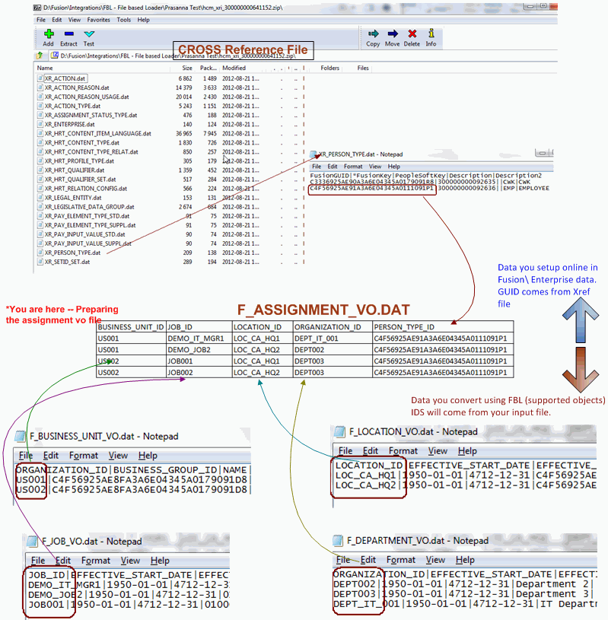
Cross Reference between the data files

Slide 19
Loading Flex Fields
FBL currently does not support loading of Flex Fields
There is a Interim work around process to load Flex field data
Details of this process here : https://beehiveonline.oracle.com/teamcollab/wiki/HCM_Data_Conversion_Reference_Library_Workspace:DFF+Load+Info

Slide 20
Demo
Scenario :
Load Locations
Update Locations
Sample Files Used In the Demo

Slide 21
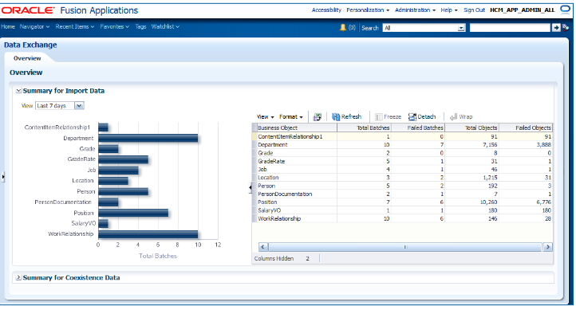
File Based Loader
Navigator->Work Force Mangement->Data Exchange
1
Load Business Object via
Flat Files
2
Submit Data Load Process
3
Monitor Data Load
4
Error Handling /Data Validation

Slide 22
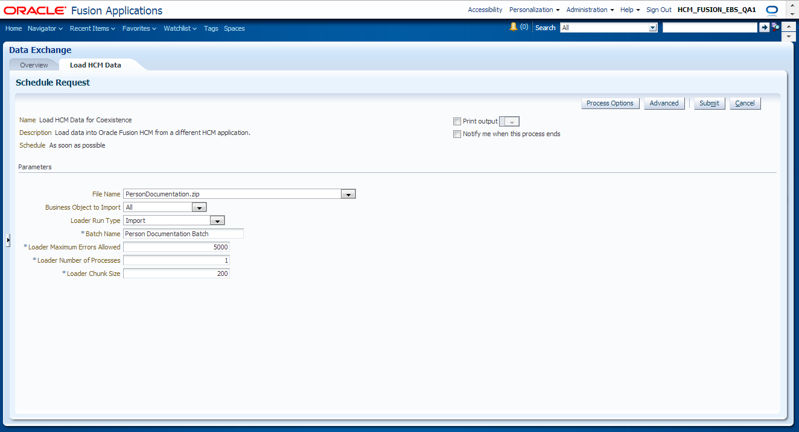
File Based Loader Load Data to Interface Tables – Load HCM Data
1
Load Business Object via
Flat Files
2
Submit Data Load Process
3
Monitor Data Load
4
Error Handling /Data Validation

Slide 23
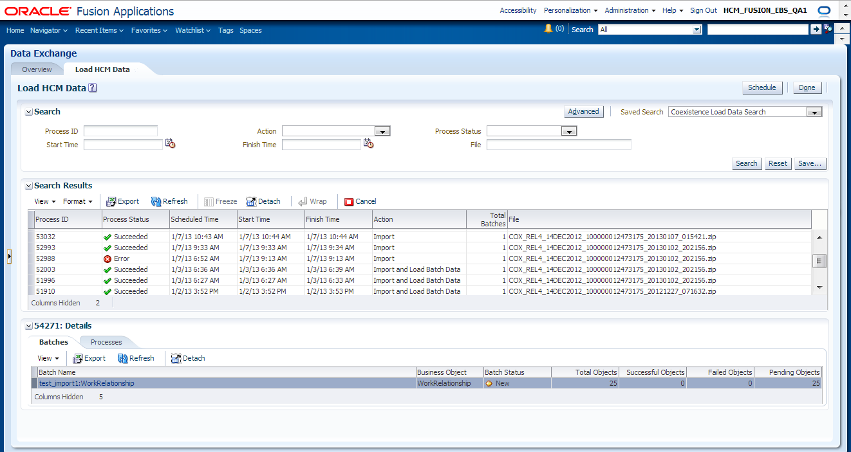
File Based Loader Load Data to Interface Tables – Load HCM Data
1
Load Business Object via
Flat Files
2
Submit Data Load Process
3
Monitor Data Load
4
Error Handling /Data Validation

Slide 24
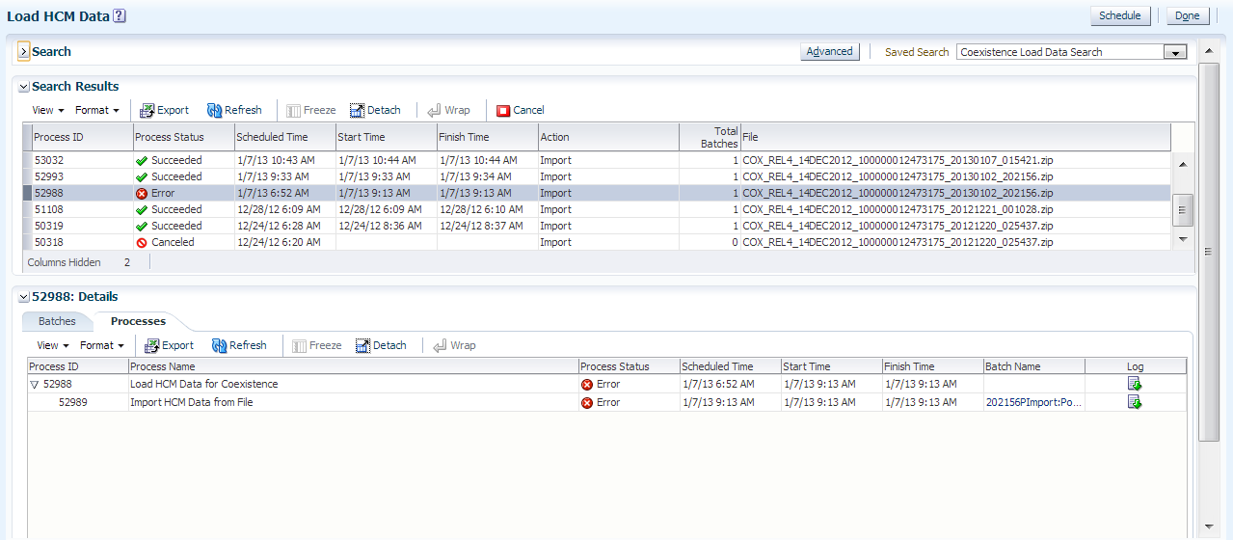
File Based Loader Load Data to Interface Tables – Load HCM Data - Error Management
1
Load Business Object via
Flat Files
2
Submit Data Load Process
3
Monitor Data Load
4
Error Handling /Data Validation

Slide 25
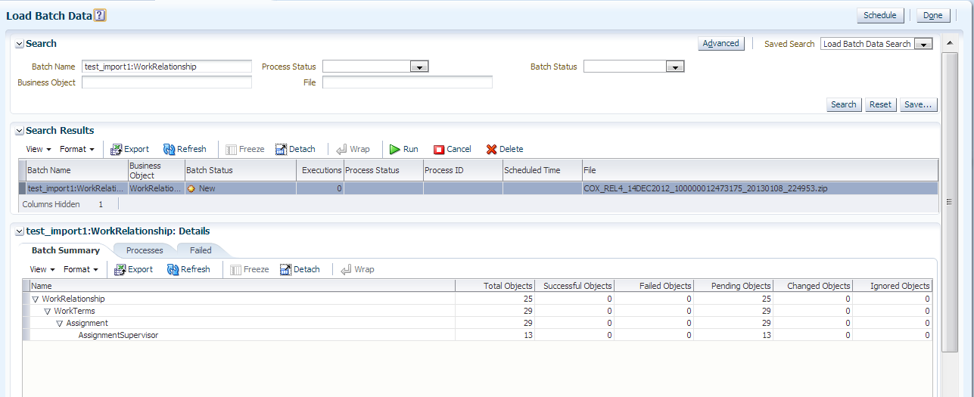
File Based Loader Load Data from Interface Tables to Application Tables– Load Batch Data
1
Load Business Object via
Flat Files
2
Submit Data Load Process
3
Monitor Data Load
4
Error Handling /Data Validation

Slide 26
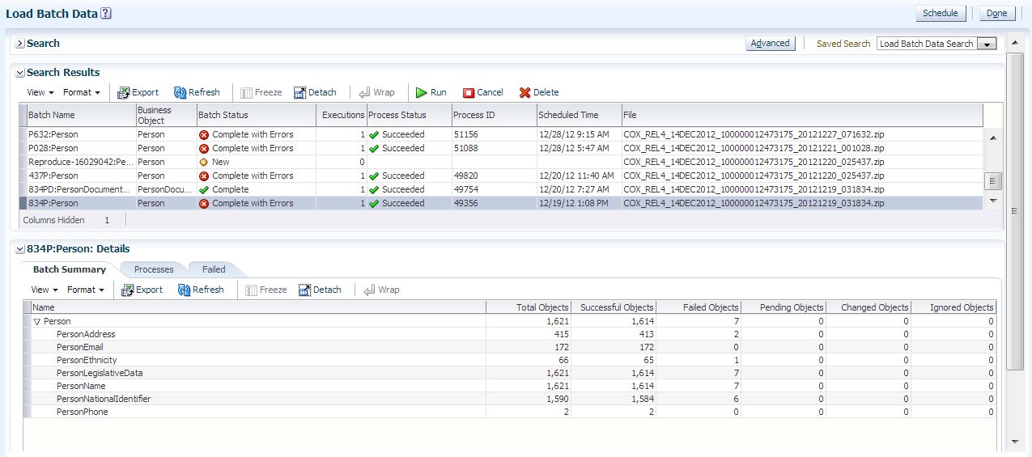
File Based Loader Load Data from Interface Tables to Application Tables– Load Batch Data – Error Management
1
Load Business Object via
Flat Files
2
Submit Data Load Process
3
Monitor Data Load
4
Error Handling /Data Validation

Slide 27
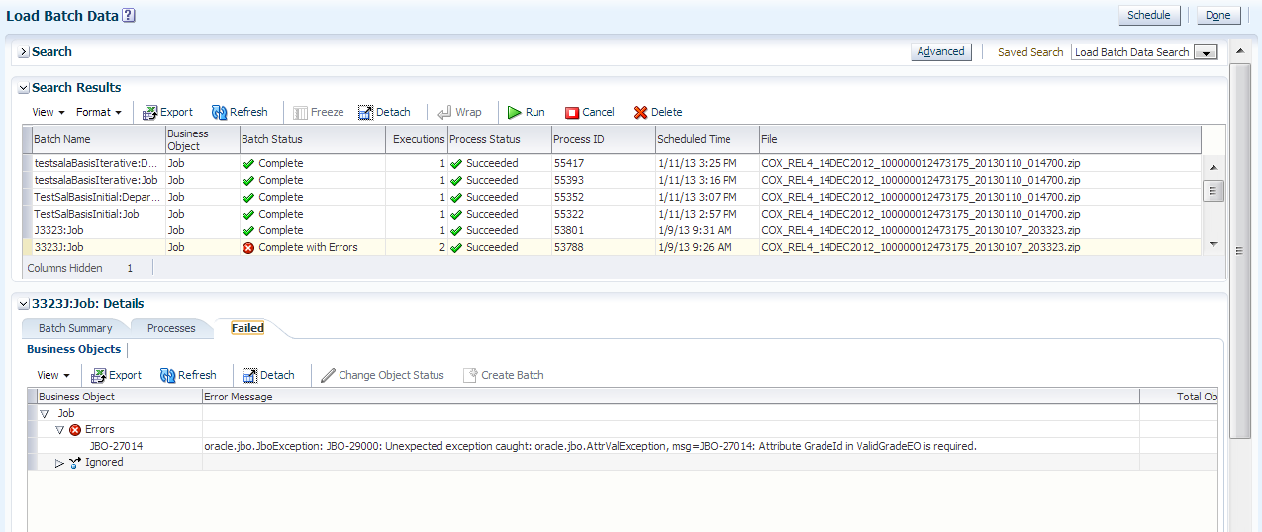
File Based Loader Load Data from Interface Tables to Application Tables– Load Batch Data – Error Management
1
Load Business Object via
Flat Files
2
Submit Data Load Process
3
Monitor Data Load
4
Error Handling /Data Validation

Slide 28
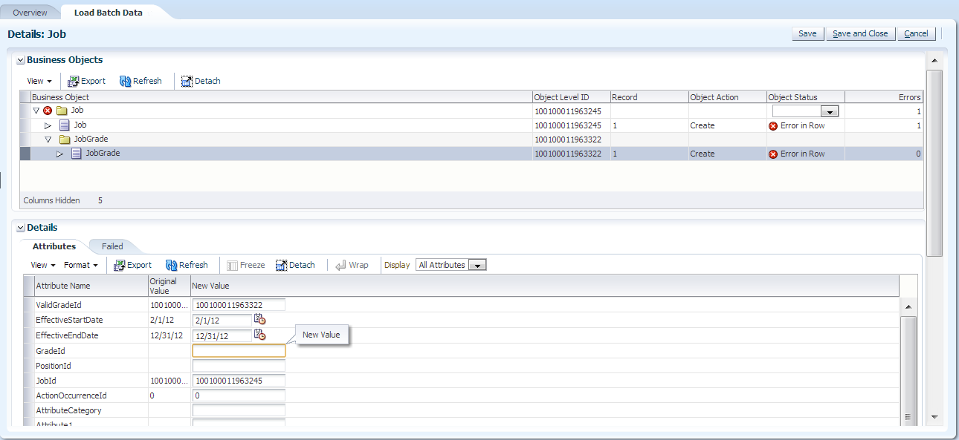
File Based Loader Load Data from Interface Tables to Application Tables– Load Batch Data – Error Management
1
Load Business Object via
Flat Files
2
Submit Data Load Process
3
Monitor Data Load
4
Error Handling /Data Validation

Slide 29
Q&A
Notes:
If you have any questions, feel free to contact me via email or the OTN forums.

