Slide 1
Tidyverse
Introduction to Computational CMB
Alex Alon
February 17th, 2025

Slide 2
Agenda
Monday
Wednesday
Dataframes
Dplyr & tidyr
Factors
Renaming
Converting
Homework 1
Homework 2

Slide 3
Monday Objectives
Load external data into dataframe
Install and load packages
Summarize contents of data frame
Indexing and Subsetting
Reorder and rename factors
Let’s start!

Slide 4
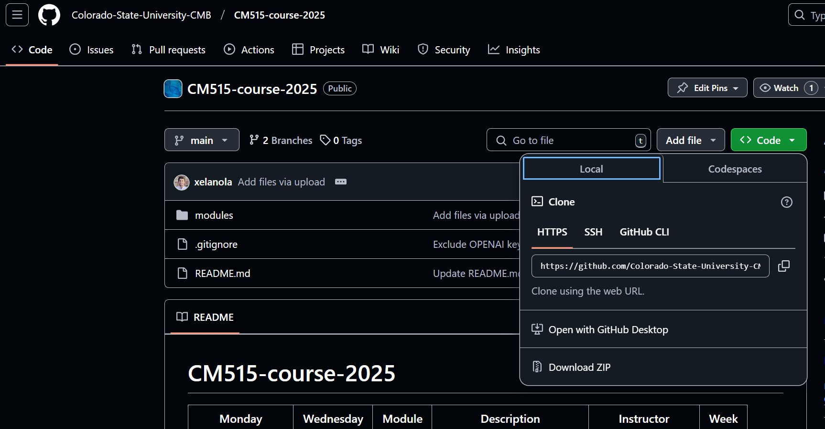
Monday Objectives
Open CMB Github
Copy link

Slide 5
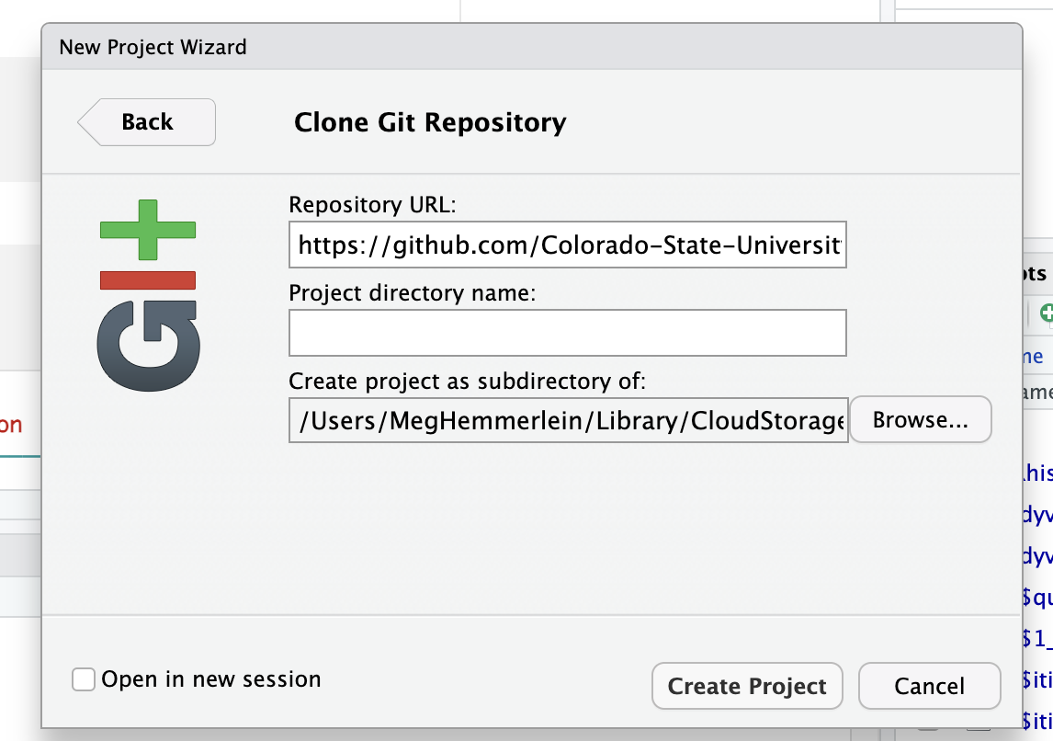
Monday Objectives
Make a new folder on your computer
Open Rstudio
New project
Version control
Git
Paste Repository URL
Specify path

Slide 6
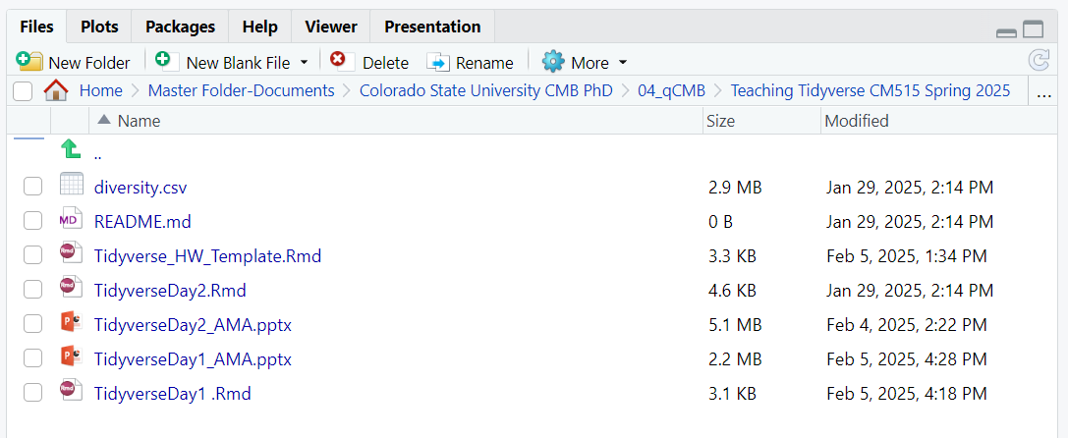
Monday Objectives
Open directory in R
modules >
04_Tidyverse >
TidyverseDay1_AMA.Rmd

Slide 7
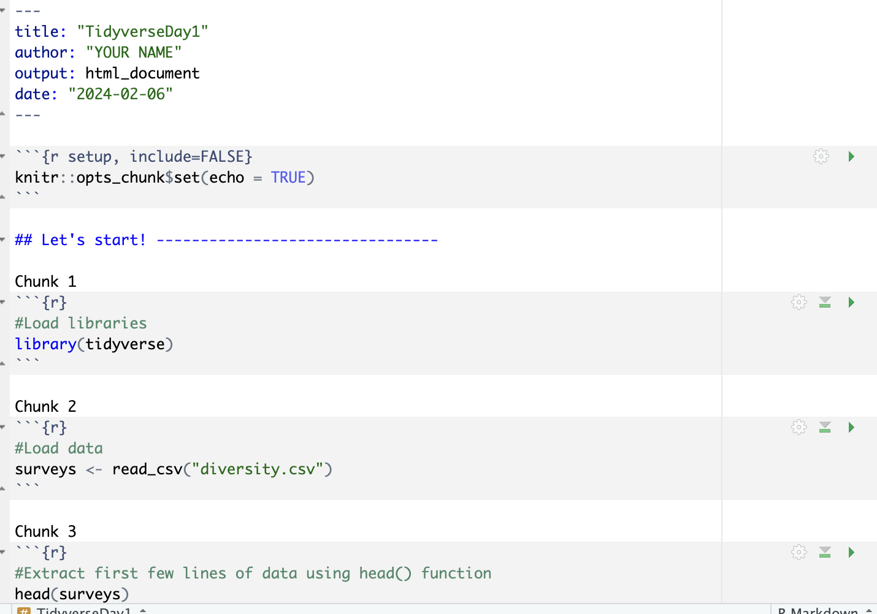
Add your name as the author
Follow along by running the chunks

Slide 8
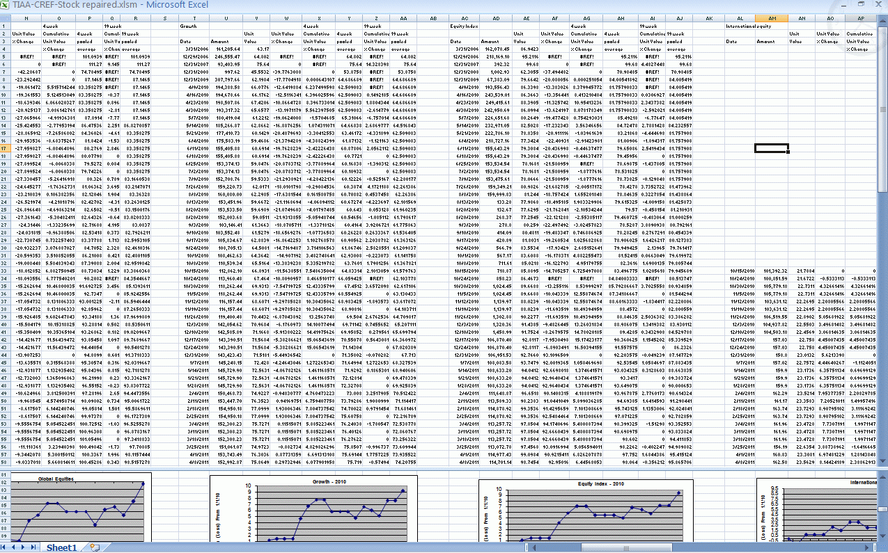

Hold on…can’t I just use excel
Crashes when too many columns and rows
Does not easily give you summary statistics
Lot of clicking and dragging to clean up
More clicking and dragging = more time being frustrated

Slide 9
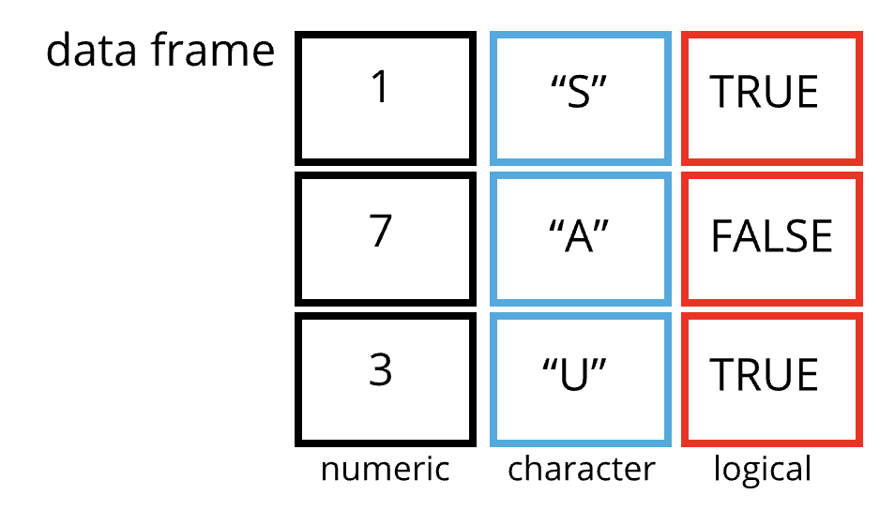
What are dataframes?
A data structure
2-dimensional table of rows and columns (similar to an excel spreadsheet)
Data types:
Character (chr; “S”)
Factor (fctr; +/-)
Numeric (int: 1, dbl; 3.4)
Boolean (bool; True/false)
Date/time
Null/missing values

Slide 10
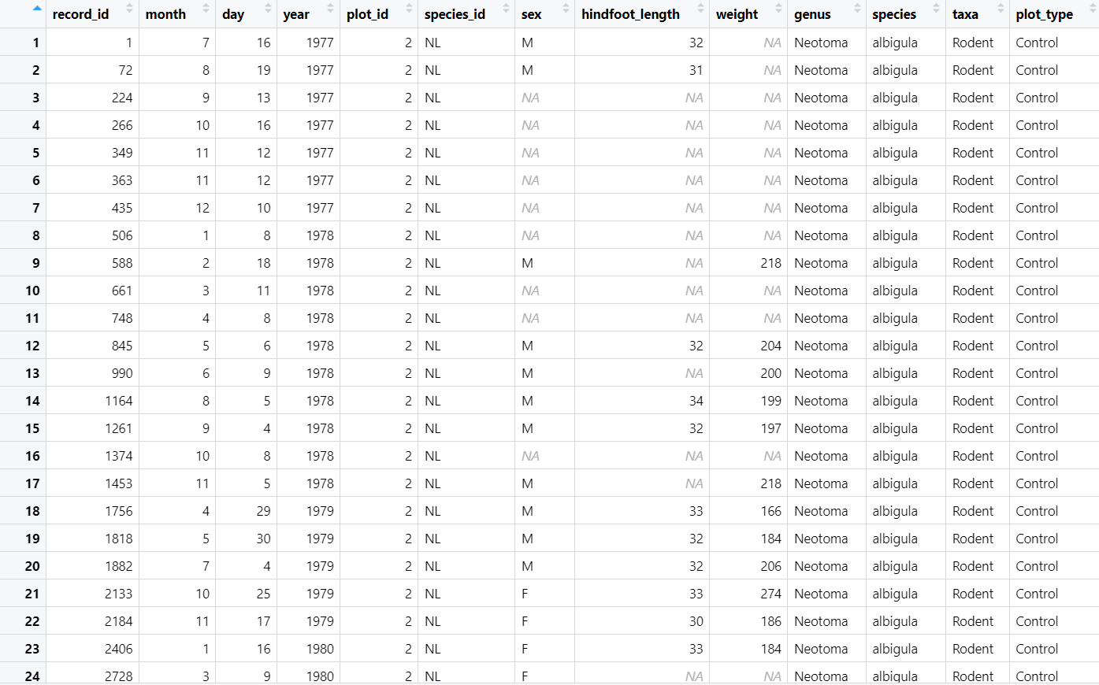
Inspecting a dataframe
Size:
dim(surveys) - returns a vector with the number of rows in the first element, and the number of columns as the second element (the dimensions of the object)
ncol(surveys) - returns the number of columns
nrow(surveys)
returns the number of rows

Slide 11
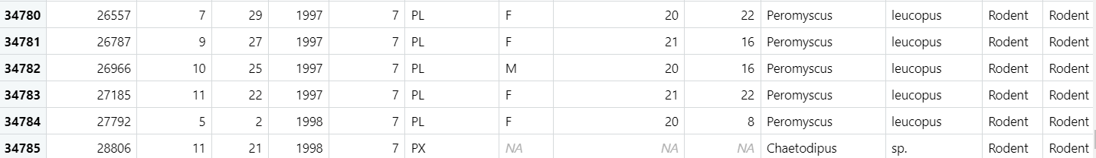
Inspecting a dataframe
Content:
head(surveys) - shows the first 6 rows
tail(surveys) - shows the last 6 rows

Slide 12
Inspecting a dataframe
Names:
names(surveys) - returns the column names (synonym of colnames() for data.frame objects)
rownames(surveys) - returns the row names

Slide 13
Inspecting a dataframe
Summary:
str(surveys) - structure of the object and information about the class, length and content of each column
summary(surveys) - summary statistics for each column
Min
1st Quartile
Median
Mean
3rd Quartile
Max
NAs

Slide 14
Indexing and subsetting dataframes
Our data frame has rows and columns (2 dimensions)
If we want to look at specific data we can specify “coordinates”
Row numbers are first
Column numbers are second
Extracting specific values
Format: data_frame[row_index, column_index]

Slide 15
Indexing and subsetting dataframes
Extracting specific values
Format: data_frame[row_index, column_index]
Example
First row and column from surveys:
surveys[1, 1]
Extracting multiple rows
Format: data_frame[c(1, 2, 3), c(5, 6)]
or data_frame[1:3, 5:6]

Slide 16
Indexing and subsetting dataframes
Subsetting
Format: data_frame[“column name”]
Example
surveys[“species_id”] *can also use surveys$species_id *

Slide 17
Indexing and subsetting dataframes
Excluding specific values
data_frame[1, ] = first row, all columns
data_frame[1, -3] = first row, all columns except the third one

Slide 18
PRACTICE TIME

Slide 19
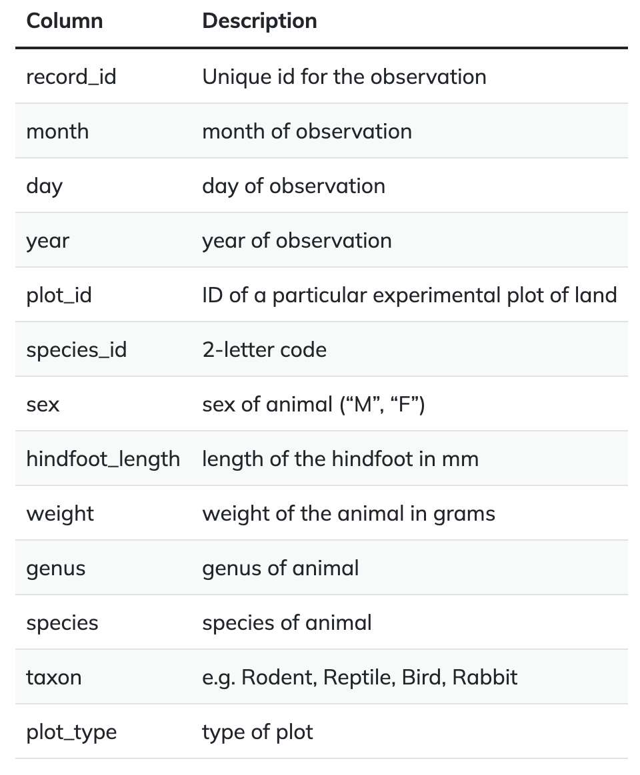
What is in our data frame?
Investigating the animal species diversity and weights found within plots at specific study sites
Desert ecosystems have long served as model systems in the study of ecological concepts (e.g., competition, resource pulses, top-down/bottom-up dynamics).
However, the inherent variability of resource availability in deserts, and hence consumer dynamics, can also make them challenging ecosystems to understand.
Study of a Chihuahuan desert ecosystem near Portal, Arizona, began in 1977. At this site, 24 experimental plots were established in 1977 and divided among controls and experimental manipulations.
S. K. Morgan Ernest, Thomas J. Valone, and James H. Brown. 2009. Long-term monitoring and experimental manipulation of a Chihuahuan Desert ecosystem near Portal, Arizona, USA. Ecology 90:1708.

Slide 20
After Chunk 18, 10 min. break

Slide 21
Data types: Factor vs Character
Character: list of strings, not ordered, each one is unique
Ex. (“male”, “female”, ”red”, “blue”)
Factor
Categorical data with fixed set of levels (ordered list of strings)
Useful when order matters
Factors have predefined levels – default is alphabetical
Fruit:
1-apple
2-orange
3-tomatoes are not a vegetable
Vegetable:
1 - avocado
2 – cabbage
3 – tomatoes are not a fruit

Slide 22
Data types: Changing factor order
fruit <- factor(c(“orange”, “lemon)
Fruit
lemon
orange
fruit <- factor(fruit, levels = c(“orange”, “level”))
Fruit
orange
lemon
Levels(fruit)[3] <- “mango”
Fruit
orange
lemon
mango

