Slide 1
Monads
Steve Goguen

Slide 2
About Me
Web Developer for Allied Building Supply
  ASP.NET, SQL Server, LINQ, etc.
Website: http://www.njgeeks.com/
Into: LINQ, F#, Functional Programming

Slide 3

What are Monads?
ADT – Abstract Data Types
They’re objects that computations and workflows – NOT DATA!
They’re combinable like Legos™

Slide 4
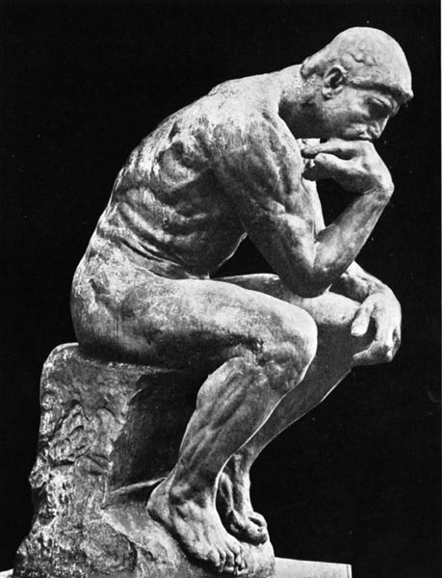
What’s the point?
Concentrate on your application domain, not the plumbing!
Separates the domain logic from the plumbing logic.

Slide 5
Monads – The Key to LINQ
LINQ is a technology for creating and using monads.
In .NET 3.5, two monads were introduced:
  IEnumerable<T> – LINQ to Objects
  IQueryable<T> – LINQ to SQL

Slide 6
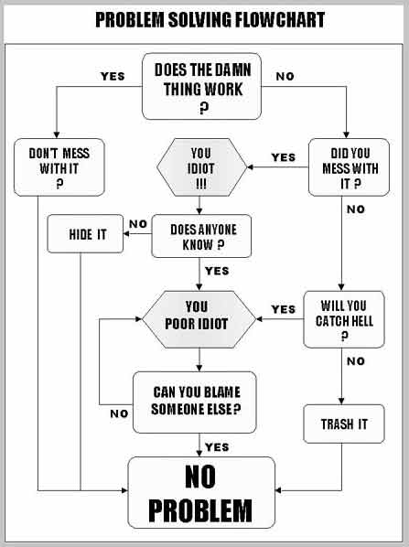
How does an object represent computations and/or workflow?

Slide 7
Consider the humble Loop…
…one that enumerates a list
foreach(var item in list) {
Console.Write(item);
}
And you have!

Slide 8
Our first Monad! - IEnumerable<T>
Represents a foreach loop, not a list!
Think action, not data! Verb, not noun.
It’s generic – the T in IEnumerable<T> denotes any type.
  IEnumerable<string> – where T = string
  IEnumerable<int> – where T = int

Slide 9
What is an enumerable?
interface IEnumerable<T> : IEnumerable {
IEnumerator<T> GetEnumerator();
}
Apparently, it’s something that can give you an enumerator!

Slide 10
So, what is an enumerator?
interface IEnumerator<T>
{
bool MoveNext();
T Current { get; }
void Reset();
}

Slide 11
Let’s make an enumerator!
IEnumerable<int> Interval
(int start, int end)
{
for(var i = start; i <= end;i++) {
yield return i;
}
}

Slide 12
Using Our Enumerator
var from5to10 = Interval(5, 10);
// Nothing has looped yet
foreach(int i in from5to10) {
Console.WriteLine(i);
}
Makes counting from 5 to 10 easy!
(Was that ever really a problem in the first place?)

Slide 13
Enumerators are not data!
They’re not lists, arrays, or collections.
They represent the act of looping over data.
When you create an enumerator, it does not execute its loop.
They only loop when you use foreach, or call the MoveNext() method.

Slide 14
TakeFirst - Let’s Create a Function
// Assume a list of employees
var first4 = TakeFirst(employees, 4)
foreach(var emp in employees) {
Console.Write(emp.Name);
}
// Would be nicer if we could do
var first4 = employees.TakeFirst(4)

Slide 15
TakeFirst – Spec
Function that takes two parameters:
  source – Any type of list (an IEnumerable<T>)
  n – The number of items you want from the list
Returns: IEnumerable<T> which only loops through the first n items.
(Remember: IEnumerable represents the loop, not the list)

Slide 16
TakeFirst – Definition
IEnumerable<T>
TakeFirst<T>(IEnumerable<T> source, int n)
{
var current = 0;
foreach(var item in source) {
yield return item;
current++;
if(current >= n) break;
}
}

Slide 17
How do we turn TakeFirst into a method?

Slide 18
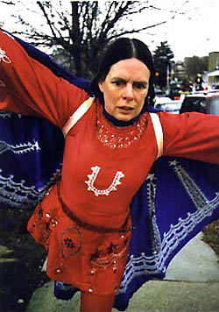
Extension Methods to the Rescue!
static IEnumerable<T>
TakeFirst<T>(this IEnumerable<T> list,
int num)
{
var count = 0;
foreach(var item in list) {
yield return item;
count++;
if(count >= num) break;
}
}

Slide 19
Next Function: Select
Think of this as a “mapping” function.
Takes two parameters:
  source – Any type of list (an IEnumerable<T>)
  f – Another function: U AnyFunction(T input)
Returns: IEnumerable<U>

Slide 20
Select(source, f)
IEnumerable<U> Select<T, U>
( this IEnumerable<T> source,
Func<T, U> f )
{
foreach(var item in source) {
yield return f(item);
}
}

Slide 21
Select – In Action
// Assume we have this function
Employee GetSalesGuy(Customer c) {
…
}
IEnumerable<Customer> customerList = …;
IEnumerable<Employee> Salesguys = customerList.Select(GetSalesGuy);

Slide 22
Select – In Action
Don’t have a function like GetSalesGuy? No problem!
// Assuming a customer has a SalesGuy property
var SalesGuys =
Customers.Select(c => c.SalesGuy);

Slide 23
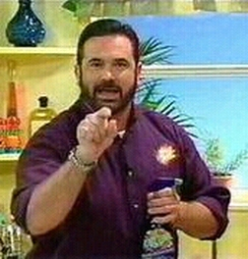
Who wants something for free?!?!
Billy Mays wants to give you some sugar!

Slide 24
Syntactic Sugar!
FREE when you implement the Select method!
<applause>
Implement Select! | Get a SQL like syntax for FREE!
Customers .Select(c => c.SalesGuy) | from c in customers select c.SalesGuy

Slide 25
But Wait! There’s more!
Implement the Where method! | Get a where keyword, for free!
customers .Where(c => c.IsActive) .Select(c => c.Name) | from c in customers where c.IsActive select c.Name

Slide 26
Why settle with one list when you can combine two!
Implement SelectMany! | And make Cartesian joins a snap!
Interval(1, 10) .SelectMany ( x => Range(1, x), (x, y) => x + y) ); | from x in Interval(1, 10) from y in Interval(1, x) select x + y;

Slide 27

Call now and get your IEnumerable Monad free with the .NET Framework 3.5!!
While everybody else
is struggling with
their enumeration
problems, you’ll be
sitting pretty!

Slide 28
Monads – A Better Definition
Has a formal mathematical definition and must possess certain mathematical properties.
In other words: Not all computation/workflow objects are monads.
Monads are designed with specific algebraic qualities in mind.

Slide 29
Must implement two operations:
  A Constructor
    Turns a basic object of type T into a Monad<T>
  A Binding Function - Select in .NET
    Accepts a mapping function Func<T,U>
    Transforms a Monad<T> into a Monad<U> using the mapping
    The Key method

Slide 30
What other kinds of computations can monads and LINQ handle?
Enumerating Lists LINQ to Objects – Allows you to create complex foreach loops. | Handling Events Rx Framework – Focuses on UI/Event based programming.
Database Queries LINQ to SQL (C# is translated into SQL) | Parallel Computation PLINQ – Framework for executing across multiple cores/processors.

Slide 31
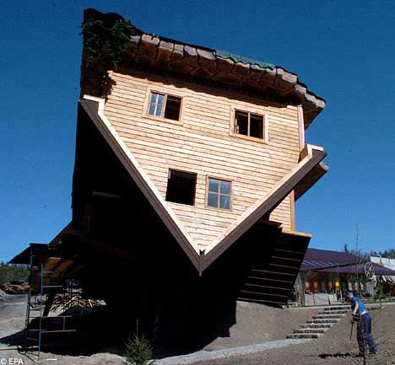
Let’s turn IEnumerable on it’s head

Slide 32
IEnumerable → IObservable
Notice how IEnumerable and IObservable complement each other
interface IEnumerable<T> : IEnumerable { IEnumerator<T> GetEnumerator(); } | interface IObservable<T> { IDisposable Subscribe(IObserver<T> o); }
interface IEnumerator<T> { bool MoveNext(); T Current { get; } void Reset(); } | interface IObserver<T> { void OnCompleted(); void OnNext(T value); void OnError(Exception e); }

Slide 33

LINQ to Events – IObservable<T>
(Currently know as Reactive Framework or Rx Framework)
from <event-arg> in <event>
select <translate-message>
…or..
from <message> in <observer>
select <translate-message>
Huh?

Slide 34
LINQ to Events – The Gist
// Create your own events
var OnDragDrop = from start_pos in OnMouseDown
from end_pos in OnMouseUp
select new {start_pos, end_pos };
/* Then subscribe to them the as you would add an
event handler */
OnDragDrop.Subscribe(MyDragDropHandler);

Slide 35
LINQ to Events – The Gist
// Create your own events
var OnDragging = from start_pos in OnMouseDown
from cur_pos in OnMouseMove
select new {start_pos, cur_pos };
/* Then subscribe to them the as you would add an
event handler */
OnDragging.Subscribe(DrawDraggingOutline);

Slide 36
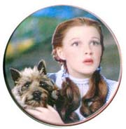
This ain’t Kansas, and we’re not creating for each loops anymore!
The Rx Framework deals with events and observers.
Think push, not pull.
Using the same query syntax, we can create complex new events with

Slide 37
LINQ to SQL
Takes to Monad metaphor to SQL queries
Similar, in behavior to LINQ to Objects
Difference: Computation runs in a database server.
This is the start to distributed programming.

Slide 38
Parallel LINQ
Like LINQ to Objects, similar in behavior
Solves problem of distributing computations over many CPUs
Much easier to manage than threads.

Slide 39
Monads – History
A concept from category theory and introduced to CompSci by Eugenio Moggi in 1991.
Popularized by the Haskell programming language, a pure functional language.
In Haskell, functions meet the mathematical definition of a function.
Until monads were introduced, things like I/O were impossible in Haskell.

Slide 40
What does it means to be purely functional?
To be purely functional, a function must always return the same output when given a specific input.
ReadFile(filename) ← Not functional
Request.Form(“User”) ← Not functional
Math.Abs(-3) ← Functional
As a result, any functions that does IO is eliminated!

Slide 41
Why go purely functional anyway?
Easier to test – Especially when writing Unit Tests
Allows the compiler to reason about your program so it can simplify and restructure it without breaking it.
Functional programs can scale across multiple processors, machines a lot easier than non-functional.
This will become a lot more relevant when we start approaching hundreds of CPU cores. (Will be here sooner than you think.)

Slide 42
Thank You

