Slide 1


By : Sumit Gole
Date : 09 Nov 2015

Slide 2

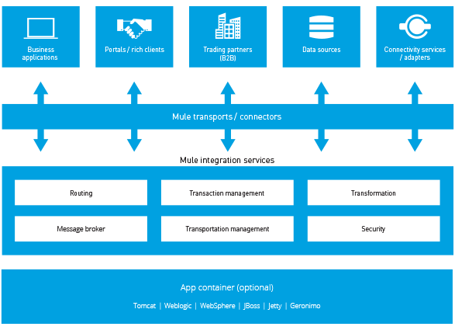
Mule Architecture

Slide 3
Component
Anypoint Platform - Transform your business with API-led connectivity.
Mule runtime engine - Deploy an ESB, iPaaS or API gateway on a single, unified runtime.
Studio - Connect apps and data on our powerful IDE
API Designer - Build, design and test enterprise grade APIs, using RAML.
API Manager - Generate proxies, or apply pre-built or custom policies with clicks.
Analytics - Get real-time views on API consumption and performance.
API Portal - Create a rich onramp for your API with docs, sample code, and interactive tools.

Slide 4

Mule scopes.
https://docs.mulesoft.com/mule-fundamentals/v/3.7/mule-filters-scopes-and-routers

Slide 5
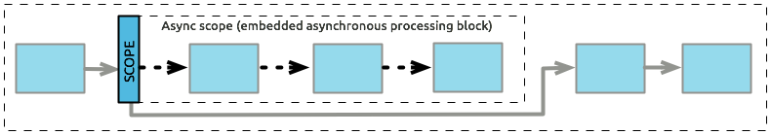

Scopes
Scopes are the wrappers on a process flow. Type of scopes
  Async :The child flow receives a message, it immediately sends one copyof that message to the next message processor in the parent flow.
  Though the copy of messaage is passed to Async flow but payload is not copied i.e. if async flow change the payload then those changes are reflected in the original flow also.
till

Slide 6
Scopes
Sync :the main flow halts, and all the message processors in the child flow execute before the parent flow resumes processing.
Cache: caches the subflow output for reusability.
  How this works?
    Mule genrate a key corresponding to a message’s payload.
    Cache scope checks the value corresponding to key.
    If key exist then corresponding value is passed without executing the flow.
    Else the value present in the memory iss passed.

Slide 7
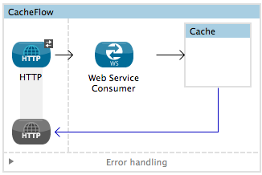
Scopes
Configuring an Object Store
      Custome object store: create custome class to store the cached responses.
      In-memory-store: by configureing properties use in memory option to store the object.
      Managed-store: store the cached responses in a place defined by ListableObjectStore.
      Simple-text-file-store: Store the object in a file.

Slide 8
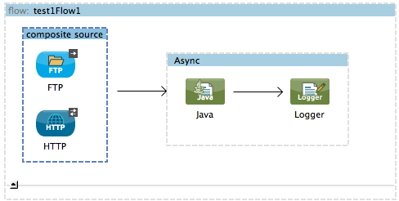
Scopes
Composite source:Accept messages from multiple input channels and pass the payload to message processors.

Slide 9
Scopes
Message Enricher: Used to enrich the incoming message with additional information.
Eg:
<flow name="orderProcessingFlow">
<inbound-endpoint ref="orderEndpoint"/>
<enricher target="#[variable:state]">
<outbound-endpoint ref="stateLookup"/>
</enricher>
<outbound-endpoint ref="orderStep2"/>
</flow>
Mule currently supports enrichment of flow variables and message headers only.

Slide 10
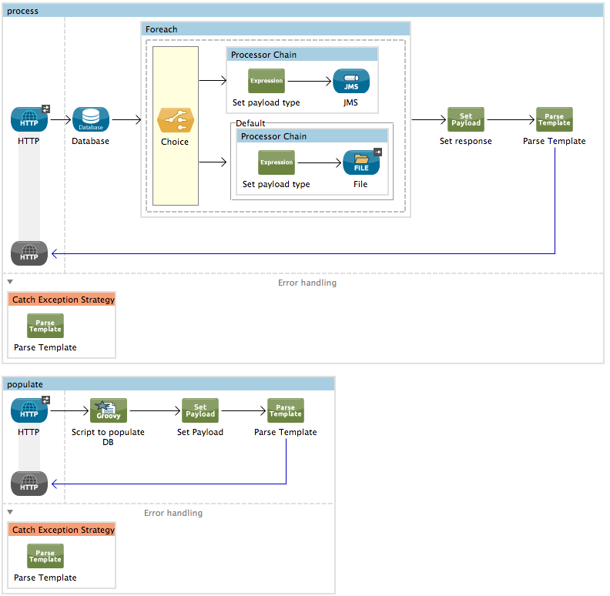
Scopes
Foreach : splits a collection in to elements and process individusal element using the processor in the scope.
Eg:

Slide 11
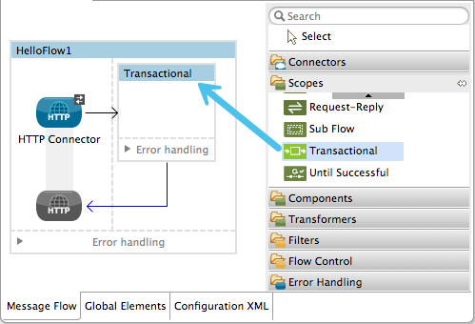
Scopes
Transactional: execute a flow as a single unit i.e. series of steps in a flow must succeed or fail as one unit.
Following connectors support transactional demarcation:
  JMS
  JDBC (Deprecated)
  VM

Slide 12
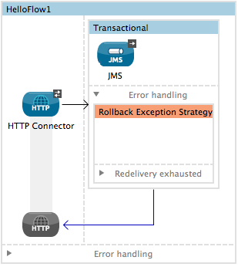
Scopes
Transactional tips:
  Operations that occur inside a transaction execute synchronously.
  Scope is from first outbound connector to next outbound connector.

Slide 13
Scopes
Until Successful: scope processes messages through the processors within it until the process succeeds.
<until-successful objectStore-ref="objectStore" maxRetries="5" secondsBetweenRetries="60" doc:name="Until Successful">
---------
</until-successful>
  Configuring a Dead Letter Queue: If maxRetries exhausted then can define a DLQ (dead letter queue) endpoint to which Mule can send such messages.

Slide 14
Exception Handling
When ever any activity in mule instance fails then mule throws an exception. Mule exceptions are categorised in two parts.
    System Exceptions
    Messaging Exceptions
System Exceptions :
  For instance exceptions occures during application startup.
  When a connection to external system fails.
  Eg: Before receving any message , Mule tries to connect to any messaging server and get exception. Then this is called system exception.
  System Exception strategy is not configurable in mule.

Slide 15
Exception Handling
When ever any activity in mule instance fails then mule throws an exception. Mule exceptions are categorised in two parts.
    System Exceptions
    Messaging Exceptions
System Exceptions :
  For instance exceptions occures during application startup.
  When a connection to external system fails.

Slide 16
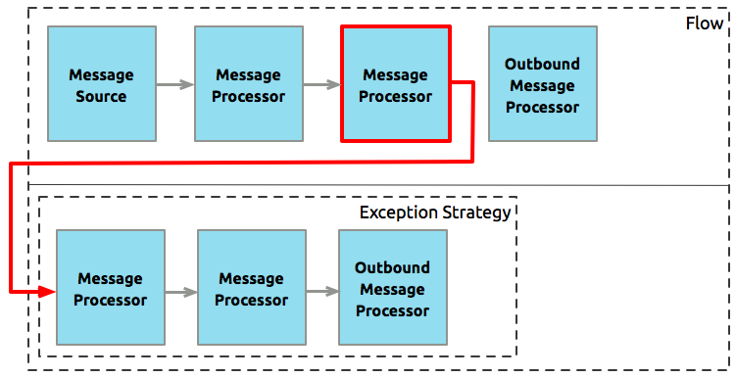
Exception Handling
Messaging Exceptions : While processing the payload if any exception occures then cooresponding defined exception strategy is executed.

Slide 17
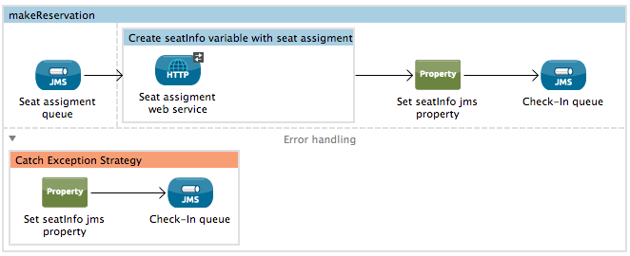
Exception Handling
Messaging Exceptions : Five ways to configure messaging exceptions.
  Default Exception Strategy : Implicitly and globally handles all messaging exceptions that are thrown in Mule applications.
  Catch Exception Strategy : It catches all the exceptions thrown by the parent flow.

Slide 18

Exception Handling
Choice Exceptions : Catches all the exceptions of parent flow and on the bases of message content route the message to appropriate exception strategy.
  Rollback Exception Strategy: For transactional flow if exception occures then it rollback the transaction in the flow.
  The rollback exception strategy catches the exception and rolls the message back for reprocessing; the message throws an error again, the rollback exception strategy catches the exception again

Slide 19
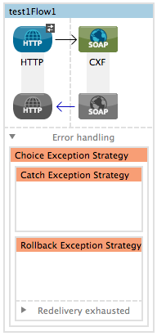
Exception Handling
Rollback Exception Strategy: There are two ways to handle two exceptions.
  One way: instructs the inbound connector transport to execute corrective actions.
  Request and response: changes the payload of a message and returns it to the client.

Slide 20
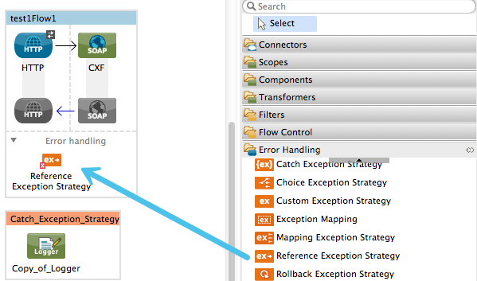
Exception Handling
Reference Exception Strategy: is used to refer the Global exception strategy in flows.
Eg:

Slide 21

Mule Error handling.
https://docs.mulesoft.com/mule-fundamentals/v/3.7/mule-exception-strategies

