Slide 1
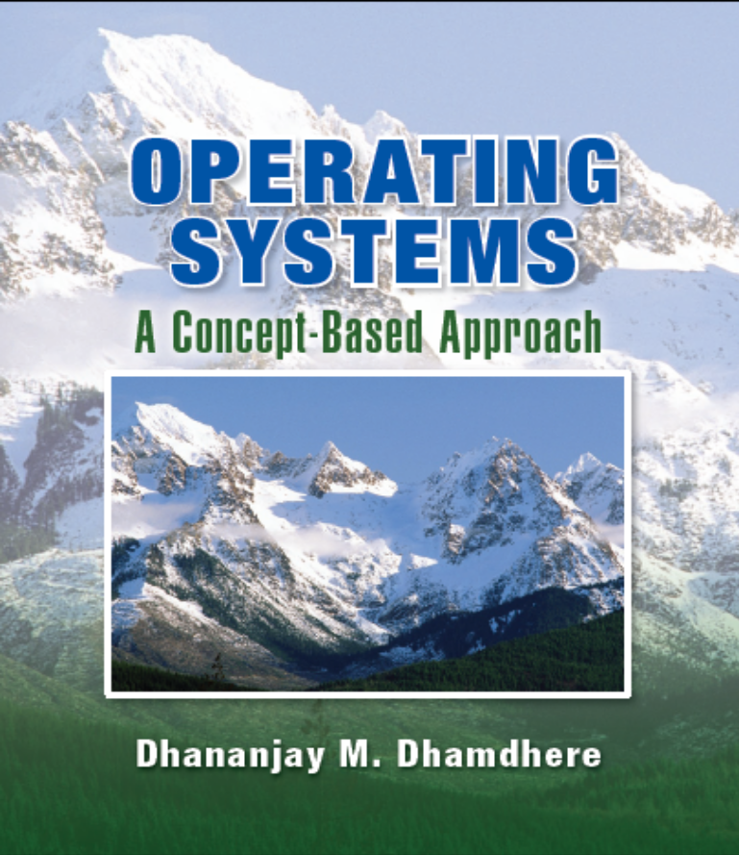
Chapter 7
Scheduling
Copyright © 2008

Slide 2
Introduction
Scheduling Terminology and Concepts
Nonpreemptive Scheduling Policies
Preemptive Scheduling Policies
Scheduling in Practice
Real-Time Scheduling
Case Studies
Performance Analysis of Scheduling Policies
Operating Systems, by Dhananjay Dhamdhere

Slide 3
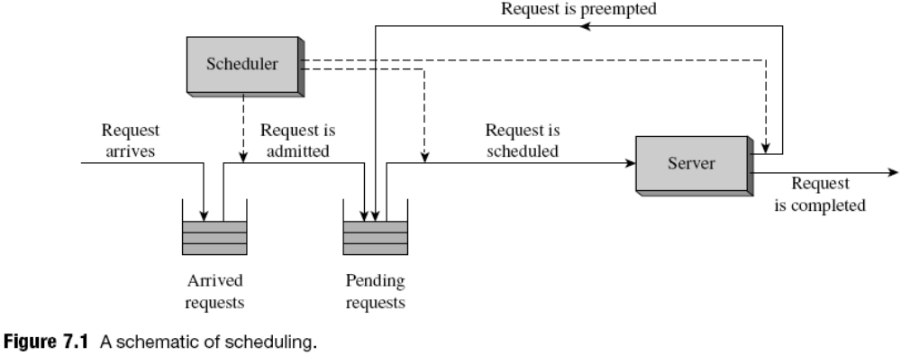
Scheduling Terminology and Concepts
Scheduling is the activity of selecting the next request to be serviced by a server
  In an OS, a request is the execution of a job or a process, and the server is the CPU
Operating Systems, by Dhananjay Dhamdhere

Slide 4
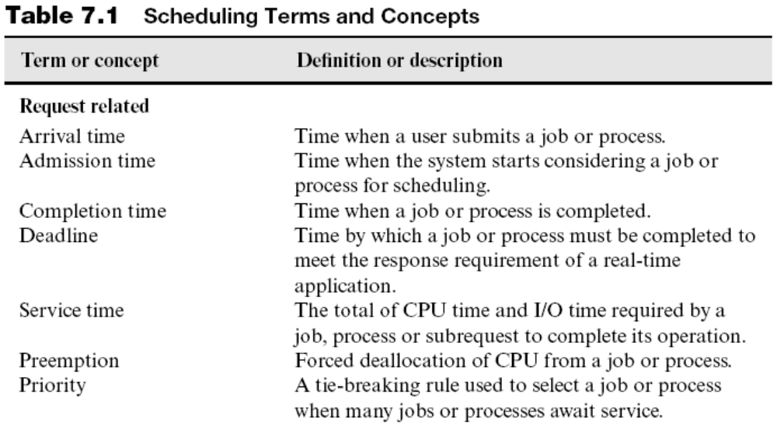
Scheduling Terminology and Concepts (continued)
Operating Systems, by Dhananjay Dhamdhere

Slide 5
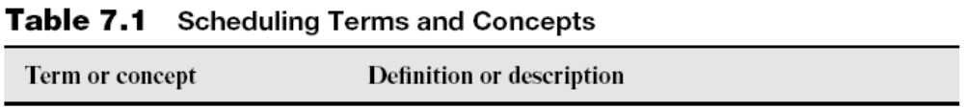
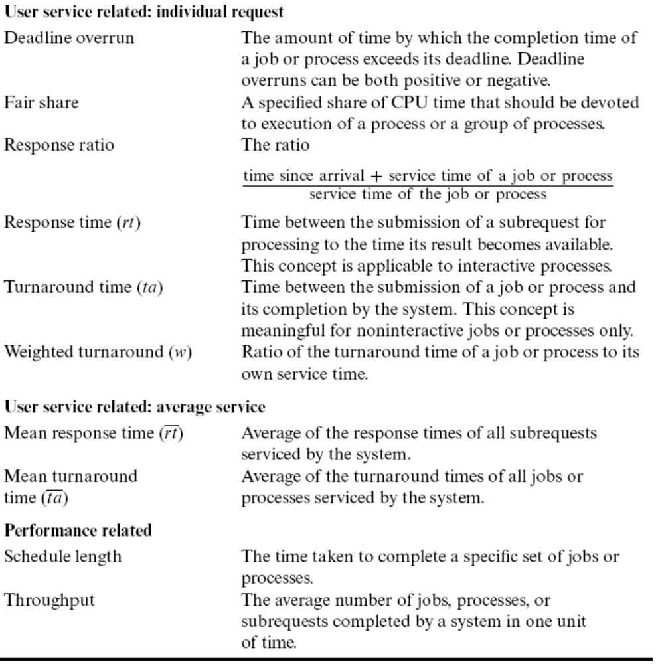

Slide 6
Fundamental Techniques of Scheduling
Schedulers use three fundamental techniques:
  Priority-based scheduling
    Provides high throughput of the system
  Reordering of requests
    Implicit in preemption
      Enhances user service and/or throughput
  Variation of time slice
    Smaller values of time slice provide better response times, but lower CPU efficiency
    Use larger time slice for CPU-bound processes
Operating Systems, by Dhananjay Dhamdhere

Slide 7
The Role of Priority
Priority: tie-breaking rule employed by scheduler when many requests await attention of server
  May be static or dynamic
Some process reorderings could be obtained through priorities
  E.g., Short processes serviced before long ones
  Some reorderings would need complex priority functions
What if processes have the same priority?
  Use round-robin scheduling
May lead to starvation of low-priority requests
  Solution: aging of requests
Operating Systems, by Dhananjay Dhamdhere

Slide 8
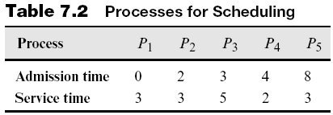
Nonpreemptive Scheduling Policies
A server always services a scheduled request to completion
Attractive because of its simplicity
Some nonpreemptive scheduling policies:
  First-come, first-served (FCFS) scheduling
  Shortest request next (SRN) scheduling
  Highest response ratio next (HRN) scheduling
Operating Systems, by Dhananjay Dhamdhere

Slide 9
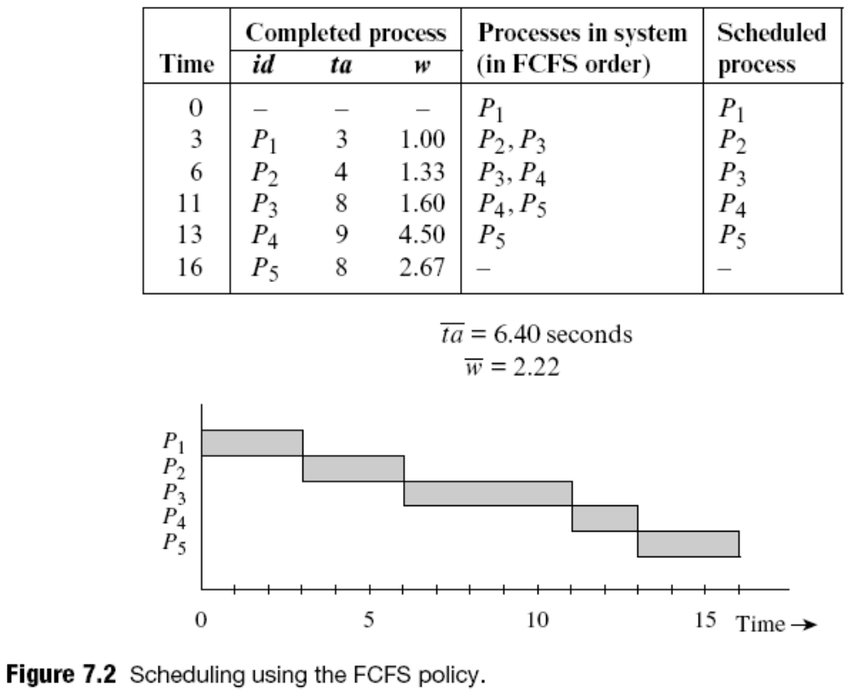
FCFS Scheduling
Operating Systems, by Dhananjay Dhamdhere

Slide 10
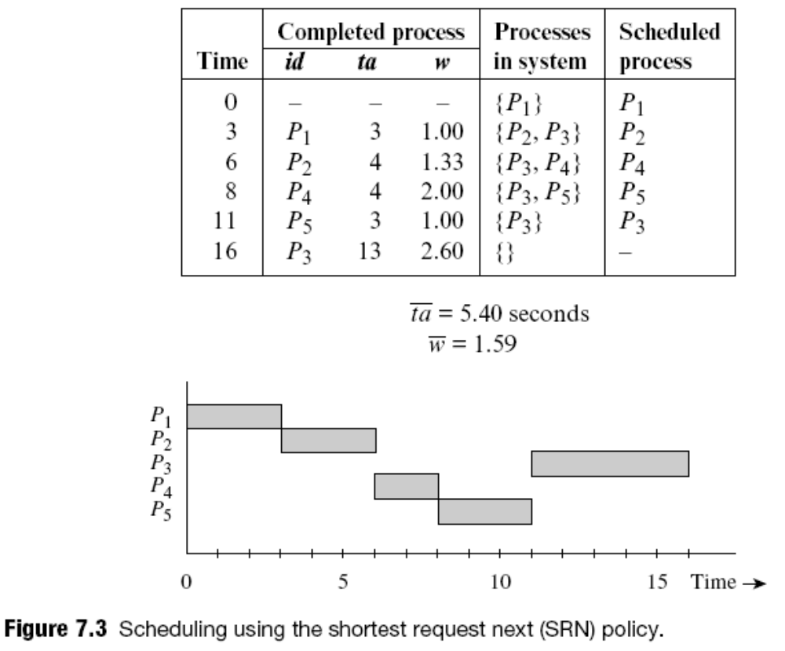
Shortest Request Next (SRN) Scheduling
May cause
starvation of
long processes
Operating Systems, by Dhananjay Dhamdhere

Slide 11
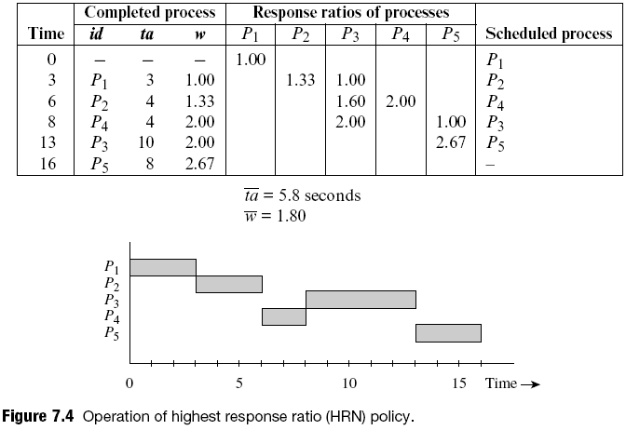
Highest Response Ratio Next (HRN)
Use of
response ratio
counters starvation
Operating Systems, by Dhananjay Dhamdhere

Slide 12
Preemptive Scheduling Policies
In preemptive scheduling, server can switch to next request before completing current one
  Preempted request is put back into pending list
  Its servicing is resumed when it is scheduled again
A request may be scheduled many times before it is completed
  Larger scheduling overhead than with nonpreemptive scheduling
Used in multiprogramming and time-sharing OSs
Operating Systems, by Dhananjay Dhamdhere

Slide 13
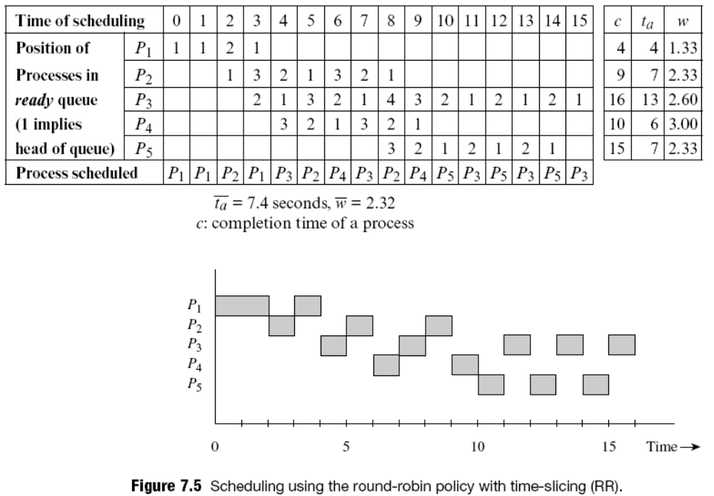
Round-Robin Scheduling with Time-Slicing (RR)
In this example, δ = 1
Operating Systems, by Dhananjay Dhamdhere

Slide 14
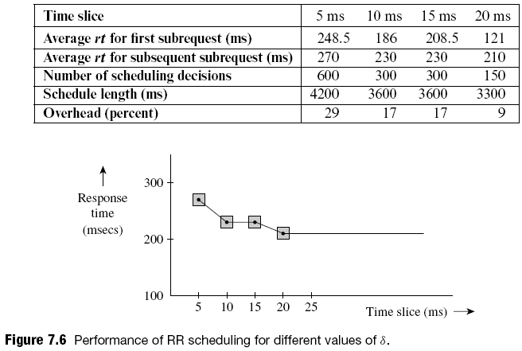
Example: Variation of Response Time in RR Scheduling
At small values of δ, rt for a request may be higher for smaller values of δ
Operating Systems, by Dhananjay Dhamdhere

Slide 15
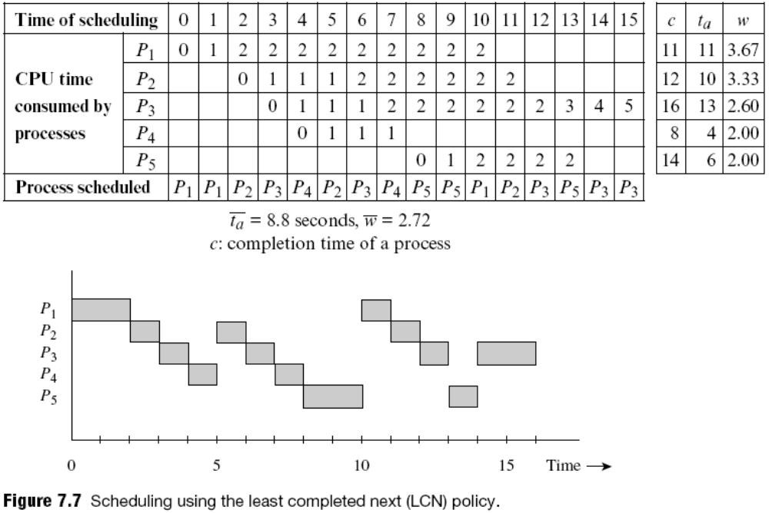
Least Completed Next (LCN)
Issues:
Short processes will finish ahead of long processes
Starves long processes of CPU attention
Neglects existing processes if new processes keep arriving in the system
Operating Systems, by Dhananjay Dhamdhere

Slide 16
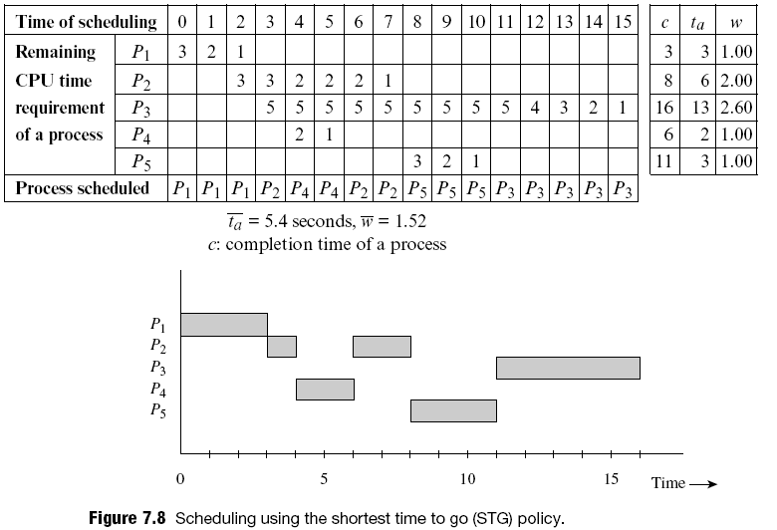
Shortest Time to Go (STG)
Since it is analogous to the SRN policy, long processes might face starvation.
Operating Systems, by Dhananjay Dhamdhere

Slide 17
Scheduling in Practice
To provide a suitable combination of system performance and user service, OS has to adapt its operation to the nature and number of user requests and availability of resources
  A single scheduler using a classical scheduling policy cannot address all these issues effectively
Modern OSs employ several schedulers
  Up to three schedulers
Some of the schedulers may use a combination of different scheduling policies
Operating Systems, by Dhananjay Dhamdhere

Slide 18
Long-, Medium-, and Short-Term Schedulers
These schedulers perform the following functions:
  Long-term: Decides when to admit an arrived process for scheduling, depending on:
    Nature (whether CPU-bound or I/O-bound)
    Availability of resources
      Kernel data structures, swapping space
  Medium-term: Decides when to swap out a process from memory and when to load it back, so that a sufficient number of ready processes are in memory
  Short-term: Decides which ready process to service next on the CPU and for how long
    Also called the process scheduler, or scheduler
Operating Systems, by Dhananjay Dhamdhere

Slide 19
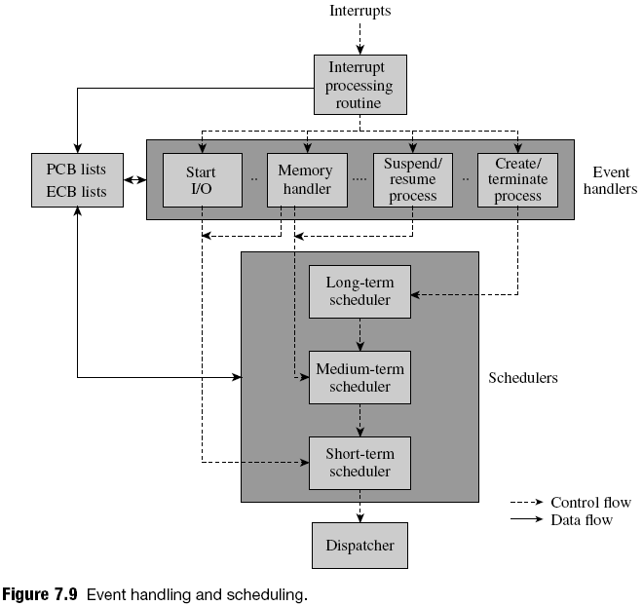
Operating Systems, by Dhananjay Dhamdhere

Slide 20
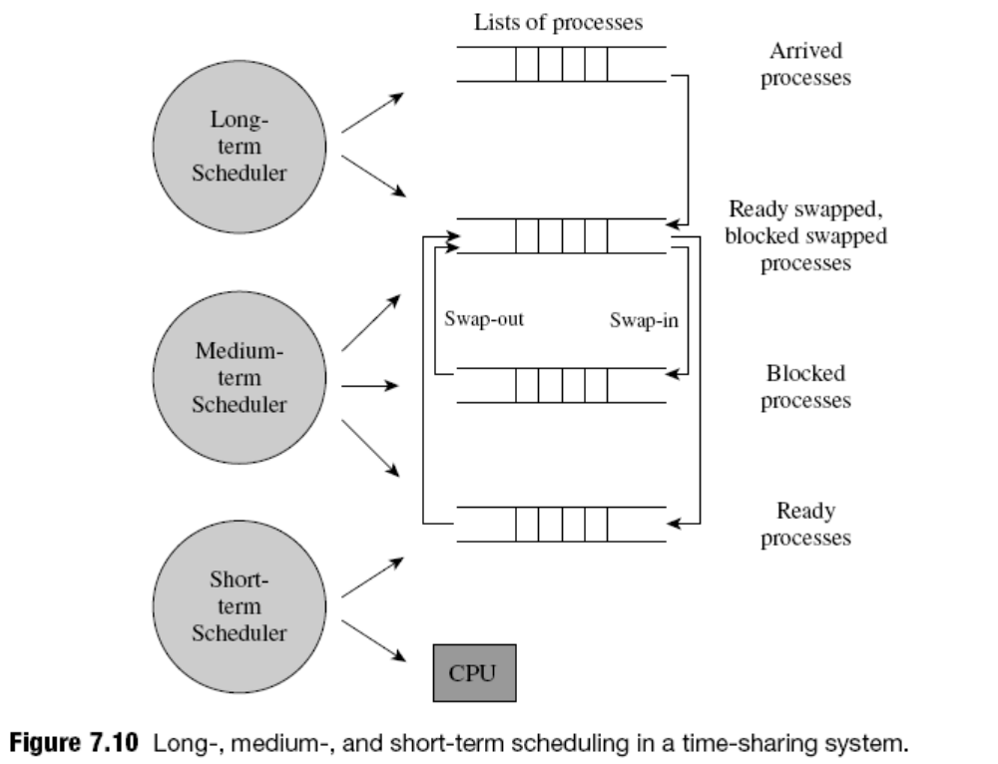
Example: Long, Medium-, and Short-Term Scheduling in Time-Sharing
Operating Systems, by Dhananjay Dhamdhere

Slide 21
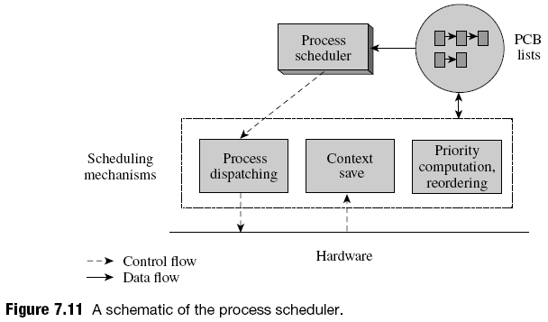
Scheduling Data Structures and Mechanisms
Interrupt servicing routine invokes context save
Dispatcher loads two PCB fields—PSW and GPRs—into CPU to resume operation of process
Scheduler executes idle loop if no ready processes
Operating Systems, by Dhananjay Dhamdhere

Slide 22
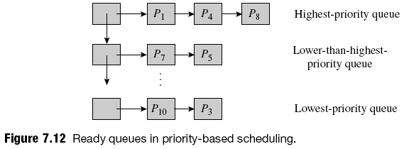
Priority-Based Scheduling
Overhead depends on number of distinct priorities, not on the number of ready processes
Can lead to starvation of low-priority processes
  Aging can be used to overcome this problem
Can lead to priority inversion
  Addressed by using the priority inheritance protocol
Operating Systems, by Dhananjay Dhamdhere

Slide 23
Round-Robin Scheduling with Time-Slicing
Can be implemented through a single list of PCBs of ready processes
  List is organized as a queue
Scheduler removes first PCB from queue and schedules process described by it
  If time slice elapses, PCB is put at the end of queue
  If process starts I/O operation, its PCB is added at end of queue when its I/O operation completes
PCB of a ready process moves toward the head of the queue until the process is scheduled
Operating Systems, by Dhananjay Dhamdhere

Slide 24
Multilevel Scheduling
A priority and a time slice is associated with each ready queue
  RR scheduling with time slicing is performed within it
  High priority queue has a small time slice
    Good response times for processes
  Low priority queue has a large time slice
    Low process switching overhead
A process at the head of a queue is scheduled only if the queues for all higher priority levels are empty
Scheduling is preemptive
Priorities are static
Operating Systems, by Dhananjay Dhamdhere

Slide 25
Multilevel Adaptive Scheduling
Also called multilevel feedback scheduling
Scheduler varies priority of process so it receives a time slice consistent with its CPU requirement
Scheduler determines “correct” priority level for a process by observing its recent CPU and I/O usage
  Moves the process to this level
Example: CTSS, a time-sharing OS for the IBM 7094 in the 1960s
  Eight-level priority structure
Operating Systems, by Dhananjay Dhamdhere

Slide 26
Fair Share Scheduling
Fair share: fraction of CPU time to be devoted to a group of processes from same user or application
Ensures an equitable use of the CPU by processes belonging to different users or different applications
Lottery scheduling is a technique for sharing a resource in a probabilistically fair manner
  Tickets are issued to applications (or users) on the basis of their fair share of CPU time
  Actual share of the resources allocated to the process depends on contention for the resource
Operating Systems, by Dhananjay Dhamdhere

Slide 27
Kernel Preemptibility
Helps ensure effectiveness of a scheduler
  With a noninterruptible kernel, event handlers have mutually exclusive access to kernel data structures without having to use data access synchronization
    If handlers have large running times, noninterruptibility causes large kernel latency
    May even cause a situation analogous to priority inversion
  Preemptible kernel solves these problems
    A high-priority process that is activated by an interrupt would start executing sooner
Operating Systems, by Dhananjay Dhamdhere

Slide 28
Scheduling Heuristics
Scheduling heuristics reduce overhead and improve user service
  Use of a time quantum
    After exhausting quantum, process is not considered for scheduling unless granted another quantum
      Done only after active processes have exhausted their quanta
  Variation of process priority
    Priority could be varied to achieve various goals
      Boosted while process is executing a system call
      Vary to more accurately characterize the nature of a process
Operating Systems, by Dhananjay Dhamdhere

Slide 29
Power Management
Idle loop used when no ready processes exist
  Wastes power
  Bad for power-starved systems
    E.g., embedded systems
Solution: use special modes in CPU
  Sleep mode: CPU does not execute instructions but accepts interrupts
Some computers provide several sleep modes
  “Light” or “heavy”
OSs like Unix and Windows have generalized power management to include all devices
Operating Systems, by Dhananjay Dhamdhere

Slide 30
Real-Time Scheduling
Real-time scheduling must handle two special scheduling constraints while trying to meet the deadlines of applications
  First, processes within real-time applications are interacting processes
    Deadline of an application should be translated into appropriate deadlines for the processes
  Second, processes may be periodic
    Different instances of a process may arrive at fixed intervals and all of them have to meet their deadlines
Operating Systems, by Dhananjay Dhamdhere

Slide 31

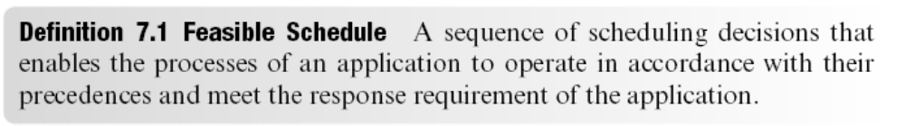
Process Precedences and Feasible Schedules
Dependences between processes (e.g., P_{i} → P_{j}) are considered while determining deadlines and scheduling
Response equirements are guaranteed to be met (hard real-time systems) or are met probabilistically (soft real-time systems), depending on type of RT system
RT scheduling focuses on implementing a feasible schedule for an application, if one exists
A process precedence graph (PPG) is a directed graph G ≡ (N,E) such that P_{i} ∈ N represents a process, and an edge (P_{i} ,P_{j}) ∈ E implies P_{i} → P_{j} . Thus, a path P_{i} , . . . ,P_{k} in PPG implies P_{i} P_{k}. A process P_{k} is a descendant of P_{i} if P_{i} P_{k}.
Operating Systems, by Dhananjay Dhamdhere

Slide 32
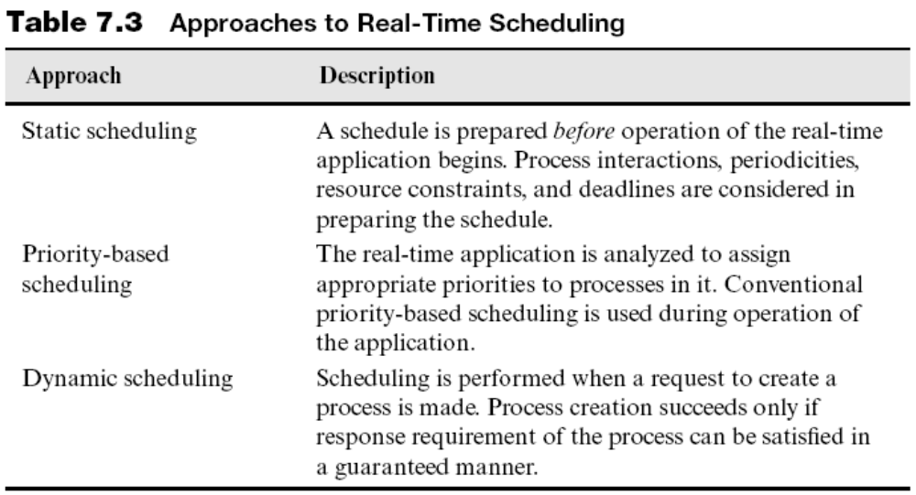
Process Precedences and Feasible Schedules (continued)
Another dynamic scheduling policy: optimistic scheduling
– Admits all processes; may miss some deadlines
Operating Systems, by Dhananjay Dhamdhere

Slide 33
Deadline Scheduling
Two kinds of deadlines can be specified:
  Starting deadline: latest instant of time by which operation of the process must begin
  Completion deadline: time by which operation of the process must complete
    We consider only completion deadlines in the following
Deadline estimation is done by considering process precedences and working backward from the response requirement of the application
D_{i} = D_{application} −∑_{k Є descendant(i)} x_{k}
Operating Systems, by Dhananjay Dhamdhere

Slide 34
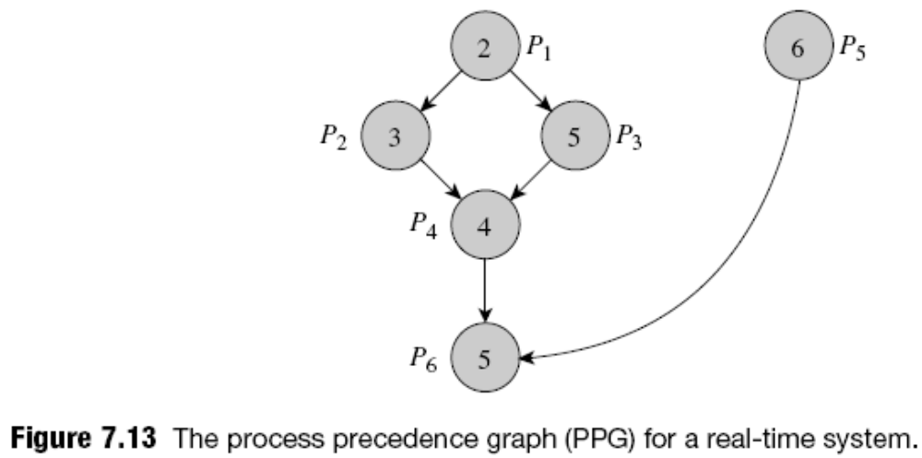
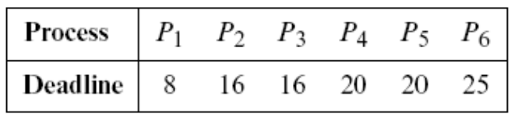
Example: Determining Process Deadlines
Total of service times of processes is 25 seconds
If the application has to produce a response in 25 seconds, the deadlines of the processes would be:
Operating Systems, by Dhananjay Dhamdhere

Slide 35
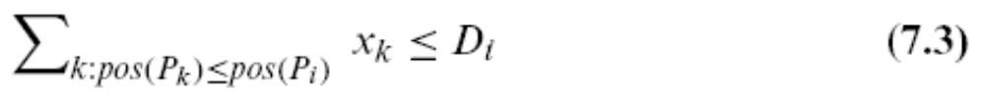
Deadline Scheduling (continued)
Deadline determination is actually more complex
  Must incorporate several other constraints as well
  E.g., overlap of I/O operations with CPU processing
Earliest Deadline First (EDF) Scheduling always selects the process with the earliest deadline
If pos(P_{i}) is position of P_{i} in sequence of scheduling decisions, deadline overrun does not occur if
  Condition holds when a feasible schedule exists
Advantages: Simplicity and nonpreemptive nature
Good policy for static scheduling
Operating Systems, by Dhananjay Dhamdhere

Slide 36
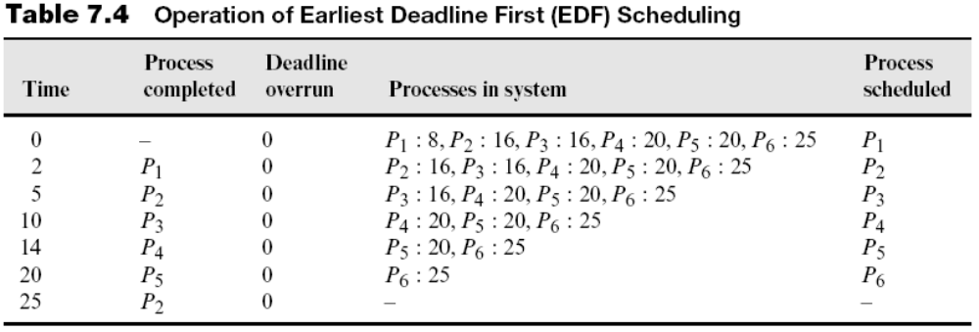
Deadline Scheduling (continued)
EDF policy for the deadlines of Figure 7.13:
P₄ : 20 indicates that P₄ has the deadline 20
P₂,P₃ and P₅,P₆ have identical deadlines
  Three other schedules are possible
  None of them would incur deadline overruns
Operating Systems, by Dhananjay Dhamdhere

Slide 37

Example: Problems of EDF Scheduling
PPG of Figure 7.13 with the edge (P₅,P₆) removed
  Two independent applications: P₁–P₄ and P₆, and P₅
  If all processes are to complete by 19 seconds
    Feasible schedule does not exist
  Deadlines of the processes:
  EDF scheduling may schedule the processes as follows: P₁,P₂,P₃,P₄,P₅,P₆, or P₁,P₂,P₃,P₄,P₆,P₅
    Hence number of processes that miss their deadlines is unpredictable
Operating Systems, by Dhananjay Dhamdhere

Slide 38

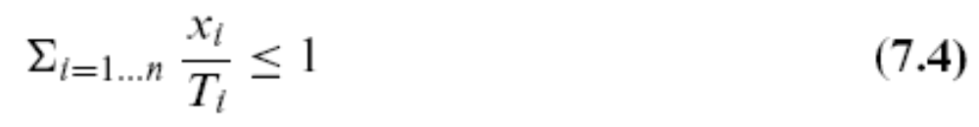
Feasibility of schedule for
Periodic Processes
Fraction of CPU time used by P_{i} = x_{i} / T_{i}
In the following example, fractions of CPU time used add up to 0.93
  If CPU overhead of OS operation is negligible, it is feasible to service these three processes
In general, set of periodic processes P₁, . . . ,P_{n} that do not perform I/O can be serviced by a hard real-time system that has a negligible overhead if:
Operating Systems, by Dhananjay Dhamdhere

Slide 39
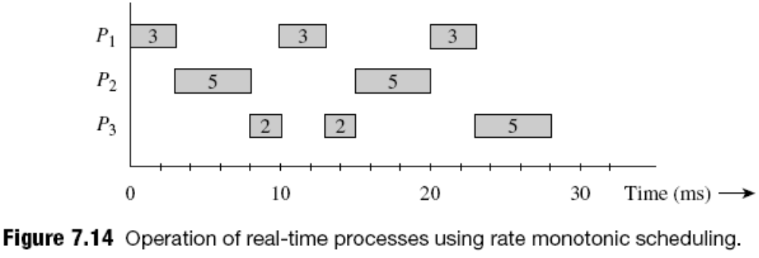
Rate Monotonic (RM) Scheduling
Determines the rate at which process has to repeat
  Rate of P_{i} = 1 / T_{i}
Assigns the rate itself as the priority of the process
  A process with a smaller period has a higher priority
Employs a priority-based scheduling
    Can complete its operation early
Operating Systems, by Dhananjay Dhamdhere

Slide 40
Rate Monotonic Scheduling (continued)
Rate monotonic scheduling is not guaranteed to find a feasible schedule in all situations
  For example, if P₃ had a period of 27 seconds
If application has a large number of processes, may not be able to achieve more than 69 percent CPU utilization if it is to meet deadlines of processes
The deadline-driven scheduling algorithm dynamically assigns process priorities based on their current deadlines
  Can achieve 100 percent CPU utilization
  Practical performance is lower because of the overhead of dynamic priority assignment
Operating Systems, by Dhananjay Dhamdhere

Slide 41
Case Studies
Scheduling in Unix
Scheduling in Solaris
Scheduling in Linux
Scheduling in Windows
Operating Systems, by Dhananjay Dhamdhere

Slide 42
Scheduling in Unix
Pure time-sharing operating system
  In Unix 4.3 BSD, priorities are in the range 0 to 127
    Processes in user mode have priorities between 50 and 127
    Processes in kernel mode have priorities between 0 and 49
Uses a multilevel adaptive scheduling policy
Process priority = base priority for user processes
+ f (CPU time used recently) + nice value
For fair share
  Add f (CPU time used by processes in group)
Operating Systems, by Dhananjay Dhamdhere

Slide 43
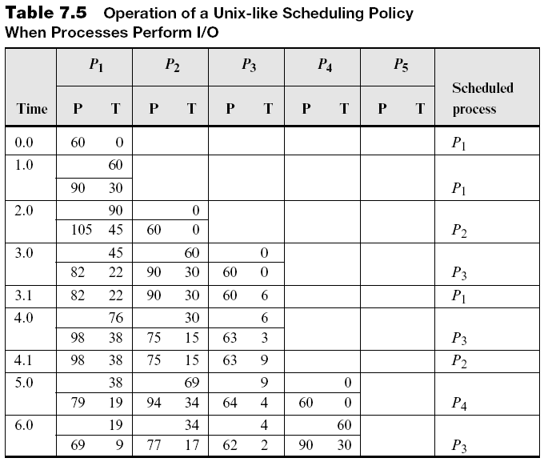
Example: Process Scheduling in Unix
Operating Systems, by Dhananjay Dhamdhere

Slide 44
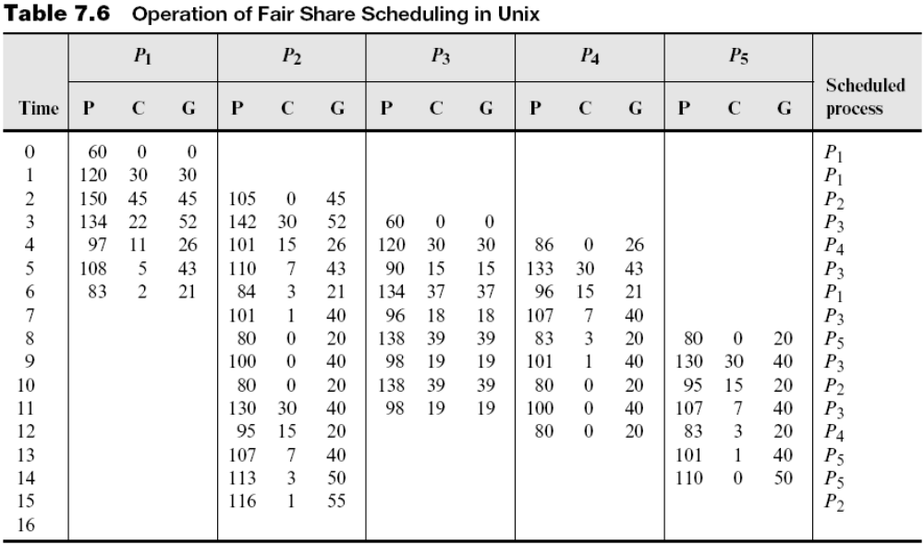
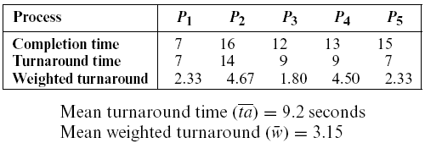
Example: Fair Share Scheduling in Unix
Operating Systems, by Dhananjay Dhamdhere

Slide 45
Scheduling in Solaris
Solaris supports four classes of processes
  Time-sharing and interactive processes have priorities between 0 and 59
    Scheduling governed by a dispatch table
      For each entry, indicates how priority should change with nature of process and to avoid starvation
  System processes have priorities between 60-99
    They are not time-sliced
  RT processes have priorities between 100 and 159
    Scheduled by a RR policy within a priority level
  Interrupt servicing threads: priorities 160 - 169
Solaris 9 supports a fair share scheduling class
Operating Systems, by Dhananjay Dhamdhere

Slide 46
Scheduling in Linux
Supports real-time and non-real-time applications
  RT processes have static priorities between 0-100
    Scheduled FIFO or RR within each priority level
      Scheduling of a process is determined by a flag
  Non RT processes have dynamic priorities (-20 to 19)
    Initially, 0 priority
    Priority can be varied through nice system calls
    Kernel varies process priority according to its nature
    Scheduled by using the notion of a time quantum
2.6 kernel uses a scheduler that incurs less overhead and scales better
Operating Systems, by Dhananjay Dhamdhere

Slide 47
Scheduling in Windows
Scheduling is priority-driven and preemptive
  Within a priority level, RR policy with time-slicing
  Priorities of non-RT threads are dynamically varied, hence also called the variable priority class
    Favor interactive threads
  RT threads are given higher priorities (16-31)
  Effective priority depends on: base priority of process, base priority of thread, and a dynamic component
Provides a number of low power-consumption system states for responsiveness, e.g., hybernate and standby
Vista introduced new state sleep, which combines features of hybernate and standby
Operating Systems, by Dhananjay Dhamdhere

Slide 48
Performance Analysis of Scheduling Policies
The set of requests directed at a scheduling policy is called its workload
  First step in performance analysis of a policy is to accurately characterize its typical workload
Three approaches could be used for performance analysis of scheduling policies:
  Implementation of a scheduling policy in an OS
  Simulation
  Mathematical modeling
Operating Systems, by Dhananjay Dhamdhere

Slide 49
Performance Analysis through Implementation
The scheduling policy to be evaluated is implemented in a real OS that is used in the target operating environment
The OS receives real user requests; services them, using the scheduling policy; and collects data for statistical analysis of the policy’s performance
Disruptive approach
  Disruption can be avoided using virtual machine software
Operating Systems, by Dhananjay Dhamdhere

Slide 50
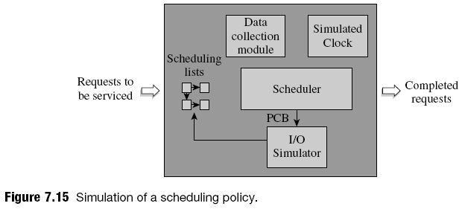
Simulation
Simulation achieved by coding scheduling policy and relevant OS functions as a simulator and using a typical workload as its input
Analysis may be repeated with many workloads to eliminate the effect of variations across workloads
Operating Systems, by Dhananjay Dhamdhere

Slide 51
Mathematical modeling
A mathematical model is a set of expressions for performance characteristics such as arrival times and service times of requests
  Queuing theory is employed
    To provide arrival and service patterns
    Exponential distributions are used because of their memoryless property
      Arrival times: F(t) =1 – e ^{–αt}, where α is the mean arrival rate
      Service times: S(t) = 1 – e ^{–ωt}, where ω is the mean execution rate
    Mean queue length is given by Little’s formula
      L = α x W, where L is the mean queue length and W is the mean wait time for a request
Operating Systems, by Dhananjay Dhamdhere

Slide 52
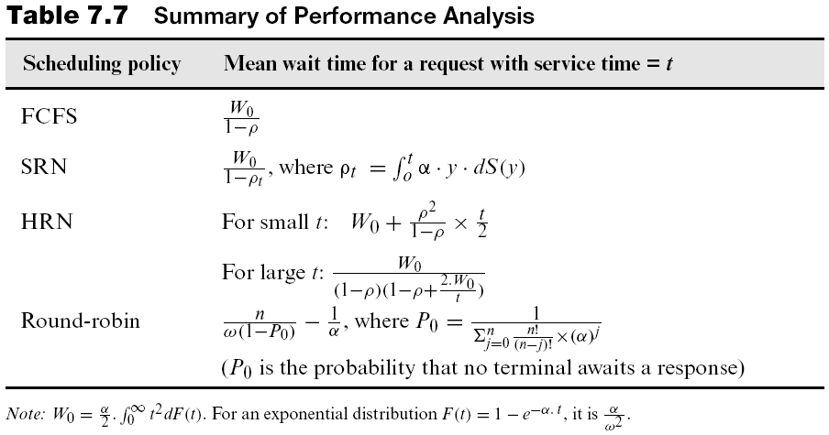
Mathematical Modeling (continued)
Operating Systems, by Dhananjay Dhamdhere

Slide 53
Summary
Scheduler decides process to service and how long
Three techniques:
  Priority-based, reordering of requests, and variation of time slice
Scheduling can be:
  Non-preemptive: E.g., SRN, HRN
  Preemptive: E.g., RR, LCN, STG
OS uses three schedulers: long-term, medium-term, and short-term scheduler
Operating Systems, by Dhananjay Dhamdhere

Slide 54
Summary (continued)
Different scheduling policies
  Time-sharing:
    Multilevel adaptive scheduling
    Fair share scheduling
  Real-time:
    Deadline scheduling
    Rate monotonic scheduling
Performance analysis is used to study and tune performance of scheduling policies
Operating Systems, by Dhananjay Dhamdhere

