Slide 1

INTERNATIONAL ENERGY STATISTICS
CIS-5900
GROUP 5 :
Sai Kiran Gontyala
Yoshitha Gattu

Slide 2

GLOBAL ENERGY TRADE AND PRODUCTION 1990-2014
The energy statistics database contains comprehensive energy statistics on the production, trade conversion and final consumption of primary and secondary; conventional and non- conventional; and new and renewable sources of energy

Slide 3

INTRODUCTION
Dataset Size: 59.7MB
Load the dataset into Elastic cloud.
Visualize the data using Kibana and categorize top important information.
https://www.kaggle.com/unitednations/international-energy-statistics#all_energy_statistics.csv

Slide 4

PROJECT OBJECTIVE
Learn how to use Elasticsearch and Kibana.
To find relevant data, analyse and discover statistical data.
Create visualizations on various aspects of the chosen dataset using kibana

Slide 5

PLATFORM SPECIFICATIONS
Dataset: energy_statistics
OS: Windows os
Dataset size: 59.7MB
Account: Elastic Cloud
Memory size: 180 GB
Storage: 682 GB
CPU Speed: 2.2GHz

Slide 6


DATA PROCESSING
DATASET

Slide 7
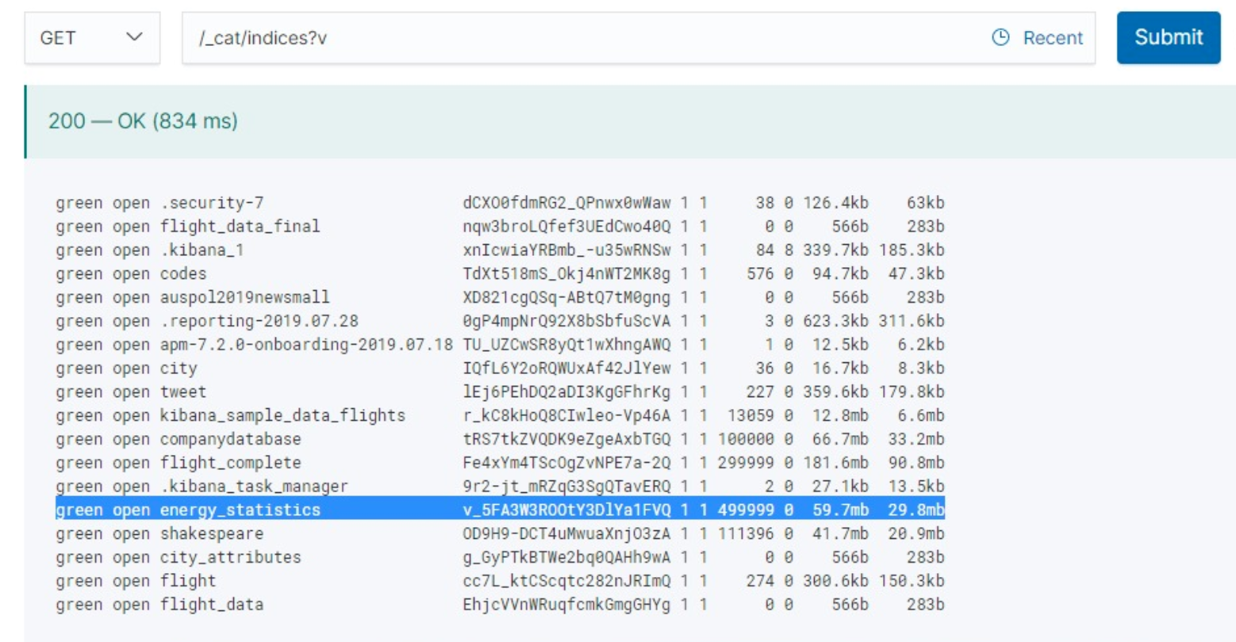
VERIFYING THE DATA LOADED
Enter the command /_cat/indices?v in the console tab to verify the data loaded.

Slide 8
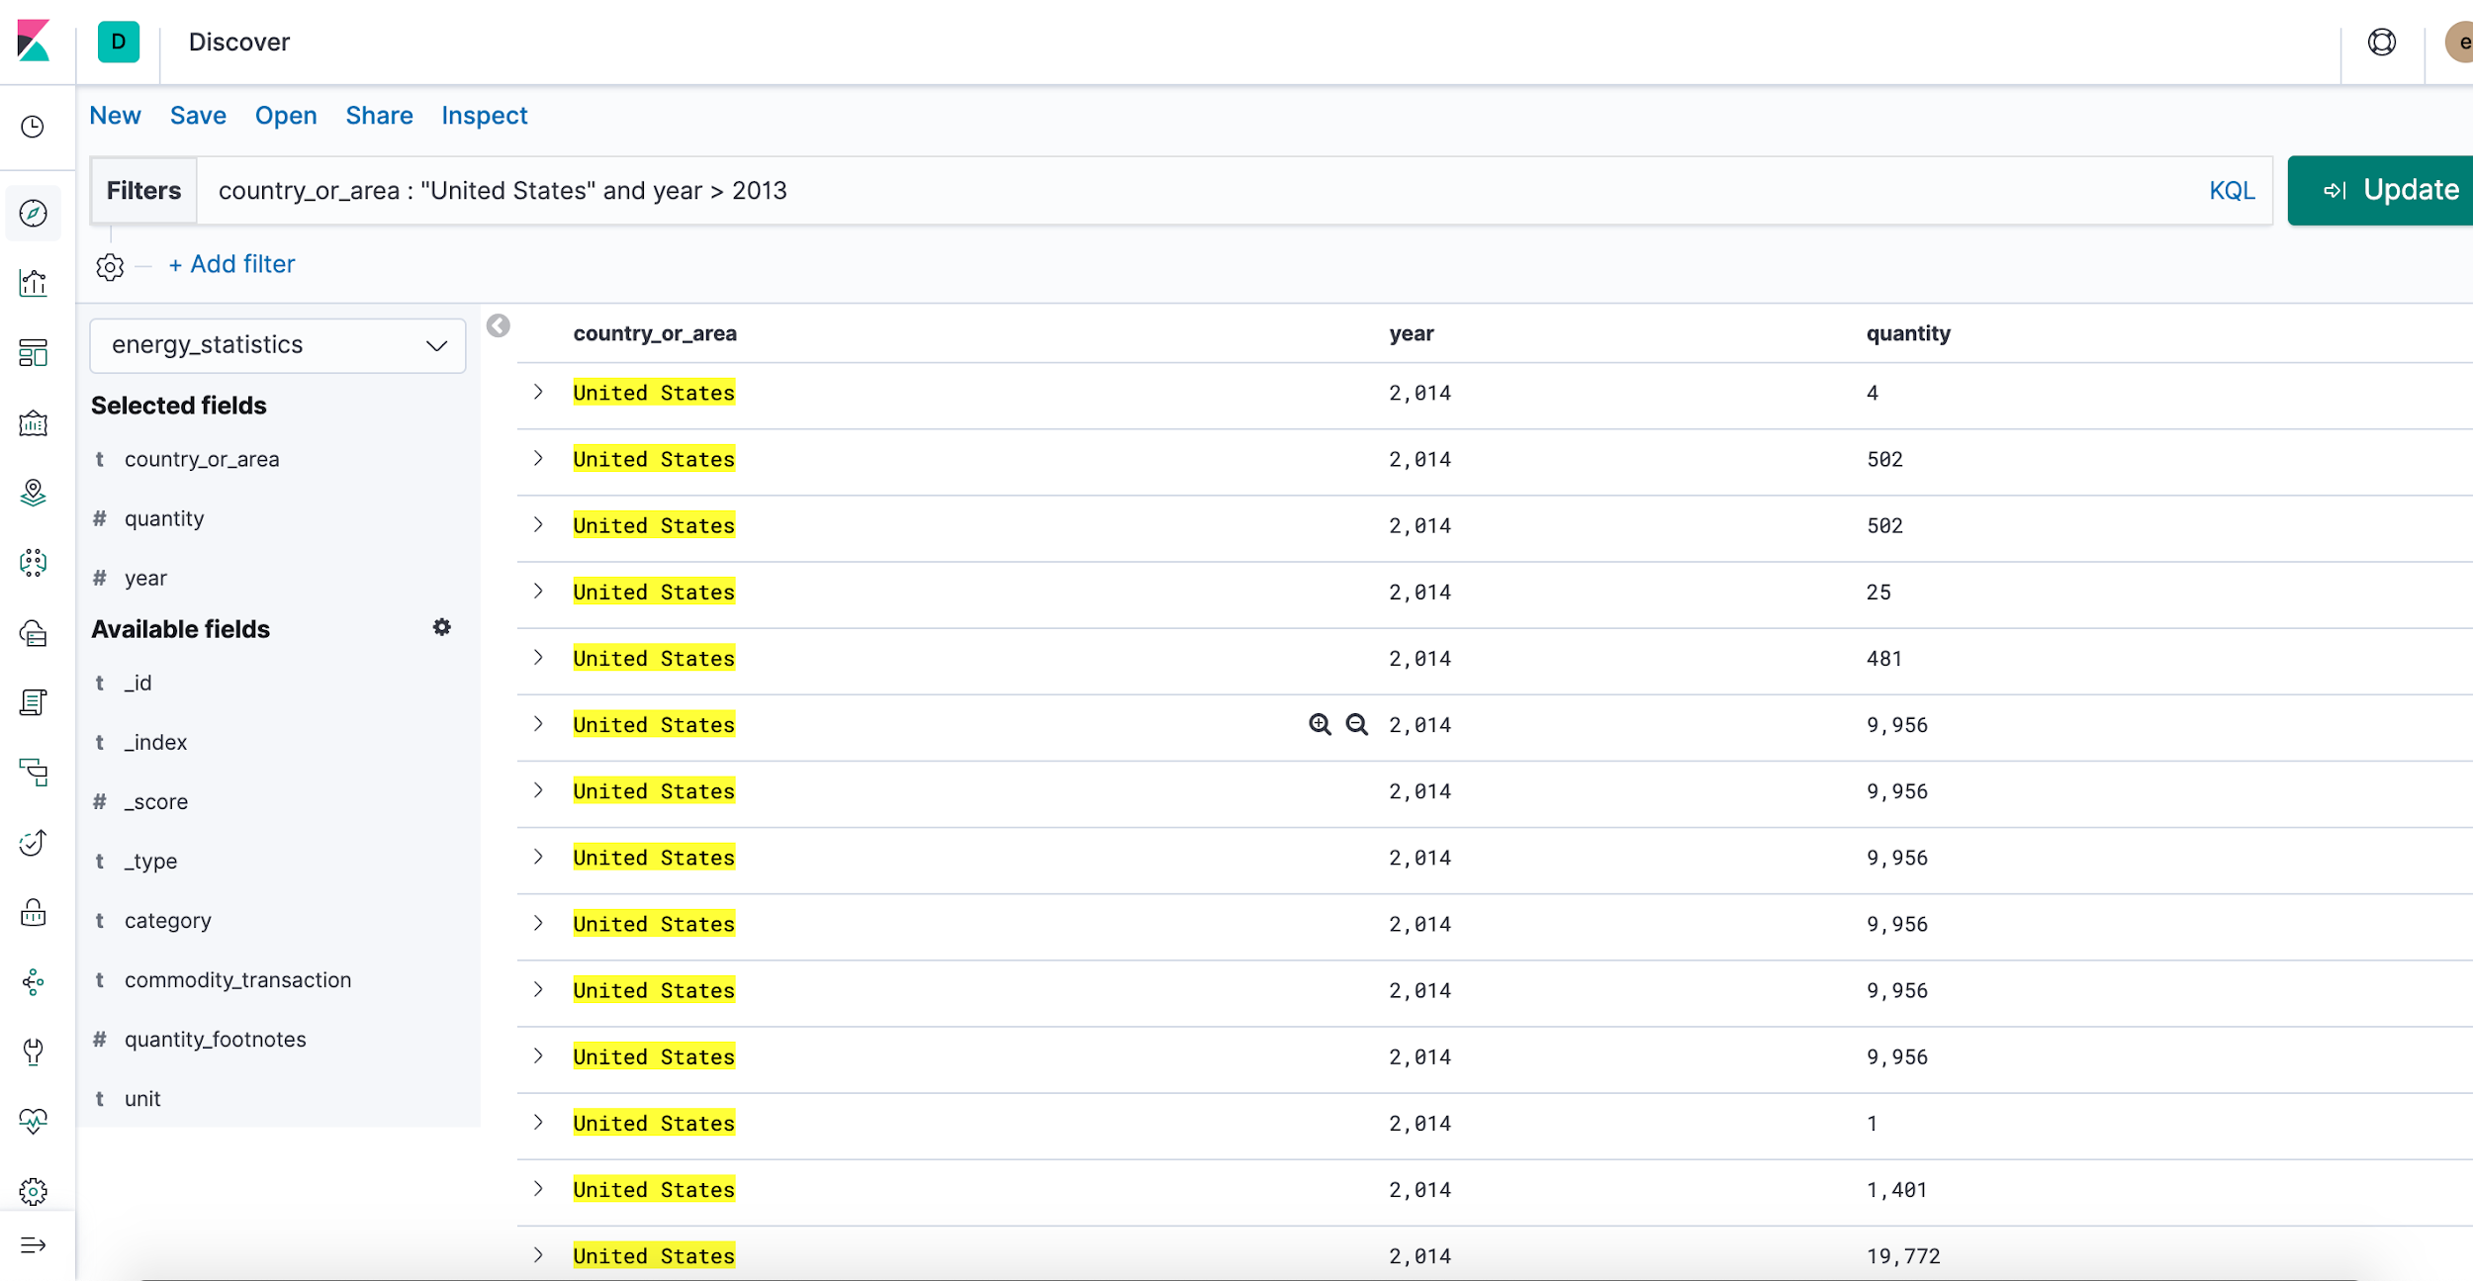
DISCOVERING THE DATA LOADED
Filtered the data using a basic SQL command, on the basis of country and year > 2013.

Slide 9
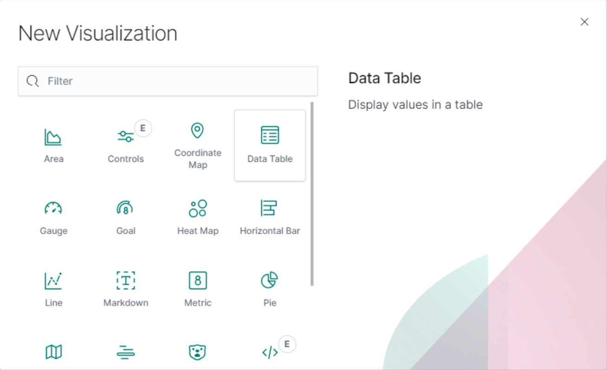

VISUALIZATION IN KIBANA
In the Visualize tab, we can shape our data using a variety of charts, tables, maps, and more.

Slide 10
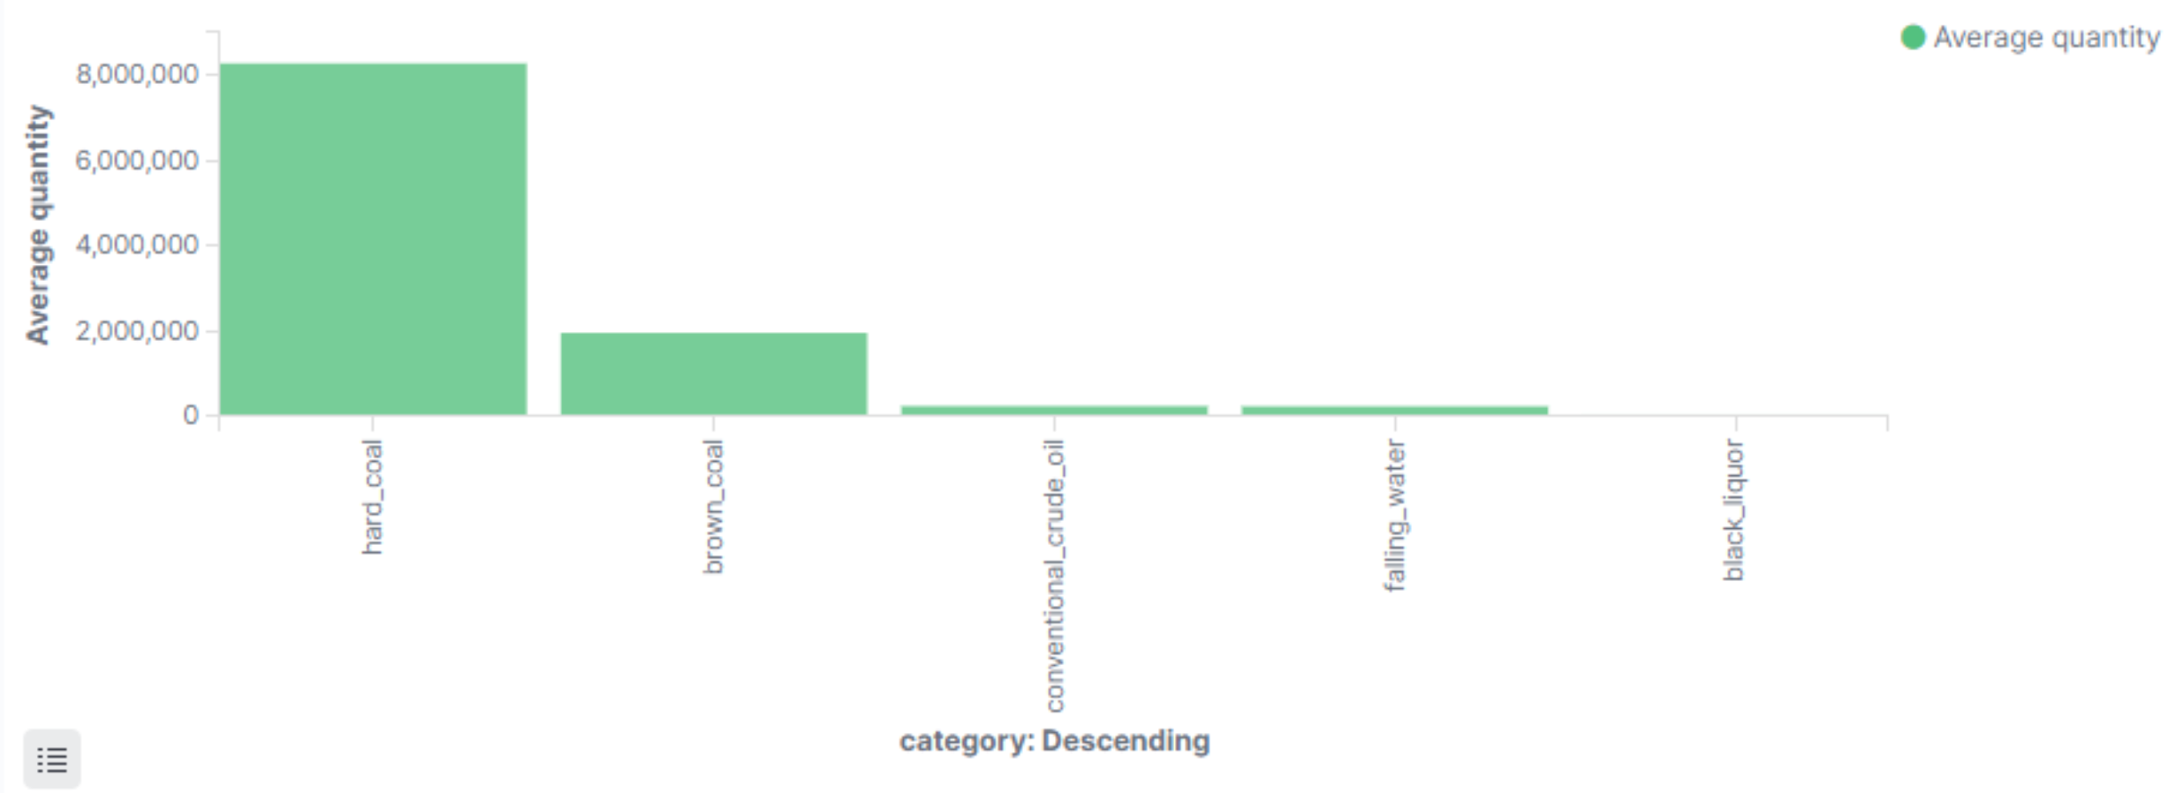
AVERAGE QUANTITY OF ENERGY PRODUCED
Hard_coal is the most used source for the production of energy

Slide 11
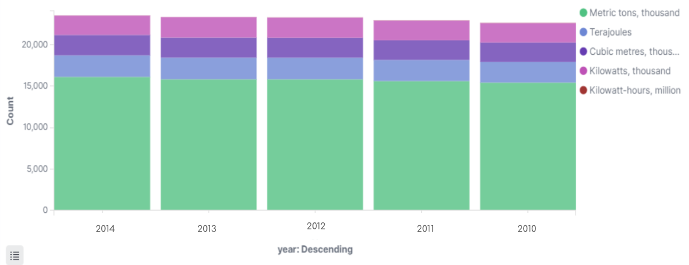
UNIT OF MEASUREMENT FOR ENERGY CONSUMPTION
Energy is often measured in “Metric tons, thousand”

Slide 12
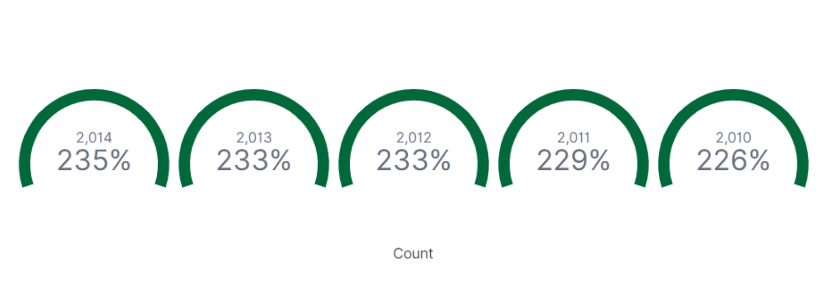
PERCENTAGE OF FUEL CONSUMED FROM 2010-2014
The fuel consumed is increasing gradually every year with 2014 being top.
2014
2013
2012
2011
2010
(data is available upto 2014 only)*

Slide 13
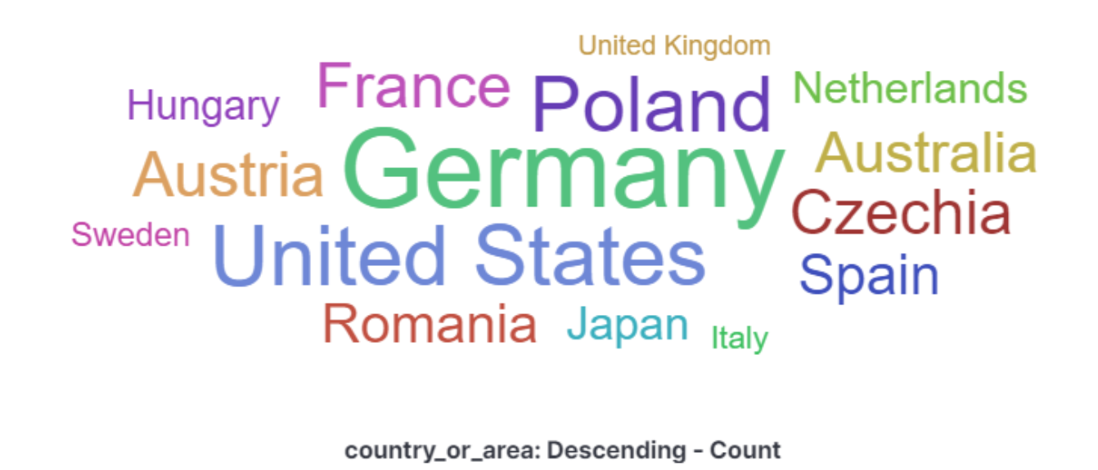
HIGHEST ENERGY CONSUMPTION COUNTRY
Germany consumes the most energy when compared to the rest.

Slide 14
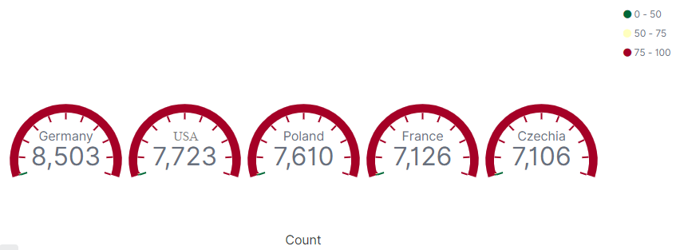
FUEL CONSUMPTION IN EACH COUNTRY
More than 75% of the energy produced is being utilized in each country.

Slide 15
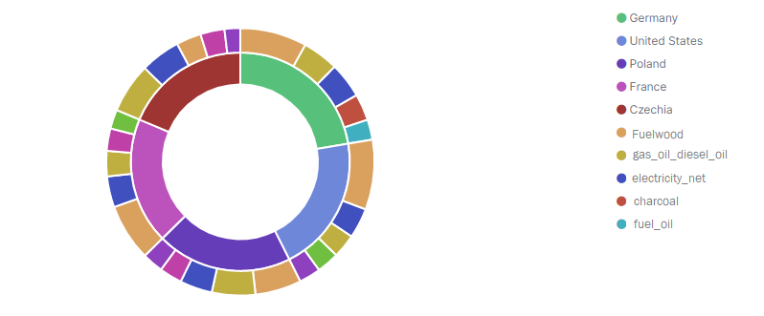
MAJOR SOURCE OF ENERGY FOR EACH COUNTRY
Fuelwood is like the main source of energy for the top energy consuming countries

Slide 16
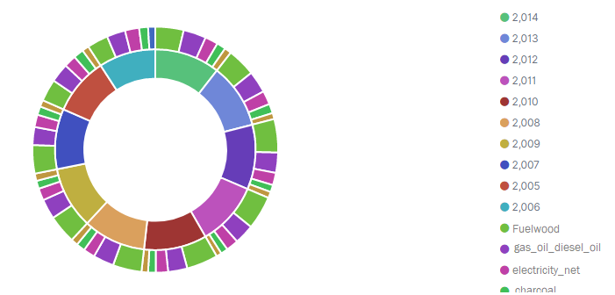
MAJOR SOURCE OF ENERGY PER YEAR
In almost every year Fuelwood occupies the first place as the source of energy production
2014
2013
2012
2011
2010
2008
2009
2007
2005
2006

Slide 17
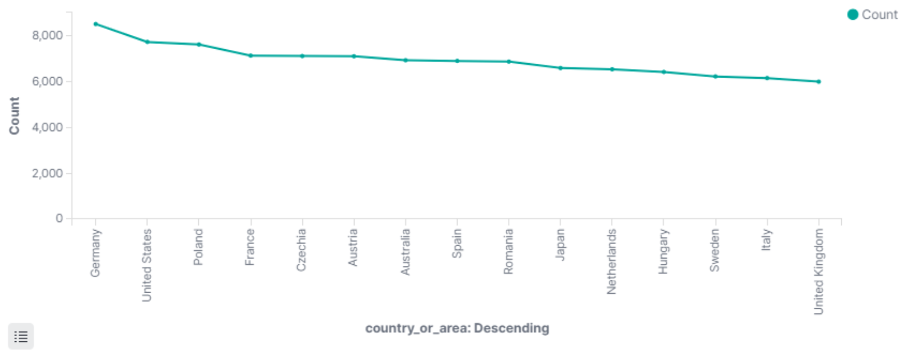
COUNTRIES AND THEIR ENERGY CONSUMPTION
We see that each country consumes more than 6,000 units of energy.

Slide 18
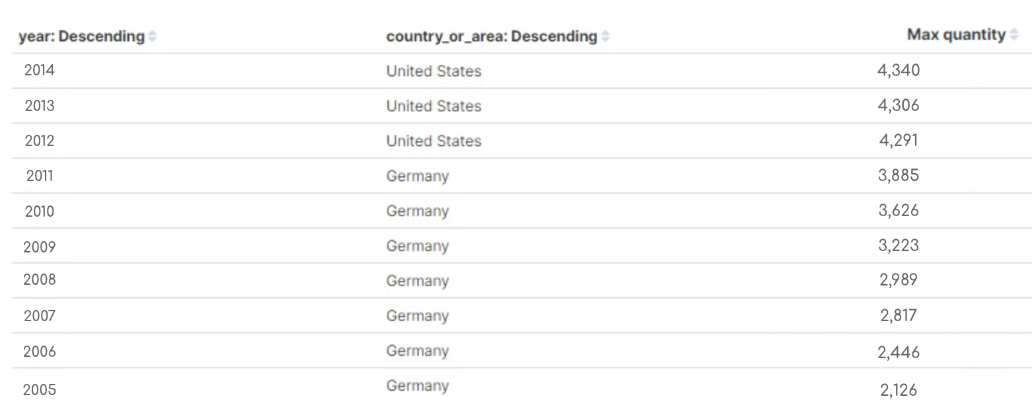
MAXIMUM QUANTITY OF ENERGY PRODUCED IN EACH COUNTRY
The maximum amount of energy is produced by the United States in the year 2014.

Slide 19
SUMMARY
Successfully used many tools learned in the class such as Elasticsearch, Kibana to analyse and visual the data using the tools.
Learned various terminologies of the data set and analysed various characteristics of the topic.
Gained insight over the international energy statistics.

Slide 20


REFERENCES
https://www.kaggle.com/unitednations/international-energy-statistics#all_energy_statistics.csv
https://github.com/sgontya/InternationalEnergyStatistics

Slide 21

THANK YOU

