Slide 1
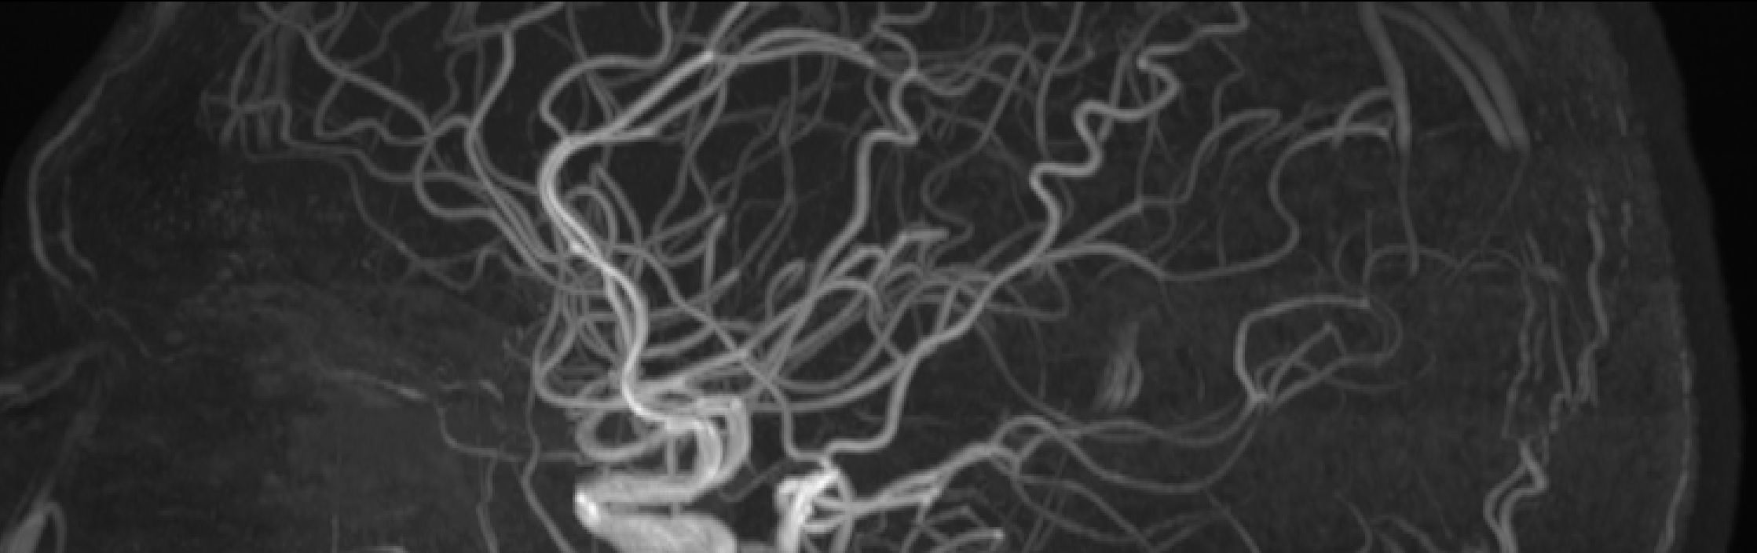
Stephen A.
Gonzalez

