Slide 1
Github – an Introduction
Theory and Computation club

Slide 2
Sharing is code is important
Most journals require that for a paper to be published you must share both your code and data
How do you share a bunch of files and the documentation at the shame which is easy to access
Need to be updateable as well

Slide 3

Github
github.com is a version control website which uses git software
Git requires the knowledge of the command line
A github account is required
It is free

Slide 4
How does Github
Github works by creation of the repositories (repos)
Think of these as project
Tracks files and they changes
Does not track directories, if there is no files in a directory then it will not track
Branches are used for when large changes are made to the code
Main code base
Branch 1
Branch 1
Dir
Dir
File
File

Slide 5
What is needed to use git
Mandatory
A GitHub account
An Internet connection
Useful to have
Markdown experience
Terminal access

Slide 6
Personal Access Token
A reality new change to using git hub via the terminal is you can’t use a password but must supply a Personal Access Token (PAT)
This is to make Github more secure with the ability to revoke permission without locking accounts down

Slide 7
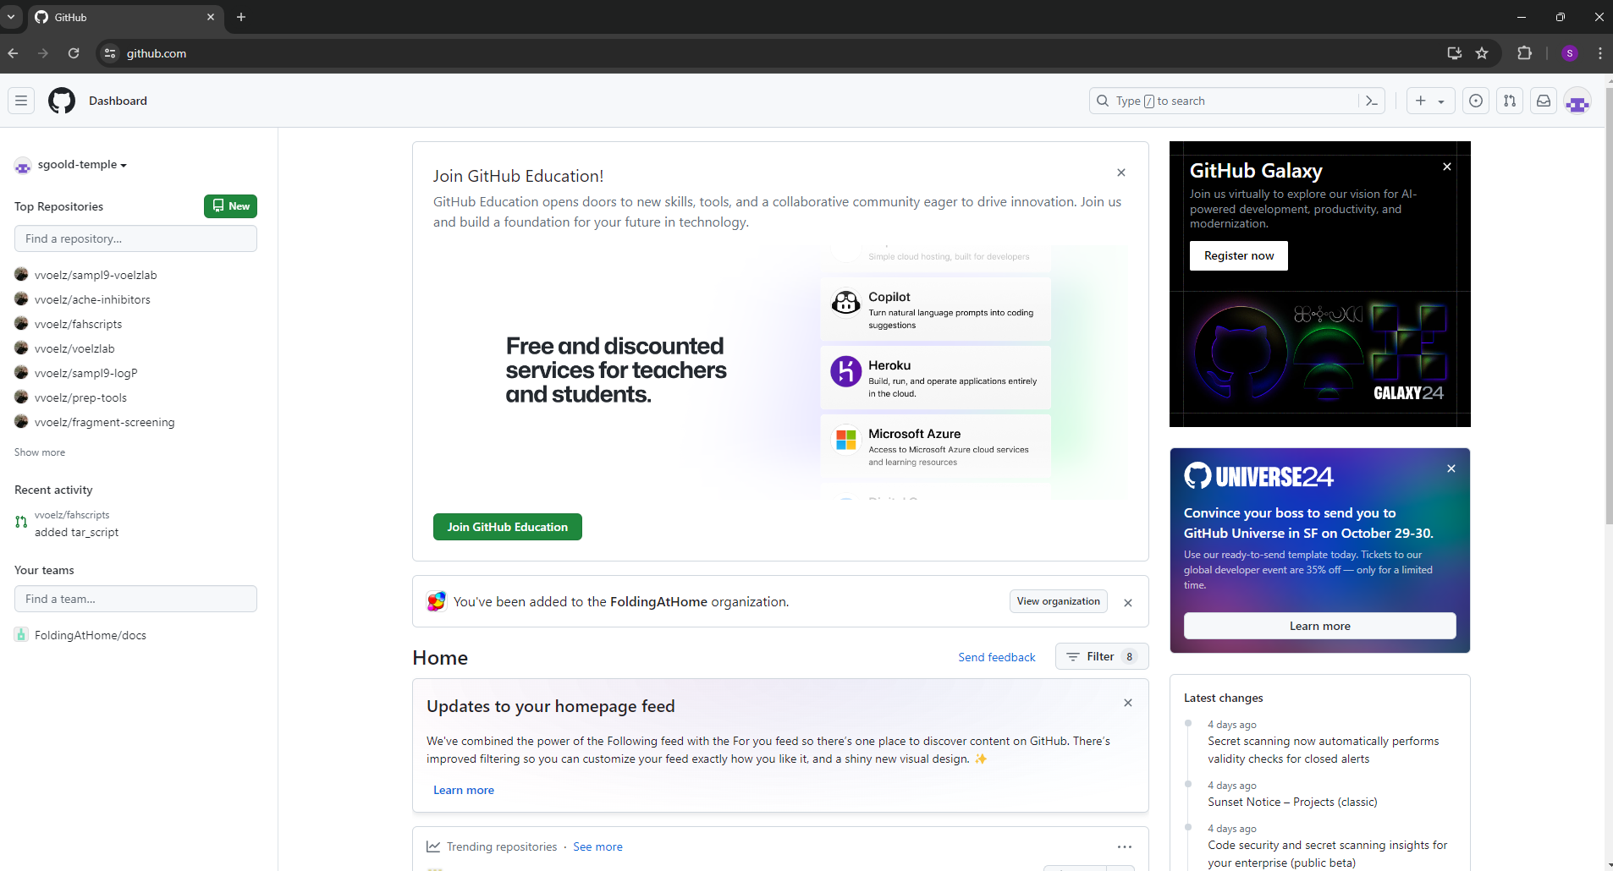

Creating a PAT
Log into your git hub account
Click on your profile picture
Click on settings
Scroll down and click on Developer settings
Click on Personal access tokens and then click on Tokens (classic)
Click on Generate new token and then click on Generate new token (classic)

Slide 8
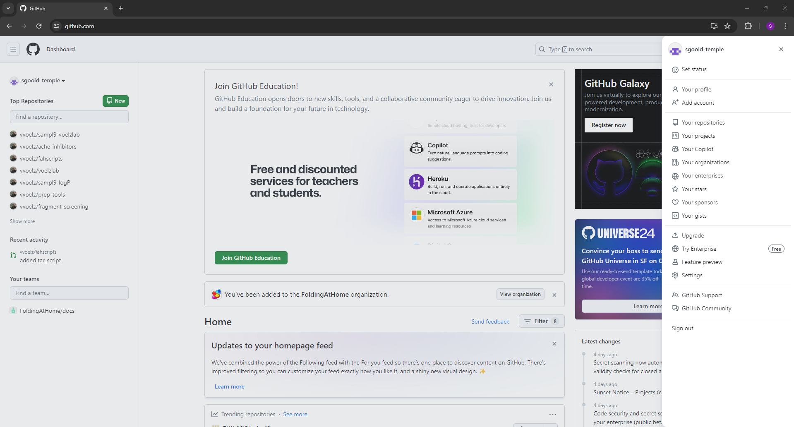
Creating a PAT
Log into your git hub account
Click on your profile picture
Click on settings
Scroll down and click on Developer settings
Click on Personal access tokens and then click on Tokens (classic)
Click on Generate new token and then click on Generate new token (classic)

Slide 9
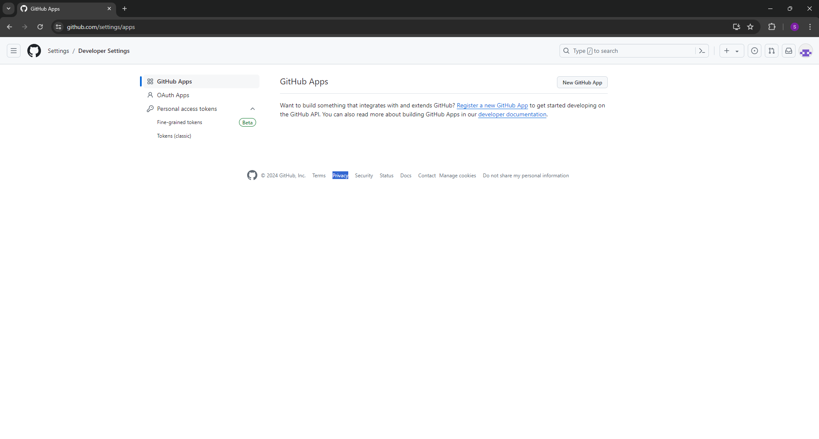
Creating a PAT
Log into your git hub account
Click on your profile picture
Click on settings
Scroll down and click on Developer settings
Click on Personal access tokens and then click on Tokens (classic)
Click on Generate new token and then click on Generate new token (classic)

Slide 10
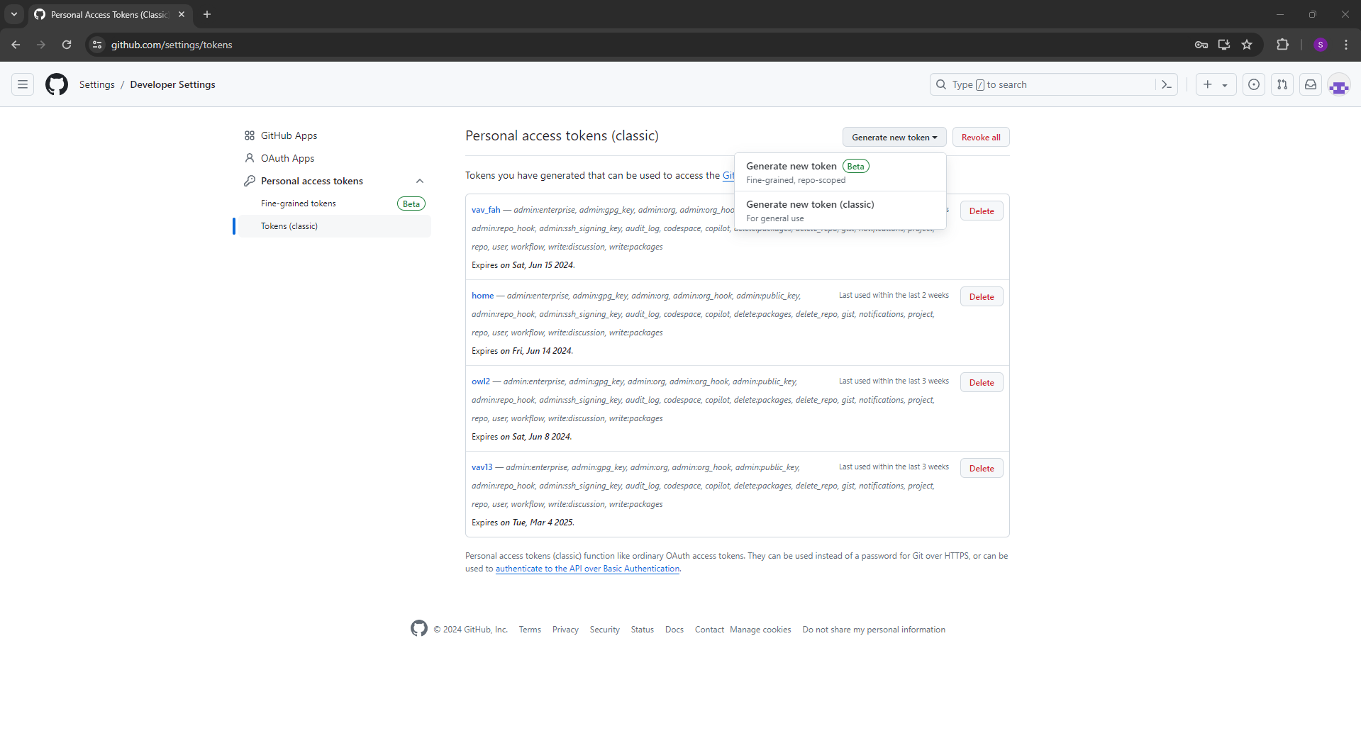
Creating a PAT
Log into your git hub account
Click on your profile picture
Click on settings
Scroll down and click on Developer settings
Click on Personal access tokens and then click on Tokens (classic)
Click on Generate new token and then click on Generate new token (classic)

Slide 11
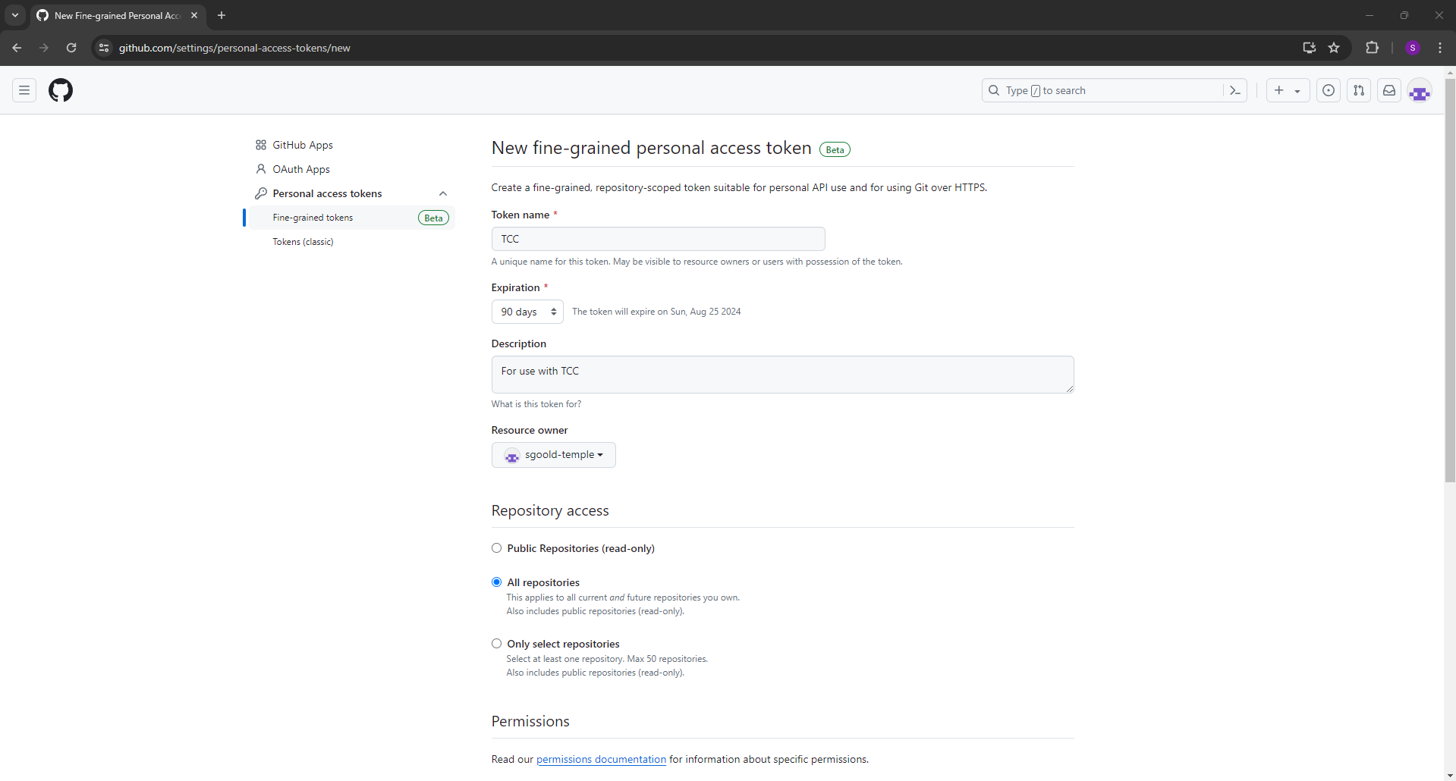
Creating a PAT
Give the token a name
Set the expiration date
Add a description
Select All repositories
Scroll down to select permissions and select the bottom option for both repository and account permissions
Click Generate token

Slide 12
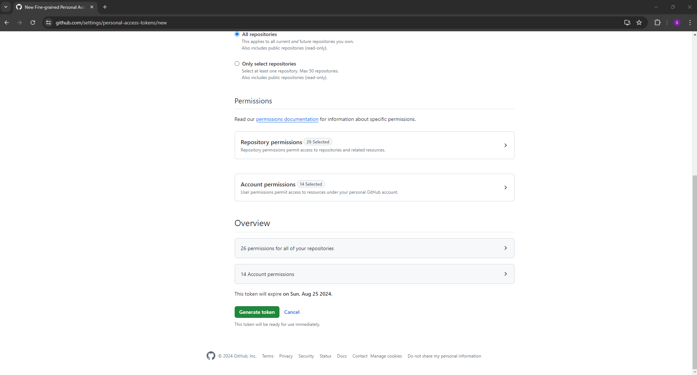
Creating a PAT
Give the token a name
Set the expiration date
Add a description
Select All repositories
Scroll down to select permissions and select the bottom option for both repository and account permissions
Click Generate token

Slide 13
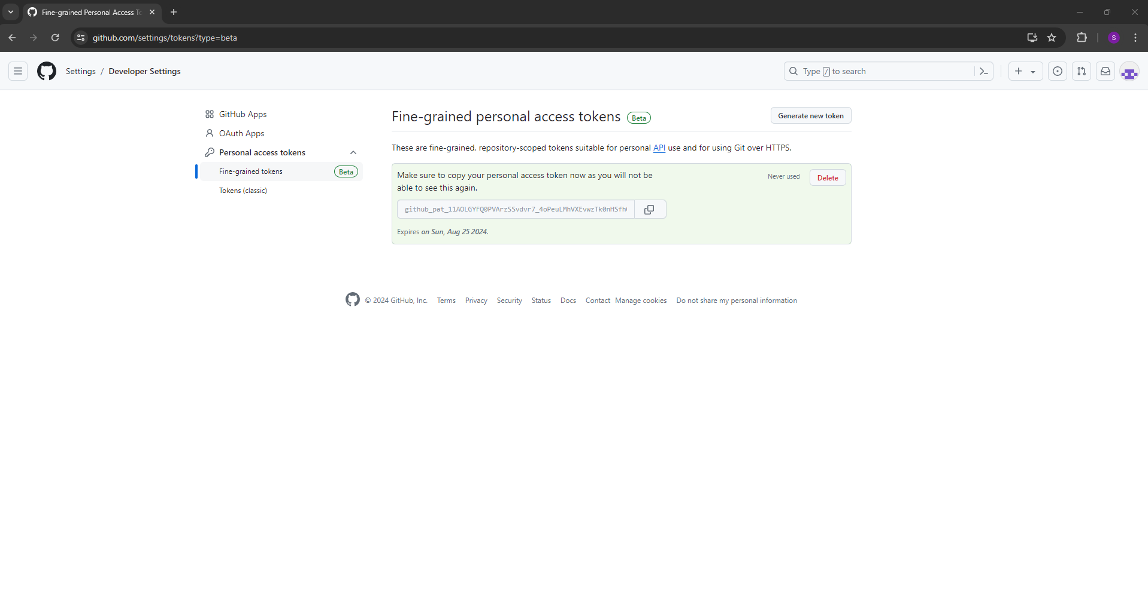
Creating a PAT
Save your PAT as you can’t see it again

Slide 14
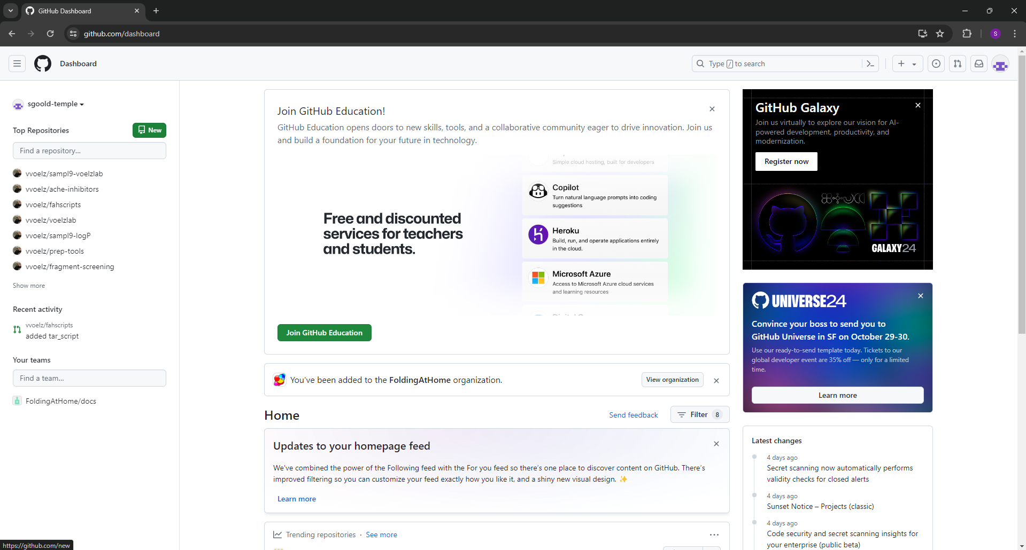
Creating a repo
Click on the New button (the one with the book
Select the owner
Give it a name and a description
Check the Add a README file option
Select the licence
Click Create repository

Slide 15
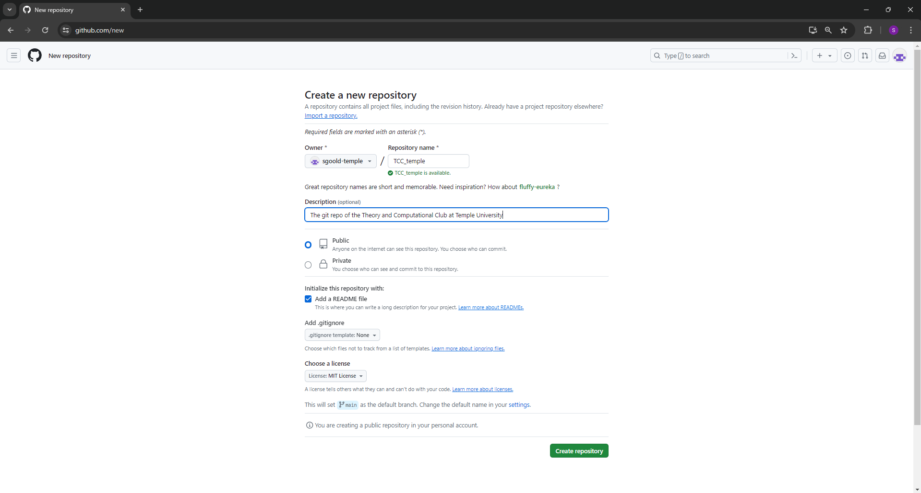
Creating a repo
Click on the New button (the one with the book
Select the owner
Give it a name and a description
Check the Add a README file option
Select the licence
Click Create repository

Slide 16
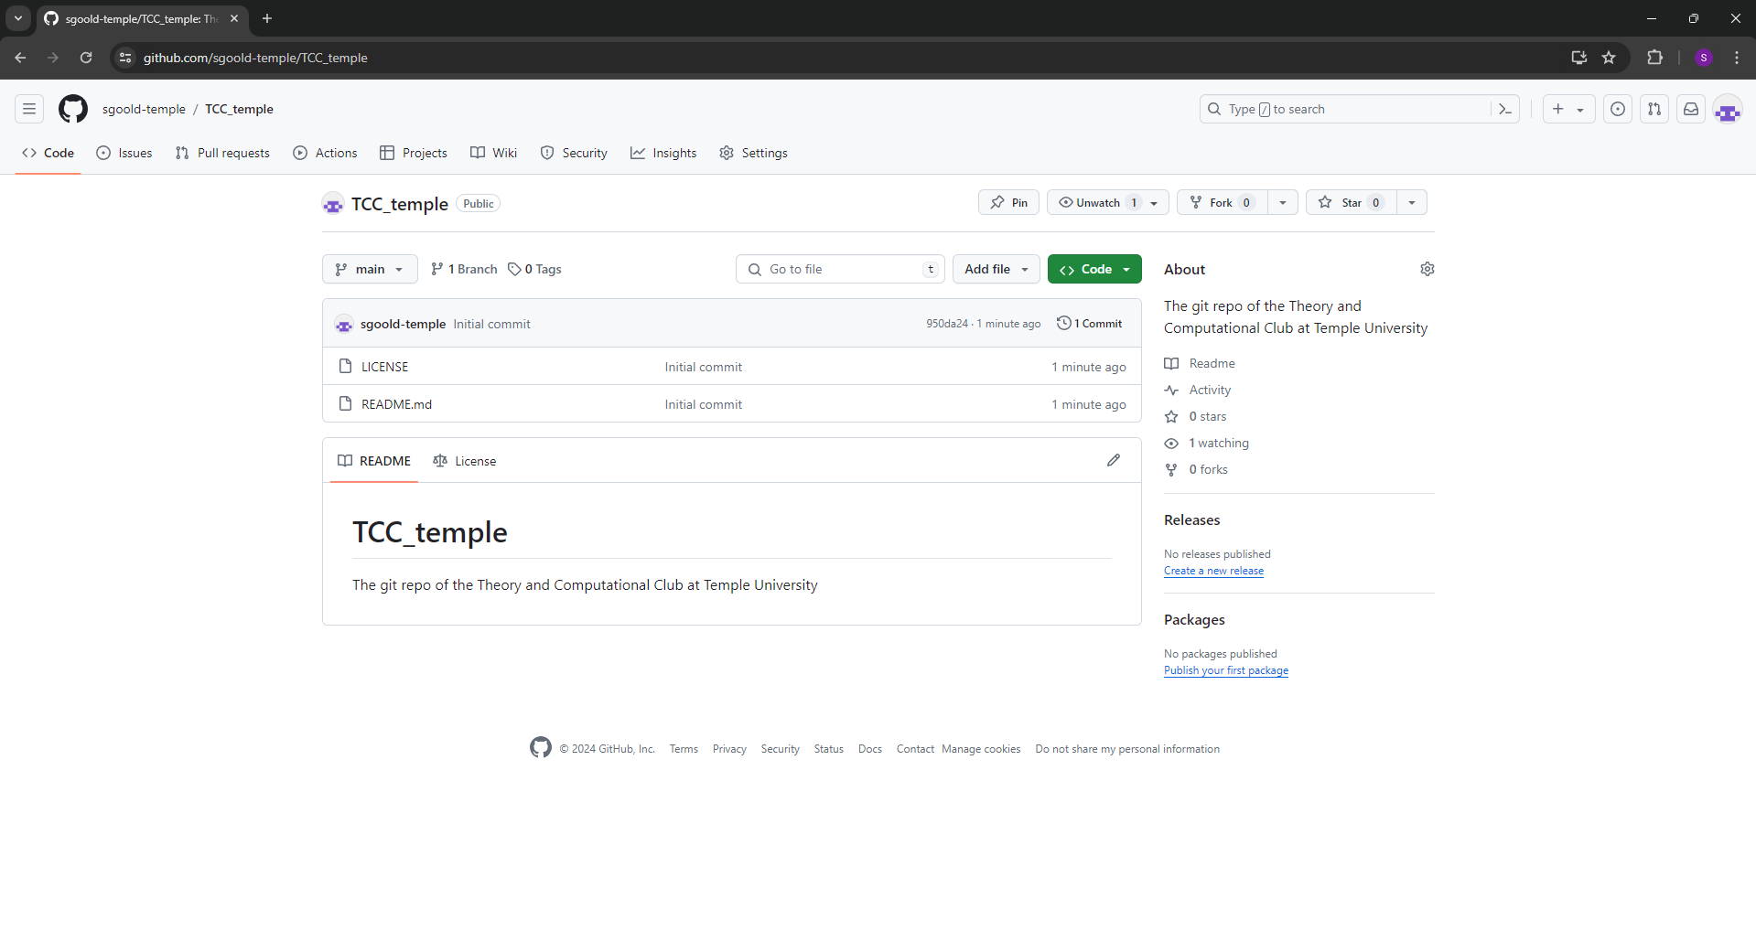
Creating a repo

Slide 17
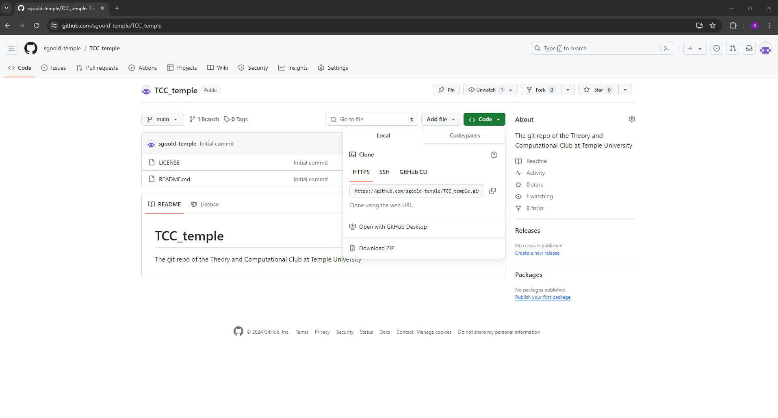
How to download a repo
This require both access to github.com and a terminal
Click on the <>Code
Then copy the hyperlink
In terminal use following command
git clone https://github.com/sgoold-temple/TCC_temple.git

Slide 18
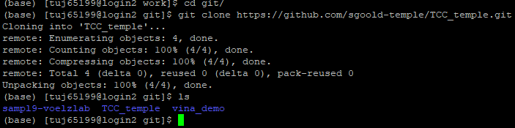
How to download a repo
Some reops might require you to log in with a PAT to download
You now have a local copy now you can start add and modifying files

Slide 19
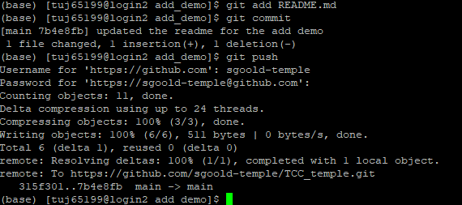
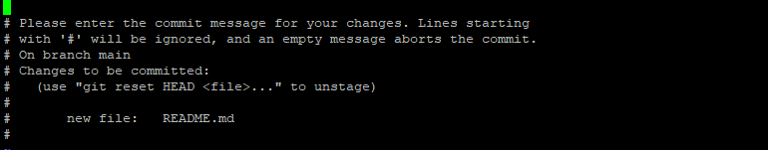
How to add files
Use the following commands
Note this adds the file to the main branch
Use the following commands
git add [file]
git commit
Add a comment
git push
Will ask for username and a PAT

Slide 20
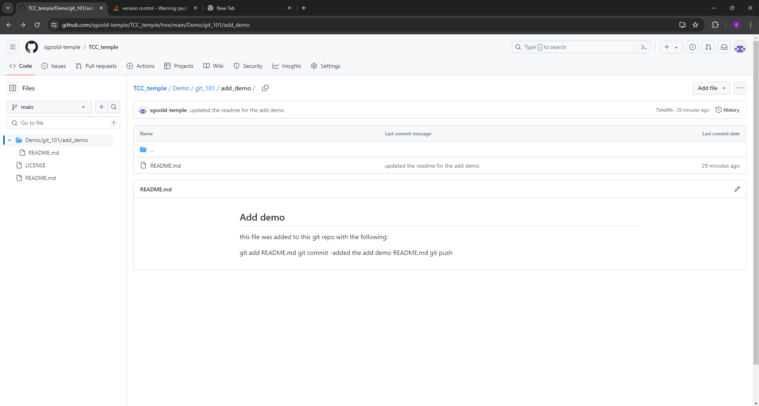
How to add files

Slide 21
How to update a repo
Use git pull
If there is no update it will print out “Already up-to-date”
If there is an update it will ask for a username and PAT

Slide 22
Branches
GitHub allows multiple developers to work on the code
So how do you stop the repo breaking?
Branches can be seen as parallel codebases that can be merged
Only directly push completely new files to main branch

Slide 23
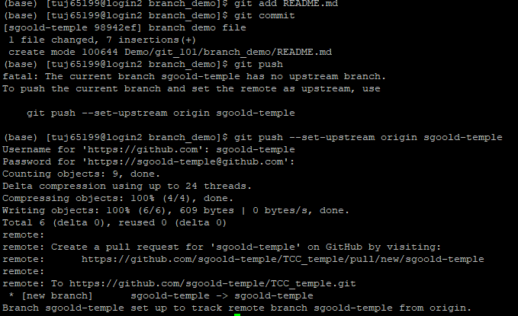
How to make a branch
Use the following command
git checkout –b [branch ]
The included file are based on when the branch was created
To switch back to the main branch use
git checkout main
The branch can be updated used like the main branch

Slide 24
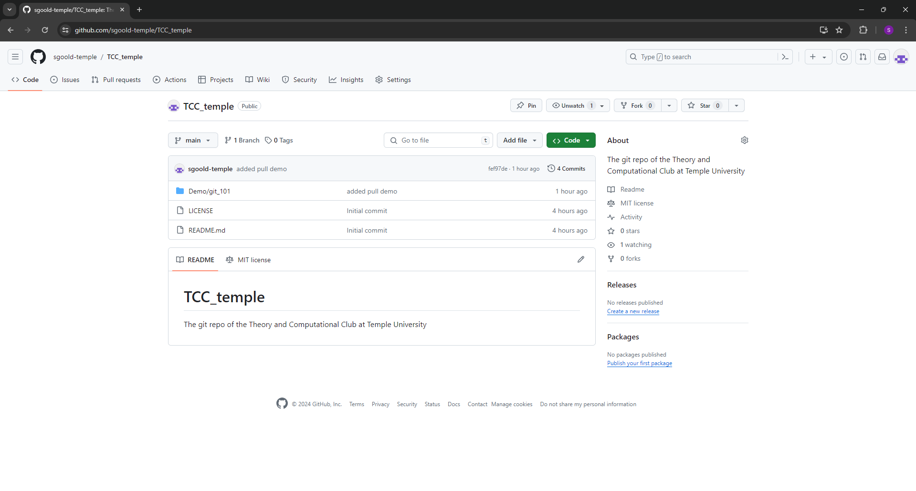
How to merge to branches
This is done the via github.com
This is called a merge request
To start go the repo’s git hub page
Click on the Pull request
Click on New pull request

Slide 25
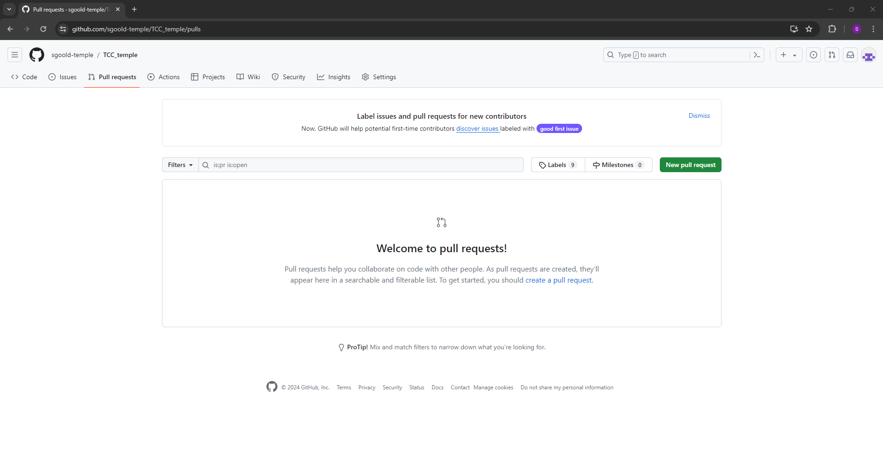
How to merge to branches
This is done the via github.com
This is called a merge request
To start go the repo’s git hub page
Click on the Pull request
Click on New pull request

Slide 26
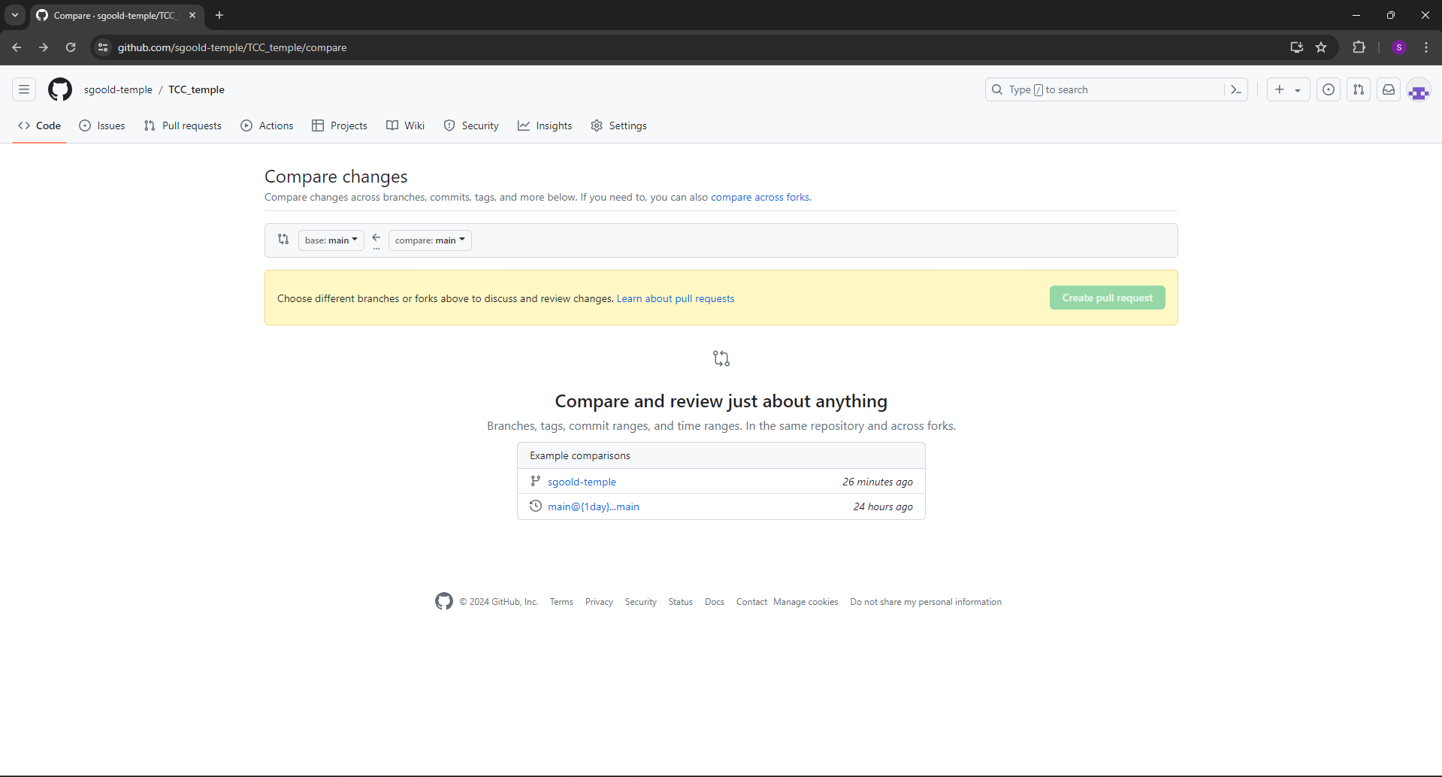
How to merge to branches
This is done the via github.com
This is called a merge request
To start go the repo’s git hub page
Click on the Pull request
Click on New pull request
For base select main and branch for compare

Slide 27
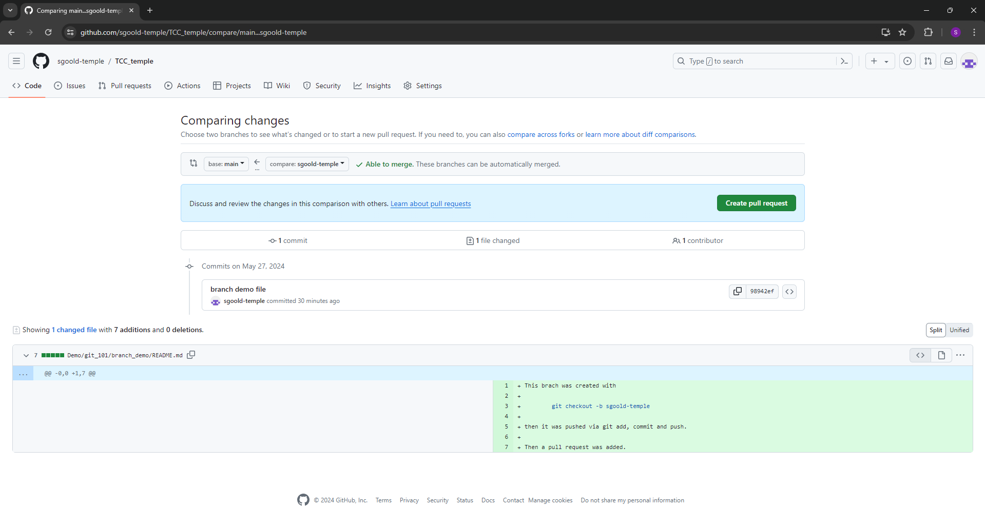
How to merge to branches
This is done the via github.com
This is called a merge request
To start go the repo’s git hub page
Click on the Pull request
Click on New pull request
For base select main and branch for compare
Click Create pull request

Slide 28
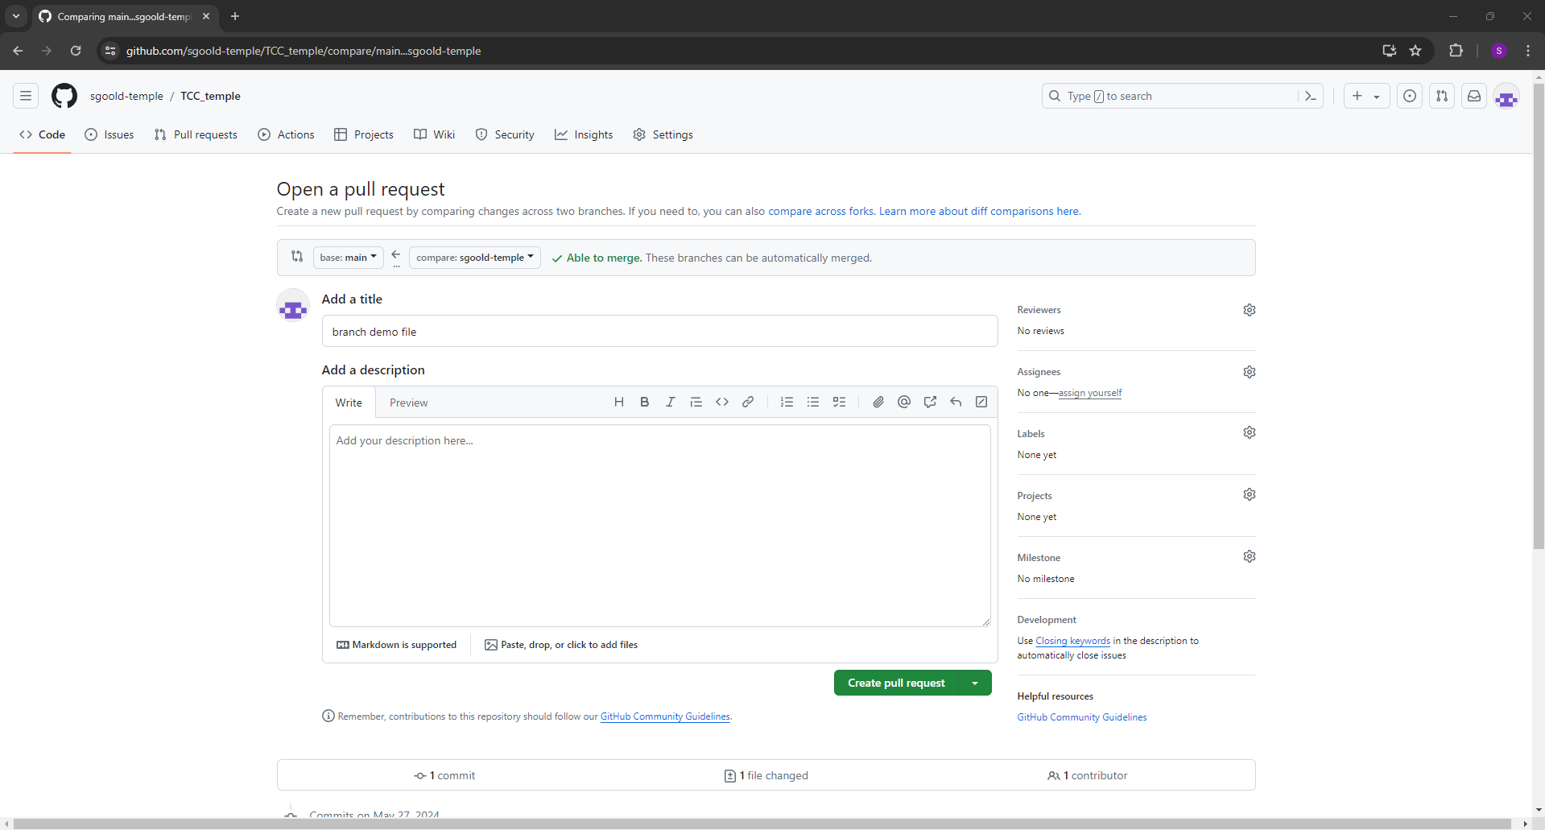
How to merge to branches
Add a tile
Add a description about what you are doing in the branches
Click on Create pull request
Git does an automictic check for conflicts but test always

Slide 29
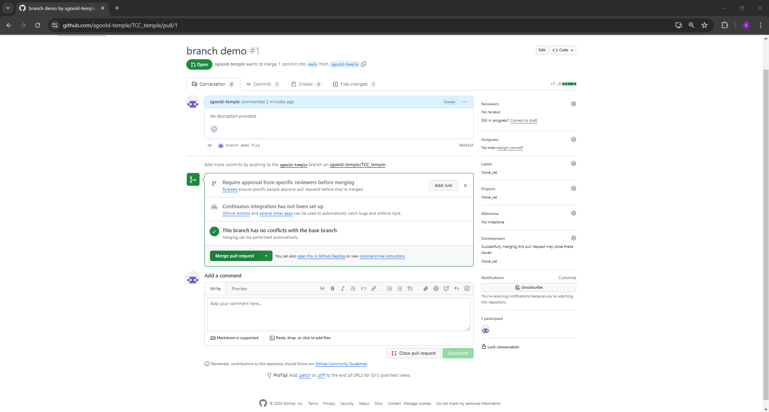
How to merge to branches
Add a tile
Add a description about what you are doing in the branches
Click on Create pull request
Git does an automictic check for conflicts but test always

Slide 30
Goals for the workshop
Create a local copy of TCC repo
Create a branch using your Github username as the branch name
Add a text file in a directory with username (in workshop)
Create a pull request to merge

