Slide 1

MEAT
Is there a link between meat consumption and the global increase in obesity?
Nashville Software School
Part Time Data Analytics Cohort 7
Capstone Project by Steven Goolsby
Python
Plotly Chart Studio
Power BI
PowerPoint

Slide 2
Agenda
What is “Obesity”?
United States: Lets look at the data
Worldwide Analysis
Outliers or Exceptions to the findings
Conclusions

Slide 3
What is “Obesity”?
Obesity: The state or condition of being very fat or overweight.
Generally thought to be caused by overeating and/or moving too little.
Worldwide obesity has nearly tripled since 1975.
Classified using “Body Mass Index”(BMI)
BMI calculation: weight in kg/height in meters squared
Class I Obesity: (>= 30kg/m2)
Class II / Severe Obesity: (>= 35kg/m2)
Class III / Morbid Obesity: (>= 40kg/m2)
* Information provided by: World Health Org. , Centers for Disease Control and Prevention. *

Slide 4
United States Data
* Data provided by: NCDRisC.org and Ourworldindata.org *

Slide 5
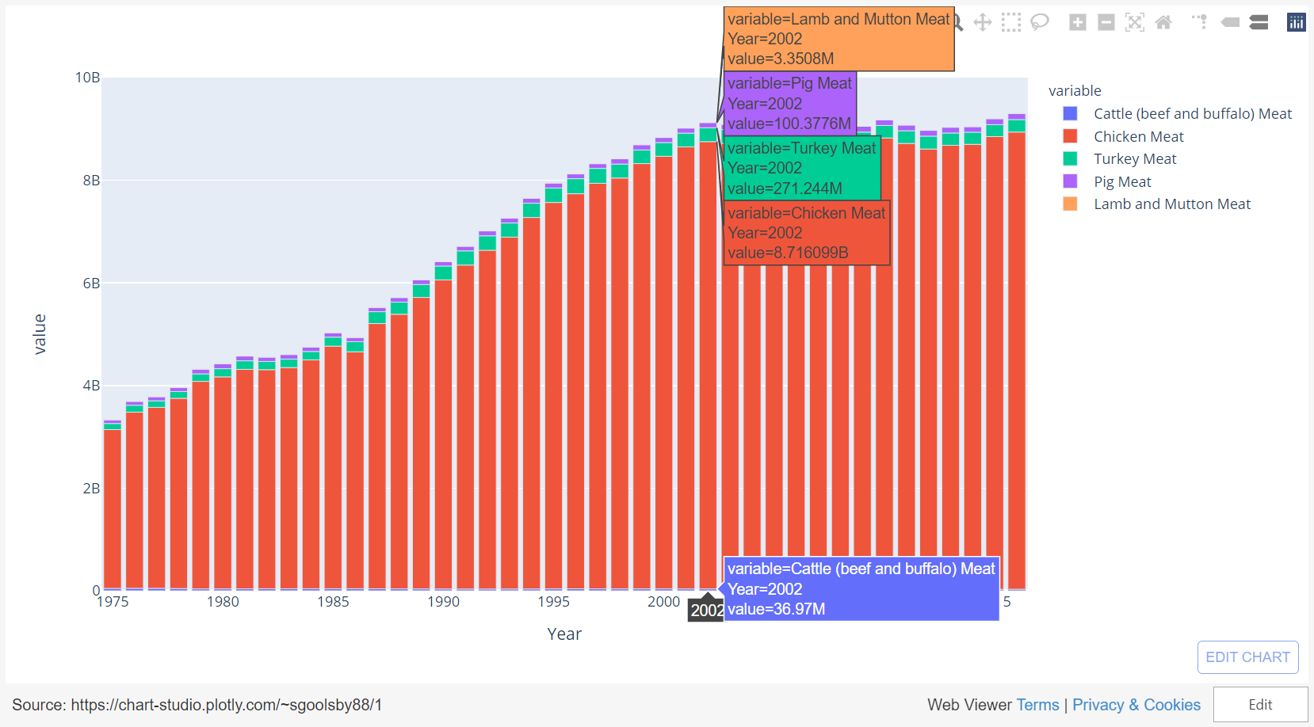
United States Total Meat Production

Slide 6
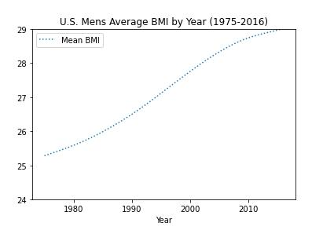
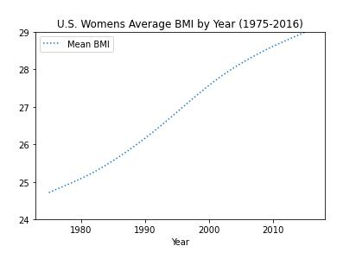

Slide 7
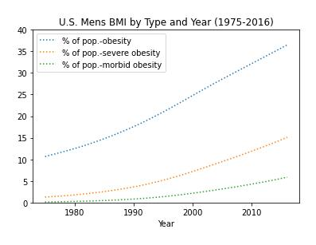
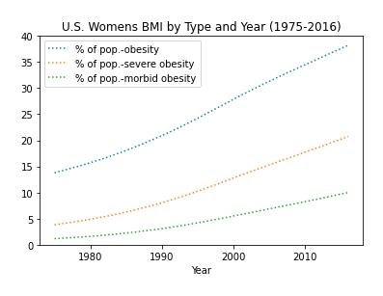

Slide 8
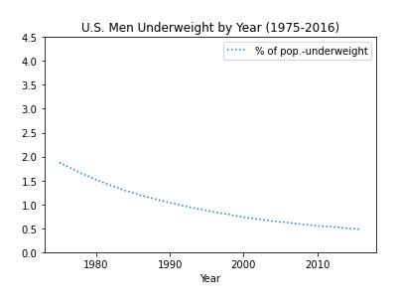
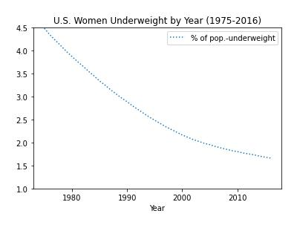

Slide 9

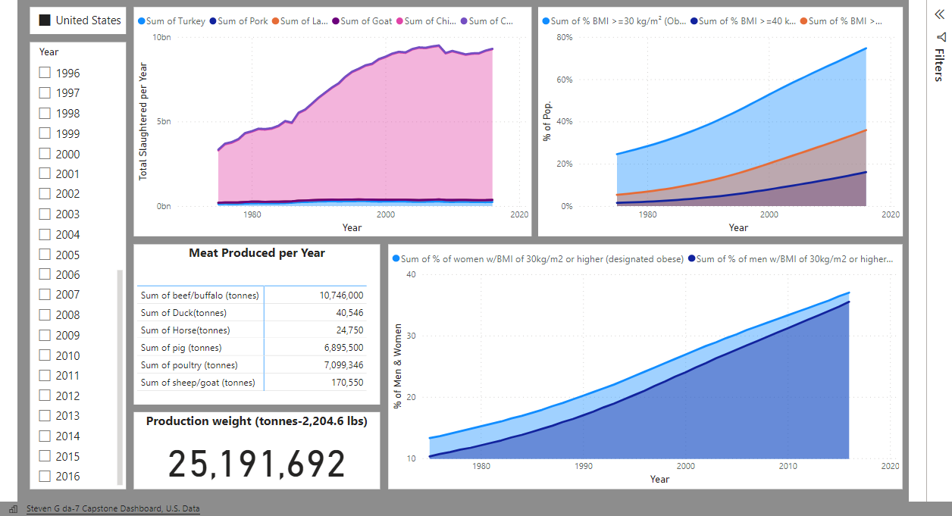

Slide 10
Worldwide Data
* Data provided by: NCDRisC.org and Ourworldindata.org *

Slide 11
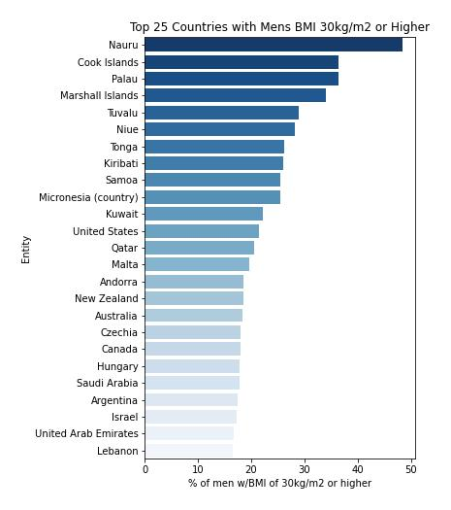
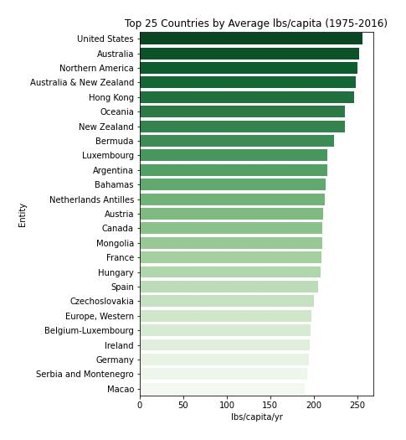
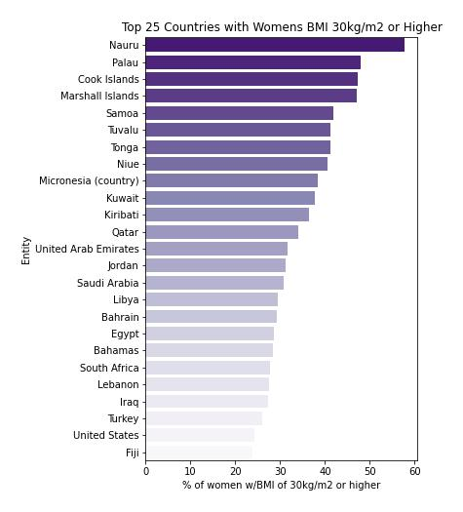

Slide 12
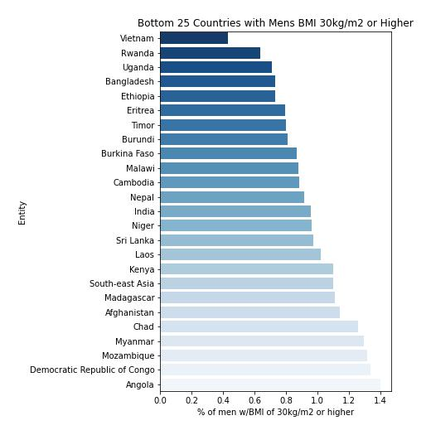
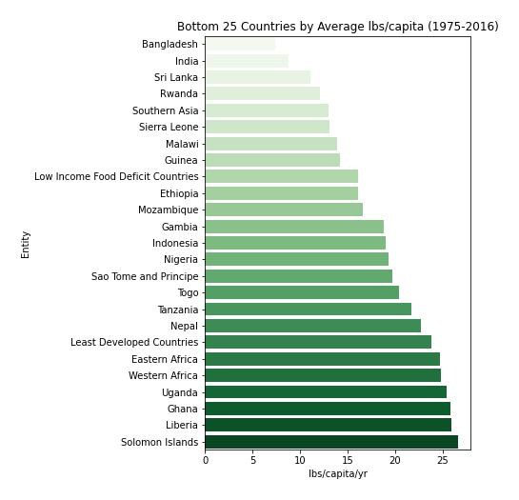
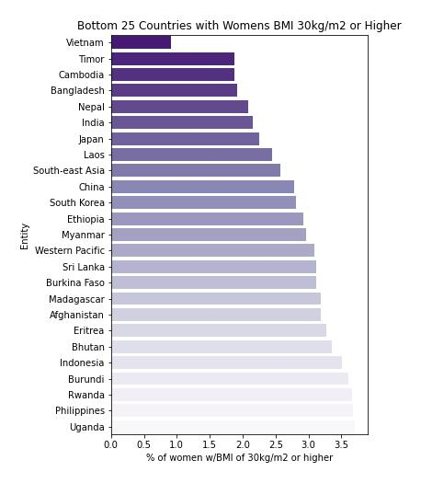

Slide 13
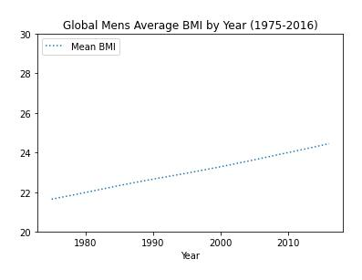
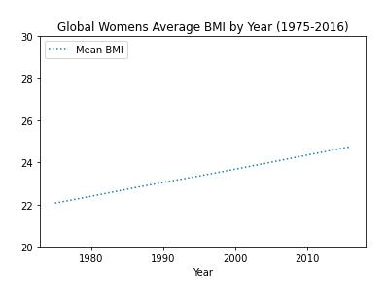

Slide 14
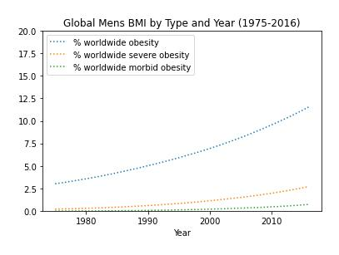
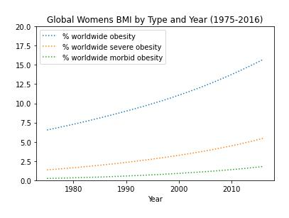

Slide 15
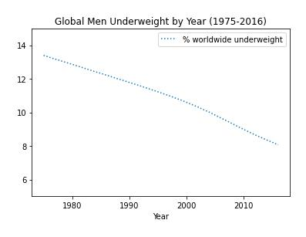
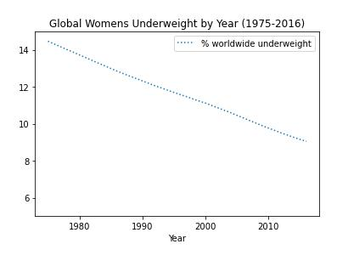

Slide 16
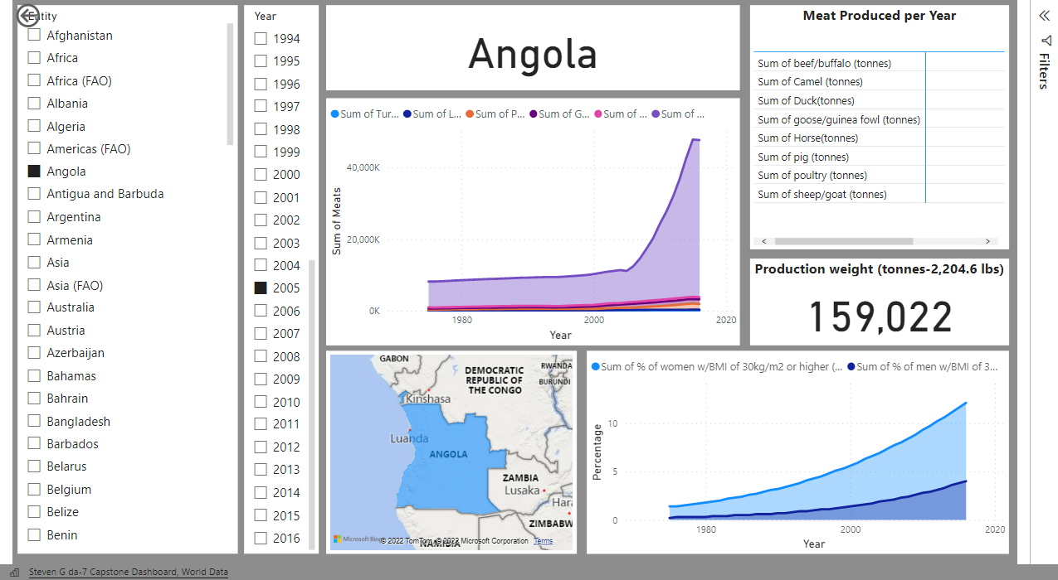

Slide 17
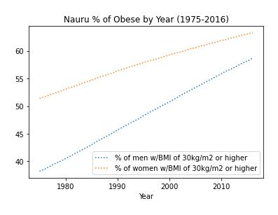
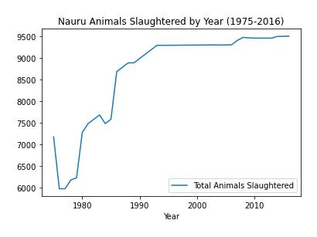
Outliers or Exceptions Example:

Slide 18
Possible Reasons:
Historically, food sources mainly consisted of marine fish, fruits, root vegetables, and coconuts.
Phosphate mining profits allowed Nauru to gain economic freedom in 1968.
Because of this, there was a vast increase in importation of western foods and a sharp decrease in fishing and gardening.
Currently 90% of the land area is covered with phosphate deposits, with the majority strip-mined and non-arable.
This has led to Nauruan reliance on imported and processed foods high in both sugar and fat.
Because of this, Nauru has the highest rate of adult type 2 diabetes in the world, 71% of the population is considered obese, and 97% of Nauruan men are considered obese.
* Information provided by: Wikipedia , World Health Organization *

Slide 19
Conclusions
There definitely appears to be a link between the increase in meat consumption and the increase in worldwide obesity.
Meat consumption and Obesity do appear to have a sharper increase in more economically developed countries. (with some exceptions)
There does not appear to be a significant difference, positive or negative, between the rates in men and women.
While these findings appear to show a link between consuming meat and obesity, there are undeniable outliers and exceptions.

Slide 20
Thank You!!

