Slide 1
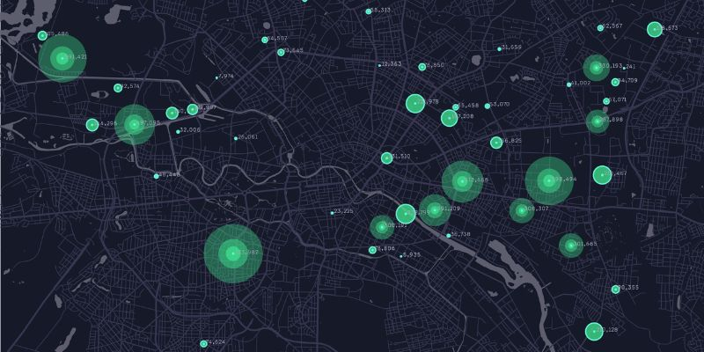
INDUSTRIAL HUMAN RESOURCE GEO-VISUALIZATION
-S GOPIKA

Slide 2
INTRODUCTION
Industrial Human Resource Geo-Visualization refers to the process of visually representing data related to the workforce within various industries across different geographical locations.
This type of visualization aims to provide insights into the distribution, characteristics, and trends of the industrial workforce in a way that is easy to interpret and analyze.

Slide 3
PROBLEM STATEMENT
In India, the industrial classification of the workforce is essential to understand the distribution of the labor force across various sectors.
The current data on this classification is outdated and may not accurately reflect the current state of the workforce.
The Aim is to update the information on the industrial classification of the main and marginal workers, other than cultivators and agricultural laborers, by sex and by section, division, and class, to provide relevant and accurate data for policy making and employment planning.

Slide 4
TOOLS USED
Python - It provides a robust environment for data analysis, visualization, and model building due to its simplicity.
Pandas - It is essential for data cleaning, transformation, and analysis.
Scikit-learn - It is used for implementing classical machine learning tasks such as data exploration, feature engineering, model building, and model testing.
NLTK(Natural Language Toolkit) - It is used for text processing and analysis.
Plotly - It is used for creating detailed and interactive visualizations.
Streamlit - It is used to develop an interactive dashboard to visualize the workers' population of various industries across different geographies.

Slide 5
APPROACHES
Merging all the CSV data files into a single dataframe and data cleaning like checking null values and data types, drop the duplicates.
Detected outliers using IQR(Inter-Quartile Range) of box plot and handled using capping method.
Standardization is applied for numerical columns which is a preprocessing technique used in machine learning.
Then Natural Language Processing (NLP) techniques to analyze core industries, enabling effective categorization and clustering.
This is unsupervised learning so used k-means clustering.

Slide 6
EDA INSIGHTS
Distribution by Region
Rajasthan(08): Holds the highest number of workers.
Maharashtra(27): Ranks second in the number of workers.
Tamil Nadu(33): Comes in third in the number of workers.
Gender Distribution in Workforce
Male Workers: There are more male workers than female workers in both rural and urban areas across
main and marginal work categories.
Female Workers: The number of female workers is higher in the marginal category than in the main
category for both rural and urban areas.
Rural vs. Urban Workforce
Main Workers: There are fewer main workers in rural areas compared to urban areas.
Marginal Workers: There are more marginal workers in rural areas compared to urban areas.

Slide 7
CONT…..
After analysis I found that majorly working industries are Retail trade,public administration ,land transport and construction building
In sex wise , female prefers to work in human health activity,in education and in service based sectors and male prefers to work in land transport, public administration, retail trade and construction building.

Slide 8
THANK YOU

