Slide 1
cancer signatures in cNF
deconstructSigs R package with cosmic signatures
two synapse files:
syn5713423 which contains germline and somatic mutations, all within genes
syn6087182 which only contains somatic mutations (but unfiltered maybe?)
Obtained signature proportions for each sample (plus a small percentage unknown)
Plot signature proportions by sample, as well as additive proportions by signature (to get an idea of which signatures are most prevalent in all samples)

Slide 2
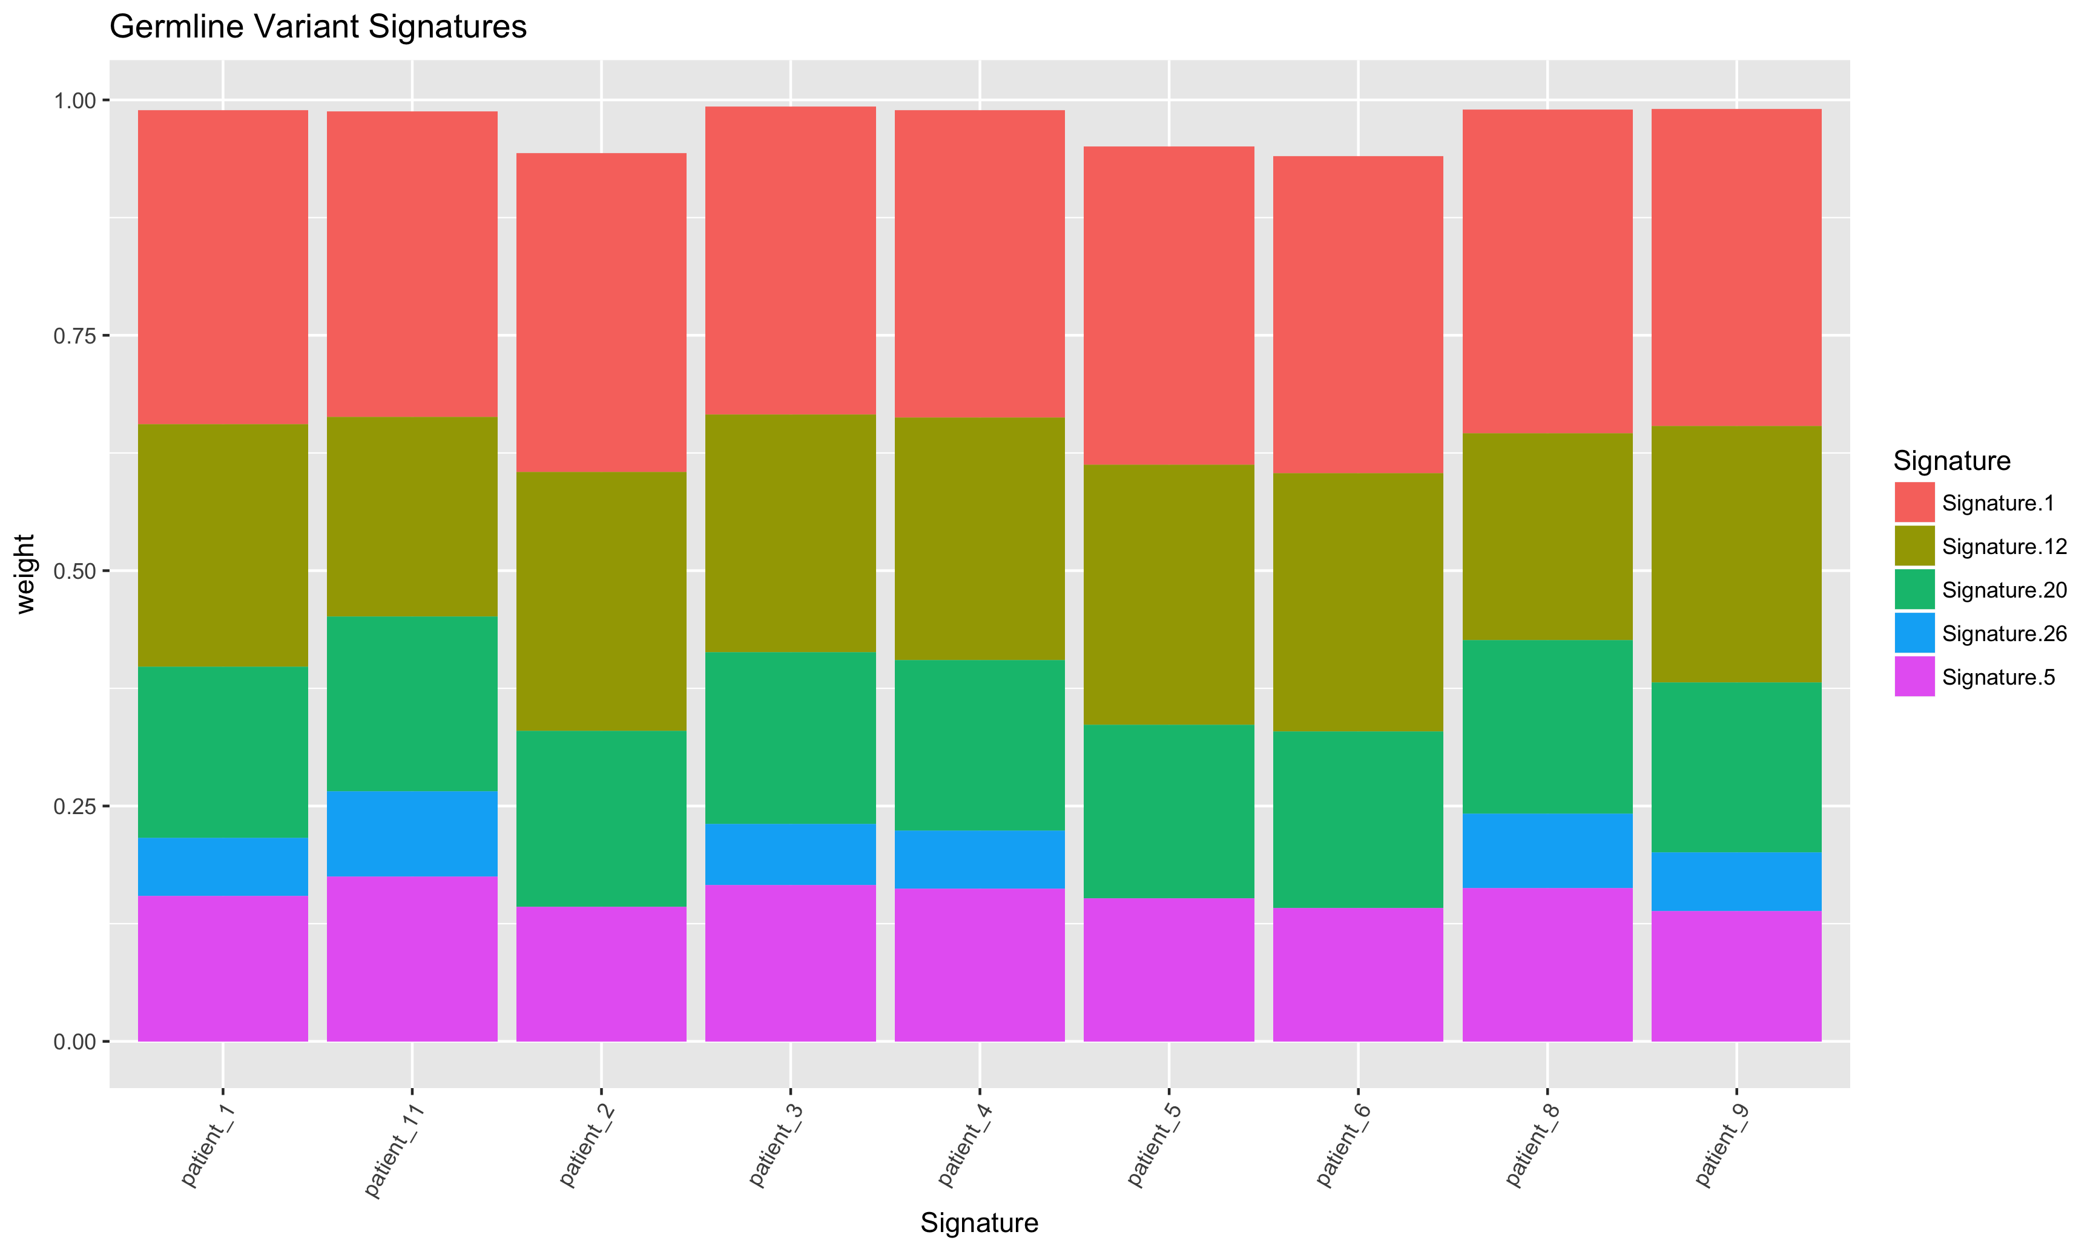
Syn5713423 – germline by sample

Slide 3
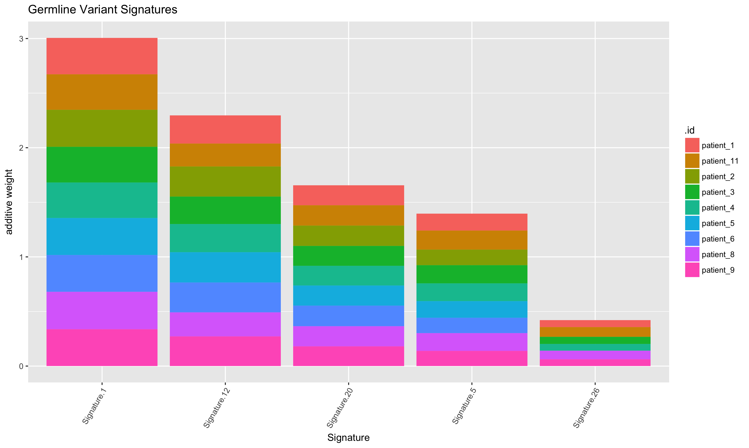
Syn5713423 – germline by signature

Slide 4
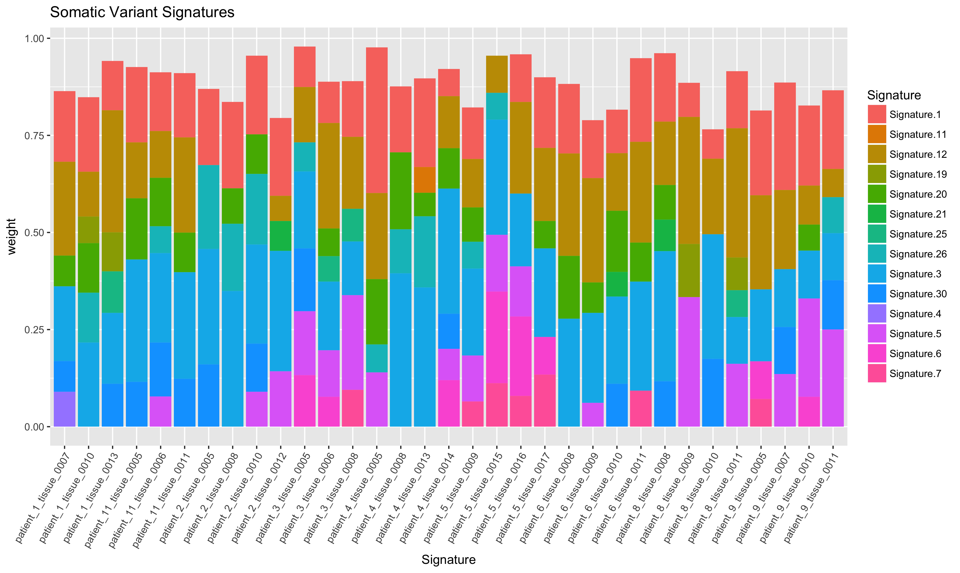
Syn5713423 – somatic by sample

Slide 5
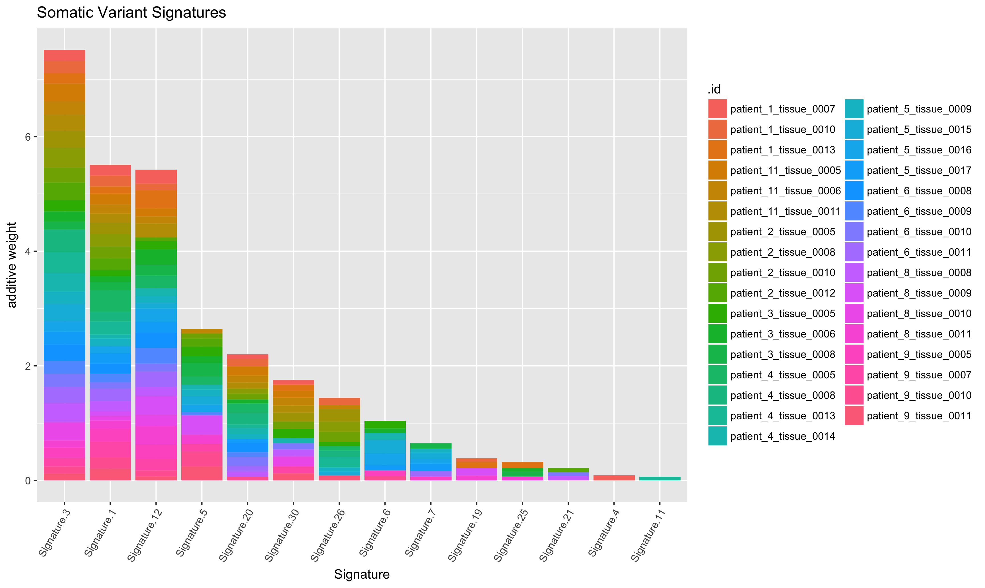
Syn5713423 – somatic by signature

Slide 6
Enriched Signatures
Germline – 1,12,20,5,26 are most prevalent in that order
Somatic – 3,1,12,20,30,26 are most prevalent in that order
Signatures 1,12,20,26 may be interesting/important – they also occur in germline (curious whether this would be the case in non-NF1 patients?)
Presence of Signature 3 in cNFs but not germline is interesting
Etiology: defects in HR pathways – BRCA1/BRCA2 mutants for example – may exhibit cisplat or parp inhibitor hypersensitivity
Cancers: breast, ovarian, pancreatic cancer

Slide 7
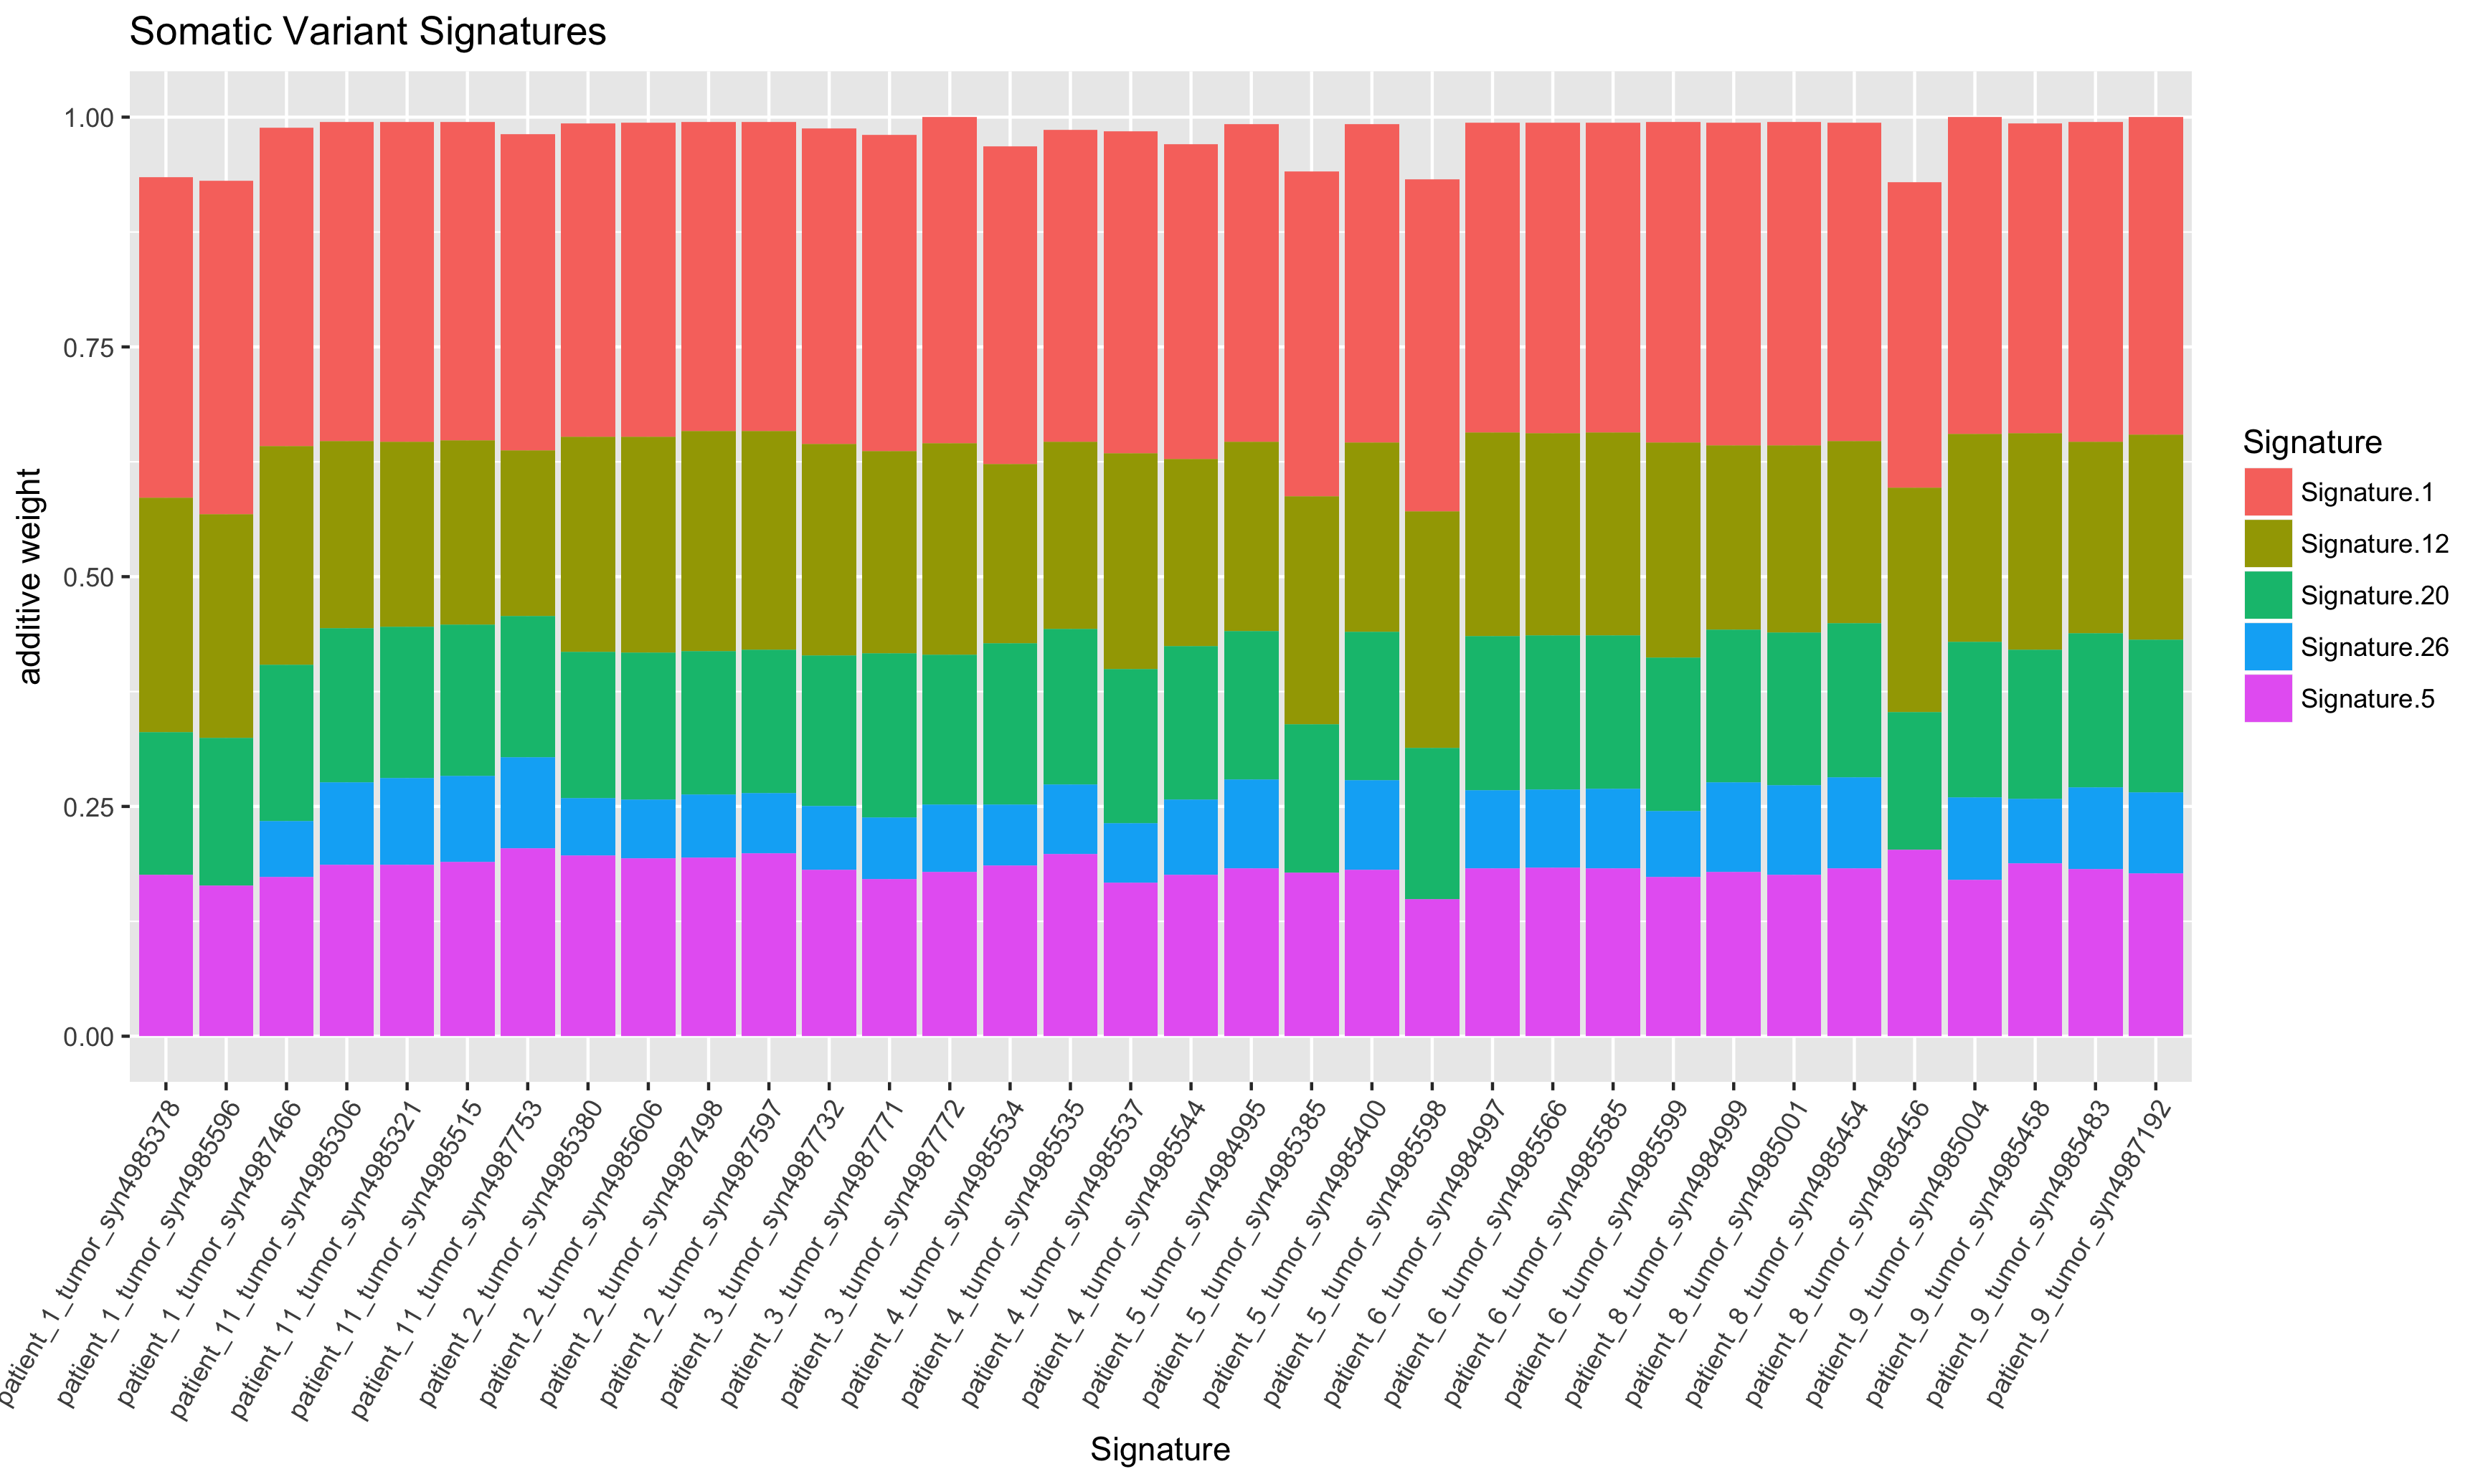
syn6087182 by sample

Slide 8
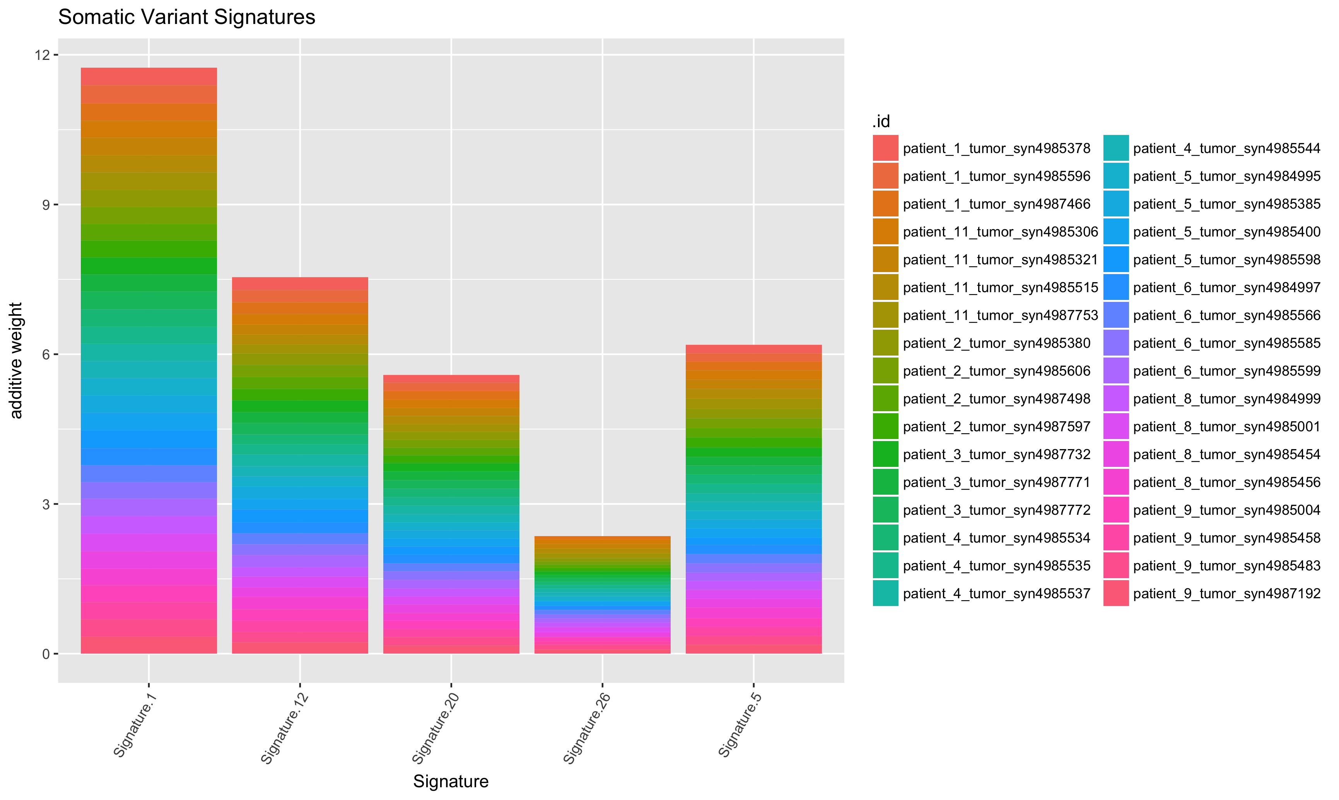
syn6087182 by sample

Slide 9
Enriched Signatures
Somatic – 1,12,5,20,26 are most prevalent in that order as in the previous germline example
There is incredible consistency across tumor samples here – also interesting, no signature 3 anymore
Is this a result of how this file was generated vs the other?

Slide 10
Enriched Signatures
Somatic – 1,12,5,20,26 are most prevalent in that order as in the previous germline example
Cancer types:
Sig 1: Pan-can
Sig 12: Liver (only!)
Sig 5: Pan-can
Sig 20: Breast, Stomach
Sig 26: Breast, cervix, stomach, uterine

Slide 11
Enriched Signatures
Somatic – 1,12,5,20,26 are most prevalent in that order as in the previous germline example
Etiology:
Sig 1: spontaneous deamination of 5-mc
Sig 12: unknown – transcript strand bias for T>C
Sig 5: unknown
Sig 20: defective mismatch repair –often found with sig 26
Sig 26: defective mismatch repair –often found with sig 20

