Slide 1
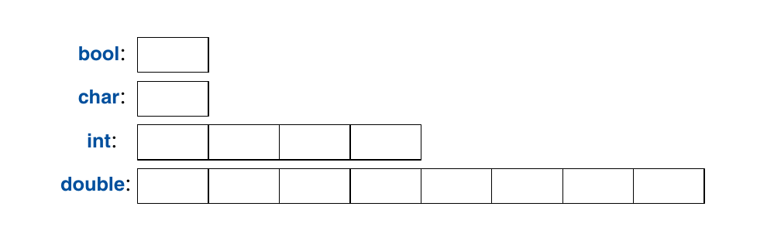
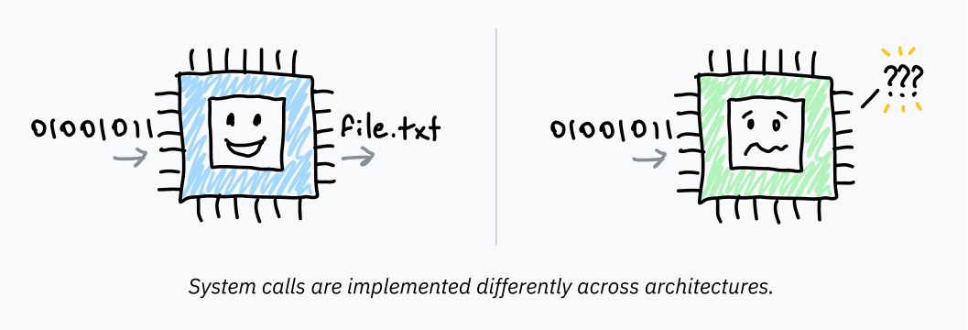
Datum, Data & CPU
One Datum, Plural Data
CPU

Slide 2
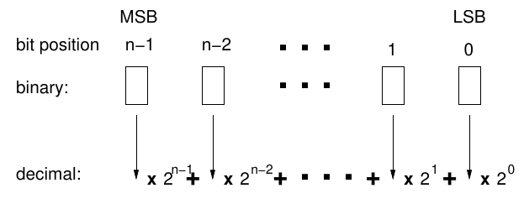
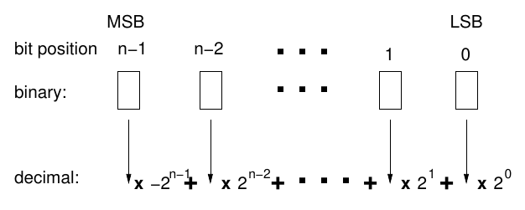
Binary Data
1 Bit can hold the values 0 or 1
1 Bit has 2 possible values
1 Bit has the value-range [0..1]
Binary | Unsigned Decimal | Signed Decimal
000 | 0 | 0
001 | 1 | 1
010 | 2 | 2
011 | 3 | 3
100 | 4 | -4
101 | 5 | -3
110 | 6 | -2
111 | 7 | -1
Binary to Unsigned Decimal Integer
Binary to Signed Decimal Integer
Value-Range of 3 Bits
Unsigned [ 0 ..7] = [ 2⁰ .. 2³-1]
Signed [-4 ..3] = [-2² .. 2²-1]

Slide 3
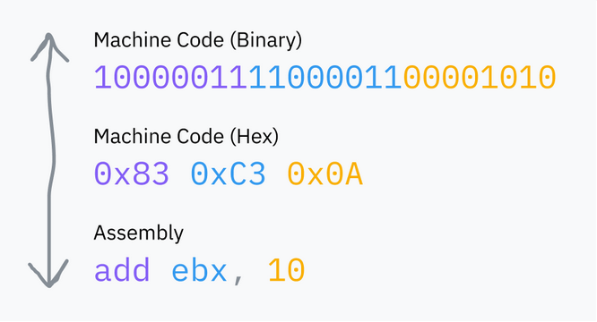
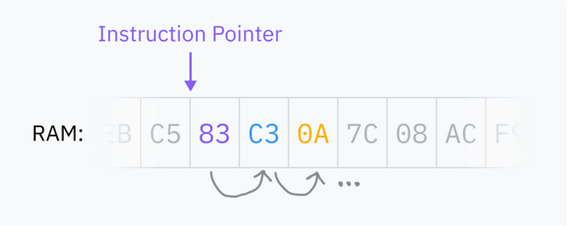
CPU & Data
What shall be done with the data?
How do I tell the CPU what to do?
CPU Instructions / Commands (Machine Code)
Machine Code is also data
The CPU processes commands sequentially
The CPU can skip commands and jump etc.

