Slide 1
CCRG Cluster Manager
2011
Nitel Muhtaroğlu, İlke Muhtaroğlu, Melih Koca

Slide 2
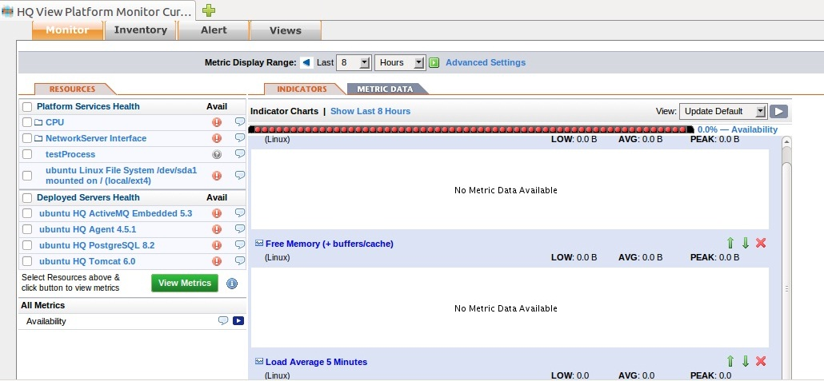
Hyperic - systems monitoring, server monitoring, and IT management

Slide 3
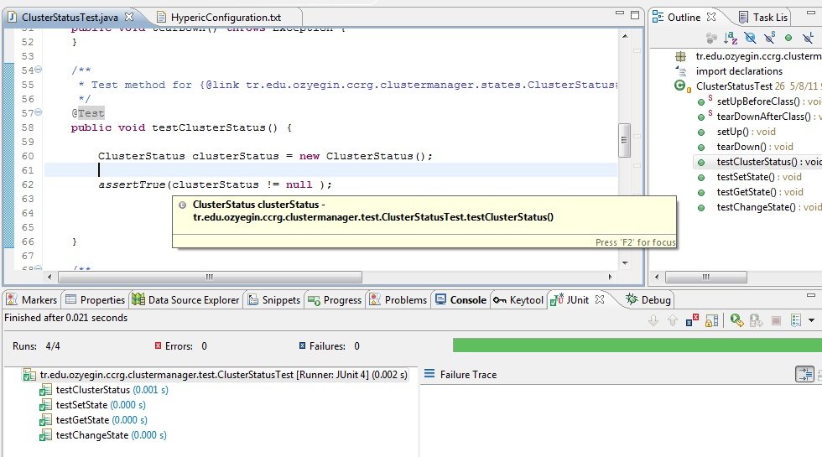
Junit

Slide 4
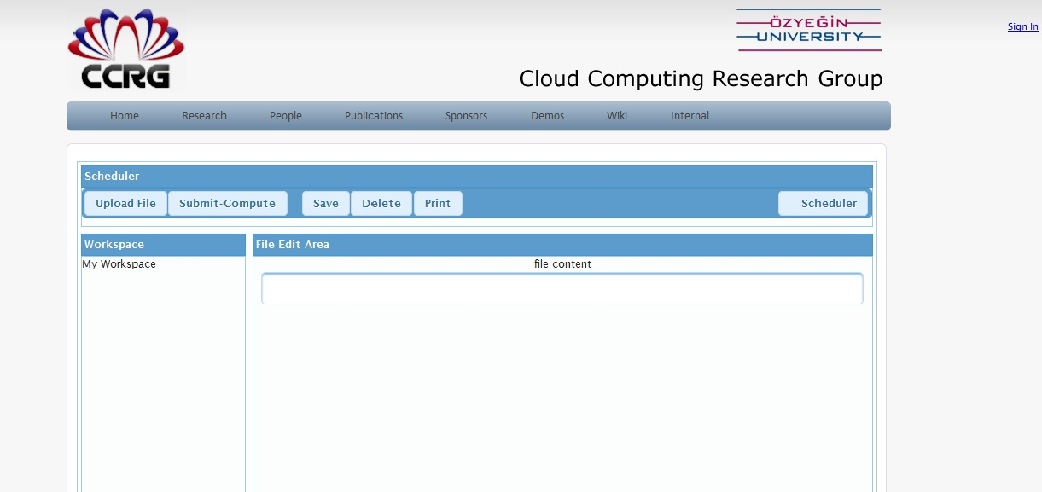
Liferay – portal

Slide 5
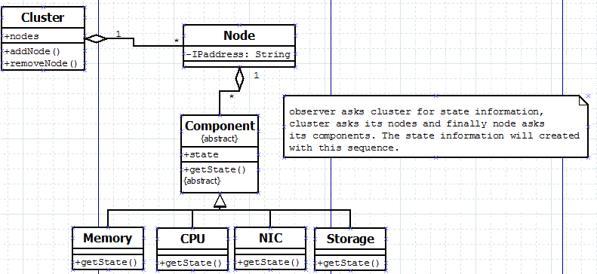

Slide 6
Which patterns used?
MVC
State Pattern
Factory Method
Observer
Singleton
Façade
Strategy Pattern

Slide 7
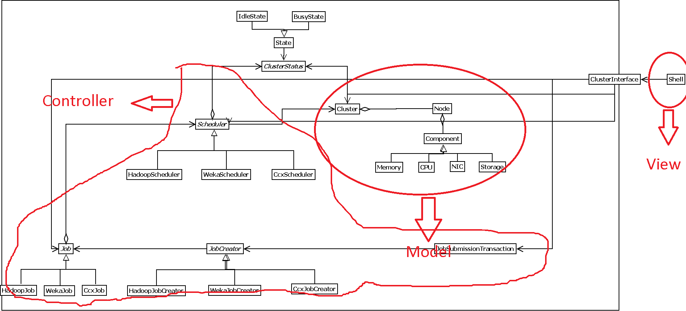
MVC

Slide 8
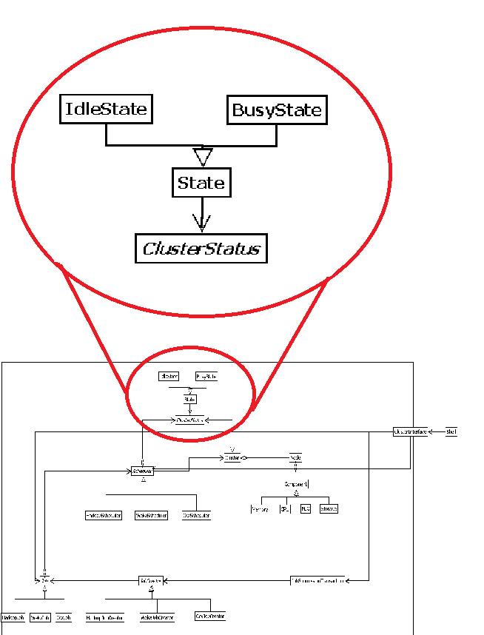
State Pattern

Slide 9
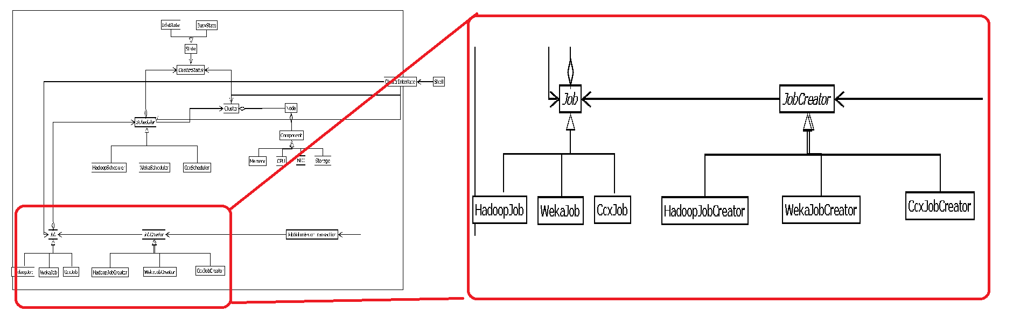
Factory Method

Slide 10
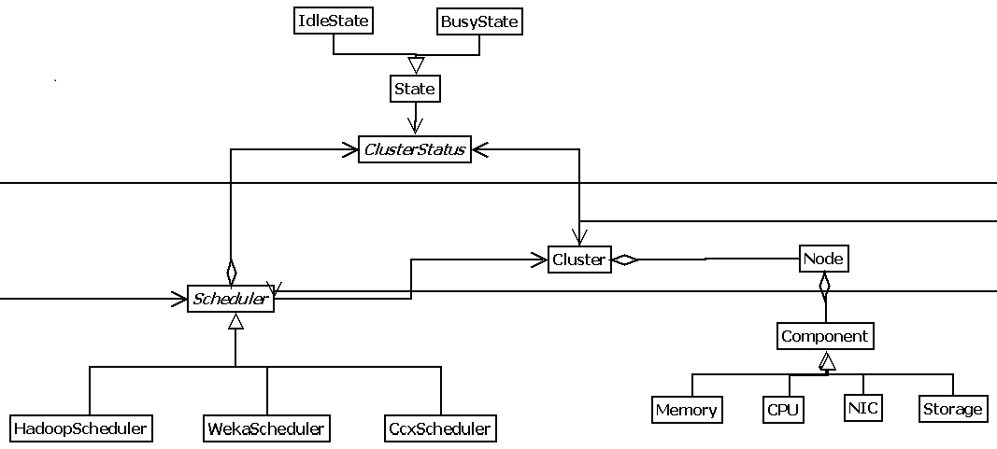
Observer Pattern

Slide 11
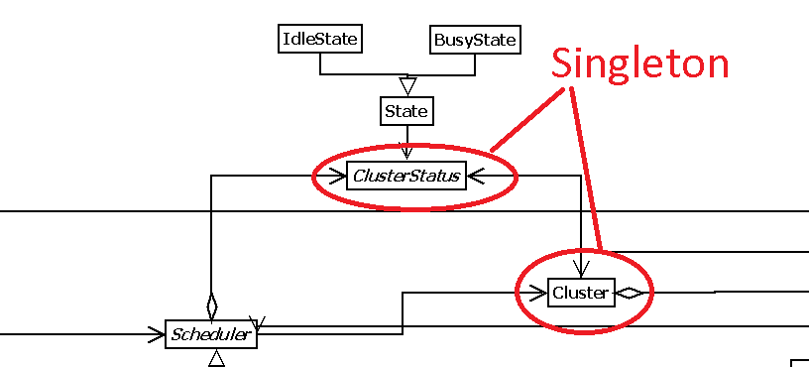
Singleton

Slide 12
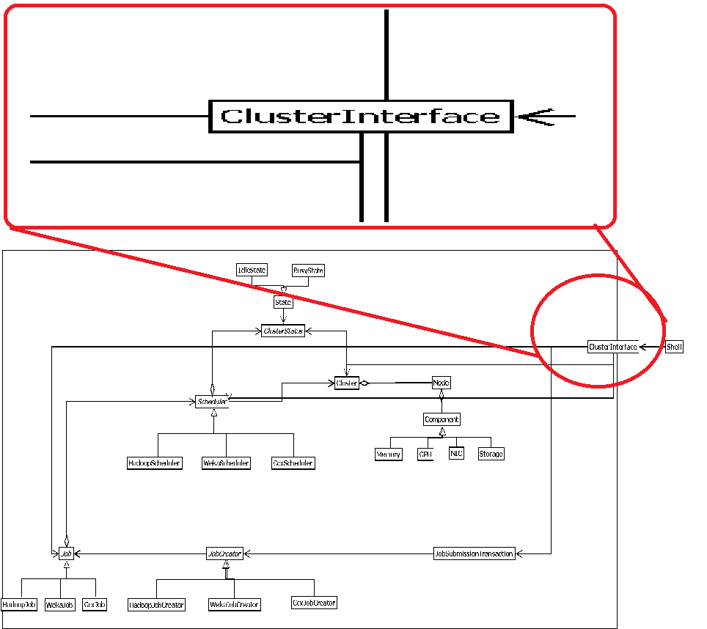
Façade

Slide 13
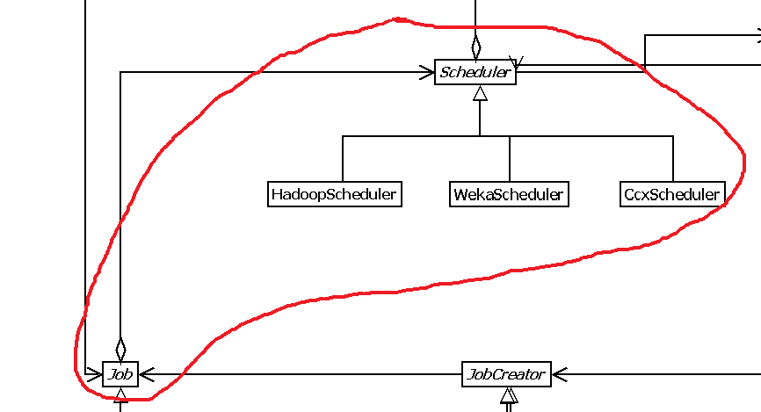
Strategy

Slide 14
Questions?

