Slide 1
ALC - PoC
Data migration from PostgreSQL to Amazon Redshift

Slide 2
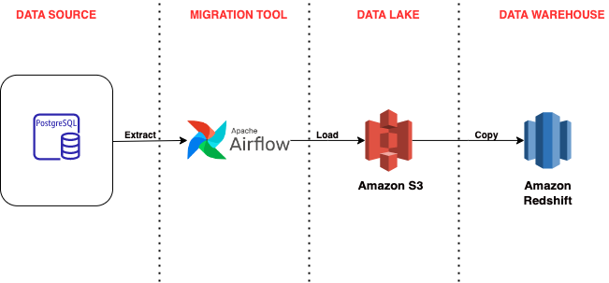
Architecture Diagram

Slide 3
Key Features
Programmatic Workflow
Task Dependency Management
Dynamic Task Mapping
Monitoring and Management Interface
Scalable

Slide 4
Workflow
Read data from PostgreSQL and upload as CSV to AWS S3 Bucket
Copy the data from S3 to staging table in Amazon Redshift
Move the data from staging table to target table

Slide 5

DEMO

