Slide 1
Sprint3: Industrial Automation
By: Shivam Goyal

Slide 2
Objective
Understanding simulation for the project
1. Creating a basic (happy) loop
2. How to move further?
Sprint 4 goals

Slide 3
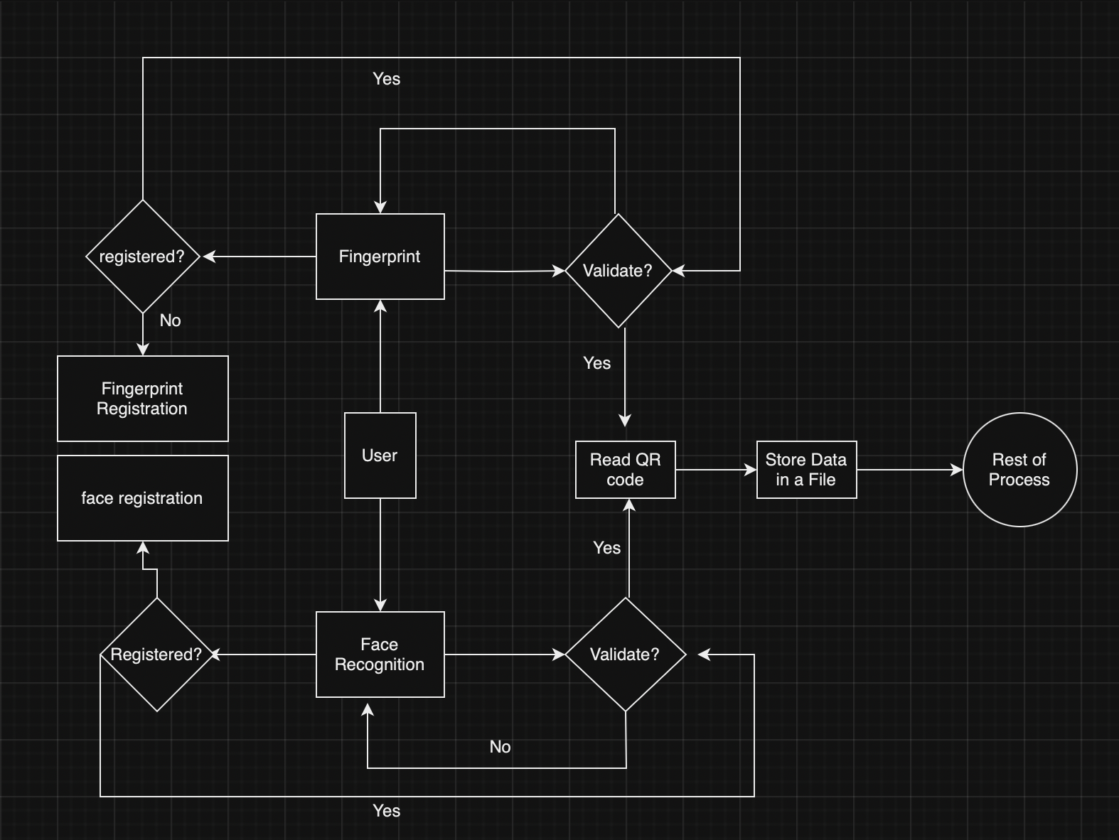
Process ER Diagram
Basic happy loop for the 1st part of the project

Slide 4
Documentation
https://github.com/pimoroni/automation-hat
https://cython.readthedocs.io/en/latest/src/userguide/source_files_and_compilation.html#source-files-and-compilation
https://github.com/sgoyal15/IndustrialAutomationEC601/tree/Sprint3_industrialAutomation

Slide 5
Sprint 4: Objectives
Implementing a config file to get the data from there
Programming for all the test cases and executing all
3. Implementation of threads for multi-threading
4. Optimizing the code

