Slide 1
Industrial Automation (Sprint 1)
Product Mission: Empower Industries with automation solutions that can strengthen the productivity, efficiency, safety and reduce production costs.

Slide 2
Users
Workers
IT and Administrative Personnel
Supervisors and Managers
Maintenance Group
Operators
Inspectors
Security Group

Slide 3
Literature Review
Industrial Automation (Industry 4.0) helps with many services such as:
1. Productivity: These systems make automation possible for factories and industrial processes, allowing a continuous mass production 24/7.
2. Quality: By means of adaptive control and monitoring in different stages and industrial processes
3. Greater consistency: Machines and computers work at a constant and continuous pace.
4. More precise information: Automation of data collection improves accuracy and reduces costs. Such increased accuracy enables company managers to make better decisions.

Slide 4
User Stories
As an IT and Administrative Personnel, I want to have special dashboard access that gives me special permission to view or stop processes.
As an Engineer, I want a properly documented and easily accessible code in order to make and edit and optimize the performance of the automated system.
As the maintenance group, I should be able to access detailed logs, in order to rectify the problem.
As a worker, I should be given a easy to use UI that can be easily managed in order to allocate tasks and shift timings for different workers.
As the security group, I should be notified that the person is on leave or has randomly given the task to somebody else.

Slide 5
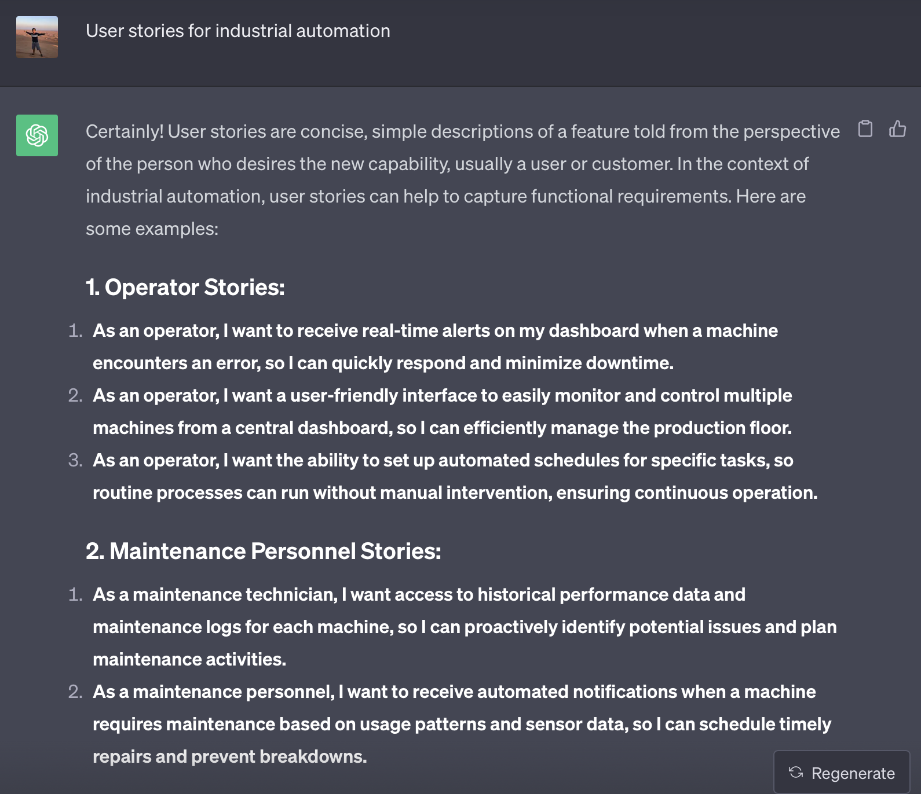
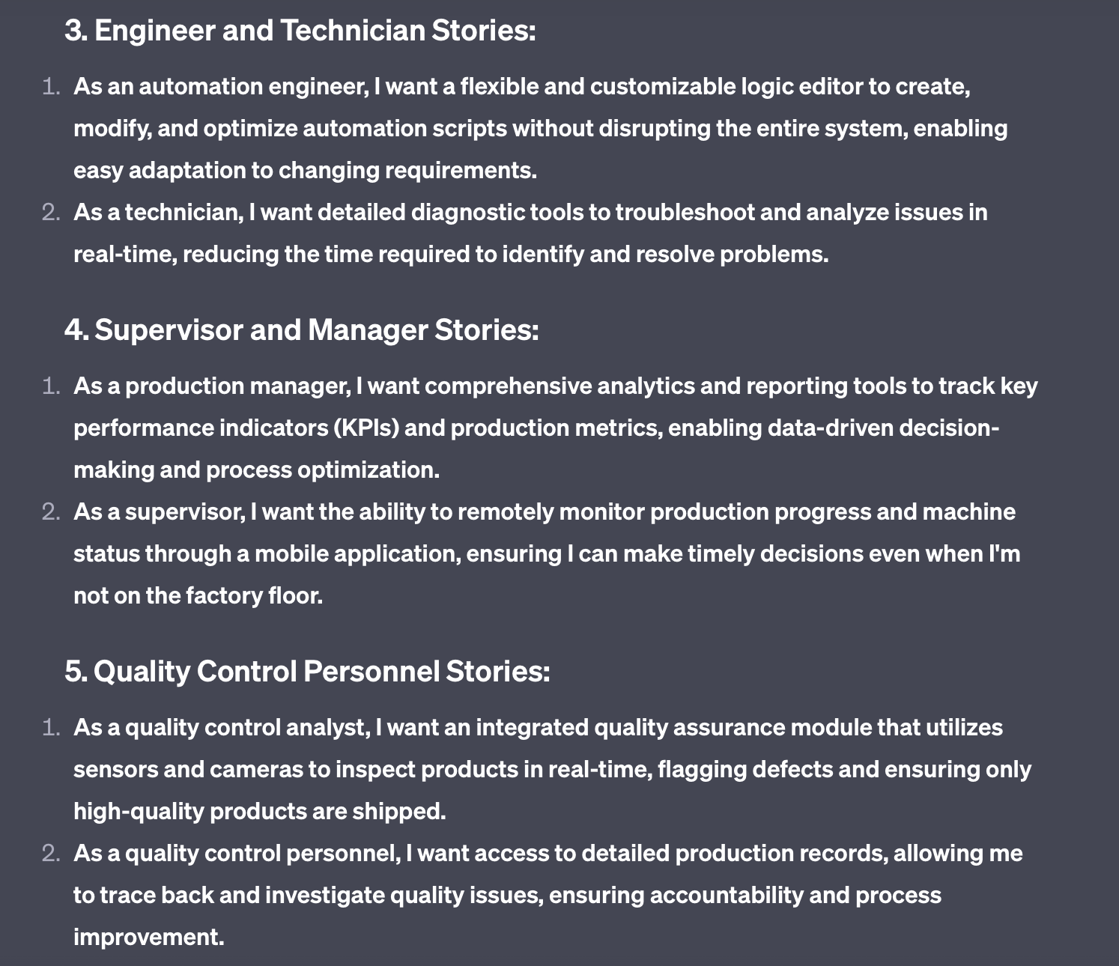
ChatGPT User Stories (Comparison)

Slide 6
Technologies Used
Software:
1. Python
2. Linux OS
3. Cython
4. JavaScript and React
Hardware:
1. Raspberry Pi
2. Automation Hat
3. Fingerprint Scanner
4. Depth Sensing Camera

Slide 7
Process for Development Environment
Designing of industrial panels or robots with the help of software such as Solid Works with accurate dimensions of all the components and the area in which the technology is to be deployed. This is then presented to the client and some changes are implemented if required and the date of POC phase is decided.
Using the industrial grade hardware such as Raspberry Pi, Automation Hat, Vision based camera system, Fingerprint scanner, etc. and creating the set of prototype panels. This can take some time as per demand of the prototype panels.
After the completion of hardware, the code for the hardware is written in Python in IDEs such as PyCharm and all of the code is pushed in git for easy access by all software developers.
Simultaneously, the frontend website in languages like JavaScript, Django, etc. and the backend of the website is created in languages such as Spring Boot, etc. for the communication of the software and hardware side of code.
Once everything is finalized, the code is then tested along with the hardware and many test cases are run based on the demands of the client. Finally the code is run in supervisor mode.
The code is then changed with the clients server IP Address and then encrypted for the privacy of the code.
After the deployment in the POC phase, changes suggested by the client are implemented locally by the software team and deployed to the client side with the access of their server. The order for the final phase is then processed and then finally deployed in the industry.

Slide 8
Next Sprint
Understand the concept of Industrial Panel Designing and develop basic knowledge of Raspberry Pi and Automation
Understand the Secugen manual for creation of fingerprint scanner code and start on the completion of logic for the Cython code for registration and authentication of fingerprint for the Fingerprint scanner.
Convert the Cython code into a module (.so file)

Slide 9
Creation and testing of APIs using Flask server in Python and test it using software such as Postman.
Pushing everything to git and merging the code with the master branch.
Create a happy loop that is a basic loop to check the proper functioning of code in ideal conditions later on to be modified as per the requirements of the client and subsequently testing it.
Using Supervisor and PyArmor to encrypt the code for privacy.

