Slide 1
Emergency Services and Disaster Management
By: Shivam Goyal

Slide 2
Product Mission
The mission is to develop an application that empowers communities, emergency responders, and local authorities to efficiently prepare for, respond to, and recover from disasters. This is achieved by providing real-time information, seamless communication, and intuitive mapping features, the application aims to save lives, reduce damage, and enhance overall disaster resilience.

Slide 3
Product User Stories
As an emergency responder, I want to receive real-time notifications about disasters and access detailed maps of affected areas so that I can plan and execute rescue operations effectively.
As a community member, I want to easily find nearby shelters, medical facilities, and emergency services during a disaster, so that I can ensure the safety of my family and myself.
As a local authority, I want to visualize disaster-prone areas, assess risks, and allocate resources efficiently, so that I can implement preventive measures and support affected communities.

Slide 4
4. As a disaster survivor, I want to report my location and request assistance quickly, so that emergency responders can locate me and provide timely help.
5. As an administrator, I want to coordinate with various response teams, share critical information, and monitor their activities, so that I can ensure a coordinated and effective disaster response.
6. As a rescue operator, I want to easily locate people that are in need of any help in order to provide them with helpful resources.

Slide 5
MVP
Real-time Disaster Alerts:
Display real-time alerts from government agencies and weather services.
Integrate a weather API to provide live weather updates and forecasts.
Interactive Disaster Maps:
Utilize Google Maps API to display disaster-affected areas, evacuation routes, and emergency facilities.
Implement custom overlays to visualize areas prone to flooding, earthquakes, or other disasters.
Emergency Services Locator:
Use Google Places API to locate nearby shelters, hospitals, police stations, and fire departments.
Allow users to search for specific services and provide directions using Google Maps Directions API.

Slide 6
Use of Third party APi
1. Weather APIs:
OpenWeatherMap API: Access current weather data, forecasts, and historical weather data for disaster-affected areas.
Weather Underground API: Provides weather data including current conditions, forecasts, and severe weather alerts.
2. Earthquake and Seismic APIs:
USGS Earthquake API: Access real-time earthquake data including magnitude, location, and depth.
IRIS (Incorporated Research Institutions for Seismology) DMC Web Service: Provides seismic data and earthquake information.

Slide 7
3. Government and Public Data APIs:
FEMA (Federal Emergency Management Agency) API: Access disaster declarations, assistance programs, and emergency response information.
NASA Earth-data API: Access satellite imagery and data for disaster monitoring and analysis.
4. Social Media APIs:
X API: Monitor tweets and hashtags related to emergencies for situational awareness.
Meta Graph API: Gather public posts and events related to disaster response efforts.
Reddit API: Spread awareness among the communities

Slide 8
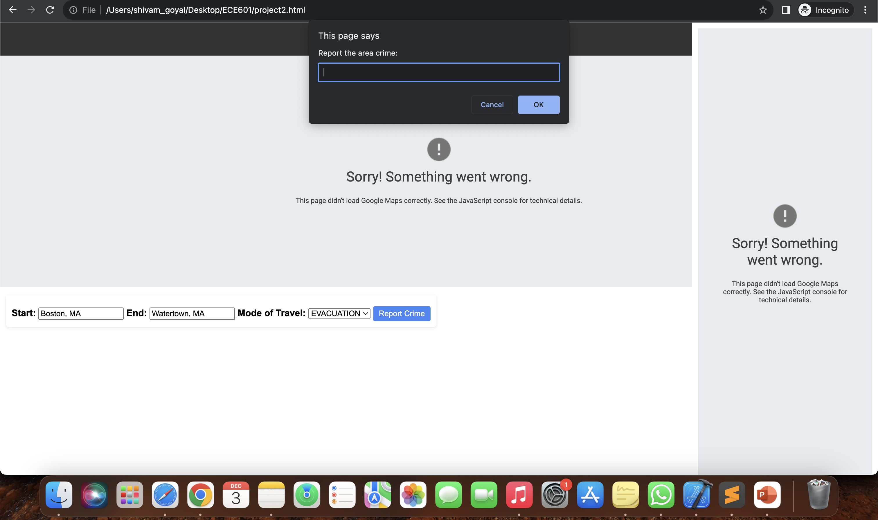
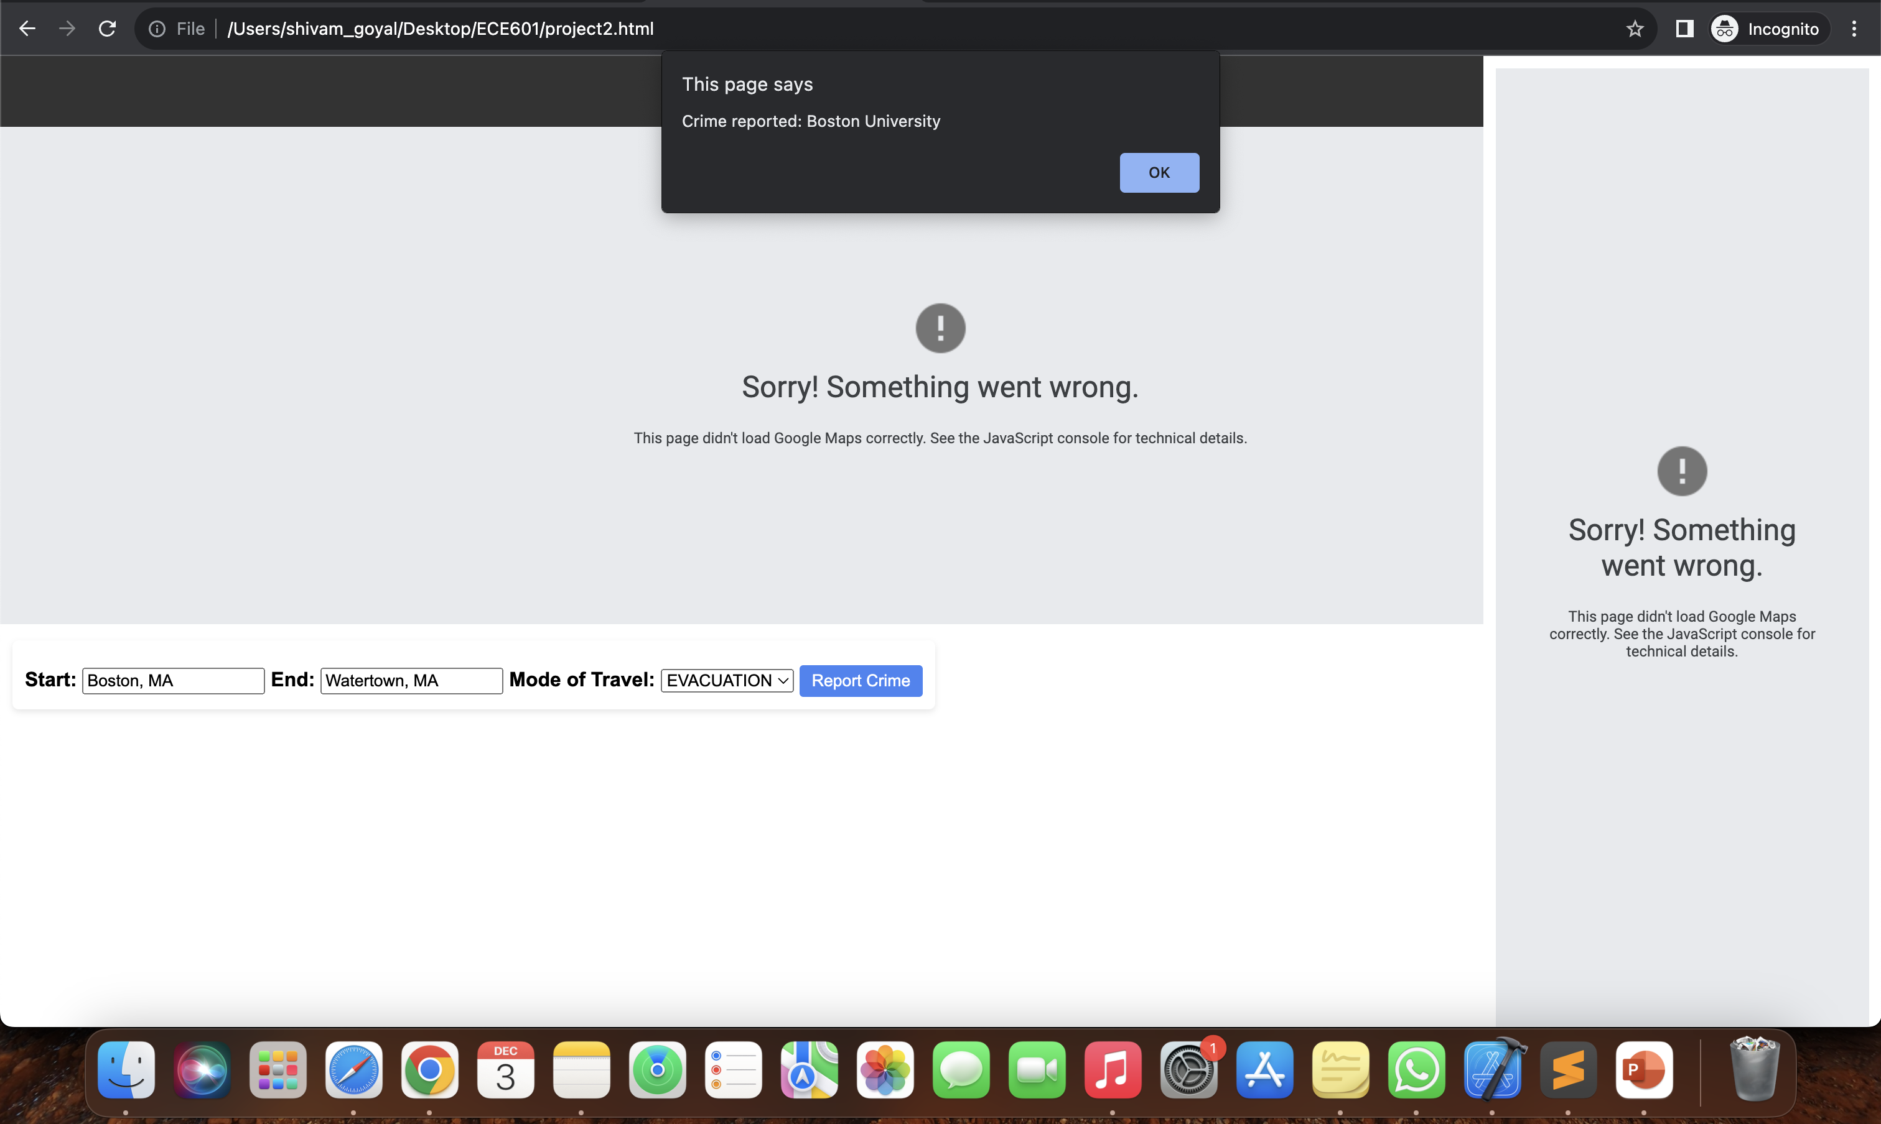
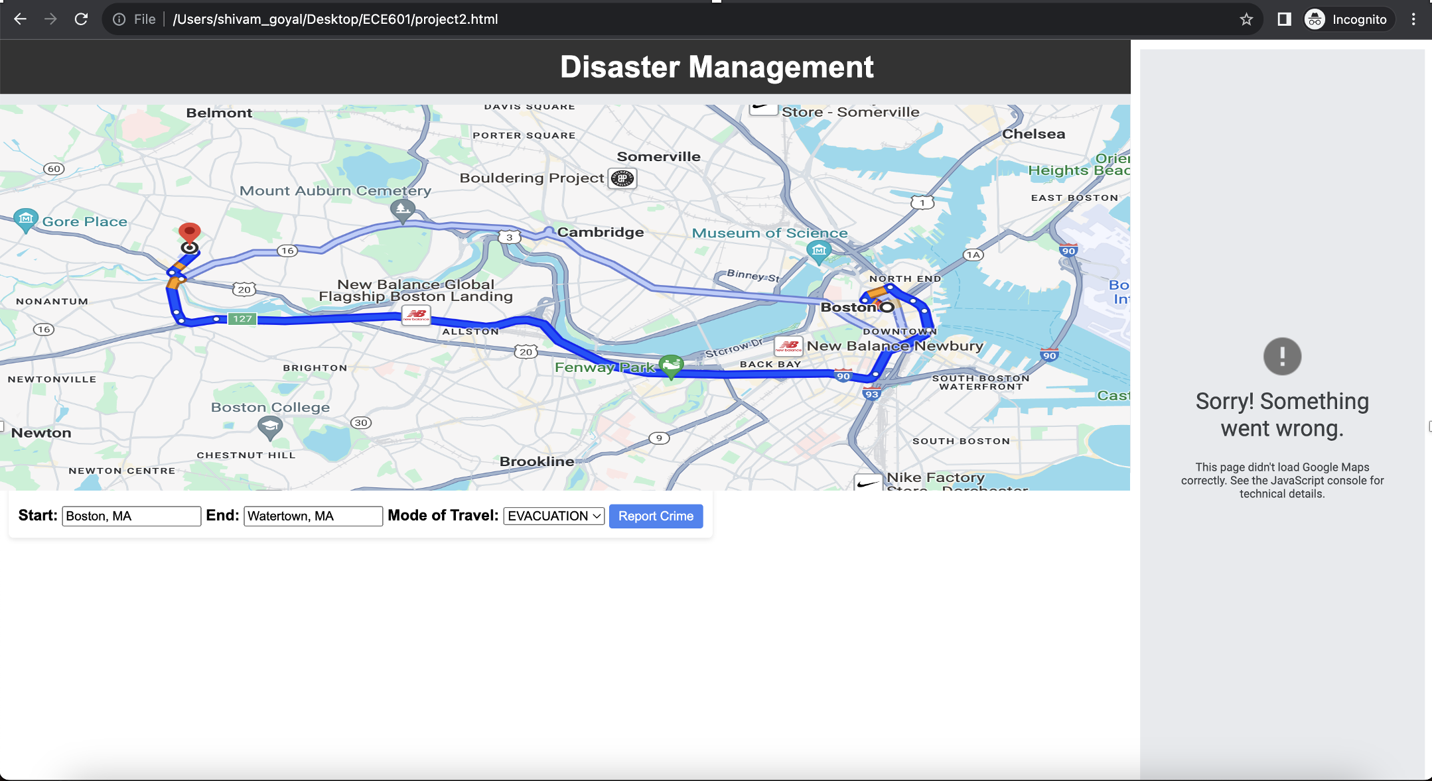
SCREENSHOTS

