Slide 1
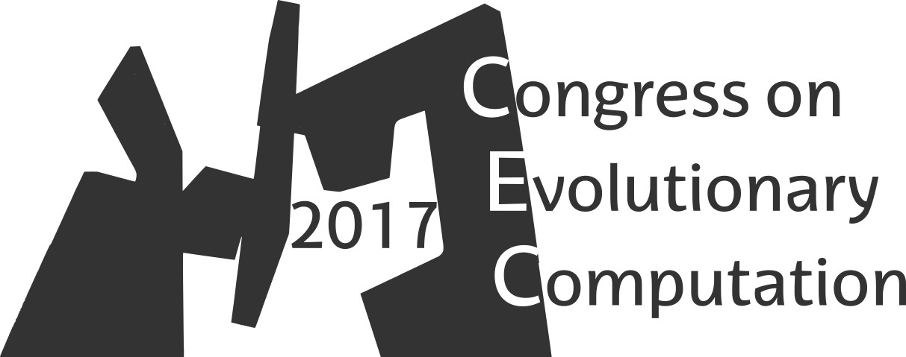

A Square Lattice Probability Model for Optimising the Graph Partitioning Problem
Josu Ceberio, Alexander Mendiburu, Jose A. Lozano
Intelligent Systems Group
Department of Computer Languages and Systems
University of the Basque Country UPV/EHU
2017 IEEE Congress on Evolutionary Computation (CEC)
Donostia / San Sebastian, 5-8 June 2017

Slide 2
Estimation of distribution algorithms Definition

Slide 3
Constrained Optimization Problems Definition
Some examples
Knapsack Problem
Graph Colouring Problem
Maximum Satisfiability Problem
Capacitated Arc Routing Problem
…
3

Slide 4
Graph Partitioning Problem
Find a k-partition of vertices minimising the weight of edges between sets: the cut size
We considered the balanced 2-partition GPP.
Solutions are codified as
Objective Function
4

Slide 5
Graph Partitioning Problem
The constraint: equal number of zeros as ones
5

Slide 6
Constrained Optimization Problems Why are they challenging?
The search space of solutions induced by the codification is…
6

Slide 7
Constrained Optimization Problems Why are challenging?
The search space of solutions induced by the codification is…
A majority of the solutions are not feasible !
7

Slide 8
What happens if we run a UMDA?
 | X₁ | X₂ | X₃ | X₄ | X₅ | X₆
0 | 0.6 | 0.5 | 0.25 | 0.66 | 0.9 | 0.5
1 | 0.4 | 0.5 | 0.75 | 0.33 | 0.1 | 0.5
0 0 1 1 0 0
1 1 0 0 0 0
0 0 1 1 0 1
0 1 0 1 0 1
0 1 0 1 1 1
8

Slide 9
What happens if we run a UMDA?
 | X₁ | X₂ | X₃ | X₄ | X₅ | X₆
0 | 0.6 | 0.5 | 0.25 | 0.66 | 0.9 | 0.5
1 | 0.4 | 0.5 | 0.75 | 0.33 | 0.1 | 0.5
0 0 1 1 0 0
1 1 0 0 0 0
0 0 1 1 0 1
0 1 0 1 0 1
0 1 0 1 1 1
Unfeasible solutions are generated…
9

Slide 10
Different approaches
Repair solutions
Penalty functions
Guarantee feasibility when sampling
Modify solutions to hold the constraints
Punish solutions to be discarded when selection
In EDAs, adapt sampling to create feasible solutions
The role of the probability model is somehow denaturalized
10

Slide 11
The Idea
Conduct the optimisation entirely
on the set of feasible solutions…
Use probability distributions that
are defined only on this set
Recently on the domain of permutations…
J. Ceberio (2015) Solving Permutation-based Combinatorial Optimization Problems with Estimation of Distribution Algorithms and Extensions Thereof. LAP Lambert Academic Publishing.
J. Ceberio, E. Irurozki, A. Mendiburu, J.A. Lozano (2014) A Distance-based Ranking Model Estimation of Distribution Algorithm for the Flowshop Scheduling Problem. IEEE Transactions on Evolutionary Computation. Vol 18, No. 2, Pp. 286-300.
J. Ceberio, A. Mendiburu, J.A. Lozano. The Plackett-Luce Ranking Model on Permutation-based Optimization Problems. 2013 IEEE Congress on Evolutionary Computation (CEC-2013), pp. 494 - 501, Cancun, Mexico, 20-23 June 2013.
…
11

Slide 12
A Square Lattice The Probability Model
Solutions are modelled as paths on a square lattice of (n/2+1)² vertices
Vertices: the number of ones and zeros at that stage
Edges: the probability of moving from one vertex to another.
Square Lattice for n=6 GPP instance
12

Slide 13
A Square Lattice The Probability Model
Solutions are modelled as paths on a square lattice of (n/2+1)² vertices
Probability of a path
Vertices: the number of ones and zeros at that stage
Edges: the probability of moving from one vertex to another
Horizontal step
Vertical step
Square Lattice for n=4 GPP instance
13

Slide 14
A Square Lattice The Probability Model - Sampling
Square Lattice for n=6 GPP instance
14

Slide 15
A Square Lattice The Probability Model - Sampling
Solutions are sampled at n stages
At each stage a decision has to be taken: up/right
Square Lattice for n=6 GPP instance
15

Slide 16
A Square Lattice The Probability Model - Sampling
Solutions are sampled at n stages
At each stage a decision has to be taken: up/right
Square Lattice for n=6 GPP instance
16

Slide 17
A Square Lattice The Probability Model - Sampling
Solutions are sampled at n stages
At each stage a decision has to be taken: up/right
Square Lattice for n=6 GPP instance
17

Slide 18
A Square Lattice The Probability Model - Sampling
Solutions are sampled at n stages
At each stage a decision has to be taken: up/right
Square Lattice for n=6 GPP instance
18

Slide 19
A Square Lattice The Probability Model - Sampling
Solutions are sampled at n stages
At each stage a decision has to be taken: up/right
Square Lattice for n=6 GPP instance
19

Slide 20
A Square Lattice The Probability Model - Sampling
Solutions are sampled at n stages
At each stage a decision has to be taken: up/right
Square Lattice for n=6 GPP instance
20

Slide 21
A Square Lattice The Probability Model - Sampling
Solutions are sampled at n stages
At each stage a decision has to be taken: up/right
As labels are interchangeable, we sample first a 0
Square Lattice for n=6 GPP instance
21

Slide 22
A Square Lattice The Probability Model – Estimating parameters
Square Lattice for n=6 GPP instance
22

Slide 23
A Square Lattice The Probability Model – The order of variables
In which order should we visit the variables?
Is there any difference?
23

Slide 24
A Square Lattice The Probability Model – The order of variables
Vertex close to the diagonal are more frequently visited
Taking a decision on these points is largely uncertain:
At (2,2) -- the solution has 2 zeros and 2 ones.
At (2,0), the preceeding
positions are filled with zeros.
Square Lattice for n=6 GPP instance
24

Slide 25
A Square Lattice The Probability Model – The order of variables
Map the best solution to the external border
First visit 0000…, and then ...1111.
And the order within the subsets?
From each set, choose the item that minimizes the cut-size, in alternated rounds.
25

Slide 26
Experimental Study Experimental Setting
UMDA *, TREE* , Lattice
(*) adapted sampling
Algorithms
22 Instances (Johnson et al.)
G-type and
U-type
n=124, 250, 500, 1000
Benchmarks
Edges with no observations are assigned 0.5
Constructive at every 40 iterations
Sample
Lattice Settings
Pop-size: 10n
Sel-size: 5n
Off-size: 10n
Max evals.: 100n²
Parameters
26

Slide 27
Experimental Study Results - Performance
Instance | Best Fitness | ARPD
 |  | Lattice | UMDA | Tree
G124.02 | 13 | 0,32 | 0,61 | 0,19
G124.16 | 449 | 0,02 | 0,05 | 0,01
G250.01 | 31 | 0,33 | 0,49 | 0,20
G250.02 | 118 | 0,07 | 0,14 | 0,06
G250.04 | 360 | 0,04 | 0,10 | 0,03
G250.08 | 830 | 0,01 | 0,05 | 0,01
G500.005 | 61 | 0,30 | 0,40 | 0,08
G500.01 | 234 | 0,09 | 0,21 | 0,07
G500.02 | 642 | 0,03 | 0,11 | 0,03
G500.04 | 1754 | 0,02 | 0,06 | 0,02
G1000.0025 | 131 | 2,96 | 3,20 | 0,74
G1000.005 | 496 | 1,22 | 1,28 | 0,88
G1000.01 | 1420 | 0,56 | 0,66 | 0,62
G1000.02 | 3450 | 0,35 | 0,40 | 0,39
U500.05 | 23 | 1,17 | 1,89 | 0,57
U500.10 | 61 | 1,05 | 1,12 | 0,57
U500.20 | 185 | 0,56 | 0,87 | 0,44
U500.40 | 412 | 0,41 | 0,38 | 0,28
U1000.05 | 77 | 1,62 | 12,83 | 2,39
U1000.10 | 170 | 1,67 | 11,67 | 3,73
U1000.20 | 352 | 1,67 | 10,58 | 4,94
U1000.40 | 862 | 1,53 | 3,24 | 2,29
27

Slide 28
Experimental Study Results - Performance
Instance | Best Fitness | ARPD
 |  | Lattice | UMDA | Tree
G124.02 | 13 | 0,32 | 0,61 | 0,19
G124.16 | 449 | 0,02 | 0,05 | 0,01
G250.01 | 31 | 0,33 | 0,49 | 0,20
G250.02 | 118 | 0,07 | 0,14 | 0,06
G250.04 | 360 | 0,04 | 0,10 | 0,03
G250.08 | 830 | 0,01 | 0,05 | 0,01
G500.005 | 61 | 0,30 | 0,40 | 0,08
G500.01 | 234 | 0,09 | 0,21 | 0,07
G500.02 | 642 | 0,03 | 0,11 | 0,03
G500.04 | 1754 | 0,02 | 0,06 | 0,02
G1000.0025 | 131 | 2,96 | 3,20 | 0,74
G1000.005 | 496 | 1,22 | 1,28 | 0,88
G1000.01 | 1420 | 0,56 | 0,66 | 0,62
G1000.02 | 3450 | 0,35 | 0,40 | 0,39
U500.05 | 23 | 1,17 | 1,89 | 0,57
U500.10 | 61 | 1,05 | 1,12 | 0,57
U500.20 | 185 | 0,56 | 0,87 | 0,44
U500.40 | 412 | 0,41 | 0,38 | 0,28
U1000.05 | 77 | 1,62 | 12,83 | 2,39
U1000.10 | 170 | 1,67 | 11,67 | 3,73
U1000.20 | 352 | 1,67 | 10,58 | 4,94
U1000.40 | 862 | 1,53 | 3,24 | 2,29
28

Slide 29
Experimental Study Results - Performance
29

Slide 30
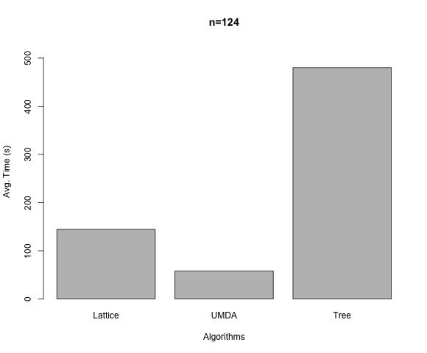
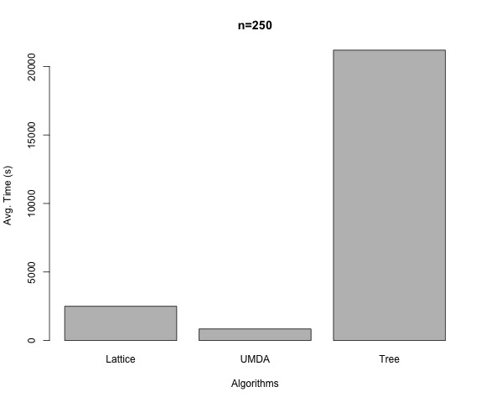
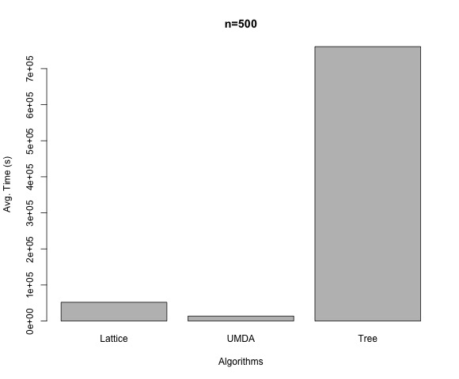
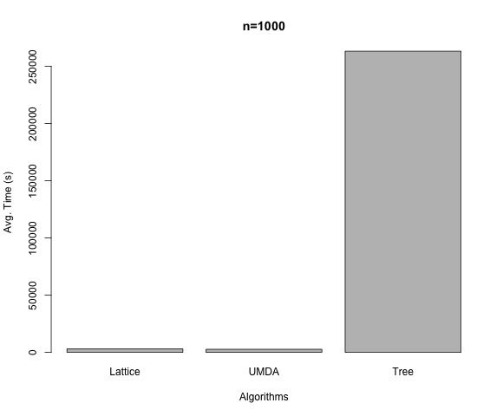
Experimental Study Results – Time Consumption
30

Slide 31
Conclusions
The experiments support the validity of our research line:
Designing probability models exclusively on the set of feasible solutions
Competitive for small instances, and better in large instances
Low time complexity
31

Slide 32
Future Work
Many aspects to be faced
Develop the idea of uncertainty of the paths in the lattice
Use information of the population as Tree
Analyze the effect of other orderings
Ordering of the variables
Larger benchmarks
Understand the dynamics of the Lattice for different problem sizes
Experimentation
Square Lattice for K≥3
The probability model
32

Slide 33
A Square Lattice Probability Model for Optimising the Graph Partitioning Problem
Josu Ceberio, Alexander Mendiburu, Jose A. Lozano
Thank you for your attention!
2017 IEEE Congress on Evolutionary Computation (CEC)
Donostia / San Sebastian, 5-8 June 2017

