Slide 1
Introducing Mixtures of Generalized Mallows in Estimation of Distribution Algorithms
Josian Santamaria
Josu Ceberio
Roberto Santana
Alexander Mendiburu
Jose A. Lozano
X Congreso Español de Metaheurísticas, Algoritmos Evolutivos y Bioinspirados - MAEB2015

Slide 2
Outline
Background
The Mallows and Generalized Mallows models
Mixtures of Generalized Mallows models
Experimentation
Conclusions and future work

Slide 3
Estimation of distribution algorithms Definition

Slide 4
Estimation of distribution algorithms Definition
Despite their success,
poor performance on permutation problems.

Slide 5
Permutation optimization problems Definition
Combinatorial problems whose solutions are naturally represented as permutations

Slide 6
Permutation optimization problems Notation
A permutation is a bijection of the set
onto itself,

Slide 7
Permutation optimization problems Goal
To find the permutation solution that minimizes
a fitness function
The search space consists of solutions.

Slide 8
Permutation optimization problems
Travelling salesman problem (TSP)
Permutation Flowshop Scheduling Problem (PFSP)
Linear Ordering Problem (LOP)
Quadratic Assignment Problem (QAP)

Slide 9
Permutation optimization problems
Travelling salesman problem (TSP)
Permutation Flowshop Scheduling Problem (PFSP)
Linear Ordering Problem (LOP)
Quadratic Assignment Problem (QAP)

Slide 10
Permutation Flowshop Scheduling Problem Definition
Total flow time (TFT)
jobs
machines
processing times
5 x 4
j₁
j₂
j₃
j₄
j₅
m₁
m₂
m₃
m₄
10

Slide 11
Estimation of Distribution Algorithms Definition
Why poor performance?
The mutual exclusivity constraints associated with permutations
Our proposal:
probability models for
permutation spaces
Mallows
Generalized Mallows
Plackett-Luce

Slide 12
The Mallows model Definition
A distance-based exponential probability model
Central permutation
Spread parameter
A distance on permutations

Slide 13
The Mallows model Definition
A distance-based exponential probability model
Central permutation
Spread parameter
A distance on permutations

Slide 14
The Mallows model Definition
A distance-based exponential probability model
Central permutation
Spread parameter
A distance on permutations

Slide 15
The Generalized Mallows model Definition
If the distance can be decomposed as sum of terms
then, the Mallows model can be generalized as
n-1 spread parameters
The Generalized Mallows model

Slide 16
The Generalized Mallows model Kendall’s-τ distance
Kendall’s-τ distance: calculates the number of pairwise disagreements.
1-2
1-3
1-4
1-5
2-3
2-4
2-5
3-4
3-5
4-5

Slide 17
The Generalized Mallows model Learning and sampling
Learning in 2 steps:
Calculate the central permutation
Maximum likelihood estimation of the spread parameters.
Sampling in 2 steps:
Sample a vector from
Build a permutation from the vector and

Slide 18
Drawbacks
The Generalized Mallows is an unimodal model, and may not detect the different modalities in heterogeneous populations.
18

Slide 19
Mixtures of Generalized Mallows models
19

Slide 20
Mixtures of Generalized Mallows models Learning
Given a data set of permutations , we calculate the maximum likelihood parameters from
Expectation Maximization (EM)
20

Slide 21
Mixtures of Generalized Mallows models Expectation Maximization (EM)
Initialize the weights to
Initialize randomly the models in the mixture
E step
Estimate the membership weight of to the cluster
M step
Compute the weights as
Compute the parameters of the models with
21

Slide 22
Mixtures of Generalized Mallows models Sampling
Stochastic Universal Sampling
22

Slide 23
Mixtures of Generalized Mallows models Sampling
Stochastic Universal Sampling
23

Slide 24
Experiments Settings
Problems:
Permutation Flowshop Scheduling Problem (10 instances)
Quadratic Assignment Problem (10 instances)

Slide 25
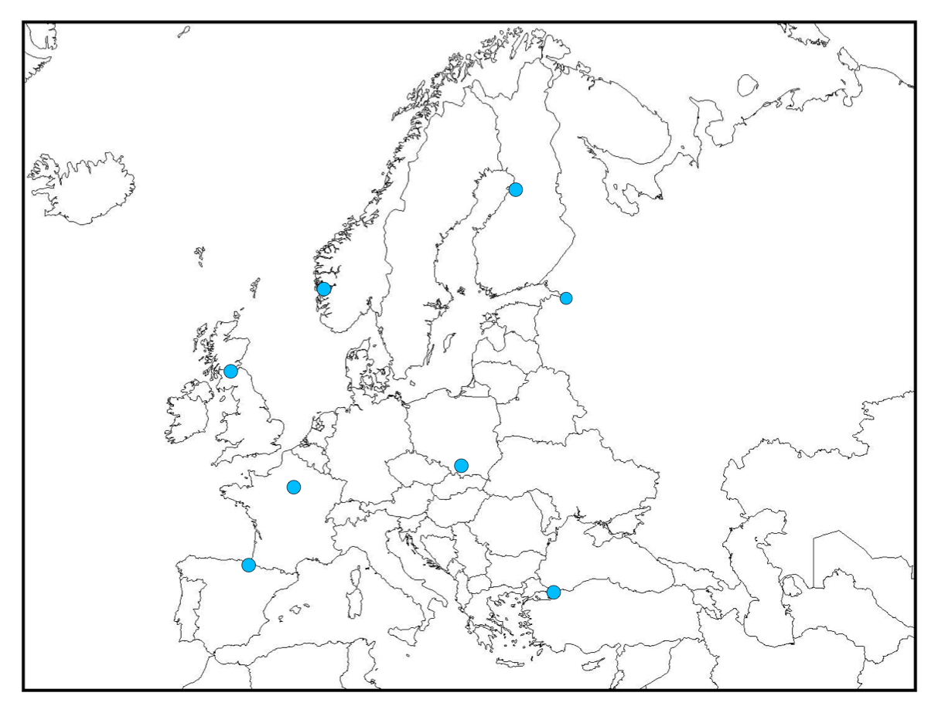

The quadratic assignment problem (QAP)
8
1
7
2
6
3
2
4
5
5
6
3
7
1
8
4

Slide 26
Elementary Landscape Decomposition The quadratic assignment problem (QAP)
The quadratic assignment problem (QAP)
8
1
7
2
6
3
2
4
5
5
6
3
7
1
8
4

Slide 27
Experiments Settings
Problems:
Permutation Flowshop Scheduling Problem (10 instances)
Quadratic Assignment Problem (10 instances)
Algorithms:
Generalized Mallows EDA – Kendall’s-tau
Mixtures of Generalized Mallows EDA – Kendall’s-tau
Generalized Mallows EDA – Cayley
Mixtures of Generalized Mallows EDA – Cayley

Slide 28
Other distances Cayley distance
Calculates the minimum number of swap operations to convert in .

Slide 29
Experiments Settings
Problems:
Permutation Flowshop Scheduling Problem (10 instances)
Quadratic Assignment Problem (10 instances)
Algorithms:
Generalized Mallows EDA – Kendall’s-tau
Mixtures of Generalized Mallows EDA – Kendall’s-tau
Generalized Mallows EDA – Cayley
Mixtures of Generalized Mallows EDA – Cayley
Two models in the mixture, G=2
Average Relative Percentage Deviation (ARPD) of 20 repetitions
Stopping criterion: 100n-1 generations

Slide 30
Experiments Settings
Extension of the toolbox MATEDA for the mathematical computing environment Matlab

Slide 31
Experimentation Results
Instance |  | GM_{ken} | Mix_{ken} | GM_{cay} | Mix_{cay}
QAP | n10.1 | 0.313 | 0.571 | 0.166 | 0.022
 | n10.2 | 0.029 | 0.038 | 0.016 | 0.006
 | n10.3 | 0.194 | 0.276 | 0.098 | 0.021
 | n10.4 | 0.060 | 0.066 | 0.032 | 0.019
 | n10.5 | 0.240 | 0.331 | 0.148 | 0.063
 | n20.1 | 0.916 | 1.254 | 1.058 | 0.548
 | n20.2 | 0.052 | 0.072 | 0.063 | 0.031
 | n20.3 | 0.849 | 0.926 | 0.911 | 0.576
 | n20.4 | 0.071 | 0.077 | 0.075 | 0.050
 | n20.5 | 0.508 | 0.679 | 0.691 | 0.419
31

Slide 32
Experimentation Results
Instance |  | GM_{ken} | Mix_{ken} | GM_{cay} | Mix_{cay}
PFSP | n10.1 | 0.005 | 0.008 | 0.003 | 0.004
 | n10.2 | 0.005 | 0.008 | 0.000 | 0.000
 | n10.3 | 0.020 | 0.017 | 0.012 | 0.005
 | n10.4 | 0.007 | 0.010 | 0.001 | 0.000
 | n10.5 | 0.006 | 0.010 | 0.002 | 0.001
 | n20.1 | 0.022 | 0.032 | 0.078 | 0.026
 | n20.2 | 0.028 | 0.031 | 0.082 | 0.034
 | n20.3 | 0.025 | 0.036 | 0.084 | 0.032
 | n20.4 | 0.021 | 0.032 | 0.086 | 0.023
 | n20.5 | 0.023 | 0.029 | 0.068 | 0.027
32

Slide 33
Results summary
Generalized Mallows EDA | Generalized Mallows EDA
Kendall’s-PFSP | Kendall’s-QAP
33

Slide 34
Results summary
Generalized Mallows EDA | Generalized Mallows EDA
Kendall’s-PFSP | Kendall’s-QAP
Mixtures of Generalized Mallows EDA | Mixtures of Generalized Mallows EDA
Cayley-PFSP | Cayley-QAP
34

Slide 35
Conclusions
Promising results of mixtures models.
35

Slide 36
Future work
Investigate the reason for which the distances behave differently.
36

Slide 37
Future work
Evaluate the performance of mixtures with more components (G>2)
and
implement methods that tune the parameter G automatically.
37

Slide 38
Future work
Extend the experimentation to larger instances
and more problems
38

Slide 39
Introducing Mixtures of Generalized Mallows in Estimation of Distribution Algorithms
Josian Santamaria
Josu Ceberio
Roberto Santana
Alexander Mendiburu
Jose A. Lozano
X Congreso Español de Metaheurísticas, Algoritmos Evolutivos y Bioinspirados - MAEB2015

