Slide 1


Dealing with constraints in estimation of distribution algorithms: a different approach
Josu Ceberio
Intelligent Systems Group
Department of Computer Languages and Systems
University of the Basque Country (UPV/EHU)
The Genetic And Evolutionary Computation Conference (GECCO)
July 15th-19th 2017, Berlin

Slide 2
Estimation of distribution algorithms Definition

Slide 3
Constrained Optimization Problems Definition
Some examples
Knapsack Problem
Graph Colouring Problem
Maximum Satisfiability Problem
Capacitated Arc Routing Problem
…
3

Slide 4
Graph Partitioning Problem
Find a k-partition of vertices minimising the weight of edges between sets: the cut size
We considered the balanced 2-partition GPP.
Solutions are codified as
Objective Function
4

Slide 5
Graph Partitioning Problem
The constraint: equal number of zeros as ones
5

Slide 6
Constrained Optimization Problems Why are they challenging?
The search space of solutions induced by the codification is…
6

Slide 7
Constrained Optimization Problems Why are they challenging?
The search space of solutions induced by the codification is…
A majority of the solutions are not feasible !
7

Slide 8
What happens if we run a UMDA?
 | X₁ | X₂ | X₃ | X₄ | X₅ | X₆
0 | 0.6 | 0.5 | 0.25 | 0.66 | 0.9 | 0.5
1 | 0.4 | 0.5 | 0.75 | 0.33 | 0.1 | 0.5
0 0 1 1 0 0
1 1 0 0 0 0
0 0 1 1 0 1
0 1 0 1 0 1
0 1 0 1 1 1
8

Slide 9
What happens if we run a UMDA?
 | X₁ | X₂ | X₃ | X₄ | X₅ | X₆
0 | 0.6 | 0.5 | 0.25 | 0.66 | 0.9 | 0.5
1 | 0.4 | 0.5 | 0.75 | 0.33 | 0.1 | 0.5
0 0 1 1 0 0
1 1 0 0 0 0
0 0 1 1 0 1
0 1 0 1 0 1
0 1 0 1 1 1
Unfeasible solutions are generated…
9

Slide 10
Different approaches
Repair solutions
Penalty functions
Guarantee feasibility when sampling
Modify solutions to hold the constraints
Punish solutions to be discarded when selection
In EDAs, adapt sampling to create feasible solutions
The role of the probability model is somehow denaturalized
10

Slide 11
The Idea
Conduct the optimisation entirely
on the set of feasible solutions…
Use probability distributions that
are defined only on this set
11

Slide 12
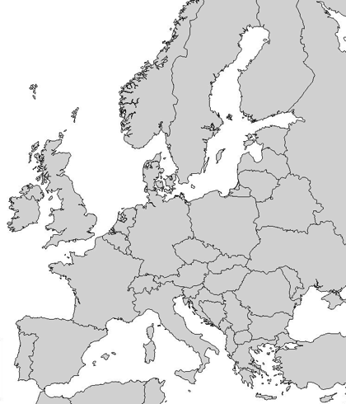
Motivation Permutation-based Problems
Travelling Salesman Problem (TSP)
Combinatorial Optimization Problems
Whose solutions are represented as permutations
8
7
6
The search space consist of
solutions
3
5
2
4
1
12

Slide 13
Motivation Permutation-based Problems
The space of permutations can be seen as a constrained space
of the integers space
(n=3)
13

Slide 14
Motivation Permutation-based Problems
The space of permutations can be seen as a constrained space
of the integers space
(n=3)
14

Slide 15
Motivation Probability Models on Rankings
Bibliography
M. A. Fligner and J. S. Verducci (1998), Multistage Ranking Models, Journal of the American Statistical Association, vol. 83, no. 403, pp. 892-901.
D. E. Critchlow, M. A. Fligner, and J. S. Verducci (1991), Probability Models on Rankings, Journal of Mathematical Psychology, vol. 35, no. 3, pp. 294-318.
P. Diaconis (1988), Group Representations in Probability and Statistics, Institute of Mathematical Statistics.
M. A. Fligner and J. S. Verducci (1986), Distance based Ranking Models, Journal of Royal Statistical Society, Series B, vol. 48, no. 3, pp. 359-369.
R. L. Plackett (1975), The Analysis of Permutations, Applied Statistics, vol. 24, no. 10, pp. 193-202.
D. R. Luce (1959), Individual Choice Behaviour, Wiley.
R. A. Bradley AND M. E. Terry (1952), Rank Analysis of Incomplete Block Designs: I. The Method of Paired Comparisons, Biometrika, vol. 39, no. 3, pp. 324-345.
L. L. Thurstone (1927), A law of comparative judgment, Psychological Review, vol 34, no. 4, pp. 273-286.
…
15

Slide 16
Motivation Probability Models on Rankings
Mallows
Generalized Mallows
Plackett-Luce
Bradley-Terry
16

Slide 17

Apply same idea in constrained COPs…
Do probability models exist for constrained spaces?
Ad-hoc models
17

Slide 18
A Square Lattice The Probability Model
Solutions are modelled as paths on a square lattice of (n/2+1)² vertices
Vertices: the number of ones and zeros at that stage
Edges: the probability of moving from one vertex to another.
Square Lattice for n=6 GPP instance
18

Slide 19
A Square Lattice The Probability Model
Solutions are modelled as paths on a square lattice of (n/2+1)² vertices
Probability of a path
Vertices: the number of ones and zeros at that stage
Edges: the probability of moving from one vertex to another
Horizontal step
Vertical step
Square Lattice for n=4 GPP instance
19

Slide 20
A Square Lattice The Probability Model - Sampling
Square Lattice for n=6 GPP instance
20

Slide 21
A Square Lattice The Probability Model - Sampling
Solutions are sampled at n stages
At each stage a decision has to be taken: up/right
Square Lattice for n=6 GPP instance
21

Slide 22
A Square Lattice The Probability Model - Sampling
Solutions are sampled at n stages
At each stage a decision has to be taken: up/right
Square Lattice for n=6 GPP instance
22

Slide 23
A Square Lattice The Probability Model - Sampling
Solutions are sampled at n stages
At each stage a decision has to be taken: up/right
Square Lattice for n=6 GPP instance
23

Slide 24
A Square Lattice The Probability Model - Sampling
Solutions are sampled at n stages
At each stage a decision has to be taken: up/right
Square Lattice for n=6 GPP instance
24

Slide 25
A Square Lattice The Probability Model - Sampling
Solutions are sampled at n stages
At each stage a decision has to be taken: up/right
Square Lattice for n=6 GPP instance
25

Slide 26
A Square Lattice The Probability Model - Sampling
Solutions are sampled at n stages
At each stage a decision has to be taken: up/right
Square Lattice for n=6 GPP instance
26

Slide 27
A Square Lattice The Probability Model - Sampling
Solutions are sampled at n stages
At each stage a decision has to be taken: up/right
As labels are interchangeable, we sample first a 0
Square Lattice for n=6 GPP instance
27

Slide 28
A Square Lattice The Probability Model – Estimating parameters
Square Lattice for n=6 GPP instance
28

Slide 29
A Square Lattice The Probability Model – The order of variables
In which order should we visit the variables?
Is there any difference?
29

Slide 30
A Square Lattice The Probability Model – The order of variables
Vertex close to the diagonal are more frequently visited
Taking a decision on these points is largely uncertain:
At (2,2) -- the solution has 2 zeros and 2 ones.
At (2,0), the preceeding
positions are filled with zeros.
Square Lattice for n=6 GPP instance
30

Slide 31
A Square Lattice The Probability Model – The order of variables
Map the best solution to the external border
First visit 0000…, and then ...1111.
And the order within the subsets?
From each set, choose the item that minimizes the cut-size, in alternated rounds.
31

Slide 32
Experimental Study Experimental Setting
UMDA *, TREE*¹ , Lattice
(*) adapted sampling
Algorithms
22 Instances (Johnson et al.)
G-type and
U-type
n=124, 250, 500, 1000
Benchmarks
Edges with no observations are assigned 0.5
Constructive at every 40 iterations
Sample
Lattice Settings
Pop-size: 10n
Sel-size: 5n
Off-size: 10n
Max evals.: 100n²
10 repetitions
Parameters
¹M. Pelikan, S. Tsutsui, and R. Kalapala, Dependency Trees, Permutations and Quadratic Assignment Problem, Medal Report No. 2007003 Tech. Rep. 2007.
32

Slide 33
Experimental Study Results - Performance
Instance | Best Fitness | ARPD
 |  | Lattice | UMDA | Tree
G124.02 | 13 | 0,32 | 0,61 | 0,19
G124.16 | 449 | 0,02 | 0,05 | 0,01
G250.01 | 31 | 0,33 | 0,49 | 0,20
G250.02 | 118 | 0,07 | 0,14 | 0,06
G250.04 | 360 | 0,04 | 0,10 | 0,03
G250.08 | 830 | 0,01 | 0,05 | 0,01
G500.005 | 61 | 0,30 | 0,40 | 0,08
G500.01 | 234 | 0,09 | 0,21 | 0,07
G500.02 | 642 | 0,03 | 0,11 | 0,03
G500.04 | 1754 | 0,02 | 0,06 | 0,02
G1000.0025 | 131 | 2,96 | 3,20 | 0,74
G1000.005 | 496 | 1,22 | 1,28 | 0,88
G1000.01 | 1420 | 0,56 | 0,66 | 0,62
G1000.02 | 3450 | 0,35 | 0,40 | 0,39
U500.05 | 23 | 1,17 | 1,89 | 0,57
U500.10 | 61 | 1,05 | 1,12 | 0,57
U500.20 | 185 | 0,56 | 0,87 | 0,44
U500.40 | 412 | 0,41 | 0,38 | 0,28
U1000.05 | 77 | 1,62 | 12,83 | 2,39
U1000.10 | 170 | 1,67 | 11,67 | 3,73
U1000.20 | 352 | 1,67 | 10,58 | 4,94
U1000.40 | 862 | 1,53 | 3,24 | 2,29
33

Slide 34
Experimental Study Results - Performance
Instance | Best Fitness | ARPD
 |  | Lattice | UMDA | Tree
G124.02 | 13 | 0,32 | 0,61 | 0,19
G124.16 | 449 | 0,02 | 0,05 | 0,01
G250.01 | 31 | 0,33 | 0,49 | 0,20
G250.02 | 118 | 0,07 | 0,14 | 0,06
G250.04 | 360 | 0,04 | 0,10 | 0,03
G250.08 | 830 | 0,01 | 0,05 | 0,01
G500.005 | 61 | 0,30 | 0,40 | 0,08
G500.01 | 234 | 0,09 | 0,21 | 0,07
G500.02 | 642 | 0,03 | 0,11 | 0,03
G500.04 | 1754 | 0,02 | 0,06 | 0,02
G1000.0025 | 131 | 2,96 | 3,20 | 0,74
G1000.005 | 496 | 1,22 | 1,28 | 0,88
G1000.01 | 1420 | 0,56 | 0,66 | 0,62
G1000.02 | 3450 | 0,35 | 0,40 | 0,39
U500.05 | 23 | 1,17 | 1,89 | 0,57
U500.10 | 61 | 1,05 | 1,12 | 0,57
U500.20 | 185 | 0,56 | 0,87 | 0,44
U500.40 | 412 | 0,41 | 0,38 | 0,28
U1000.05 | 77 | 1,62 | 12,83 | 2,39
U1000.10 | 170 | 1,67 | 11,67 | 3,73
U1000.20 | 352 | 1,67 | 10,58 | 4,94
U1000.40 | 862 | 1,53 | 3,24 | 2,29
34

Slide 35
Experimental Study Results - Performance
35

Slide 36
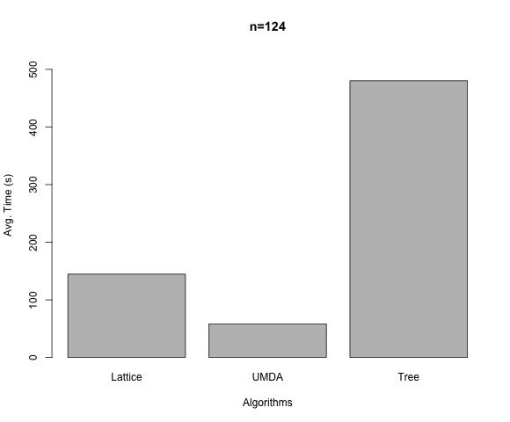
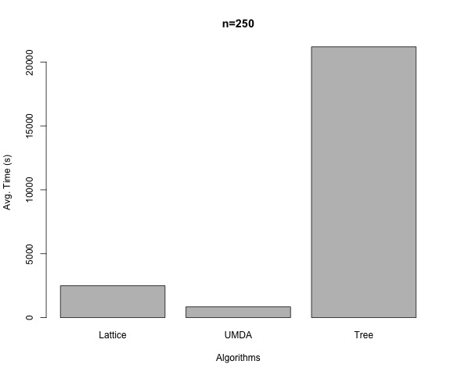
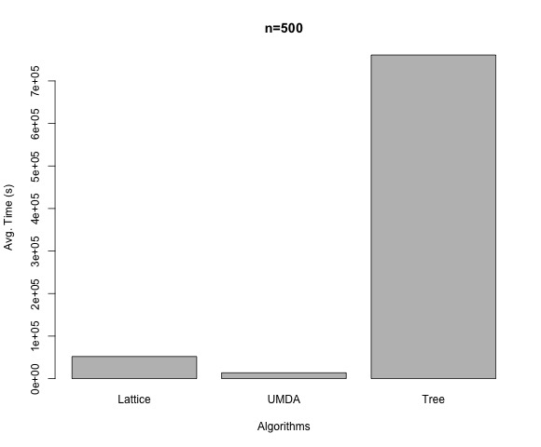
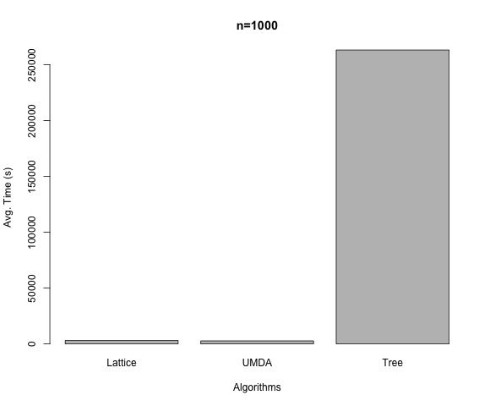
Experimental Study Results – Time Consumption
n=124
n=250
Lattice
UMDA
TREE
Lattice
UMDA
TREE
n=500
n=1000
Lattice
UMDA
TREE
Lattice
36
UMDA
TREE

Slide 37
Conclusions
The experiments support the validity of our research line:
Designing probability models exclusively on the set of feasible solutions
Competitive for small instances, and better in large instances
Low time complexity
37

Slide 38
Future Work
Many aspects to be faced in this work
Develop the idea of uncertainty of the paths in the lattice
Analyze the effect of other orderings
Use information of the population as Tree
Ordering of the variables
Larger benchmarks
Understand the dynamics of the Lattice for different problem sizes
Experimentation
Square Lattice for K≥3
The probability model
38

Slide 39
Future Research Lines Other models
Distance-based exponential probability models
A distance-metric
Spread parameter
Central solution
Normalization function
The size of the search space. GPP:
39

Slide 40
Dealing with constraints in estimation of distribution algorithms: a different approach
Josu Ceberio
Thank you for your attention!
The Genetic And Evolutionary Computation Conference (GECCO)
July 15th-19th 2017, Berlin

