Slide 1
Decision Support Ontology
Staff
Wage
Level / Role
Processing Required
Machine (Blanco, PAT)
Cost of process
Refund
Risk Realised Cost
Part (family, features)
Status (Quality)
Reman VALUE
Reman COST
Penalty (Fine)
SPARUL
CDF
Risks
Scrap Value
Repair / Scrap Partition
Reasoned Decision
User Interface
SPARQL
Changing cost and value (decision) with time, depending on status (quality) change as parts pass through processes

Slide 2
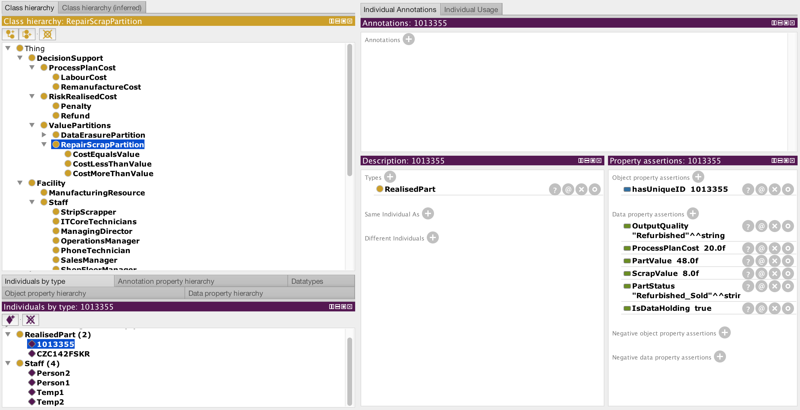
Decision Support Ontology

