Slide 1

Introduction to Python
FO-Technology
Session 2

Slide 2


Configurations
Wi-Fi: A55oc1ate
Anaconda and Visual Studio Code installation https://www.anaconda.com/distribution
Download GitHub repository: http://github.com/sgpy/foconnect/tree/HongKong

Slide 3
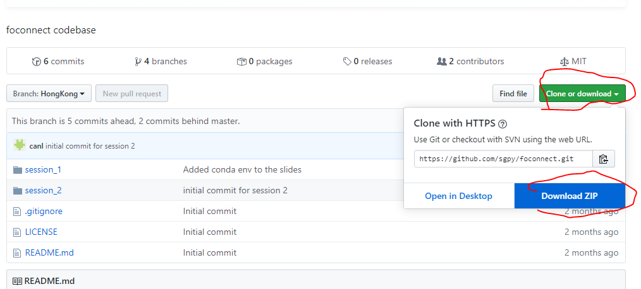
Download GitHub repository
http://github.com/sgpy/foconnect/tree/HongKong

Slide 4
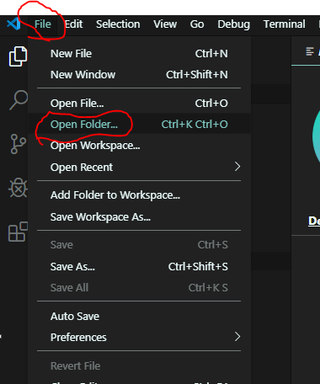
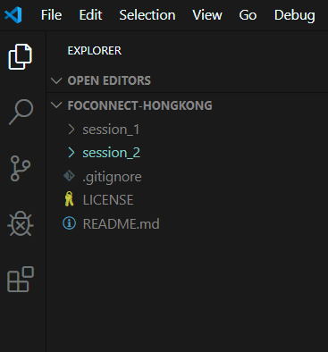
VS Code -> Open Folder

Slide 5
Extensions
Excel Viewer
Code Runner
Material Theme (optional)
File -> Auto Save ✔

Slide 6
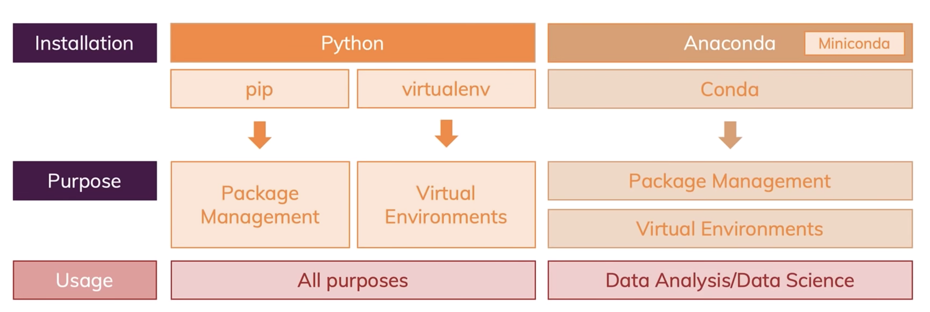

Slide 7


Why Python
Once you learn it you can find opportunities in web development, data science, machine learning, AI, web scrapping, game development, scientific and numeric computing, the list goes on, making it the versatile language to learn.

Slide 8
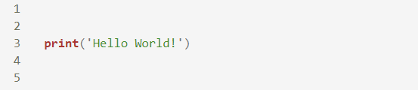
Q: How to write a “Hello World” program？
Write a python script that displays “Hello World!” in console.

Slide 9


Q: How to create a list？
Create a list of strings with p, y, t, h, o, and n.
Q: Get the 3rd element from above list？

Slide 10
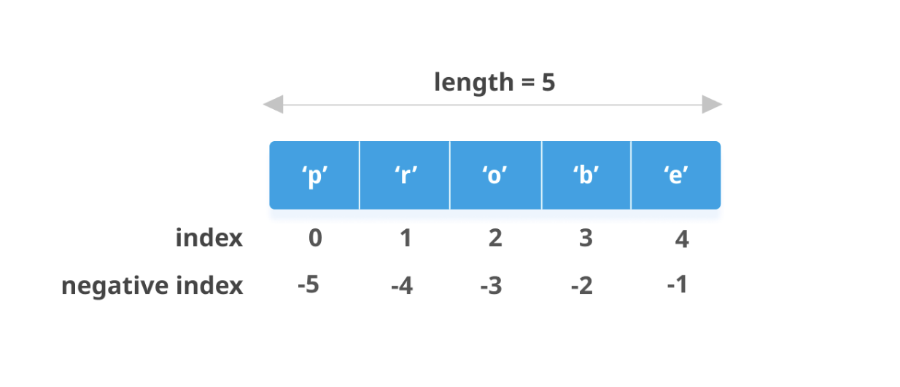
List indexing

Slide 11

Q: What is the output of the following program?
Choose One
[1, -1]
[‘p’, ‘n’]
[‘p’, ‘y’, ‘t’, ‘h’, ‘o’, ‘n’]
[‘y’, ‘t’, ‘h’, ‘o’]

Slide 12

Q: What is the output of the following program?
Choose One
[4, 6]
[1, 2, 3, 4]
[[1, 2], [3, 4]]
Error!

Slide 13
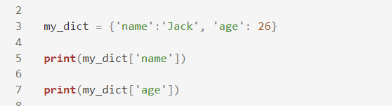
Q: How to create a dictionary？
Create a dictionary with ‘name’ and ‘age’ as keys.

Slide 14

Flow control statements
“if-else” statement controls what would happen if some condition was met and what otherwise. The code to be executed is based on the checking some conditions during the run-time.
session2/flow_control.py

Slide 15
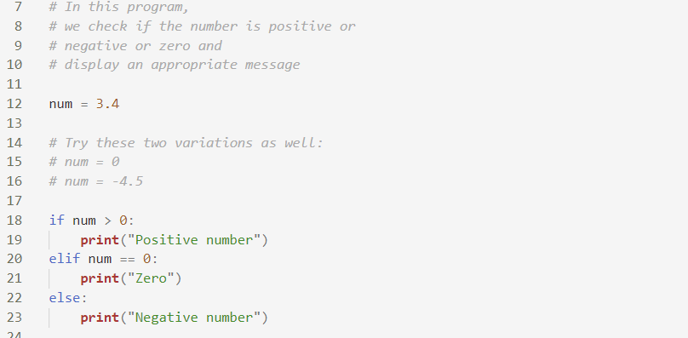
if-elif-else statement
session2/flow_control.py

Slide 16
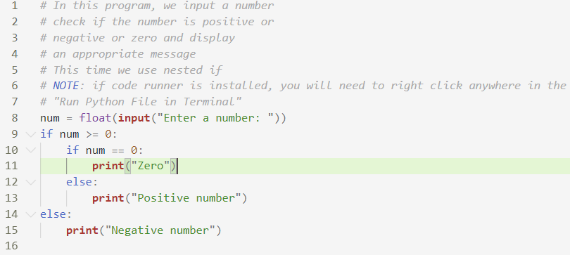
if-else statement with input
session2/flow_control_terminal.py

Slide 17
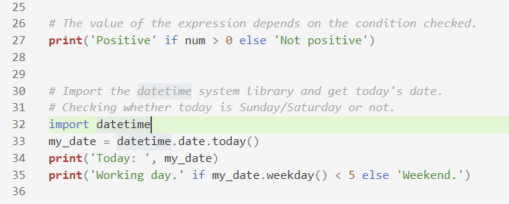
if-else in an expression
“if-else” can also be used in an expression for simplifying code in some cases.
session2/flow_control.py

Slide 18
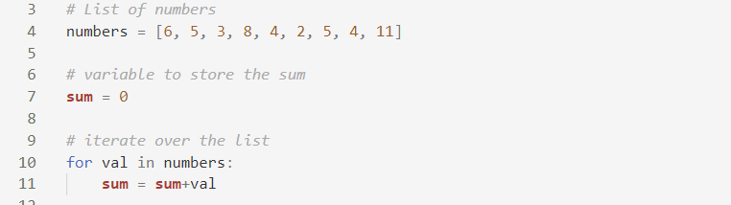
Iteration
We use “for…in” statement to process each element of a data container such as list, dictionary etc..
session2/iteration.py

Slide 19
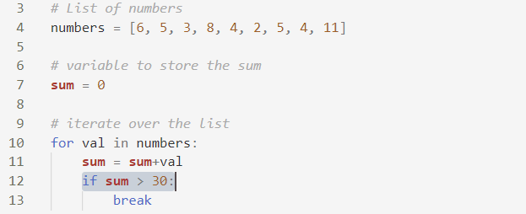
Break the iteration
During the iteration we can also stop when some condition was met.
session2/iteration.py

Slide 20
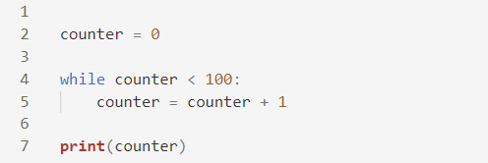
while statement
Apart from “for…in” loop, we can also loop using “while” statement.
session2/while_terminal.py

Slide 21
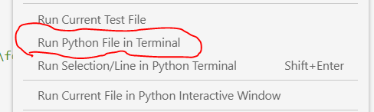
while statement
Please run while_terminal.py from “Run Python File in Terminal” in the right-click menu.
session2/while_terminal.py

Slide 22
Exercise

Slide 23
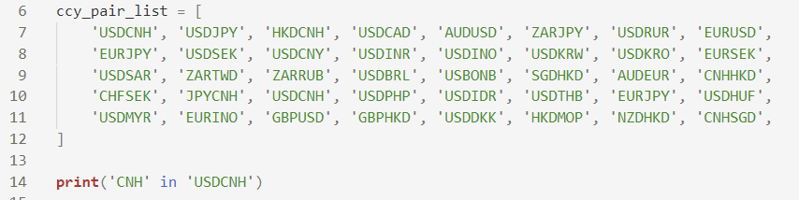
Exercise
Please open session2/exercise.py
Here is a list of currency pairs. Please find out how many pairs that contain 'CNH' currency.
Hint: 'CNH' in 'USDCNH'
session2/exercise.py

Slide 24
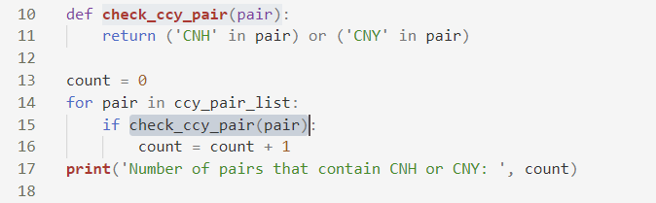
function
Tired of repetitive work? We can define a function and call it multiple times.
session2/functions.py

Slide 25
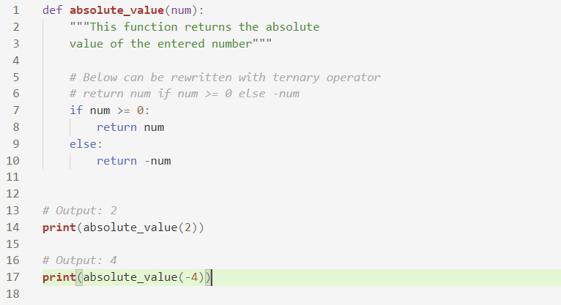
function
session2/functions.py

Slide 26
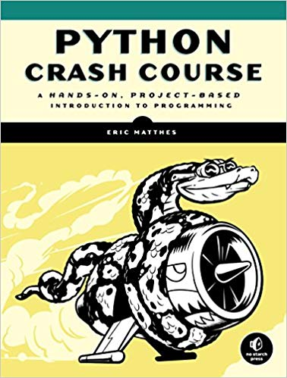
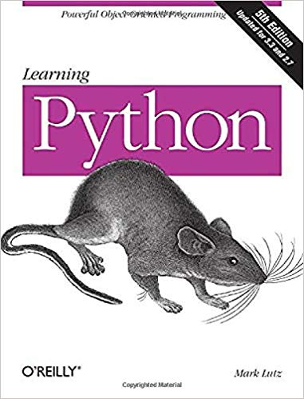
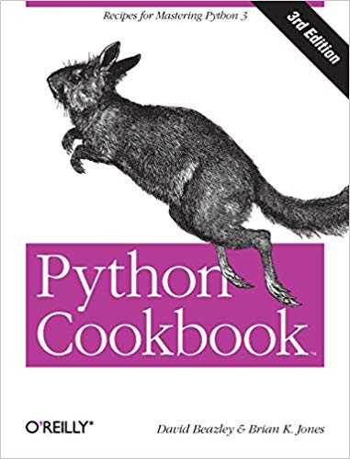
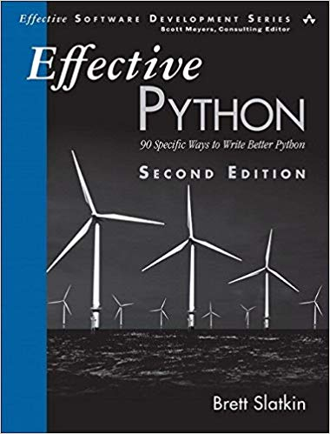
References
Python Documentation (Official): https://docs.python.org/3/tutorial/index.html
YouTube or GT&O University
Books
Cheat-sheet

