Slide 1

PYTHON

Slide 2





I. PRIMITIVE DATA TYPE (1/3)
FEW CONCEPTS:
Variable is used to store value.
Single equal sign (=) is used for assignment. When you write x = 1 , this mean you assign the value of 1 to variable x. Now x is 1.
WARNING! Ensure to differentiate between String and Variable.
e.g.
Printing “iAm” will produce the text(string) “iAm” as the quotation mark denotes a string. While printing the variable iAm, will give the value of the variable.
Numbers - Digits, including decimal.
Booleans - True / False
Strings – Text
None – absence of value
https://www.w3schools.com/python/python_datatypes.asp

Slide 3
PRIMITIVE DATA TYPE – Exercise (2/3)
Assign 10 to x , 2 to y . Multiply x and y , then assign it to z. Print z.
Assign -3 to a , 2 to b . Divide a and b , then assign it to c. Print c.
Assign 10 to x , 2 to y . Assign the remainder of x divided by y to r. Print r.
Assign “My” to a, “name” to b, “is” to c, and your name to d. Combine a,b,c,d (and white spaces) to produce: “My name is yourName”
Print “My age is : 21” by combining two variables x and y.
**FLIP TO NEXT SLIDE FOR ANSWER

Slide 4
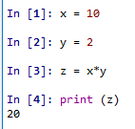
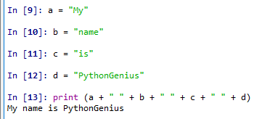
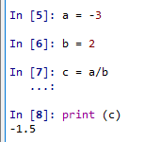
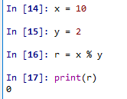
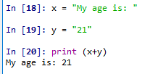
PRIMITIVE DATA TYPE – Solutions (3/3)
1.
2.
3.
4.
NOTE: Anything between quotes are string.
That includes space “ “, symbols “^%$#@$#@” ,
and even empty string “” .
5.
NOTE: You can only concatenate string (str) object with string(str). Not str with any number including integer (int). Digits between quotes are still string.
e.g. “123” is a string.
NOTE: https://www.w3schools.com/python/python_operators.asp

Slide 5
II. Collections (1/4)
Collection in Python denotes collection of zero or more elements.
Collection is iterable, this means, you can iterate through each elements.
Samples:
empty collection
e.g. []
- word is collection of letters
e.g. [“C”,”A”,”T”,”D”,”O”,”G”]
- Rows / columns in excel are collection.
Numbers = [1,2,3] # collection of numbers
Name = [‘Bob’,’Teddy’,’Sandra’] # collection of words
Profession = [‘Programmer’,’Tree Hugger’,’Data Scientist’]
Rows = [ [1, ’Bob’, 32, ‘Programmer’], # collection of collection
[2, ‘Teddy’, 34, ‘Tree Hugger’],
[3, ‘Sandra’, 31, ‘Data Scientist’] ]
TYPES of collections:
List - collection of any elements.
Adding element to a list. E.g. Adding 5 to the list.
Get element(s) from a list.
NOTE: Any collection with index starts with position ZERO (0).
To get the first element of the list x will be
:x[0]
x = [1,2,3,4] | x = [True,True,False]
x = ['a','b','c','asd'] | x =[None, None]
x = [1,2,3,4]
x.append(5)
No. | Name | Age | Profession
1 | Bob | 32 | Programmer
2 | Teddy | 34 | Tree Hugger
3 | Sandra | 31 | Data Scientist
x[0] | Get the first element
x[1:3] | Get the 2nd (inclusive) to 4th (exclusive) elements
x[:3] | Get the 1st until 3rd (exclusive) elements
x.pop() | Get the last element

Slide 6
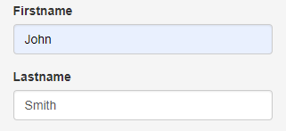

II. Collections (2/4)
2. Set – collection of unique elements. There is no duplicate in a set.
Two ways to create set:
1) 2)
Add 4 to a set Remove ‘a’ from a set
List vs set:
3. Dictionary - collection of KEY , VALUE lookup.
Consider the typical form.
KEY
VALUE
This can be represented in dictionary:
KEY : VALUE
To get the value of they key “Firstname” :
s = {1,2,3}
x = [4,5,6,6]
setX = set(x)
s.add(4)
s = {'a','b'}
s.remove('a')
List | 1 | 1 | 2 | 3 | 4 | 4 | 5
Set | 1 | 2 | 3 | 4 | 5
Note:
You can use len() function to get the length of the collection. e.g. len([1,2,3]) , len({“a”:1,”b”:2})
https://www.w3schools.com/python/python_lists.asp
https://www.w3schools.com/python/python_sets.asp
https://www.w3schools.com/python/python_dictionaries.asp

Slide 7
II. Collections (3/4)
Create a list that contains different data types.
From the list in Q1, get the last element.
From the list in Q1, get the last 2 elements.
Find the unique elements of [1,1,2,3,4]
Create a dictionary containing price of the fruits:
Apple = 1 , Orange = 2 , Grape = 3
From the dictionary from Q5, get the price for Orange.
**FLIP TO NEXT SLIDE FOR ANSWER

Slide 8

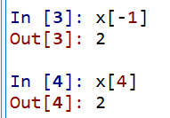

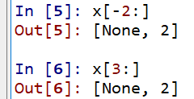

II. Collections – Solutions (4/4)
1.
2.
3.
4.
5.
6.

Slide 9
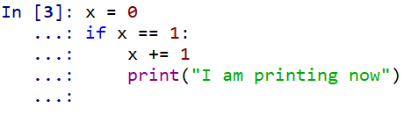
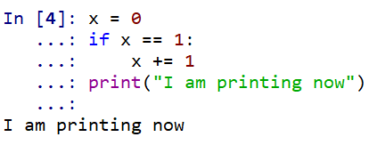

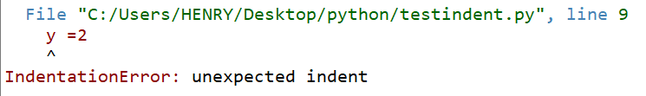
Few Gotchas
1. Python is case sensitive.
e.g. camel is not the same as Camel.
2. Name a variable with the best description of what value it store.
e.g. myMoney=100 is better to describe the amount of money I have compared to x=100.
3. Indentation will determine the flow of the code. Use TAB for best programming habit.
e.g. in #3 below, print function will only run if x is equal to 1 because it is indented 1 tab to the right of the if.
while #4, will run the print function because it is on the same indentation as the if.
Improper indentation can even cause code error.

Slide 10
III. Control Statements - Operator (1/4)
Operators are used to perform operations on variables and values.
Comparison operators Logical operators Identity operators
Membership operators
more…
https://www.w3schools.com/python/python_operators.asp
Symbol | Name | Sample
== | Equal to | 1 == 1
!= | Not Equal to | "a" != "abc"
> | Greater than | 5 > 1
< | Lesser than | 1 < 2
>= | Greater equal than | 2 >= 2
 |  | 2 >= 1
<= | Lesser equal than | 5 <= 5
 |  | 5 <= 6
Keywords
and
or
not
Keywords
is
is not
Keywords
in
not in

Slide 11
III. Control Statements – if – elif – else (2/4)
If / elif / else statement can be used to control the flow of the program.
Consider the below
Problem statement: Pseudocode: Code:
Today’s plan:
Go to lunch at 1 o’clock. Get some tea at 3 o’clock. Keep working otherwise.
It’s 2 o’clock, what should I do?
It is 2 o’clock now. If now is 1 o’clock,
go to lunch
Else if now is 3 o’clock,
get some tea
Otherwise
keep working
now = 2
if now == 1:
print (“go to lunch”)
elif now == 3:
print (“get some tea”)
else:
print (“keep working”)
Pseudocode is an informal way of programming description that does not require any strict programming language syntax. It is used for creating an outline or a rough draft of a program.
Note that colon (:) is used after every condition any code on under (:) with the same indentation is considered to be in the same code block and executed together.
https://www.w3schools.com/python/python_conditions.asp

Slide 12
III. Control Statements – Exercise (3/4) (use the code editor)
1. Write down the following statements into pseudocode and code.
I have some money and I want to spend it. Either I’ll buy a car ($9) , a bicycle ($5) or simply spend all my money on the most expensive shoes that I can afford.
If I have no more money left, indicate “I am broke”. Otherwise, indicate “I need to save”.
Test the above if statement with different initial money. E.g. 12, 5, 3. Try another numbers and predict the outcome before running the program.
With starting money of $12, it should print:
“buy a car”
“I need to save”
With starting money of $5, it should print:
“buy a bicycle”
“I am now broke”
With starting money of $1, it should print:
“spend all on new shoes”
“I am now broke”
2. Write the code: If “fruit” in the list of “key”, “money”, “fruit” , then print “it exist !”
**FLIP TO NEXT SLIDE FOR ANSWER

Slide 13
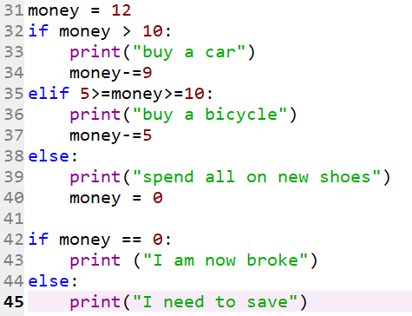
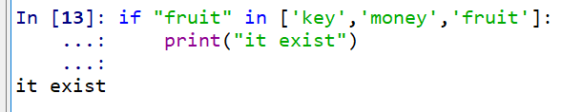
III. Control Statements – Solutions (4/4)
Pseudocode Code
Starting money = 12
If money > 10
print “buy a car”
decrease money by 9
Else if money >= 5 and money <= 10
print “buy bicycle”
decrease money by 5
Else
print “spend all on new shoes”
money = 0
If money is 0
print “I am now broke”
Else
print “I need to save”
Starting money = 12
If money > 10
print “buy a car”
decrease money by 9
Else if money >= 5 and money <= 10
print “buy bicycle”
decrease money by 5
Else
print “spend all on new shoes”
money = 0
If money is 0
print “I am now broke”
Else
print “I need to save”
IMPORTANT!
Keep a habit of writing pseudocode before writing the actual code.
This will help to list out the key important items to be written to your code.
2.

Slide 14

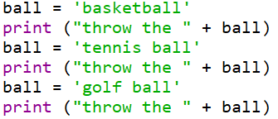


IV. Loop (1/4)
Loop enable block of code to be repeated. There are two loops: for-loop and while-loop.
Consider the problem statement: Given different variety of balls, throw the ball.
Sample output:
Code without loop:
But consider if you have 100 different type of balls.
This code will become extremely long.
for loop: https://www.w3schools.com/python/python_for_loops.asp
In for loop, you iterate each item in the collection and perform the given instruction.
Pseudocode
basket contains ['basketball','tennis ball','golf ball']
for each balls in the basket,
print "throw the ball“
Code with for loop:
while loop: https://www.w3schools.com/python/python_while_loops.asp
In while loop, perform the given instruction while the condition is fulfilled (True).
Pseudocode
basket contains ['basketball','tennis ball','golf ball’]
While I have ball in basket:
take one ball and print “Throw the ball”
Code with while loop:

Slide 15
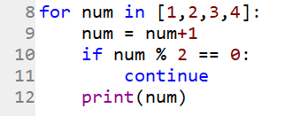
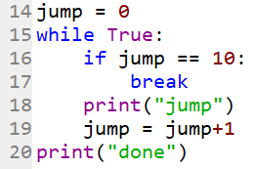
IV. Loop (2/4)
continue
This keyword can be used to skip the rest of the code in the block and continue with the next iteration.
E.g.
for each number in the list [1,2,3,4] , if number+1 is even number, continue (skip line 12 and start with next iteration on line 9). Otherwise, print the number.
break
This keyword can be used to exit the loop.
E.g.
“while True” will cause the code to run indefinitely.
The below code will print “jump” and increment the variable jump by 1 (line 18 and 19). Once jump is equal to 10, break, exit the loop to line 20.

Slide 16
IV. Loop Exercise (3/4)
1. Using for loop, count the sum of all numbers in the list.
2. Using while loop, count the sum of all numbers in the list.
3. Given a random string, print each letter. If it is a vowel, print “vowel”. If it is consonant, print the letter. If it is letter “e”, exit the loop.
Note that you can iterate through a string.
e.g. x = "daoigheaoigneao“
d
vowel
vowelvowel
g
h
vowel
**FLIP TO NEXT SLIDE FOR ANSWER

Slide 17

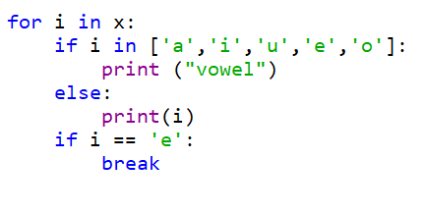
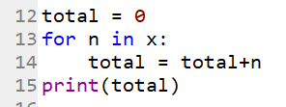
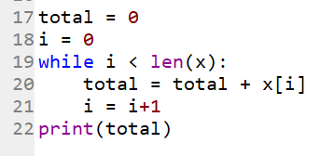
IV. Loop - Solutions (4/4)
x = [1,2,3,4,5,6]
1.
2.
3.

Slide 18
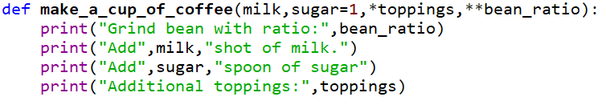
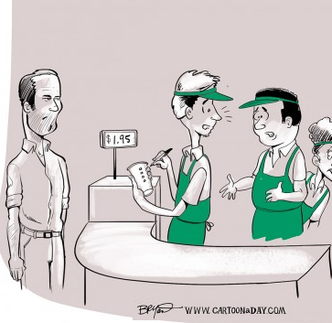
V. Functions (1/6)
Function is a group of instruction(s).https://www.w3schools.com/python/python_functions.asp.
Consider all of the instructions that the customer ask to get a cup of coffee, it would be easier to be called
make_a_cup_of_coffee() .
Structure of a function.
0. Key word def is needed to define the function. Function need to be defined before it can be used.
Name of the function. It follows variable naming convention.
2. Mandatory argument. This will be the value given to the function.
3. Optional/default argument. If the value is not given, it will be default to the specified value defined.
4. Wait for it…
5. Wait for it…
6. Body of the function. Contain codes of instructions.
Hi, please:
Grind bean with arabica 70% and robusta 30% ratio. Add 1 shot of milk. Add 2 spoon of sugar. And add cocoa and whipcream.
0
1
2
3
6

Slide 19
V. Functions (2/6)
Function is a group of instruction(s).https://www.w3schools.com/python/python_functions.asp.
Consider all of the instructions that the customer ask to get a cup of coffee, it would be easier to be called
make_a_cup_of_coffee() .
Structure of a function.
0. Key word def is needed to define the function. Function need to be defined before it can be used.
Name of the function. It follows variable naming convention.
2. Mandatory argument. This will be the value given to the function.
3. Optional/default argument. If the value is not given, it will be default to the specified value defined.
4. Arbitrary argument list (optional). The values will be passed to a list.
5. Wait for it…
6. Body of the function. Contain codes of instructions.
Hi, please:
Grind bean with arabica 70% and robusta 30% ratio. Add 1 shot of milk. Add 2 spoon of sugar. And add cocoa and whipcream.
0
1
2
3
4
6

Slide 20
V. Functions (3/6)
Function is a group of instruction(s).https://www.w3schools.com/python/python_functions.asp.
Consider all of the instructions that the customer ask to get a cup of coffee, it would be easier to be called
make_a_cup_of_coffee() .
Structure of a function.
0. Key word def is needed to define the function. Function need to be defined before it can be used.
Name of the function. It follows variable naming convention.
2. Mandatory argument. This will be the value given to the function.
3. Optional/default argument. If the value is not given, it will be default to the specified value defined.
4. Arbitrary argument list (optional). The values will be passed to a list.
5. Arbitrary named arguments. The values will be passed to a dictionary.
6. Body of the function. Contain codes of instructions.
Hi, please:
Grind bean with arabica 70% and robusta 30% ratio. Add 1 shot of milk. Add 2 spoon of sugar. And add cocoa and whipcream.
0
1
2
3
4
5
6

Slide 21

V. Functions (4/6)
How to call / invoke a function:
1. Start by specifying the name of the function to be called.
2. The mandatory argument.
3. The default argument.
4. Arbitrary argument list.
5. Arbitrary named arguments.
Output:
NOTE:
1. The number of arguments in a function can be zero or as many as intended. Example of function with zero argument:
2. To define a function, arguments need to be wrapped with bracket and semi colon. i.e.
3. To call the function, arguments need to be wrapped with bracket (NO semi colon). i.e. run()
1
2
3
4
4
5
5

Slide 22
V. Functions – Exercise (5/6)
Create a function with 3 parameters (1 mandatory and 2 optional with default value) that will print and return the sum of all of the parameters.
Create a function that call another function.
Create a function that print anything that is passed to it.
Create a function that takes two equal length list, keys and values, and return a dictionary with each element of the keys mapped to each element of the values list.
Ensure that you test each function
**FLIP TO NEXT SLIDE FOR ANSWER

Slide 23




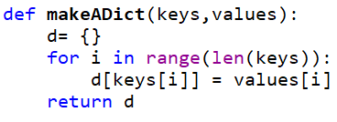


V. Functions – Solutions (6/6)
1.
2.
3.
4.

Slide 24
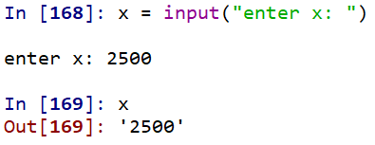
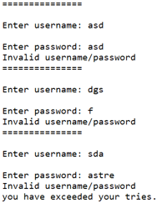
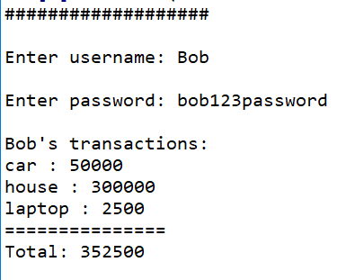
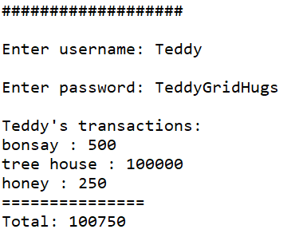
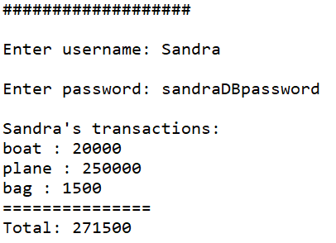
Mini Project (1/3)
Immitate a login process.
Create a dictionary containing username, password of users. Username as a key, password as value.
Ask the user for username , password up to 3 times before showing an error “you have exceeded your tries.” . You can use input() to get a user input.
If the login successful, show each of the user transaction and calculate the total. Use the appropriate collection to store all of the necessary transaction data of a given user.
If the login failed, show the error “Invalid username/password”.
Sample fail login: Sample successful login:
**FLIP TO NEXT SLIDE FOR ANSWER
**FLIP TO NEXT SLIDE FOR ANSWER

Slide 25
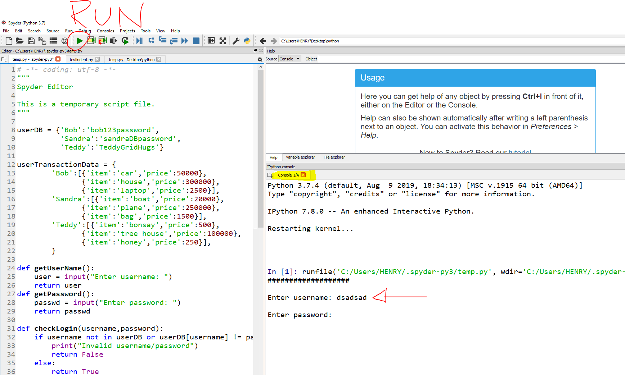
Mini Project –Solutions (2/3)
Write a simple code and hit the run button to ensure that your code is running (and your environment is configured correctly).

Slide 26
Mini Project –Solutions (3/3)
copy paste the code to your python file and run it.
userDB = {'Bob':'bob123password',
'Sandra':'sandraDBpassword',
'Teddy':'TeddyGridHugs'}
userTransactionData = {
'Bob':[{'item':'car','price':50000},
{'item':'house','price':300000},
{'item':'laptop','price':2500}],
'Sandra':[{'item':'boat','price':20000},
{'item':'plane','price':250000},
{'item':'bag','price':1500}],
'Teddy':[{'item':'bonsay','price':500},
{'item':'tree house','price':100000},
{'item':'honey','price':250}],
}
def getUserName():
user = input("Enter username: ")
return user
def getPassword():
passwd = input("Enter password: ")
return passwd
def checkLogin(username,password):
if username not in userDB or userDB[username] != password:
print("Invalid username/password")
return False
else:
return True
def getUserTransaction(user):
transaction = userTransactionData[user]
total = 0
print("\n%s's transactions:"%user)
for tran in transaction:
print("%s : %d"%(tran['item'], tran['price']))
total+= tran['price']
print("===============")
print("Total: " + str(total))
def main():
tries = 0
while tries < 3:
print("###################")
user = getUserName()
pwd = getPassword()
if checkLogin(user,pwd):
getUserTransaction(user)
break
else:
tries+=1
if tries == 3:
print("you have exceeded your tries.")
if __name__ == "__main__":
main()

