Slide 1
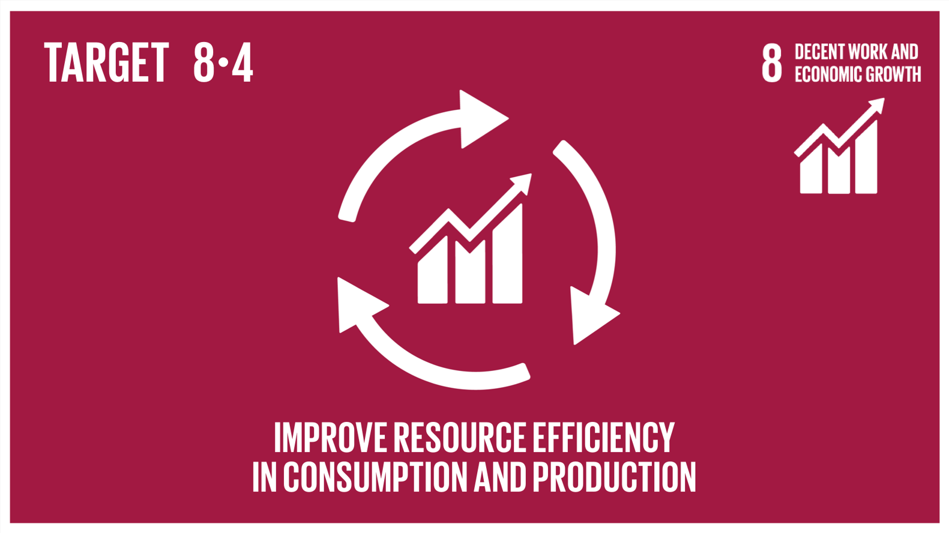
HOME BUDGET ECONOMY
By
Sagar singh
cs19b038

Slide 2
Motivation for the idea
When I was going through all the SDGs, I tried to speculate why is it so difficult to overcome these problems.
I realised that people barely care about most of the goals mentioned in SDG as everyone’s life is difficult as it is and it takes extra effort to think about SDG problems.
All the goals can only be achieved by a communal effort.

Slide 3
Motivation for the idea (Contd.)
Thus solving one of the fundamental problem becomes imminent.
People get exhausted from stress, money-shortage, relations, etc, and they cope with this problem by spending money in order to treat themselves.
I decide to tackle the money shortage problem by promoting income-management.
For this, I wanted to make a website that promotes savings.

Slide 4
Uniqueness of my application
The existing solutions for this problem are various home budget planning calculators such as bankrate.com, moneycontrol.com, smartasset.com, etc.
These main problem with some of these websites is that they have outdated UI and conceptual advice which is essential but difficult to understand. Most Importantly, they are centred towards promoting investments and provide advice for the same.
My application would provide fast user input and modern UI. Along with this, it would help the user visualize data and provide practical tips for management.

Slide 5
End product
I have seen my parents log their expenditure data or investment data on an excel spreadsheet twice or thrice a month.
Although being a good habit, a major problem with this is that all the small purchases that occur daily are ignored.
These micro expenditures pile up into a considerable expense at the end of the month.

Slide 6
End product (contd.)
I envision a budgeter where filling data should take as less time as possible so that the users use this website daily and make it into a habit.
The final product should be able categorize the data according to the type of expenditure and provide a visualization for the same through area charts.
Lastly, it should be able to motivate the user through rewards and tips.

Slide 7
Progress report
Release 1
Adequate APIs are built for the Backend for existing features.
Authentication Backend and Authentication UI requires no fixes.
Currently (26/10/2021), 4 webpages are present in the website: Home, Authentication(Sign in, Sign up), Budgeter and Analytics (Analytics is still incomplete).
User can view, add, edit and delete entries/transactions in Budgeter.

Slide 8
Progress report
Release 2 tasks
UI bug fixes in Budgeter.
Content update in Home.
Media queries for frontend.
Adding Analytics in order to have area chart.
Adding additional features to Budgeter.
Adding a customer feedback section which should be visible to all the users.
(For more information I advice you to read README)

