Slide 1
Pacman – Ghosts activate on sight
Mao L., Wang C., Sebastian G.

Slide 2
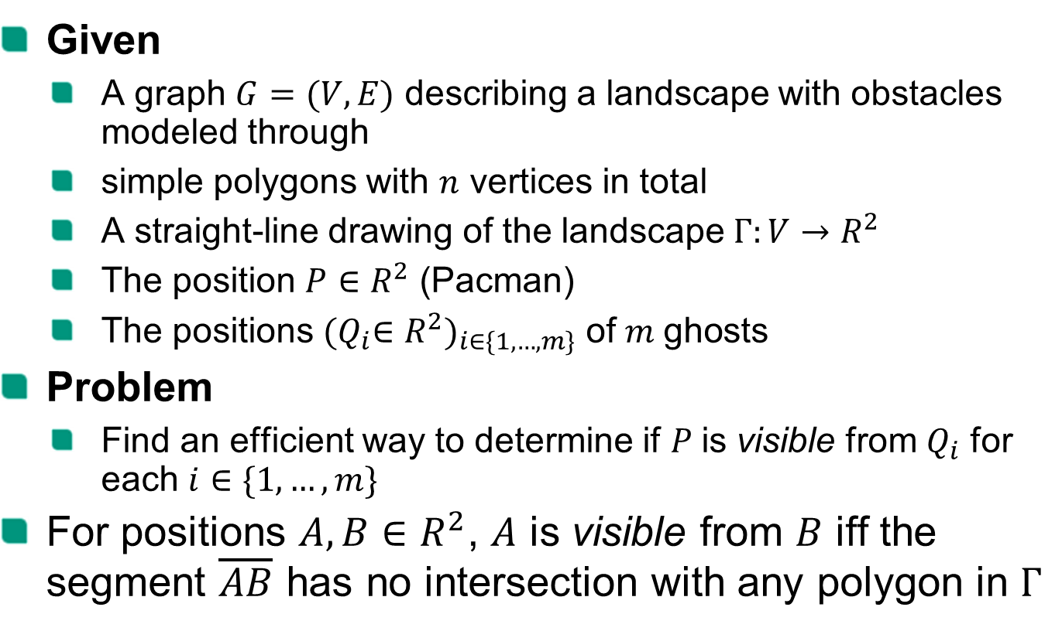
Problem specification
Given
A graph $G=(V, E)$ describing a landscape with obstacles modeled through
simple polygons with $n$ vertices in total
A straight-line drawing of the landscape $Γ:V→R^{2}$
The position $P∈R^{2}$ (Pacman)
The positions ${{(Q}_{i}∈R^{2})}_{i∈\{1,…,m\}}$ of$m$ghosts
Problem
Find an efficient way to determine if $P$is visible from $Q_{i}$ for each $i∈\{1,…,m\}$
For positions $A,B∈R^{2}$, $A$ is visible from $B$ iff the segment $\overline{AB}$ has no intersection with any polygon in $Γ$
Notes:
The outline is just an and has to be adjusted example (see https://sdqweb.ipd.kit.edu/wiki/Vortragshinweise) and copied to each slide manually. The current chapter should be in bold font. The distance of the words can be adjusted automatically by PowerPoint: select all words and arrows and then select “Anordnen -> Ausrichten -> Horizontal verteilen” (PowerPoint2007).

Slide 3
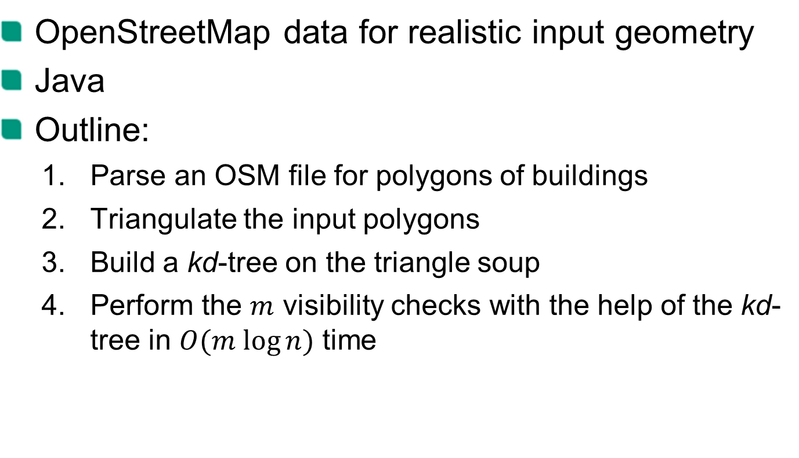
Our approach
OpenStreetMap data for realistic input geometry
Java
Outline:
Parse an OSM file for polygons of buildings
Triangulate the input polygons
Build a kd-tree on the triangle soup
Perform the $m$ visibility checks with the help of the kd-tree in $O(m log⁡n)$ time

Slide 4
DEMO

Slide 5
Ear Clipping
Triangulation of Simple Polygons

Slide 6
Intersection test
kd-tree

Slide 7
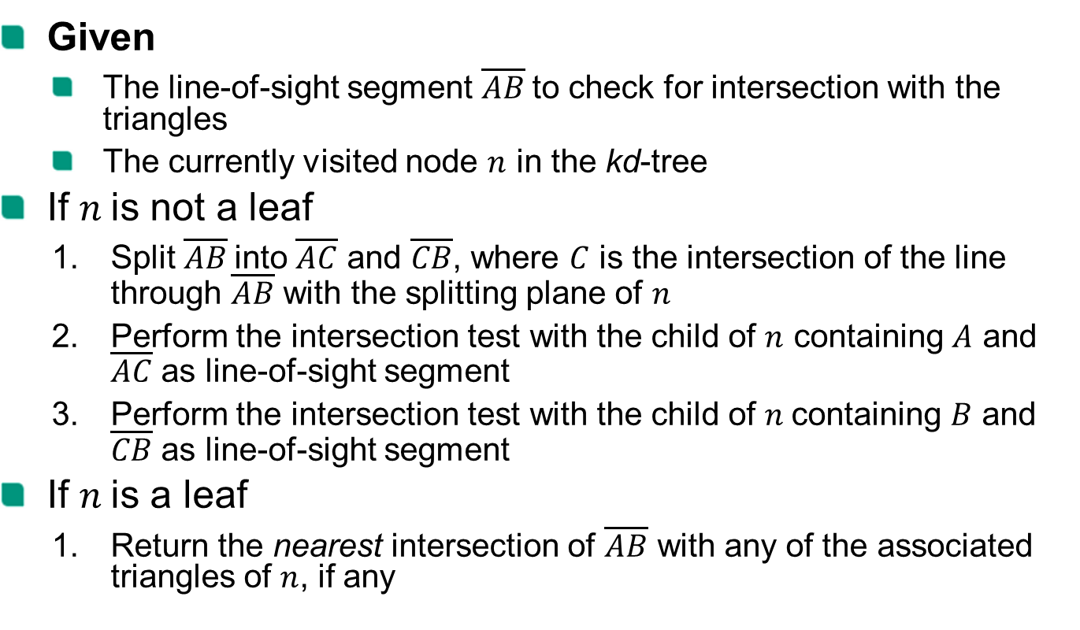
Intersection test
Given
The line-of-sight segment $\overline{AB}$to check for intersection with the triangles
The currently visited node $n$ in the kd-tree
If $n$is not a leaf
Split $\overline{AB}$into $\overline{AC}$ and $\overline{CB}$, where $C$ is the intersection of the line through $\overline{AB}$ with the splitting plane of $n$
Perform the intersection test with the child of $n$ containing $A$ and $\overline{AC}$ as line-of-sight segment
Perform the intersection test with the child of $n$containing $B$ and $\overline{CB}$ as line-of-sight segment
If $n$is a leaf
Return the nearest intersection of $\overline{AB}$ with any of the associated triangles of $n$, if any

Slide 8
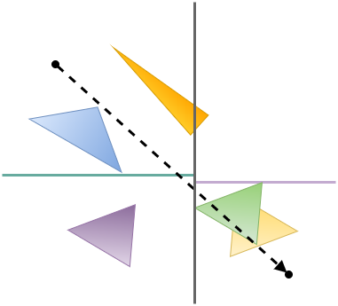
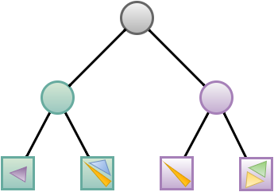
Intersection test - example

Slide 9

Intersection test - example
Split $\overline{AB}$into $\overline{AC}$ and $\overline{CB}$, where $C$ is the intersection of the line through $\overline{AB}$ with the splitting plane of $n$
A
B

Slide 10
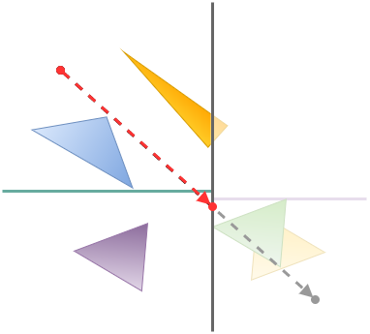
Intersection test - example
Split $\overline{AB}$into $\overline{AC}$ and $\overline{CB}$, where $C$ is the intersection of the line through $\overline{AB}$ with the splitting plane of $n$
A
C
B

Slide 11

Intersection test - example
Perform the intersection test with the child of $n$ containing $A$ and $\overline{AC}$ as line-of-sight segment
A
C
B

Slide 12
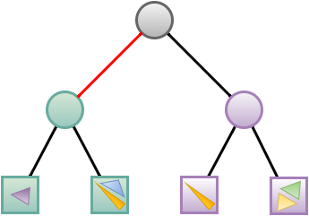
Intersection test - example
Perform the intersection test with the child of $n$ containing $A$ and $\overline{AC}$ as line-of-sight segment

Slide 13
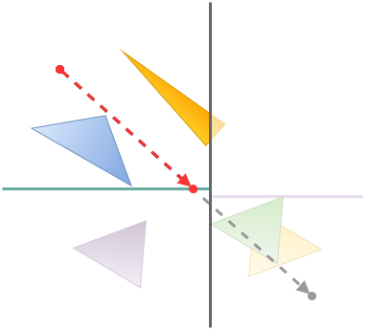
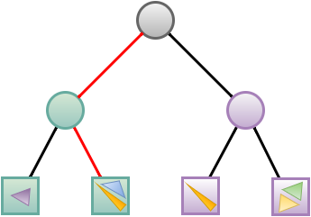
Intersection test - example
Perform the intersection test with the child of $n$ containing $A$ and $\overline{AC}$ as line-of-sight segment

Slide 14

Intersection test - example
Return the nearest intersection of $\overline{AB}$ with any of the associated triangles of $n$, if any

Slide 15

Intersection test - example
Perform the intersection test with the child of $n$ containing $B$ and $\overline{CB}$ as line-of-sight segment

Slide 16
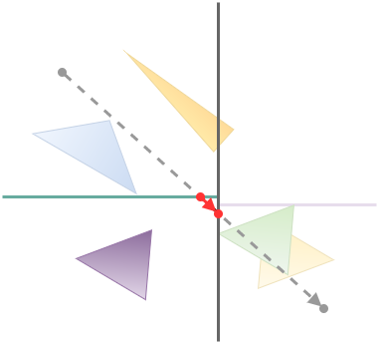
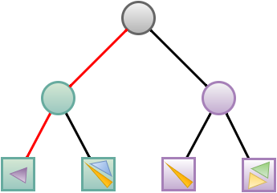
Intersection test - example
Perform the intersection test with the child of $n$ containing $B$ and $\overline{CB}$ as line-of-sight segment

Slide 17
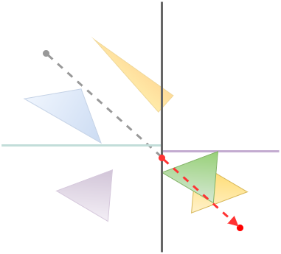
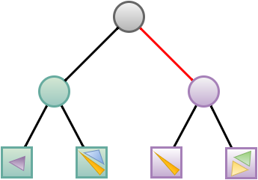
Intersection test - example

Slide 18
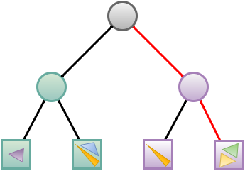
Intersection test - example

Slide 19
Intersection test - example
Return the nearest intersection of $\overline{AB}$ with any of the associated triangles of $n$, if any

Slide 20
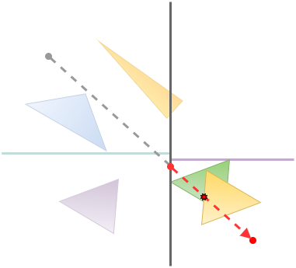
Intersection test - example
Return the nearest intersection of $\overline{AB}$ with any of the associated triangles of $n$, if any

Slide 21
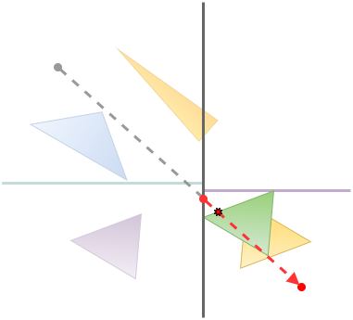
Intersection test - example
Return the nearest intersection of $\overline{AB}$ with any of the associated triangles of $n$, if any

Slide 22
construction
kd-tree

Slide 23
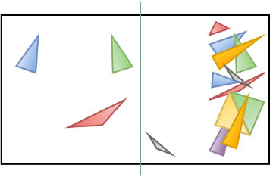
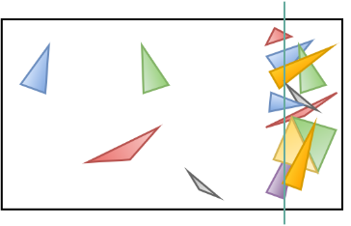

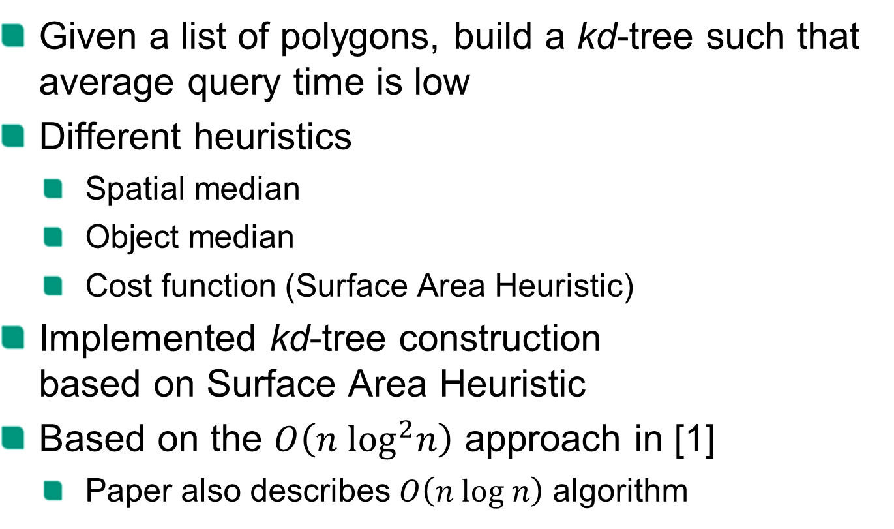
Construction
Given a list of polygons, build a kd-tree such that average query time is low
Different heuristics
Spatial median
Object median
Cost function (Surface Area Heuristic)
Implemented kd-tree construction based on Surface Area Heuristic
Based on the $O\left(n \log^{2}n\right)$ approach in [1]
Paper also describes $O\left(n log n\right)$ algorithm

Slide 24
Surface Area Heuristic
Assigns costs to splits
Lowest scoring splits (perfect splits) are optimal under the following assumptions:
Assuming uniformly distributed rays penetrating the bounding box
kd-tree traversal costs and triangle intersection costs are known

Slide 25
Surface Area Heuristic
The cost function depends on
The surface area of the current node‘s bounding box
The surface areas of the split bounding boxes
The number of triangles intersecting the right or left split bounding box

Slide 26
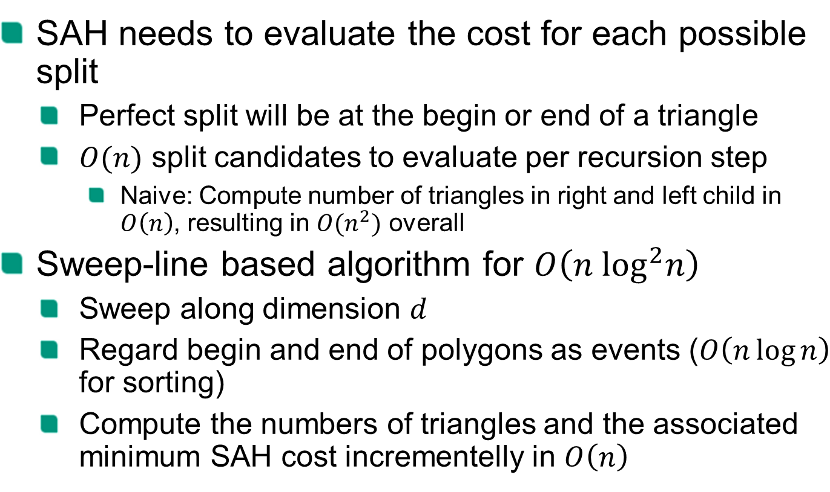
Construction
SAH needs to evaluate the cost for each possible split
Perfect split will be at the begin or end of a triangle
$O(n)$ split candidates to evaluate per recursion step
Naive: Compute number of triangles in right and left child in $O\left(n\right)$, resulting in $O(n^{2})$ overall
Sweep-line based algorithm for $O\left(n \log^{2}n\right)$
Sweep along dimension $d$
Regard begin and end of polygons as events ($O\left(n\log{n}\right)$ for sorting)
Compute the numbers of triangles and the associated minimum SAH cost incrementelly in $O\left(n\right)$

Slide 27
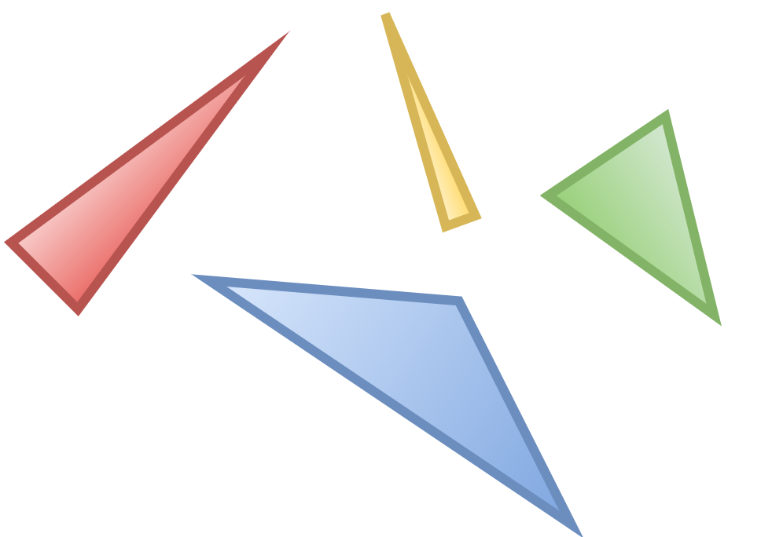
Sweep-line-based Perfect Split
Triangles left of sweep line: 0
Triangles right of sweep line: 4

Slide 28
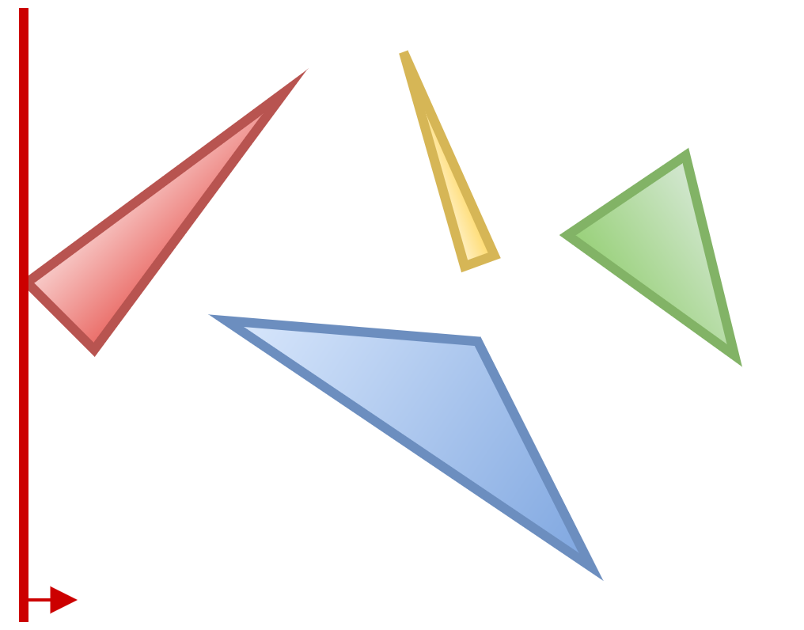
Sweep-line-based Perfect Split
Triangles left of sweep line: 1
Triangles right of sweep line: 4

Slide 29
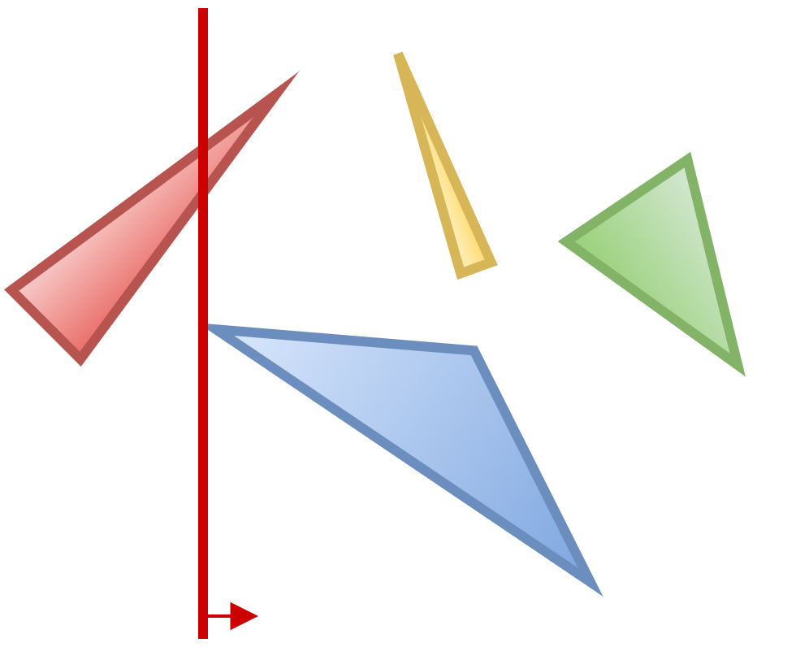
Sweep-line-based Perfect Split
Triangles left of sweep line: 2
Triangles right of sweep line: 4

Slide 30
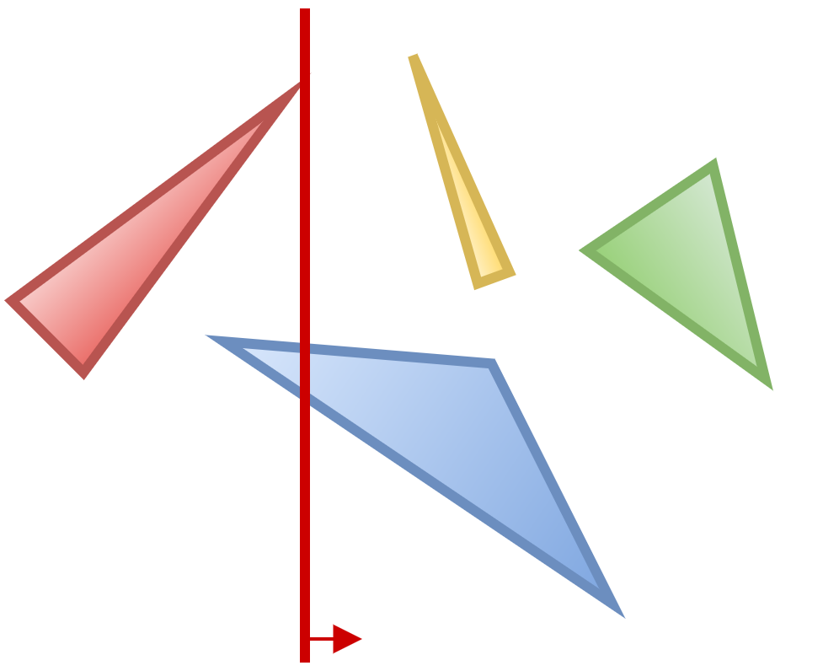
Sweep-line-based Perfect Split
Triangles left of sweep line: 2
Triangles right of sweep line: 3

Slide 31
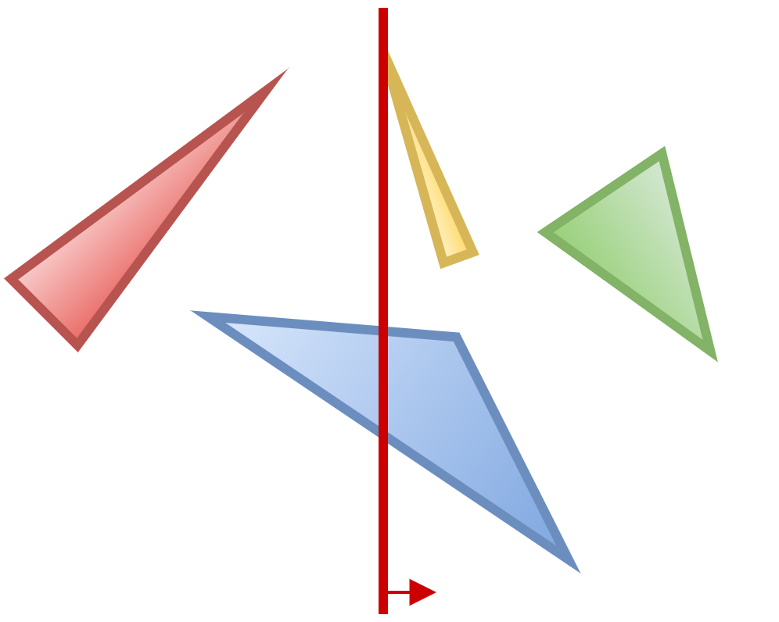
Sweep-line-based Perfect Split
Triangles left of sweep line: 3
Triangles right of sweep line: 3

Slide 32
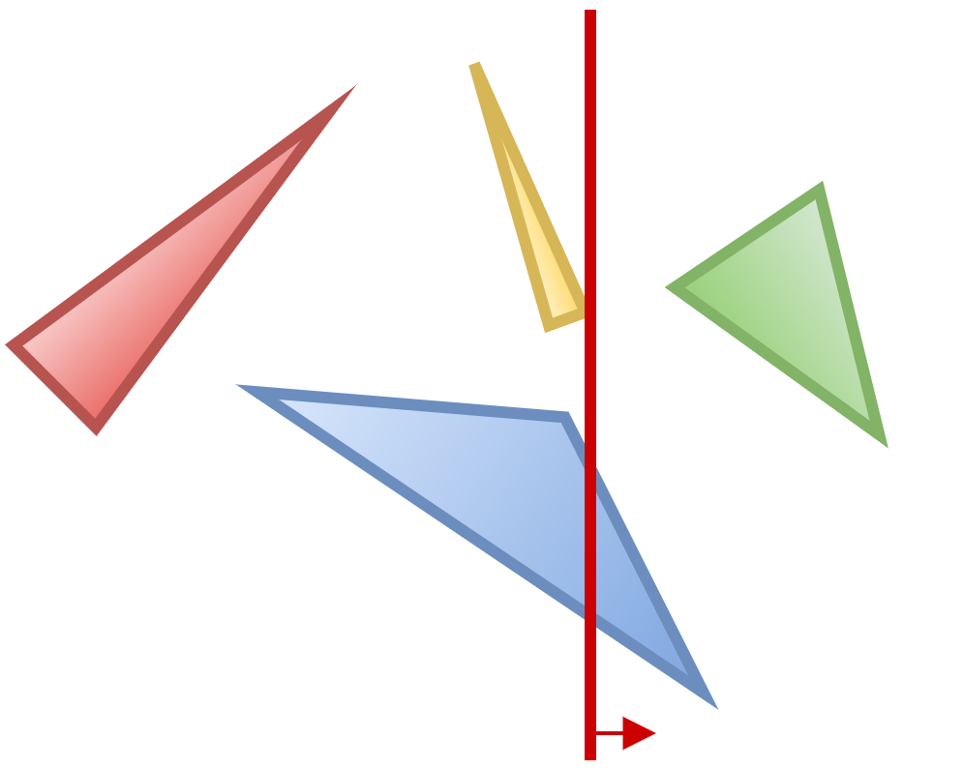
Sweep-line-based Perfect Split
Triangles left of sweep line: 3
Triangles right of sweep line: 2

Slide 33
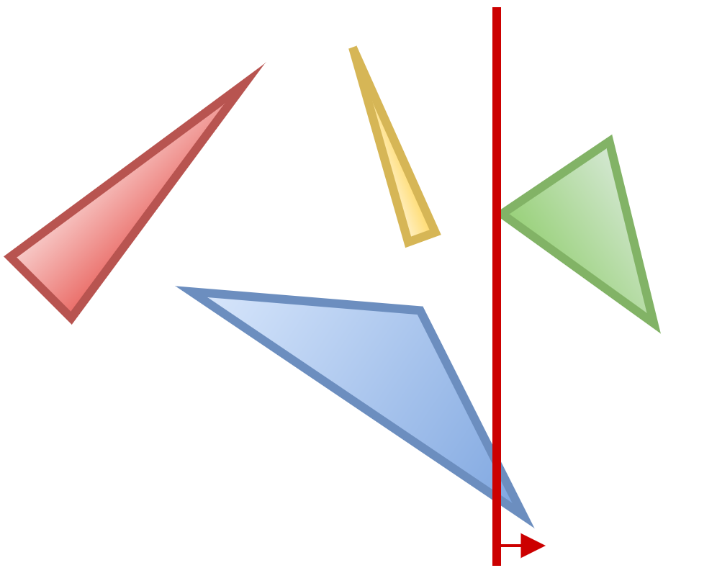
Sweep-line-based Perfect Split
Triangles left of sweep line: 4
Triangles right of sweep line: 2

Slide 34
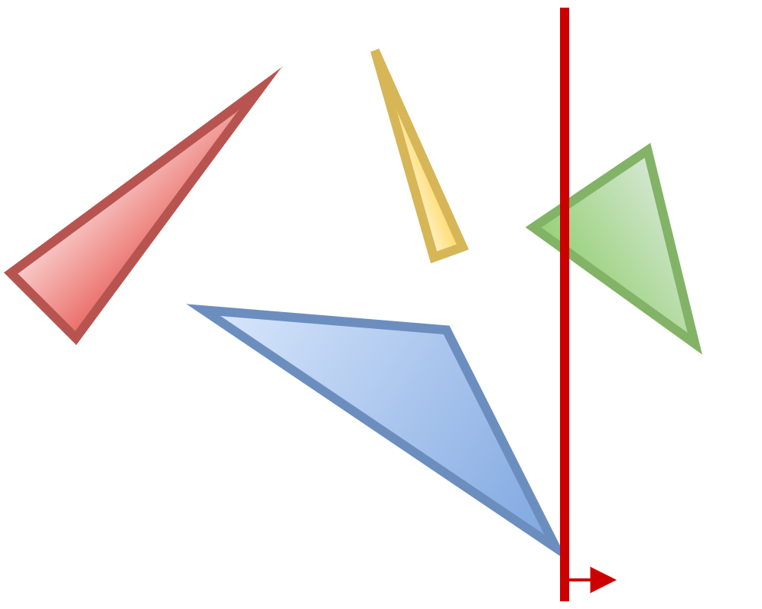
Sweep-line-based Perfect Split
Triangles left of sweep line: 4
Triangles right of sweep line: 1

Slide 35
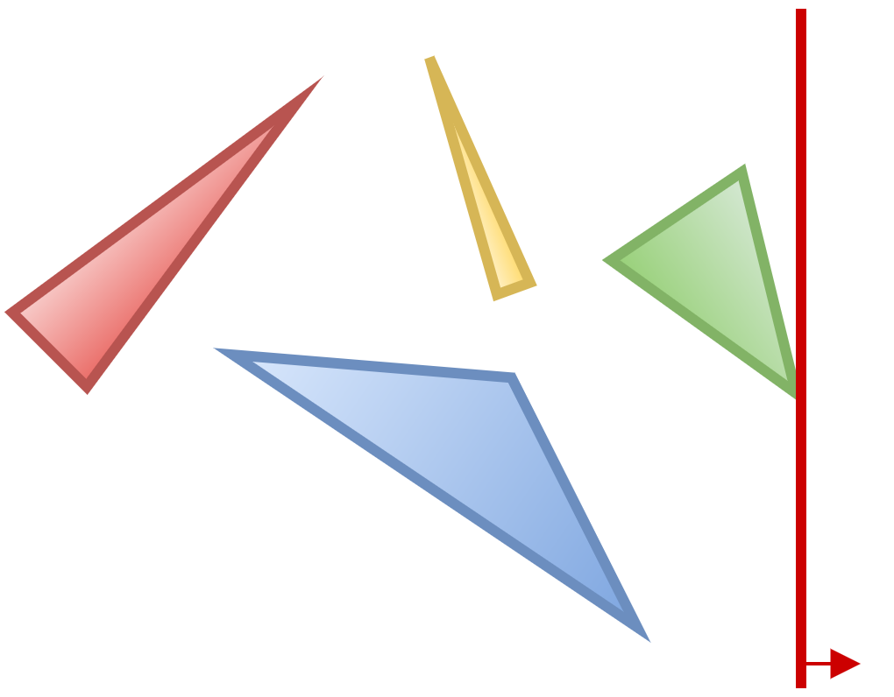
Sweep-line-based Perfect Split
Triangles left of sweep line: 4
Triangles right of sweep line: 0

Slide 36
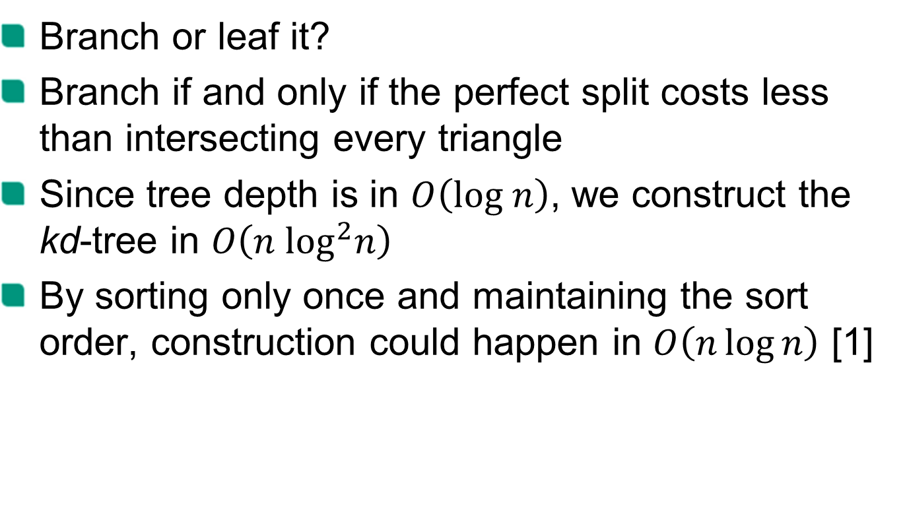
Construction
Branch or leaf it?
Branch if and only if the perfect split costs less than intersecting every triangle
Since tree depth is in $O\left(log n\right)$, we construct the kd-tree in $O\left(n \log^{2}n\right)$
By sorting only once and maintaining the sort order, construction could happen in $O\left(n\log{n}\right)$ [1]

Slide 37
Performance

Slide 38

Performance
Benchmark system:
Intel Xeon E3-1231v3 4x 3.40GHz
Windows
Java HotSpot 64-Bit Server VM (build 25.66-b18)
Max. JVM heap size: 4 GB
number of triangles | naïve (µs per random query) | kd-tree (ns per random query)
2,117 | 29.9 | 902.2
14,485 | 242.4 | 1025.0
305,662 | 18244.5 | 1961.5
1,283,858 | 48345.6 | 3489.4

Slide 39
Performance

Slide 40
Performance

Slide 41
References
[1] On building fast kd-Trees for Ray Tracing, and on doing that in O(N log N) (2006), Ingo Wald, Vlastimil Havran

