Slide 1
Pacman – Ghosts activate on sight
Mao L., Wang C., Sebastian G.

Slide 2
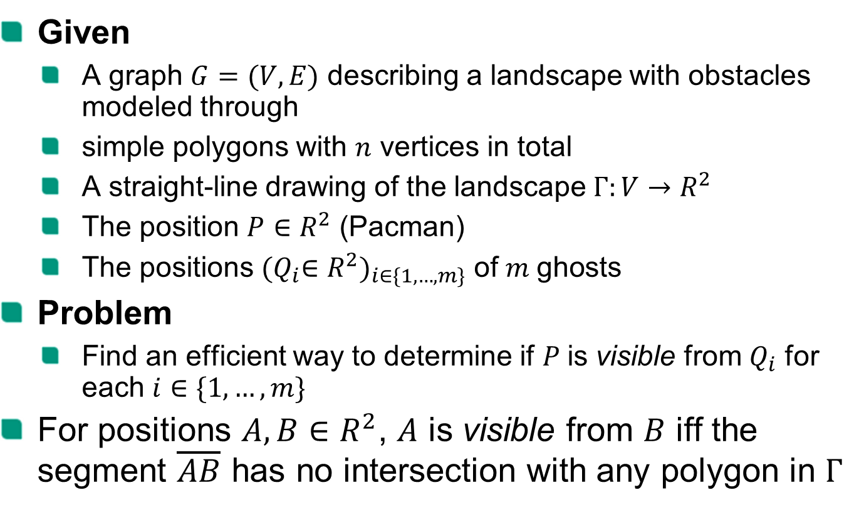
Problem specification
Given
A graph $G=(V, E)$ describing a landscape with obstacles modeled through
simple polygons with $n$ vertices in total
A straight-line drawing of the landscape $Γ:V→R^{2}$
The position $P∈R^{2}$ (Pacman)
The positions ${{(Q}_{i}∈R^{2})}_{i∈\{1,…,m\}}$ of$m$ghosts
Problem
Find an efficient way to determine if $P$is visible from $Q_{i}$ for each $i∈\{1,…,m\}$
For positions $A,B∈R^{2}$, $A$ is visible from $B$ iff the segment $\overline{AB}$ has no intersection with any polygon in $Γ$
Notes:
The outline is just an and has to be adjusted example (see https://sdqweb.ipd.kit.edu/wiki/Vortragshinweise) and copied to each slide manually. The current chapter should be in bold font. The distance of the words can be adjusted automatically by PowerPoint: select all words and arrows and then select “Anordnen -> Ausrichten -> Horizontal verteilen” (PowerPoint2007).

Slide 3
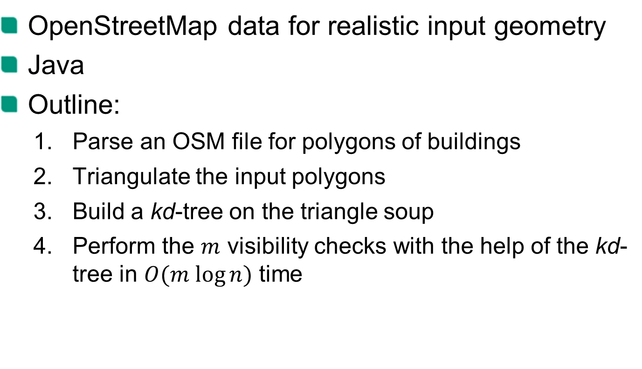
Our approach
OpenStreetMap data for realistic input geometry
Java
Outline:
Parse an OSM file for polygons of buildings
Triangulate the input polygons
Build a kd-tree on the triangle soup
Perform the $m$ visibility checks with the help of the kd-tree in $O(m log⁡n)$ time

Slide 4
DEMO

Slide 5
Ear Clipping
Triangulation of Simple Polygons

Slide 6
Intersection test
kd-tree

Slide 7
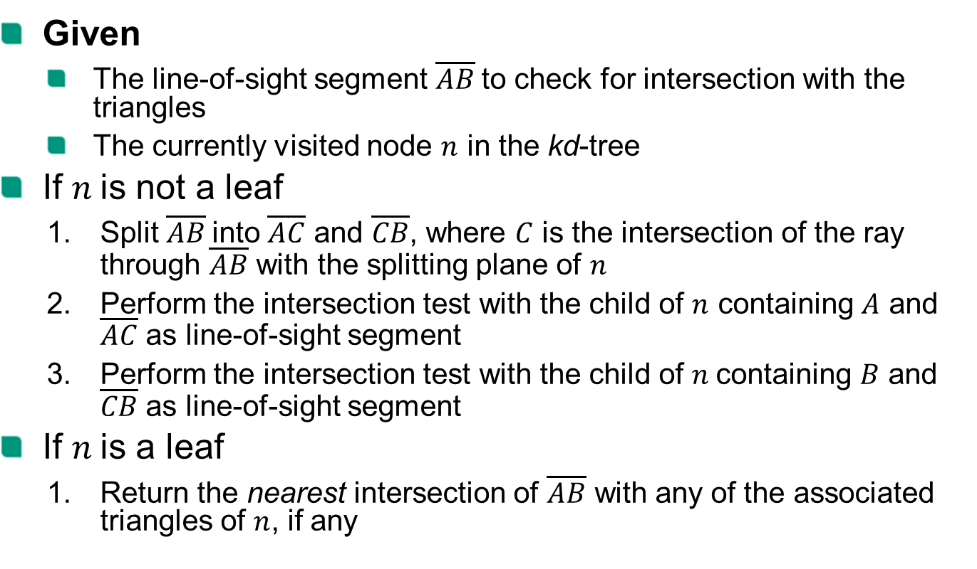
Intersection test
Given
The line-of-sight segment $\overline{AB}$to check for intersection with the triangles
The currently visited node $n$ in the kd-tree
If $n$is not a leaf
Split $\overline{AB}$into $\overline{AC}$ and $\overline{CB}$, where $C$ is the intersection of the ray through $\overline{AB}$ with the splitting plane of $n$
Perform the intersection test with the child of $n$ containing $A$ and $\overline{AC}$ as line-of-sight segment
Perform the intersection test with the child of $n$containing $B$ and $\overline{CB}$ as line-of-sight segment
If $n$is a leaf
Return the nearest intersection of $\overline{AB}$ with any of the associated triangles of $n$, if any

Slide 8
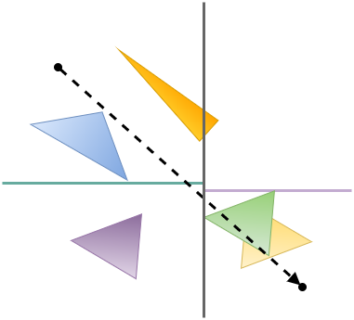
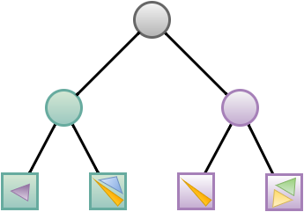
Intersection test - example

Slide 9

Intersection test - example
Split $\overline{AB}$into $\overline{AC}$ and $\overline{CB}$, where $C$ is the intersection of the ray through $\overline{AB}$ with the splitting plane of $n$
A
B

Slide 10
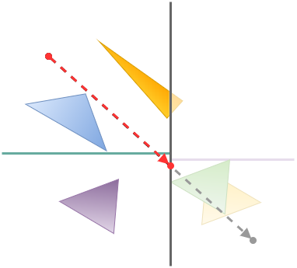
Intersection test - example
Split $\overline{AB}$into $\overline{AC}$ and $\overline{CB}$, where $C$ is the intersection of the ray through $\overline{AB}$ with the splitting plane of $n$
A
C
B

Slide 11

Intersection test - example
Perform the intersection test with the child of $n$ containing $A$ and $\overline{AC}$ as line-of-sight segment
A
C
B

Slide 12
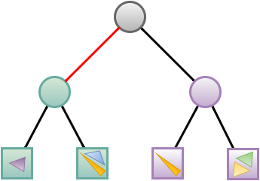
Intersection test - example
Perform the intersection test with the child of $n$ containing $A$ and $\overline{AC}$ as line-of-sight segment

Slide 13
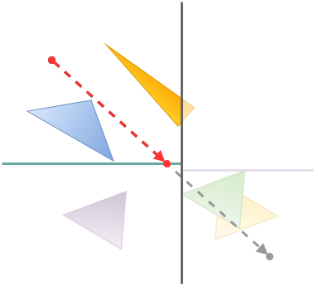
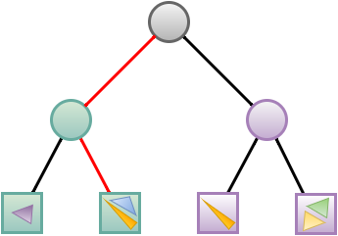
Intersection test - example
Perform the intersection test with the child of $n$ containing $A$ and $\overline{AC}$ as line-of-sight segment

Slide 14

Intersection test - example
Return the nearest intersection of $\overline{AB}$ with any of the associated triangles of $n$, if any

Slide 15

Intersection test - example
Perform the intersection test with the child of $n$ containing $B$ and $\overline{CB}$ as line-of-sight segment

Slide 16
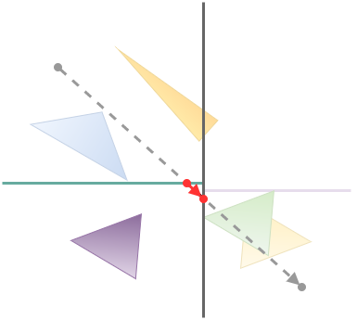
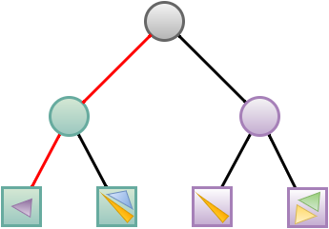
Intersection test - example
Perform the intersection test with the child of $n$ containing $B$ and $\overline{CB}$ as line-of-sight segment

Slide 17
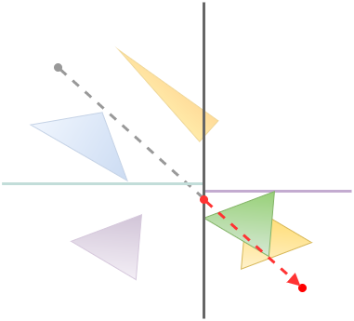
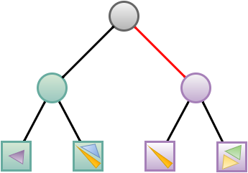
Intersection test - example

Slide 18
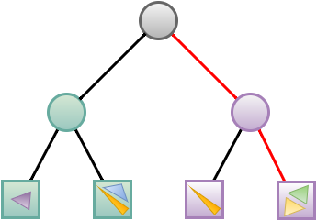
Intersection test - example

Slide 19
Intersection test - example
Return the nearest intersection of $\overline{AB}$ with any of the associated triangles of $n$, if any

Slide 20
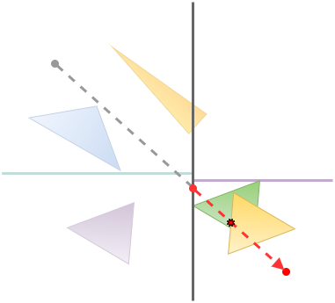
Intersection test - example
Return the nearest intersection of $\overline{AB}$ with any of the associated triangles of $n$, if any

Slide 21
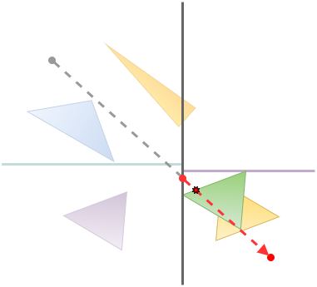
Intersection test - example
Return the nearest intersection of $\overline{AB}$ with any of the associated triangles of $n$, if any

Slide 22
construction
kd-tree

Slide 23
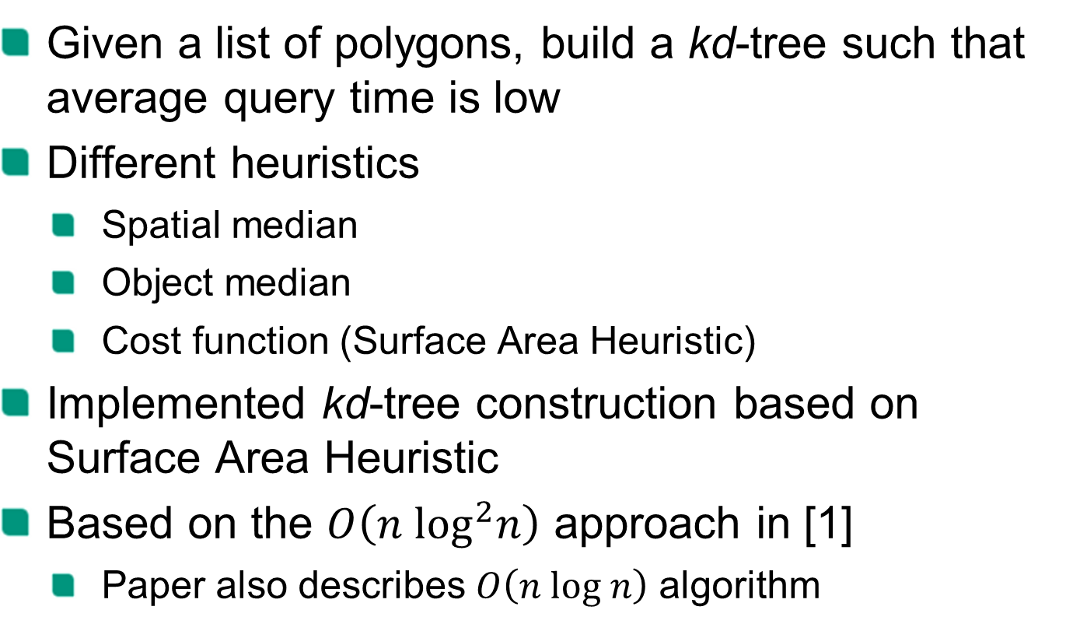
Construction
Given a list of polygons, build a kd-tree such that average query time is low
Different heuristics
Spatial median
Object median
Cost function (Surface Area Heuristic)
Implemented kd-tree construction based on Surface Area Heuristic
Based on the $O\left(n \log^{2}n\right)$ approach in [1]
Paper also describes $O\left(n log n\right)$ algorithm

Slide 24
Performance

Slide 25
References
[1] On building fast kd-Trees for Ray Tracing, and on doing that in O(N log N) (2006), Ingo Wald, Vlastimil Havran

