Slide 1
Pacman – Ghosts activate on sight
Mao L., Wang C., Sebastian G.

Slide 2
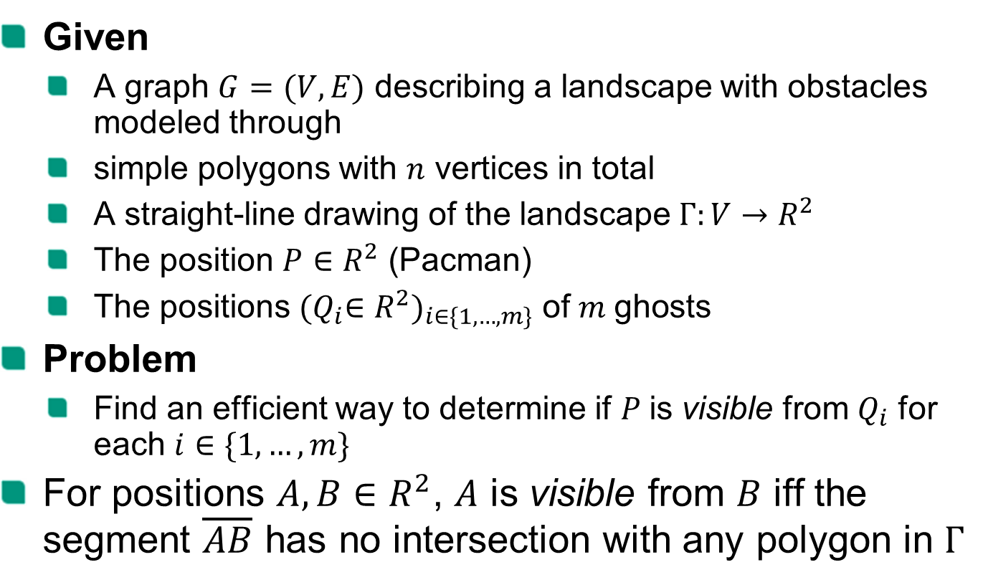
Problem specification
Given
A graph $G=(V, E)$ describing a landscape with obstacles modeled through
simple polygons with $n$ vertices in total
A straight-line drawing of the landscape $Γ:V→R^{2}$
The position $P∈R^{2}$ (Pacman)
The positions ${{(Q}_{i}∈R^{2})}_{i∈\{1,…,m\}}$ of$m$ghosts
Problem
Find an efficient way to determine if $P$is visible from $Q_{i}$ for each $i∈\{1,…,m\}$
For positions $A,B∈R^{2}$, $A$ is visible from $B$ iff the segment $\overline{AB}$ has no intersection with any polygon in $Γ$

Slide 3
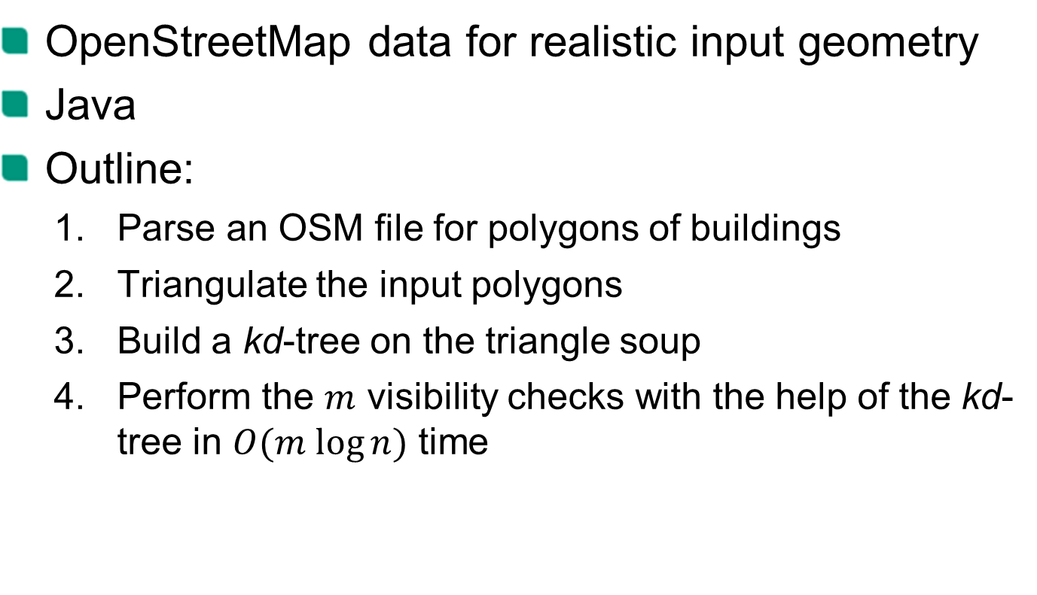
Our approach
OpenStreetMap data for realistic input geometry
Java
Outline:
Parse an OSM file for polygons of buildings
Triangulate the input polygons
Build a kd-tree on the triangle soup
Perform the $m$ visibility checks with the help of the kd-tree in $O(m log⁡n)$ time

Slide 4
DEMO

Slide 5
Ear Clipping
Polygon Triangulation

Slide 6
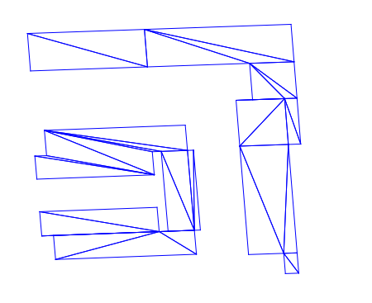
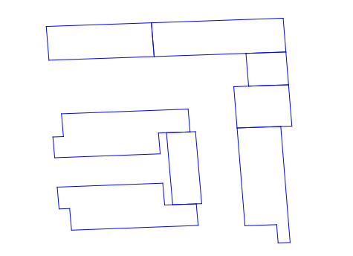
Task
Decompose polygons into a collection of triangle
untriangulated
triangulated

Slide 7
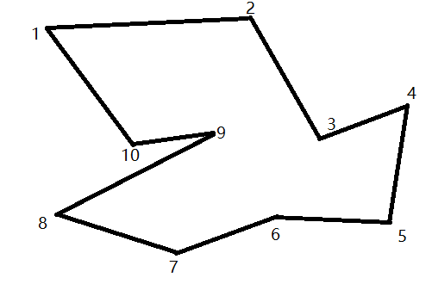
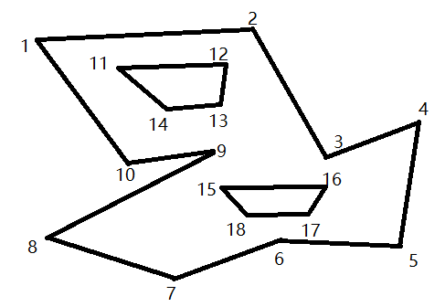
Types of polygons
Simple polygon
Polygon with holes

Slide 8
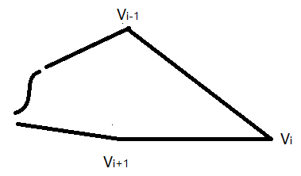
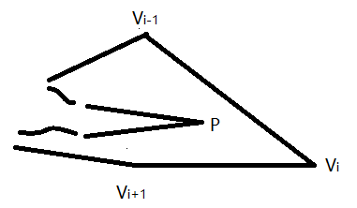
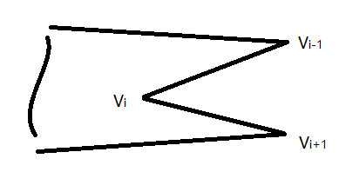



Ear Clipping for the simple polygon
Is Vi an Ear in Polygon?
Theorem :
Any triangulation of n vertices polygon has n−2 triangles
A polygon has at least two nonoverlapping ears

Slide 9
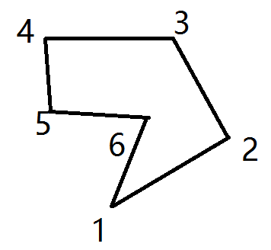
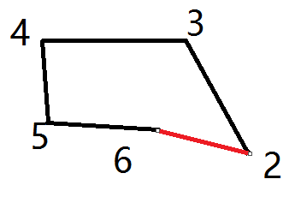
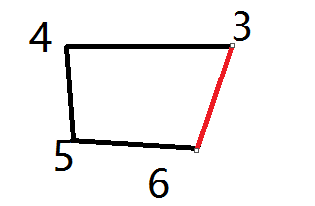
Ear Clipping Example
The initial list of ears is E = { 1, 3, 4, 5 }
The ear at vertex 1 is removed, add vertex 2, E = { 2, 3, 4，5 }
Removed vertex 2, E = { 3, 4, 5, 6 }

Slide 10
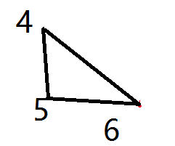
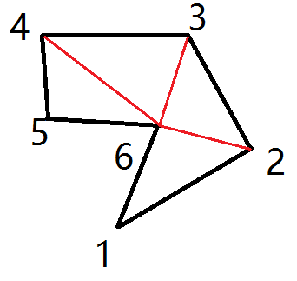
Ear Clipping Example
Removed vertex 3, the number of vertices less than four, then end
The full triangulation of the original polygon

Slide 11
Time Complexity
There are O(n) ears. Each update of an adjacent vertex involves an earnesstest, a process that is O(n) per update. Thus, the total removal process is O(n*n).

Slide 12
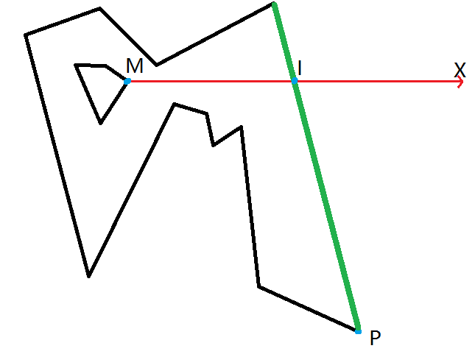
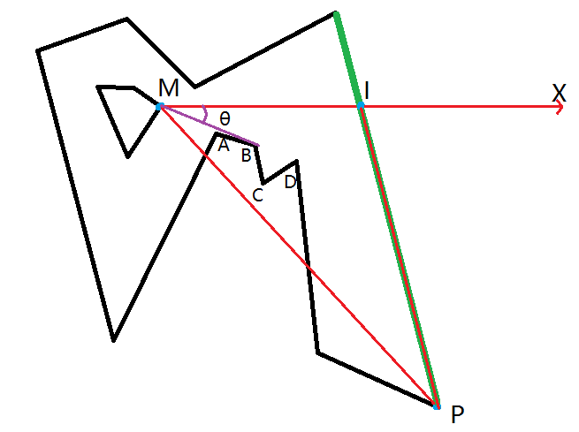
Polygon with holes
Idea
Connect two vertex, one vertex from the outer polygon and one vertex from the inner polygon
The Vertex M and B are what we want to connect

Slide 13
Polygons with Multiple Holes
Algorithm
Find the inner polygon with the vertex of maximum x-value
Use the previously mentioned algorithm to combine the outer polygon and the select inner polygon
Repeated with the new outer polygon and the remaining inner polygons

Slide 14
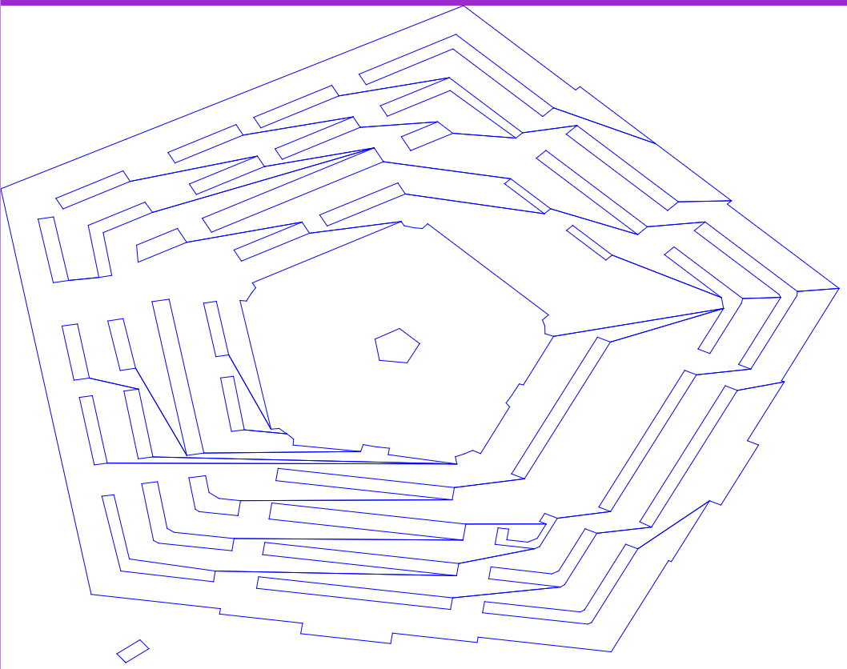
Time Complexity
There are O(m) inner polygons. Each connection building needs O(n). Thus, the total process is O(m*n).
Example polygon with holes to simple polygon

Slide 15
BVH
Bounding Volume Hierarchy

Slide 16
BVH Structure
A
B
B
C
C
A

Slide 17
BVH Introduction
Tree structure on a set of geometric objects

Slide 18
BVH Introduction
Tree structure on a set of geometric objects
Leaf nodes of the tree:
Geometric objects ( wrapped in bound volumes )

Slide 19
BVH Introduction
Tree structure on a set of geometric objects
Leaf nodes of the tree:
Geometric objects ( wrapped in bound volumes )
Child Nodes → Small sets
➔ Father node ( with larger bounding volumes )

Slide 20
BVH in the project
Leaves of the tree
Triangles ( triangulated form the polygons )

Slide 21
BVH in the project
Leafs of the tree
Triangles ( triangulated form the polygons )
yMax
yMin
xMin
xMax

Slide 22
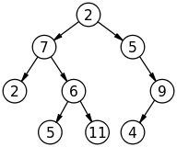
BVH in the project
Leafs of the tree
Structure of the tree
Triangles ( triangulated form the polygons )
Binary tree
yMax
yMin
xMin
xMax

Slide 23
BVH build up
Method :
Find the nearest bounding volumes
Combination ➔ new BVH node generated
……
When only one activated node exists
➔BVH completed

Slide 24
BVH search
Method :
When node A need to be searched:
Segment intersects A’s bounding volume?
Yes
A is a leaf node ➔ report A
A is not a leaf node ➔ search A’s children

Slide 25
BVH search example
A
A
B
C
B
C
D
E
F
G
Intersect ?
Leaf node?

Slide 26
BVH search example
A
A
B
C
B
C
D
E
F
G
Intersect ?
Leaf node?

Slide 27
BVH search example
A
A
B
C
B
C
D
E
F
G
Intersect ?
Leaf node?

Slide 28
BVH search example
A
A
B
C
B
C
D
E
F
G
Intersect ?
Leaf node?

Slide 29
BVH search example
A
A
B
C
B
C
D
E
F
G
Report
Intersect ?
Leaf node?

Slide 30
BVH search example
A
A
B
C
B
C
D
E
F
G
Intersect ?
Leaf node?

Slide 31
BVH search example
A
A
B
C
B
C
D
E
F
G
Report
Intersect ?
Leaf node?

Slide 32
BVH search example
A
A
B
C
B
C
D
E
F
G
Intersect ?
Leaf node?

Slide 33
BVH search example
A
A
B
C
B
C
D
E
F
G
Result : E , F reported

Slide 34
BVH Summary
Advantages:
Simple structure
Allows overlapped triangles
Fast binary search

Slide 35
BVH Summary
Disadvantages：
Needs one more step to check if the triangles themselves intersects the segment
reason : segment intersects the bounding volumes but not intersects the triangles < one intersected triangle is enough>
Long preparing time
<reason : find the nearest bounding volumes costs to much time O(n²)>

Slide 36
Optimization assumptions
For every polygon from the map build up a BVH-Tree.
Use triangles(triangulated from the polygon) as leaf nodes of the BVH-Tree for the polygon.
Search the polygons’ BVH first, then search each reported polygons’ own BVH-Tree.

Slide 37
Intersection test
kd-tree

Slide 38
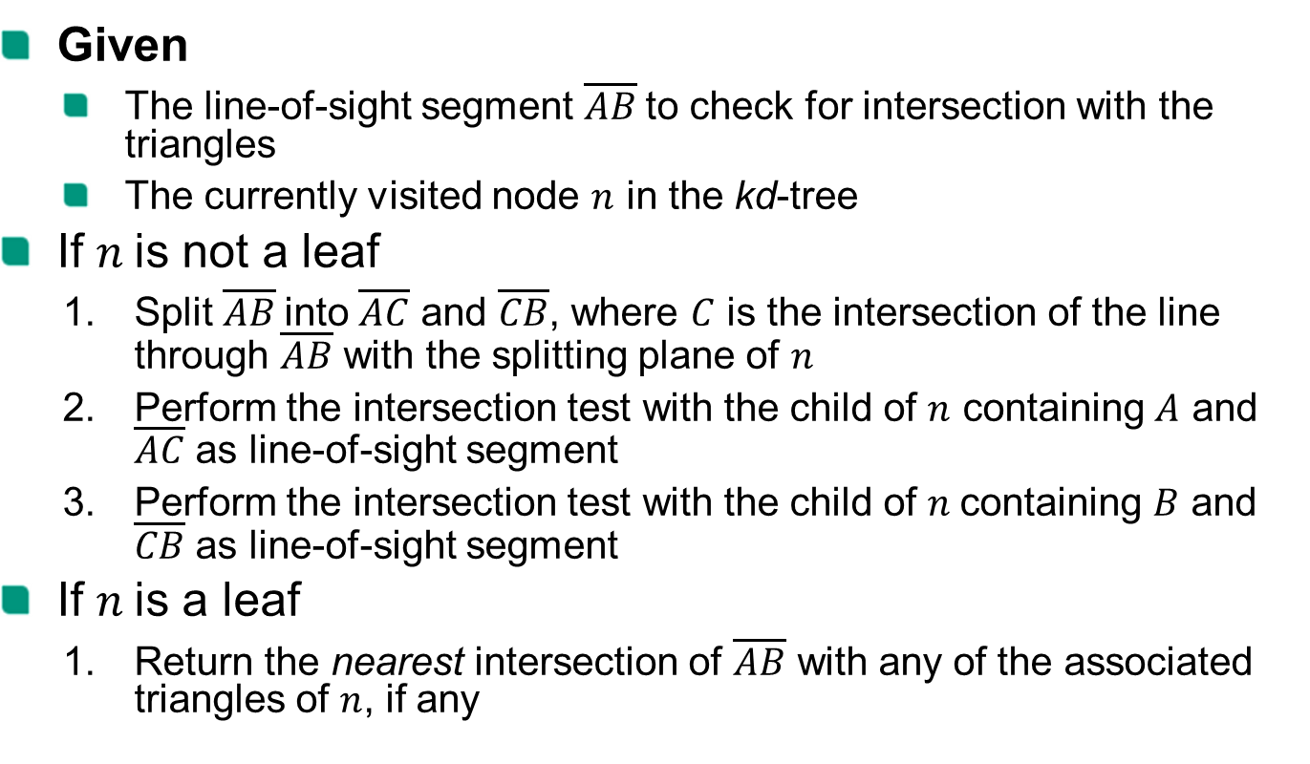
Intersection test
Given
The line-of-sight segment $\overline{AB}$to check for intersection with the triangles
The currently visited node $n$ in the kd-tree
If $n$is not a leaf
Split $\overline{AB}$into $\overline{AC}$ and $\overline{CB}$, where $C$ is the intersection of the line through $\overline{AB}$ with the splitting plane of $n$
Perform the intersection test with the child of $n$ containing $A$ and $\overline{AC}$ as line-of-sight segment
Perform the intersection test with the child of $n$containing $B$ and $\overline{CB}$ as line-of-sight segment
If $n$is a leaf
Return the nearest intersection of $\overline{AB}$ with any of the associated triangles of $n$, if any

Slide 39
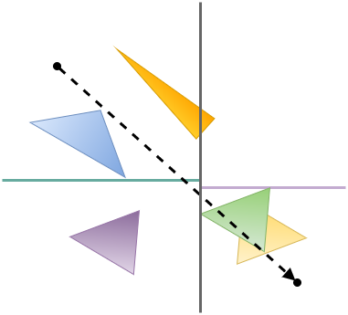
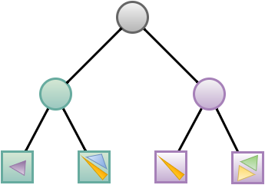
Intersection test - example

Slide 40

Intersection test - example
Split $\overline{AB}$into $\overline{AC}$ and $\overline{CB}$, where $C$ is the intersection of the line through $\overline{AB}$ with the splitting plane of $n$
A
B

Slide 41
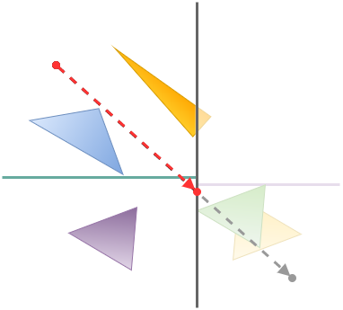
Intersection test - example
Split $\overline{AB}$into $\overline{AC}$ and $\overline{CB}$, where $C$ is the intersection of the line through $\overline{AB}$ with the splitting plane of $n$
A
C
B

Slide 42

Intersection test - example
Perform the intersection test with the child of $n$ containing $A$ and $\overline{AC}$ as line-of-sight segment
A
C
B

Slide 43
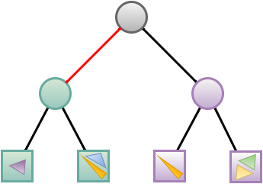
Intersection test - example
Perform the intersection test with the child of $n$ containing $A$ and $\overline{AC}$ as line-of-sight segment

Slide 44
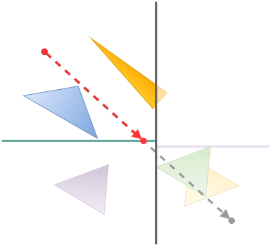
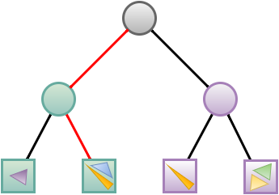
Intersection test - example
Perform the intersection test with the child of $n$ containing $A$ and $\overline{AC}$ as line-of-sight segment

Slide 45

Intersection test - example
Return the nearest intersection of $\overline{AB}$ with any of the associated triangles of $n$, if any

Slide 46

Intersection test - example
Perform the intersection test with the child of $n$ containing $B$ and $\overline{CB}$ as line-of-sight segment

Slide 47
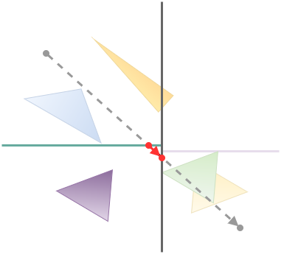
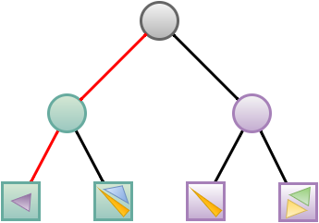
Intersection test - example
Perform the intersection test with the child of $n$ containing $B$ and $\overline{CB}$ as line-of-sight segment

Slide 48
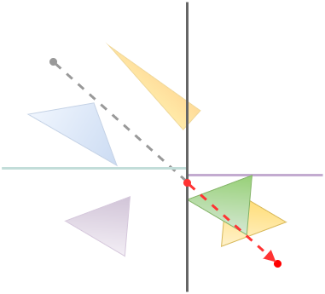
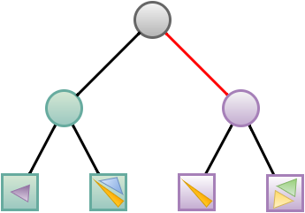
Intersection test - example

Slide 49
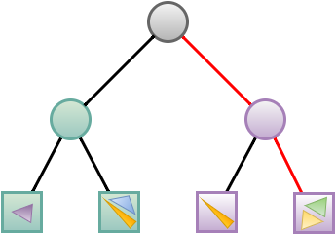
Intersection test - example

Slide 50
Intersection test - example
Return the nearest intersection of $\overline{AB}$ with any of the associated triangles of $n$, if any

Slide 51
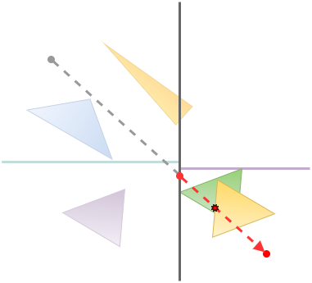
Intersection test - example
Return the nearest intersection of $\overline{AB}$ with any of the associated triangles of $n$, if any

Slide 52
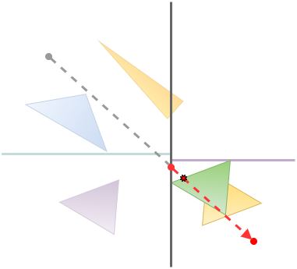
Intersection test - example
Return the nearest intersection of $\overline{AB}$ with any of the associated triangles of $n$, if any

Slide 53
construction
kd-tree

Slide 54
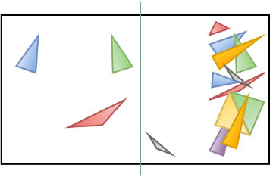
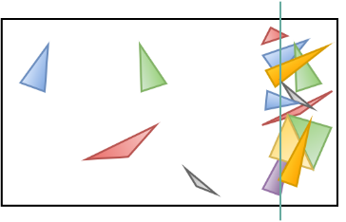

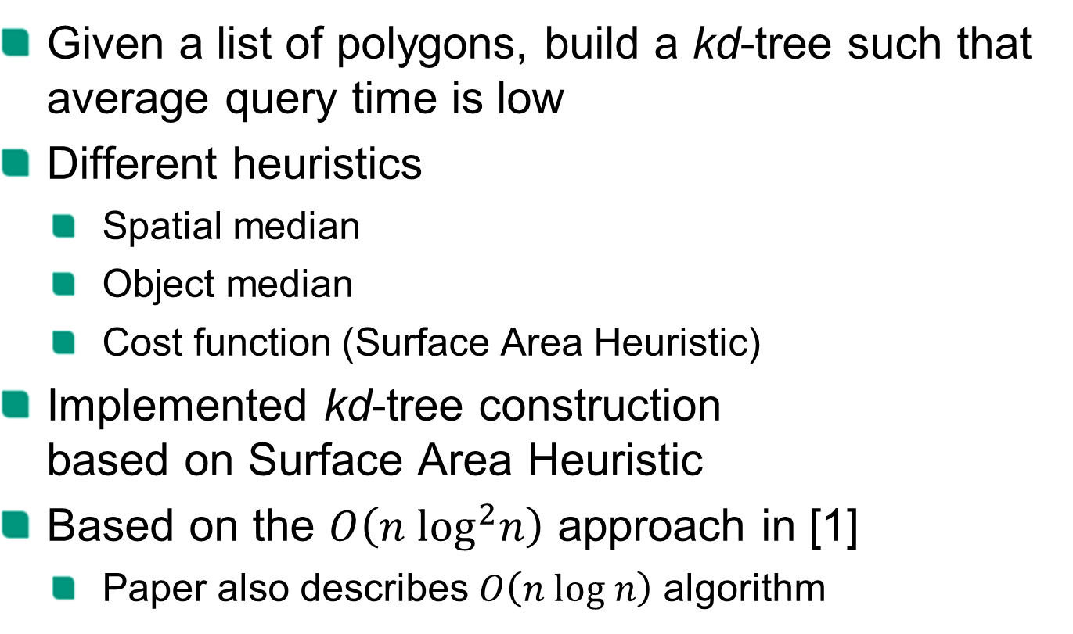
Construction
Given a list of polygons, build a kd-tree such that average query time is low
Different heuristics
Spatial median
Object median
Cost function (Surface Area Heuristic)
Implemented kd-tree construction based on Surface Area Heuristic
Based on the $O\left(n \log^{2}n\right)$ approach in [1]
Paper also describes $O\left(n log n\right)$ algorithm

Slide 55
Surface Area Heuristic
Assigns costs to splits
Lowest scoring splits (perfect splits) are optimal under the following assumptions:
Assuming uniformly distributed rays penetrating the bounding box
kd-tree traversal costs and triangle intersection costs are known

Slide 56
Surface Area Heuristic
The cost function depends on
The surface area of the current node‘s bounding box
The surface areas of the split bounding boxes
The number of triangles intersecting the right or left split bounding box

Slide 57
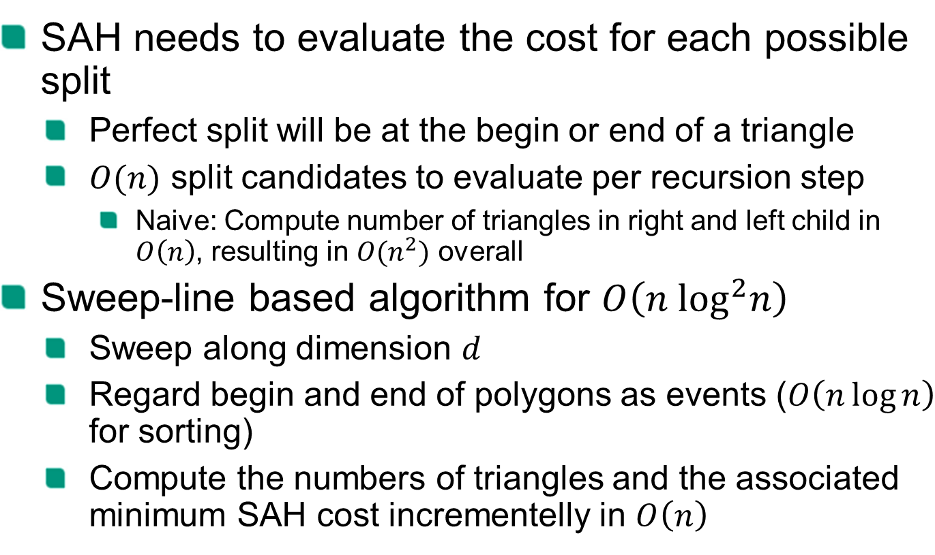
Construction
SAH needs to evaluate the cost for each possible split
Perfect split will be at the begin or end of a triangle
$O(n)$ split candidates to evaluate per recursion step
Naive: Compute number of triangles in right and left child in $O\left(n\right)$, resulting in $O(n^{2})$ overall
Sweep-line based algorithm for $O\left(n \log^{2}n\right)$
Sweep along dimension $d$
Regard begin and end of polygons as events ($O\left(n\log{n}\right)$ for sorting)
Compute the numbers of triangles and the associated minimum SAH cost incrementelly in $O\left(n\right)$

Slide 58
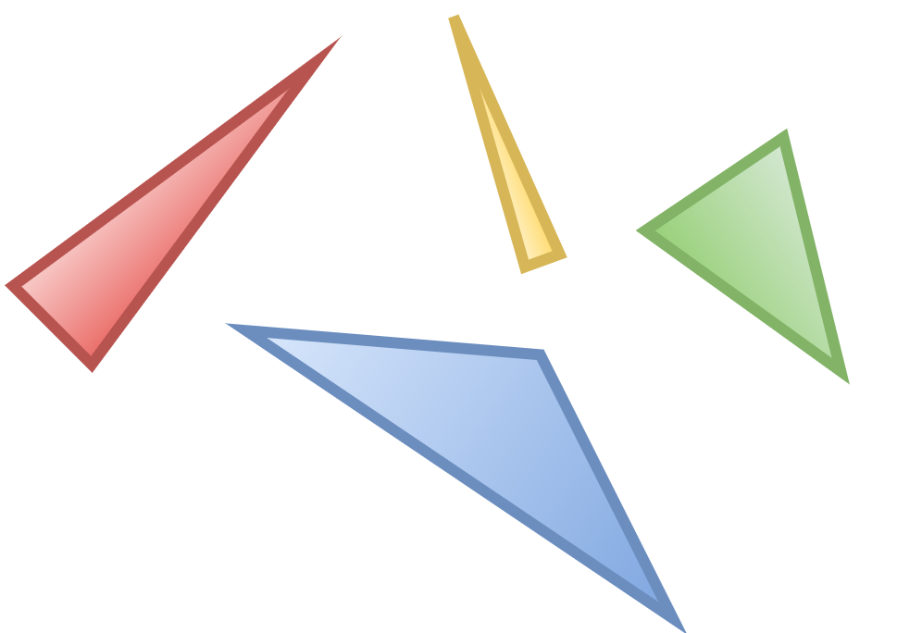
Sweep-line-based Perfect Split
Triangles left of sweep line: 0
Triangles right of sweep line: 4

Slide 59
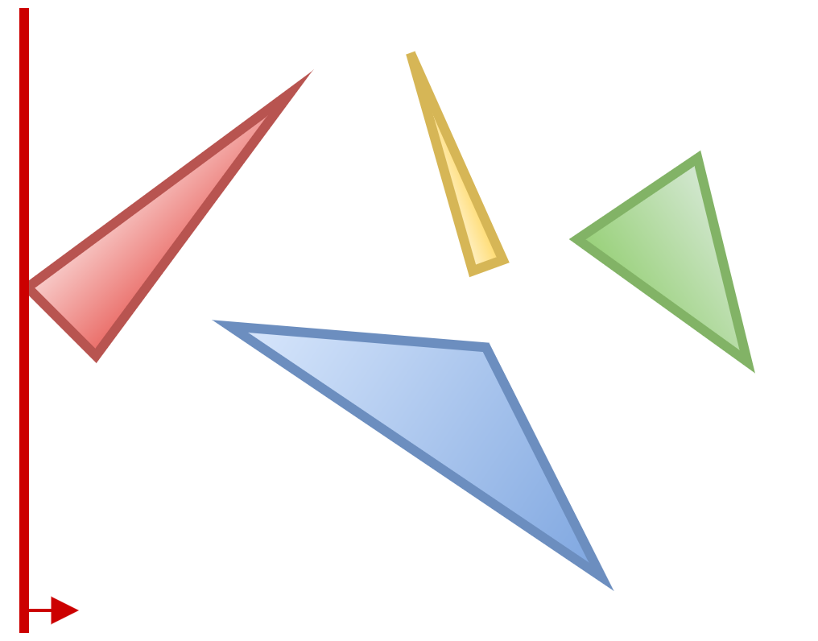
Sweep-line-based Perfect Split
Triangles left of sweep line: 1
Triangles right of sweep line: 4

Slide 60
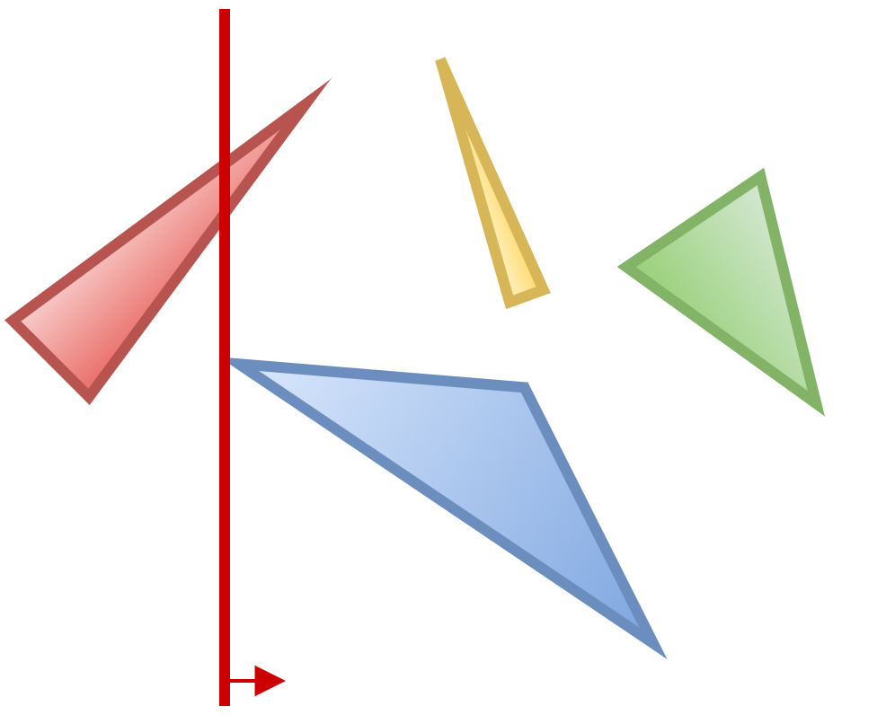
Sweep-line-based Perfect Split
Triangles left of sweep line: 2
Triangles right of sweep line: 4

Slide 61
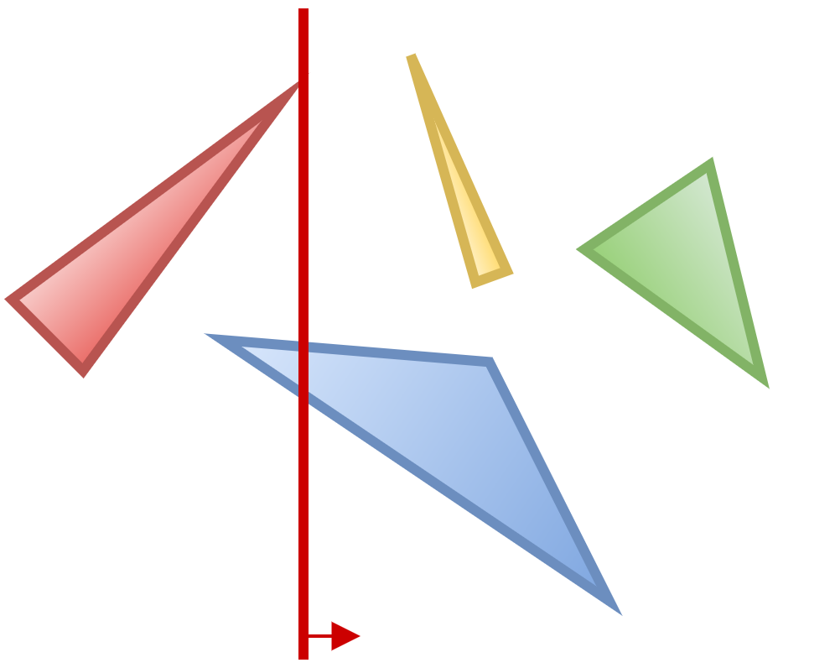
Sweep-line-based Perfect Split
Triangles left of sweep line: 2
Triangles right of sweep line: 3

Slide 62
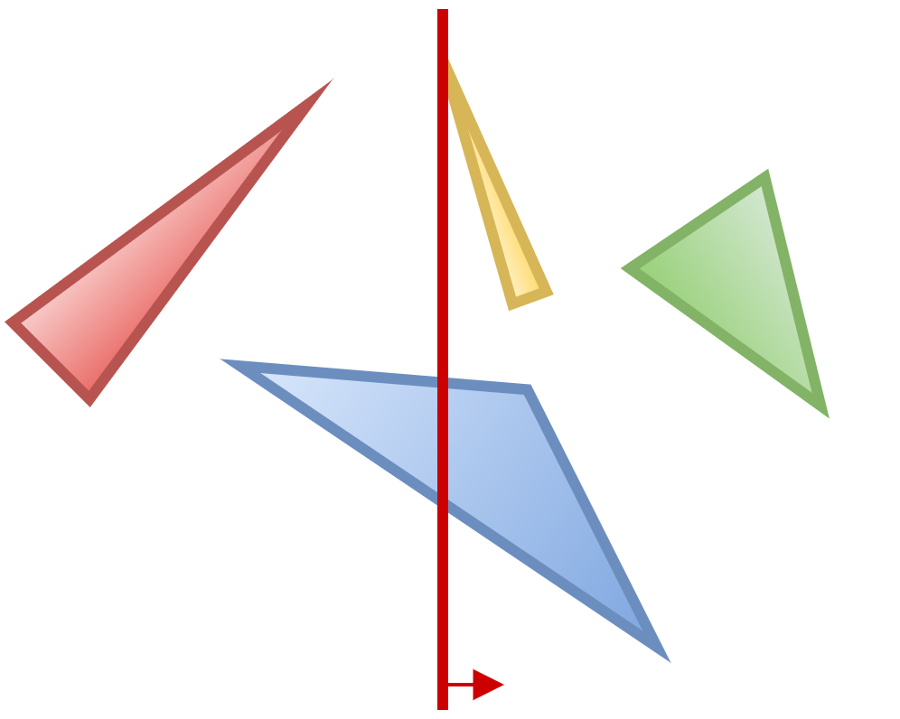
Sweep-line-based Perfect Split
Triangles left of sweep line: 3
Triangles right of sweep line: 3

Slide 63
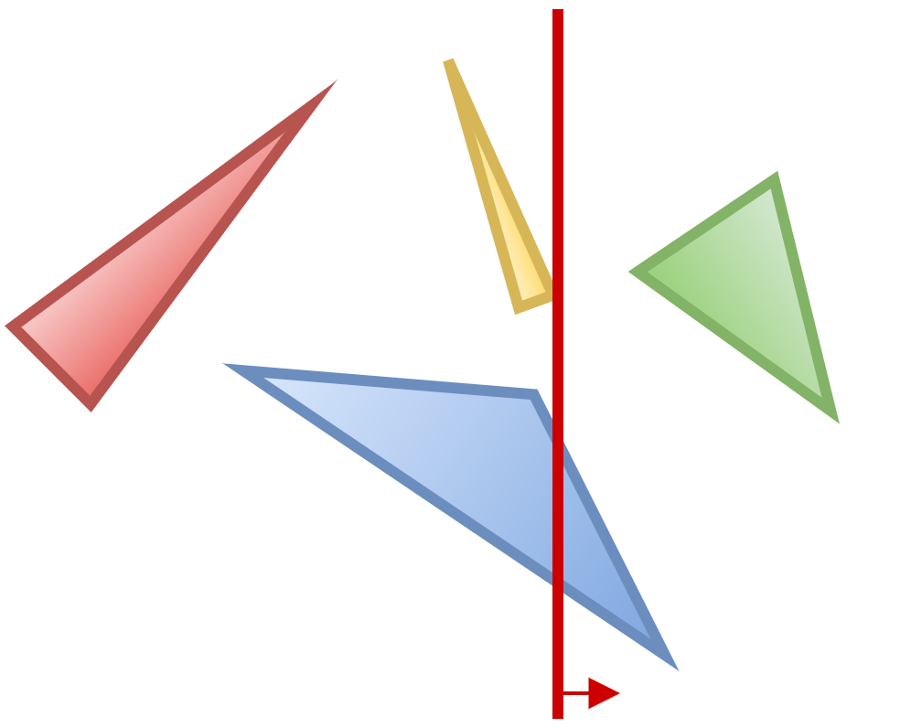
Sweep-line-based Perfect Split
Triangles left of sweep line: 3
Triangles right of sweep line: 2

Slide 64
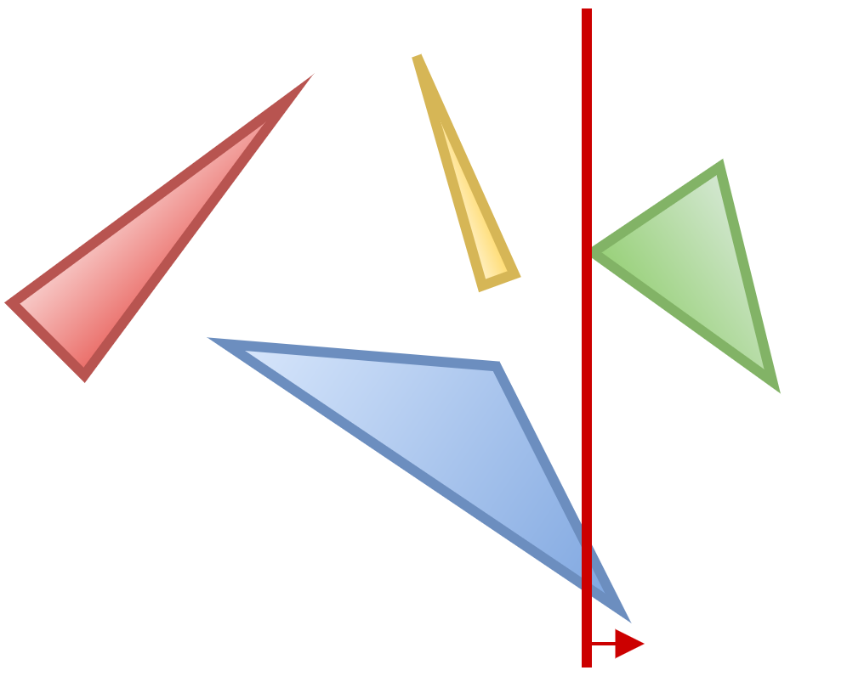
Sweep-line-based Perfect Split
Triangles left of sweep line: 4
Triangles right of sweep line: 2

Slide 65
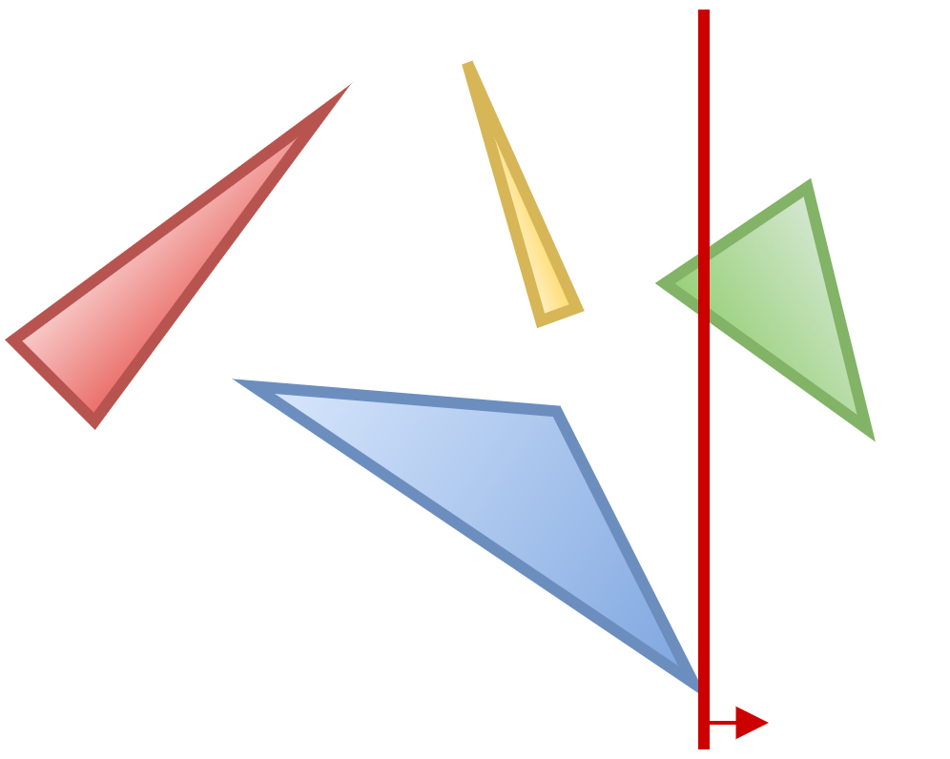
Sweep-line-based Perfect Split
Triangles left of sweep line: 4
Triangles right of sweep line: 1

Slide 66
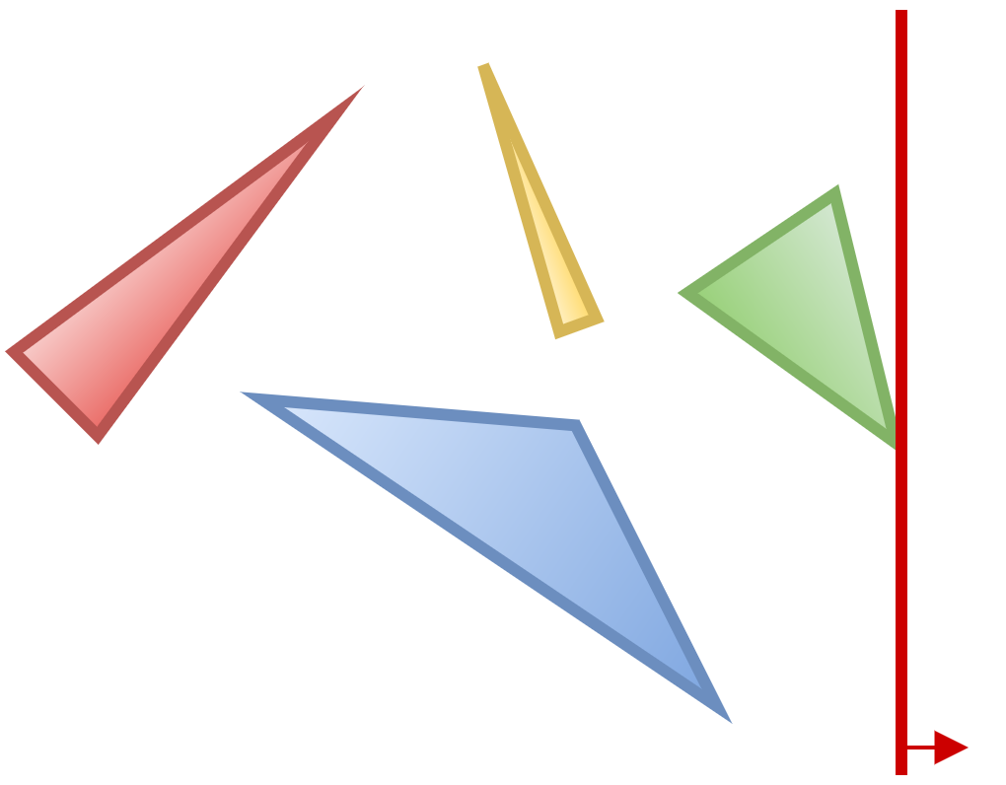
Sweep-line-based Perfect Split
Triangles left of sweep line: 4
Triangles right of sweep line: 0

Slide 67
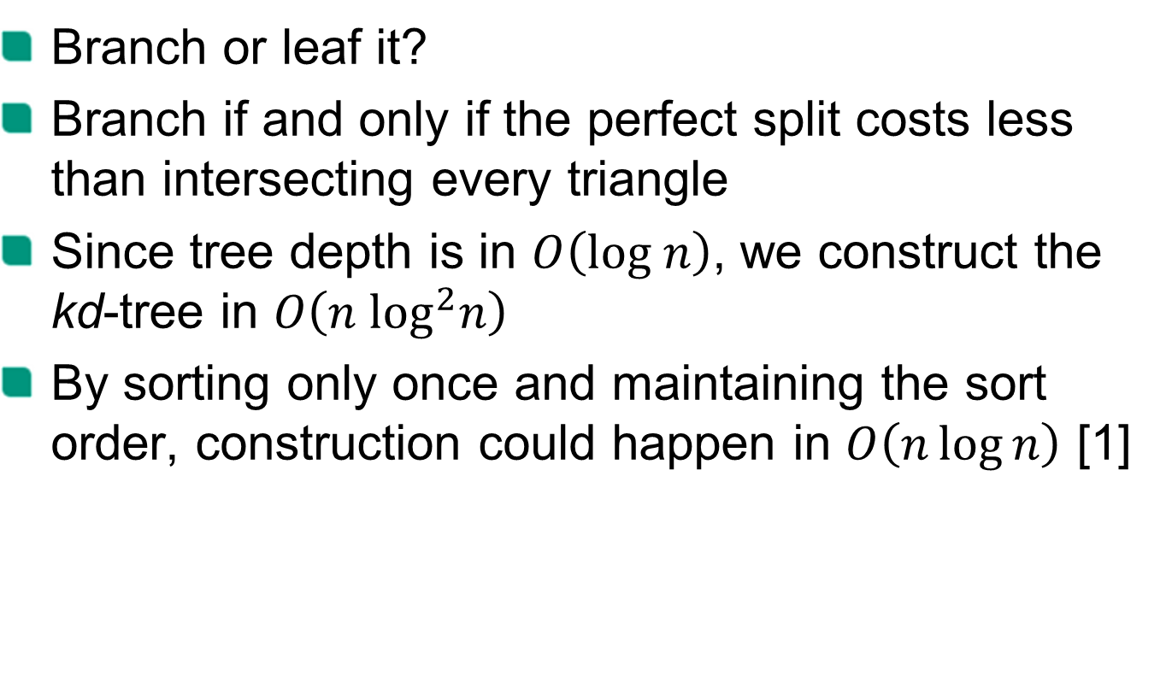
Construction
Branch or leaf it?
Branch if and only if the perfect split costs less than intersecting every triangle
Since tree depth is in $O\left(log n\right)$, we construct the kd-tree in $O\left(n \log^{2}n\right)$
By sorting only once and maintaining the sort order, construction could happen in $O\left(n\log{n}\right)$ [1]

Slide 68
Performance

Slide 69
Performance
Benchmark system:
Intel Xeon E3-1231v3 4x 3.40GHz
Windows
Java HotSpot 64-Bit Server VM (build 25.66-b18)
Max. JVM heap size: 4 GB
number of triangles | naïve (µs per random query) | kd-tree (ns per random query)
2,117 | 29.9 | 902.2
14,485 | 242.4 | 1025.0
305,662 | 18244.5 | 1961.5
1,283,858 | 48345.6 | 3489.4

Slide 70
Performance

Slide 71
Performance

Slide 72
References
[1] On building fast kd-Trees for Ray Tracing, and on doing that in O(N log N) (2006), Ingo Wald, Vlastimil Havran

