Slide 1
70-533 : Implementing Microsoft Azure Infrastructure Solutions

Slide 2
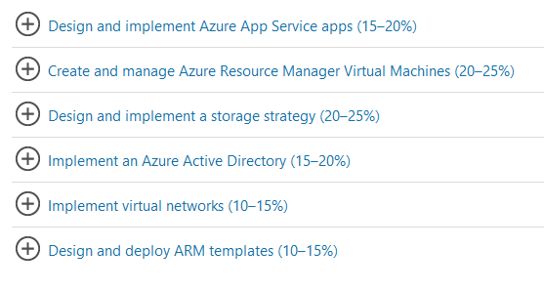
70-533 : Implementing Microsoft Azure Infrastructure Solutions

Slide 3
Implement Images and Disks (VM storage)

Slide 4
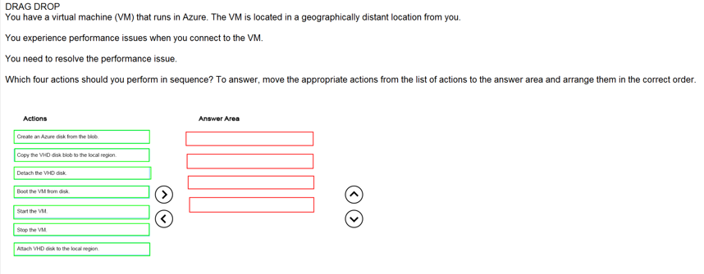
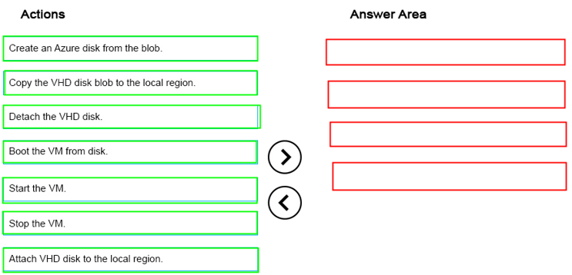
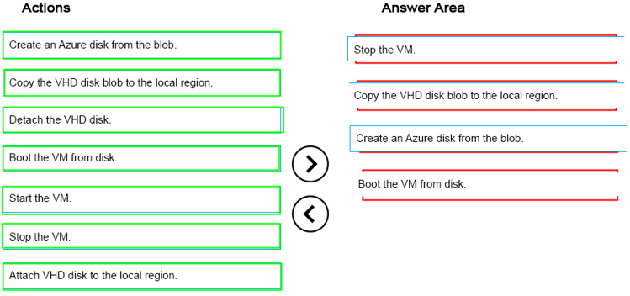
Ans =
Latency Low in local region

Slide 5
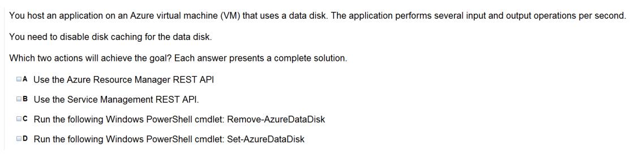
Ans = A & D
1) Disks used by VMs- OS / Temp / Data Disk
2) For All OS disks, in memory caching is done by default unless it is turn off by user manually
3) Set- AzureDataDisk command is to update cache attribute of your existing data disk ( non/ read only / read & Write)

Slide 6
Operating system disk- Every virtual machine has one attached operating system disk. It’s registered as a SATA drive and is labeled /dev/sda by default. This disk has a maximum capacity of 1023 gigabytes (GB).
Temporary disk- Each VM contains a temporary disk. The temporary disk provides short-term storage for applications and processes and is intended to only store data such as page or swap files. Data on the temporary disk may be lost during a maintenance event or when you redeploy a VM. During a standard reboot of the VM, the data on the temporary drive should persist.
Data Disk - A data disk is a VHD that’s attached to a virtual machine to store application data, or other data you need to keep. Data disks are registered as SCSI drives, A data disk is a VHD that’s attached to a virtual machine to store application data, or other data you need to keep. Data disks are registered as SCSI drives and are labeled with a letter that you choose. Each data disk has a maximum capacity of 1023 GB. The size of the virtual machine determines how many data disks you can attach to it and the type of storage you can use to host the disks.

Slide 7
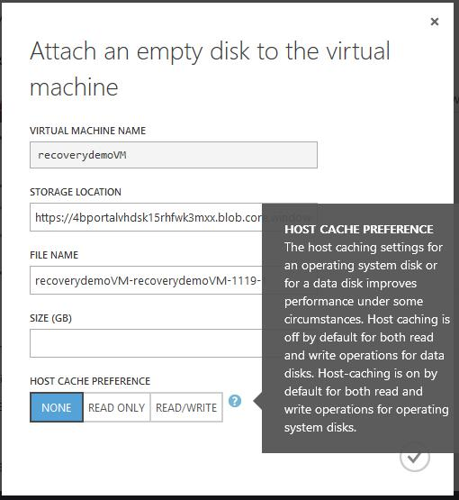

Slide 8
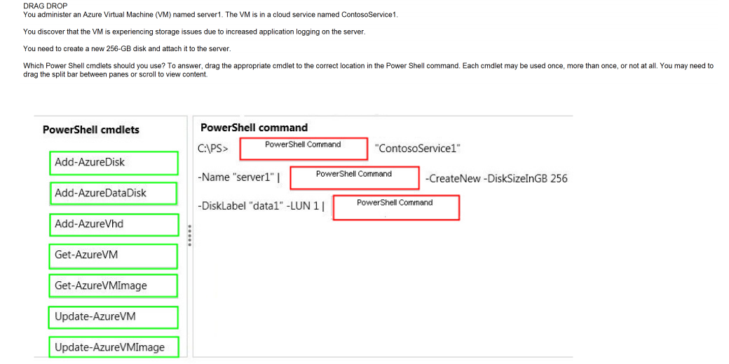
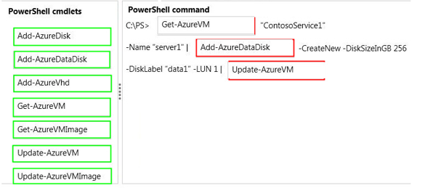
Ans =
The set-Azuredisk is for caching setting

Slide 9
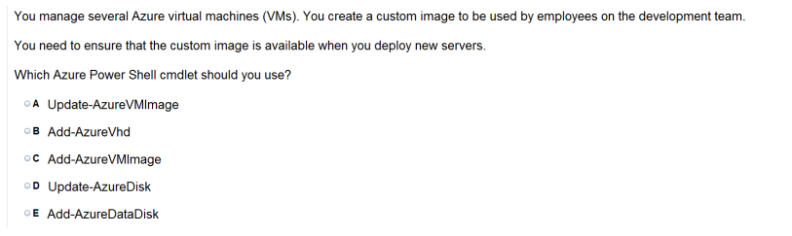
Ans = C
Add-AzureVMImage
Adds an operating system image to the image repository.
Syntax
Parameter Set: Default Add-AzureVMImage [-ImageName] <String> [-MediaLocation] <String> [-OS] <String> [[-Label] <String> ] [[-Eula] <String> ] [[-Description] <String> ] [[-ImageFamily] <String> ] [[-PublishedDate] <DateTime> ] [[-PrivacyUri] <Uri> ] [[-RecommendedVMSize] <String> ] [ <CommonParameters>]

Slide 10
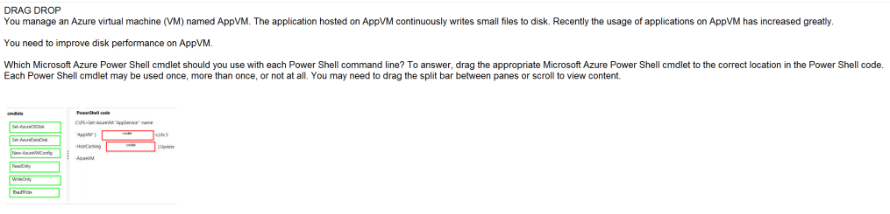
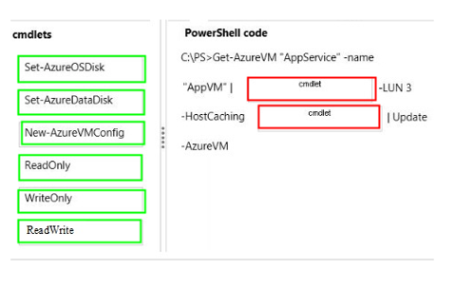
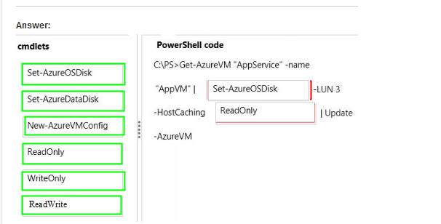
Ans =
The job here is to increase the performance of OS disk to read the data written over data disk ( as you are writing small files )

Slide 11
Perform Configuration Management

Slide 12
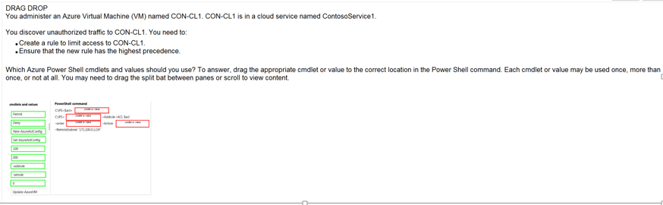
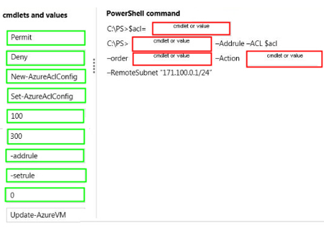
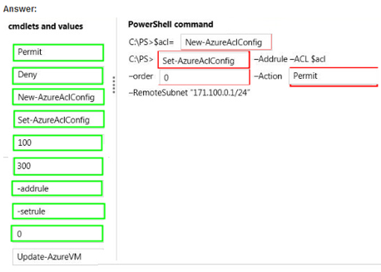
Ans =
Access control List -The second command updates the ACL object with a rule that permits incoming network traffic only from remote subnet 10.0.0.0/8. When we specify on an enpoint a portfor that ACL get modified to accommodate the data…

Slide 13
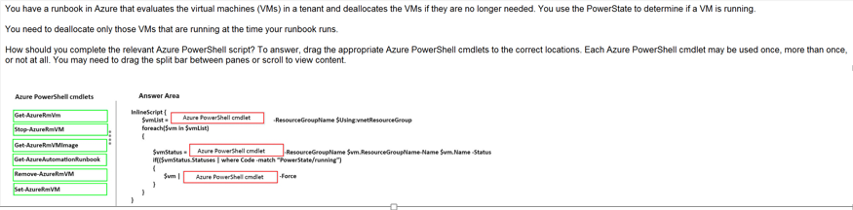
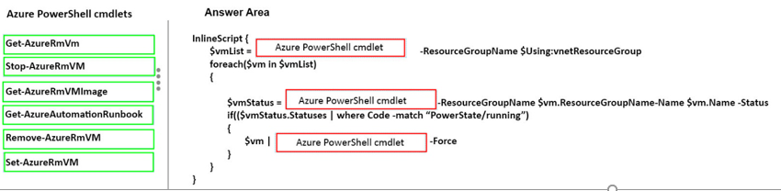
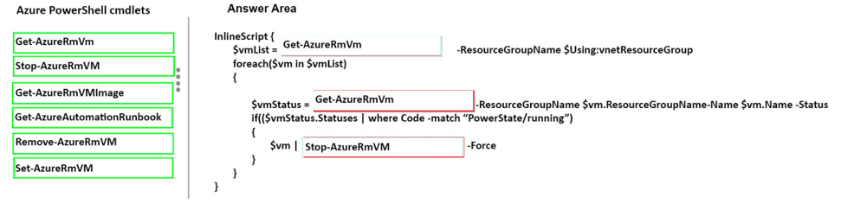
Ans =
Runbook is a set of task for performingsome automated process

Slide 14
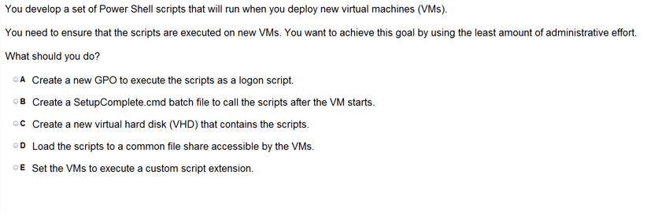
Ans = E
custom script extension is use for post deployment configuration of VM without any administration – the script is downloaded from Github and storsage ..
After you deploy a Virtual Machine you typically need to make some changes before it’s ready to use. This is something you can do manually or you could use Remote PowerShell to automate the configuration of yourVM after deployment for example. But now there’s a third alternative available allowing you customize your VM: the CustomScript extension. This CustomScript extension is executed by the VM Agent and it’s very straightforward: you specify which files it needs to download from your storage account and which file it needs to execute. You can even specify arguments that need to be passed to the script. The only requirement is that you execute a .ps1 file.

Slide 15
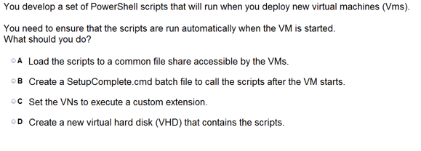
Ans =B
setup command.cmd bath file ? If you want to create aphache server then custom script extension will work but if you want every day you want start a service of apache server etc… you need setupcoimplete.cmd

Slide 16
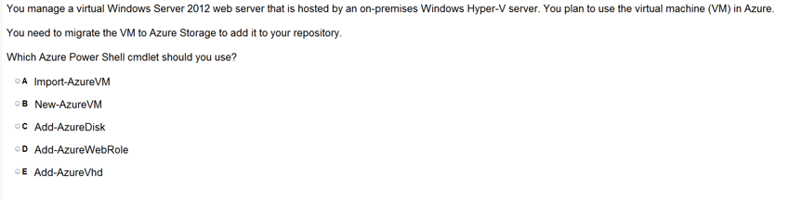
Ans =E
Add-AzureVhd
[This topic is pre-release documentation and is subject to change in future releases. Blank topics are included as placeholders.]
Add-AzureVhd
Uploads a virtual hard disk (in .vhd file format) from an on-premises virtual machine to a blob in a cloud storage account in Azure.
Syntax
Parameter Set: Vhd Add-AzureVhd [-Destination] <Uri> [-LocalFilePath] <FileInfo> [[-NumberOfUploaderThreads] <Int32> ] [[-BaseImageUriToPatch] <Uri> ] [[-OverWrite]] [ <CommonParameters>]

Slide 17
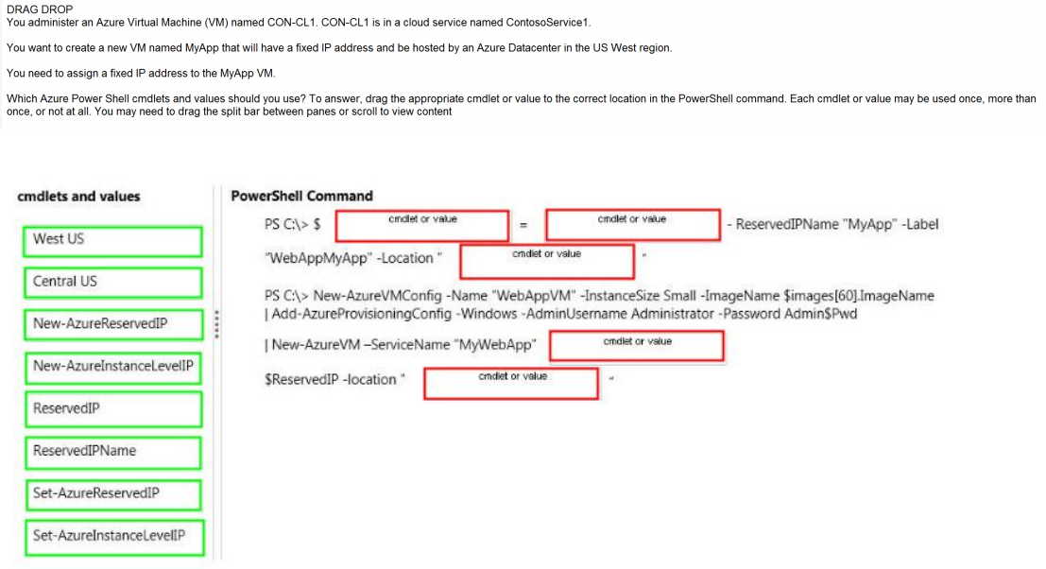
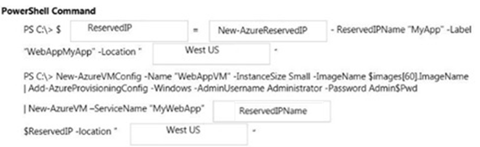
Ans =

Slide 18
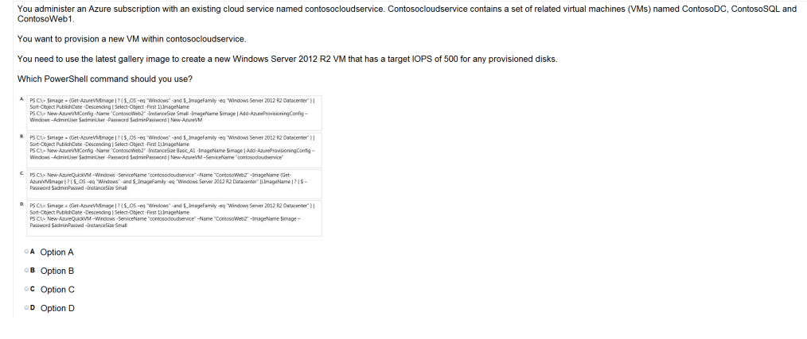
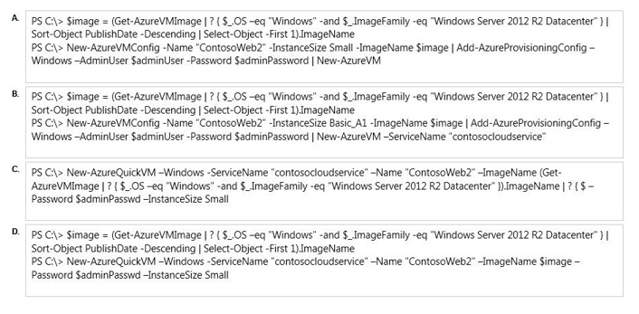
Ans = D New-AzureQuickVM uses for existing service. The New-AzureQuickVM cmdlet sets the configuration for a new virtual machine and creates the virtual machine. You can create a new Azure service for the virtual machine by specifying either the Location or AffinityGroup parameters, or deploy the new virtual machine into an existing service. ( cloud service)

Slide 19
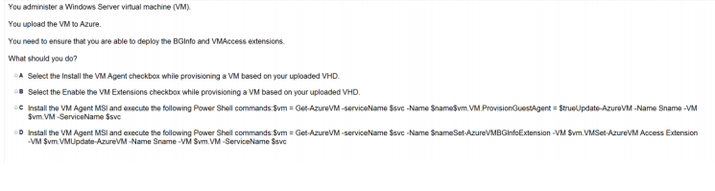
Ans – C Background Info – it is utility to display the server information like IP and disk space on desktop as a wall paper and VM access ill help you to changes the login credentials. Remember you are uploading the VM to the Azure and not Provisioning the VM..

Slide 20
Deploy VM and Workload

Slide 21
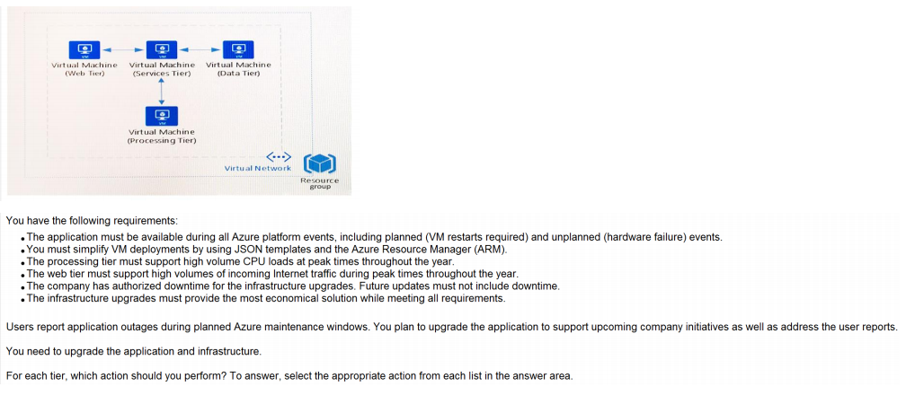
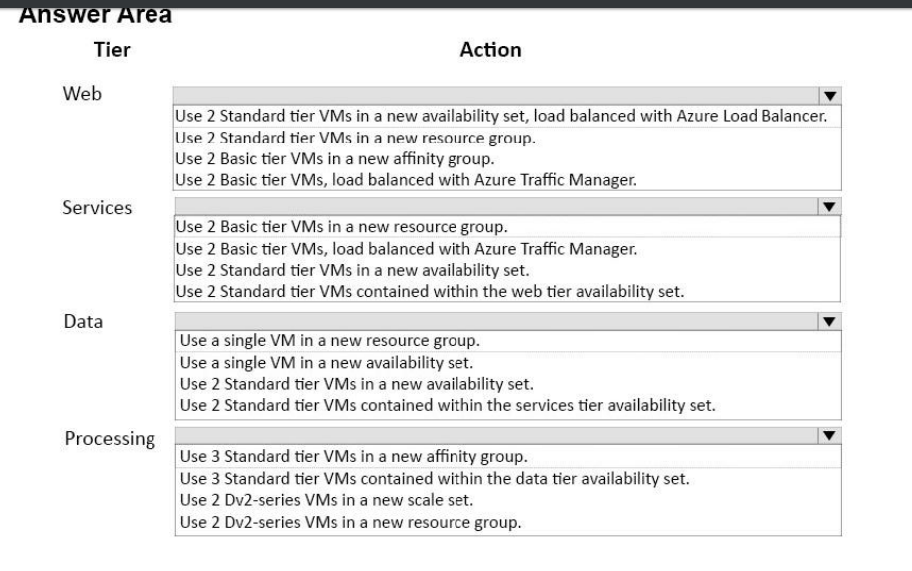

Slide 22
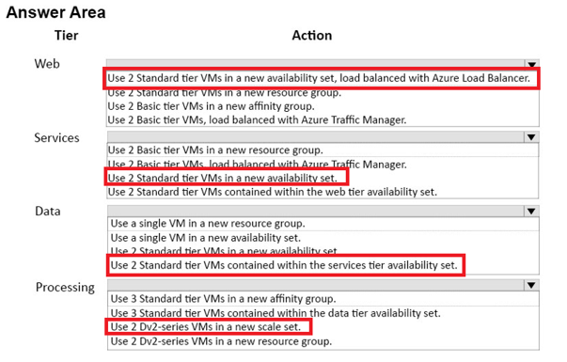

Slide 23
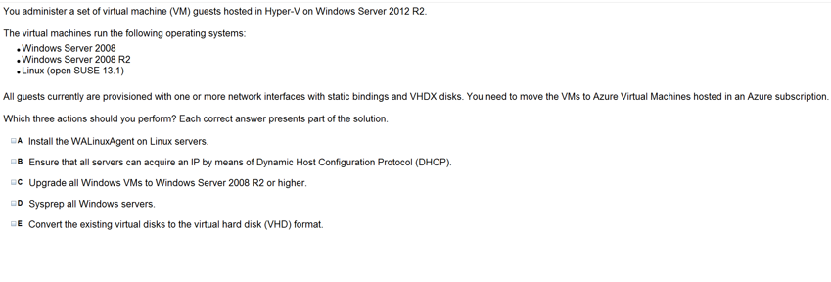
Ans = A & C & E
1) VHD is only supported on cloud
2) Windows server 2008 Rs or Higher
3) WAlinuxAgent should be installed on Linus disc image that are build to run on Azure Environment

Slide 24
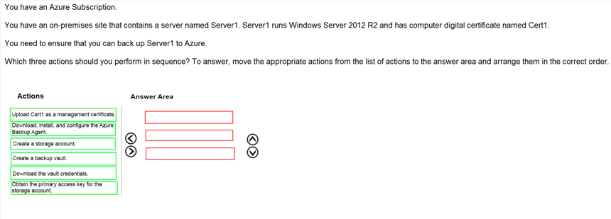
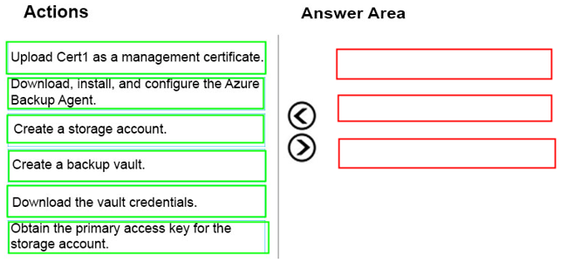
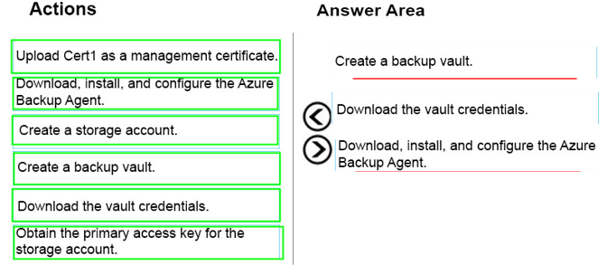
Ans =

Slide 25
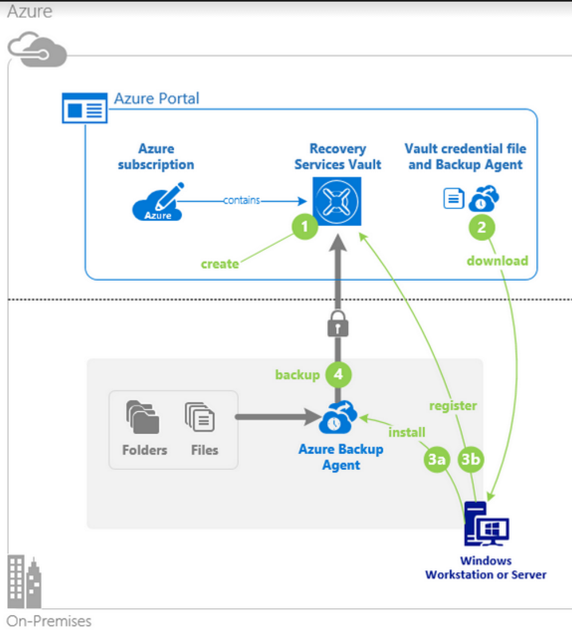

Slide 26
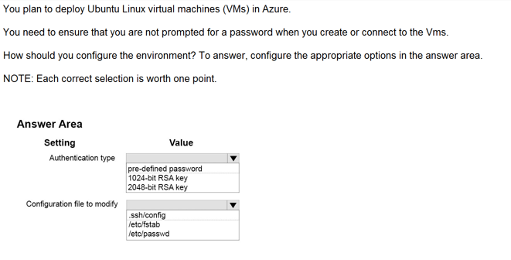
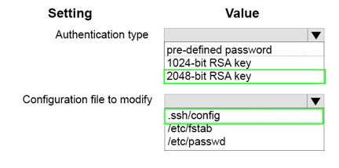
Ans =
The Authentication Type is not selected for User name and password.

Slide 27
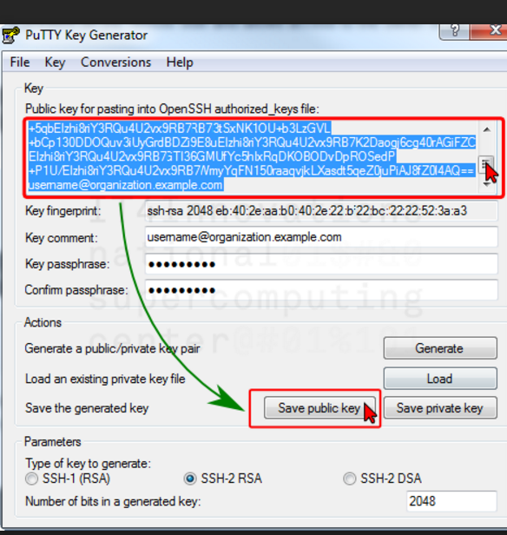

Slide 28
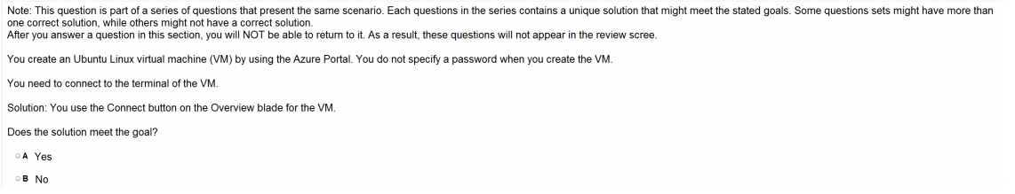
Ans = B

Slide 29
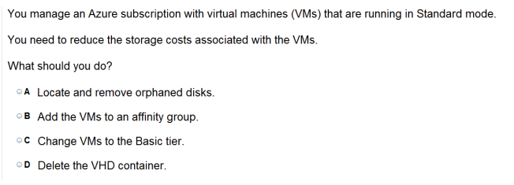
Ans = C

Slide 30
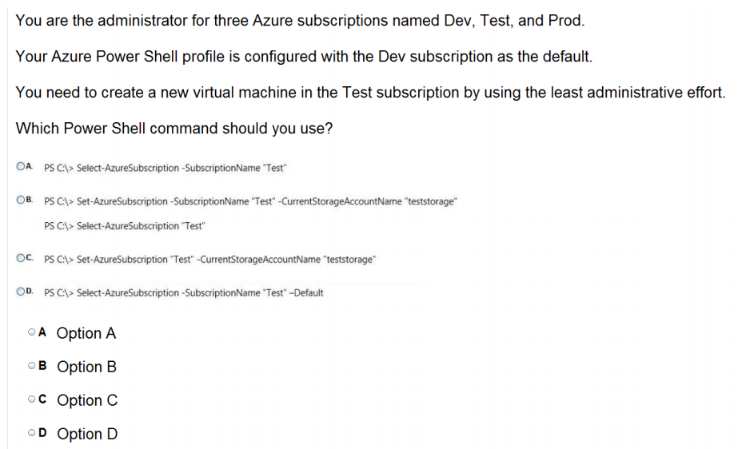
Ans = A
The Subscription is already there so no need to Select and not set

