Slide 1
70-533 : Exam Prep Session Get ready for- Implementing Microsoft Azure Infrastructure Solutions

Slide 2
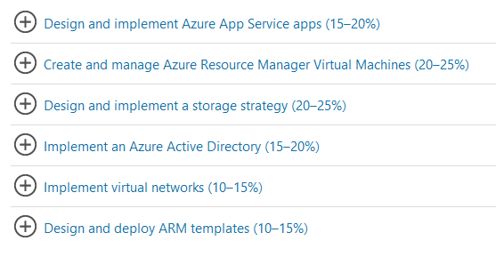
70-533 : Implementing Microsoft Azure Infrastructure Solutions

Slide 3
Configure Scale & Resilience

Slide 4
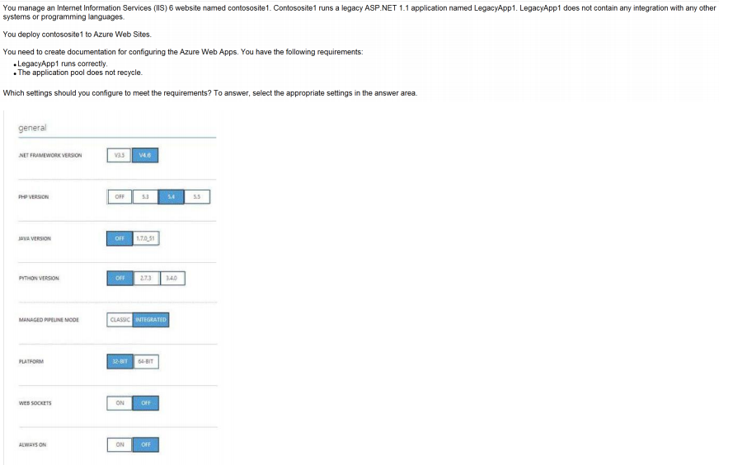
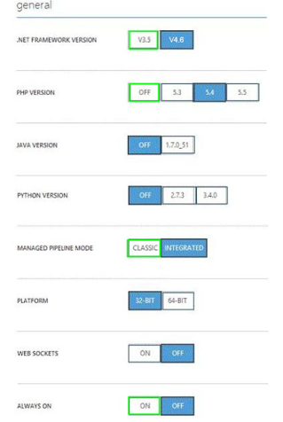
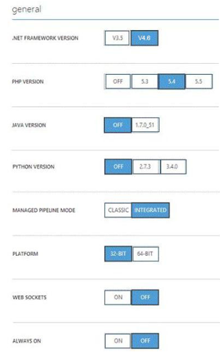
Ans =

Slide 5
Explanation:
* Managed Pipeline Mode. Sets the IIS pipeline mode. Leave this set to Integrated (the default) unless you have a legacy website that requires an older version of IIS *
Always on: ON Always On. By default, websites are unloaded if they are idle for some period of time.
This lets the system conserve resources. In Basic or Standard mode, you can enable Always On to keep the site loaded all the time. If your site runs continuous web jobs, you should enable Always On, or the web jobs may not run reliably.

Slide 6
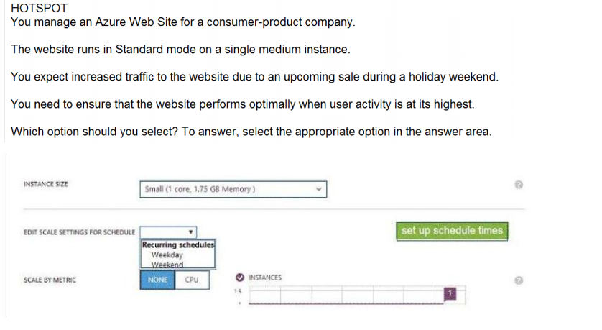
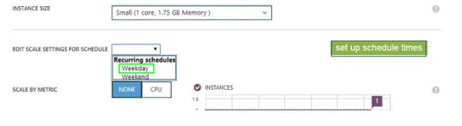
Ans =

Slide 7
Managing Hosting Plan

Slide 8
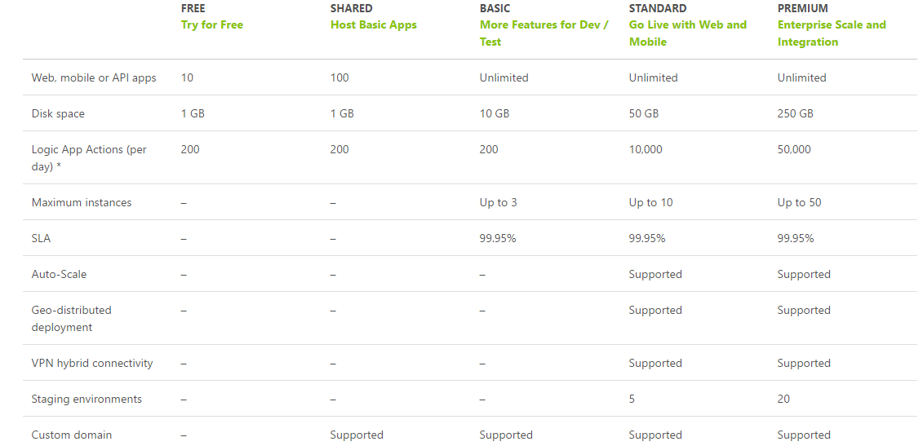

Slide 9
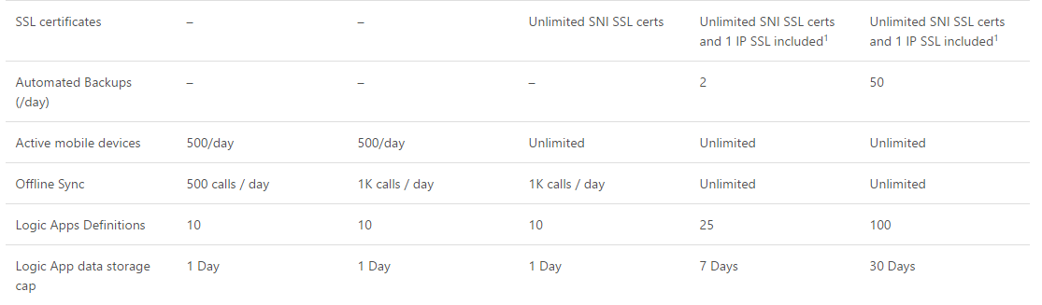

Slide 10
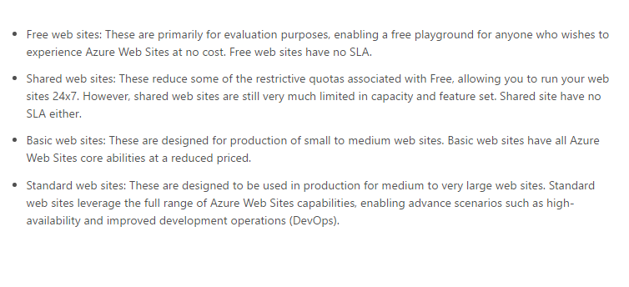

Slide 11
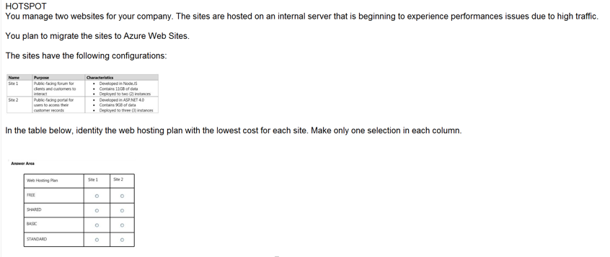
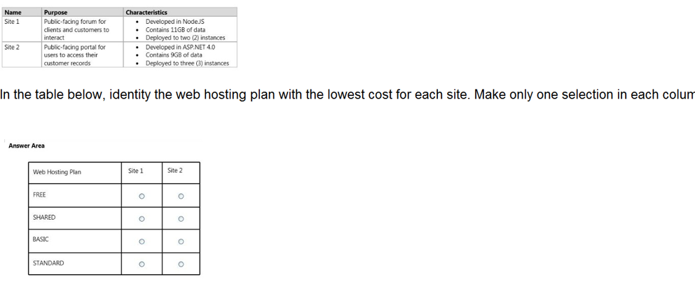
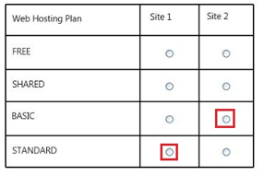
Ans =

Slide 12
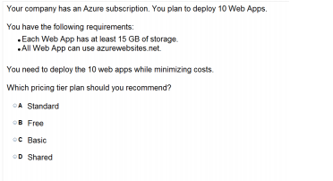
Ans = A Free- 1 GB Shared – 1 GB Basic- 10 GB Standard – 50 GB Premium – 250 GB

Slide 13
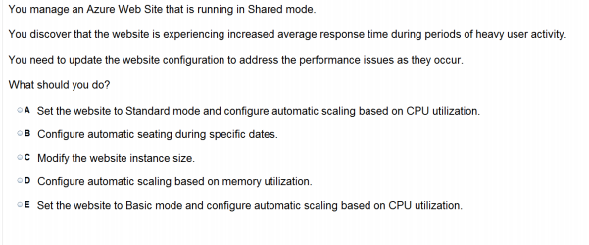
Ans – A Automatic Scalling supported in Standard only

Slide 14
Explanation:
Scaling to Standard Plan expands the Capacity section to give the Instance Size and Instance Count options, and is also available in Basic mode. But The Edit Scale Settings for Schedule and Scale by Metric options is only in Standard.

Slide 15
Custom Domain & SSL Certificate

Slide 16
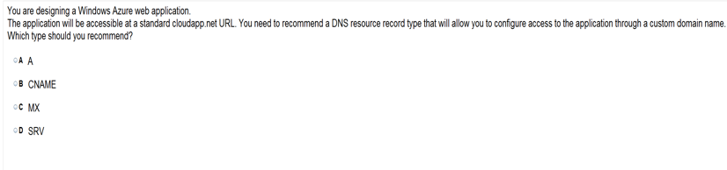
Ans = B

Slide 17
You create an Azure Active Directory (Azure AD)tenant named Tenant1 that has a domain name of tenant1.onmicrosoft.com. You need to add the contoso.com domain name to Tenant1. Which DNS record should you add to the contoso.com zone to be able to verify from Azure whether you own the contoso.comdomain?
A) standard alias (CNAME)
B) mail exchanger (MX)
C) host (AAAA)
D) signature (SIG)
E) A

Slide 18
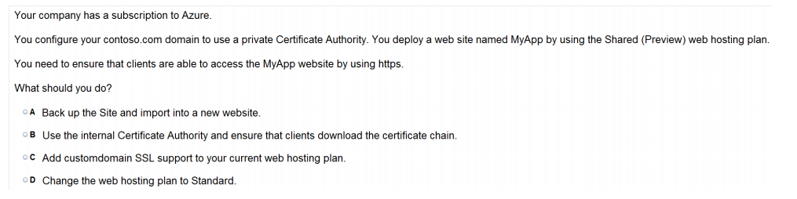
Ans = D

Slide 19
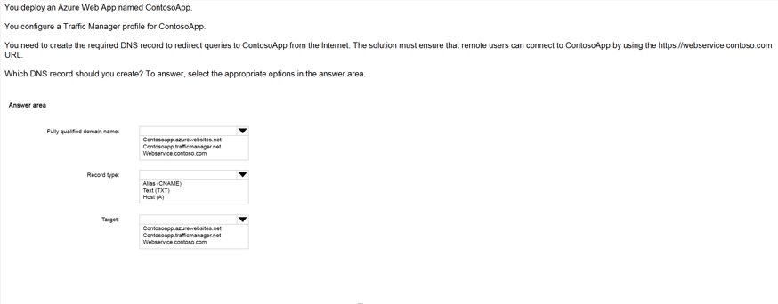
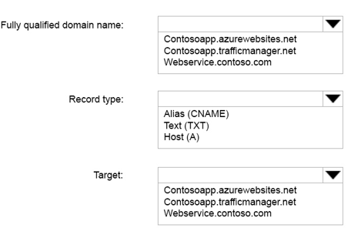
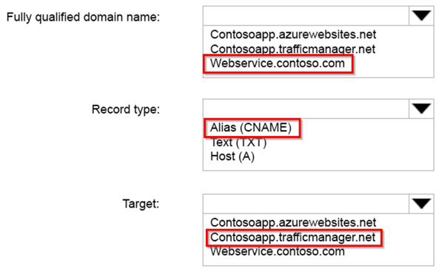
Ans =

Slide 20
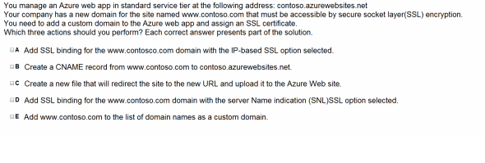
Ans – A & B & C What to Explain

Slide 21
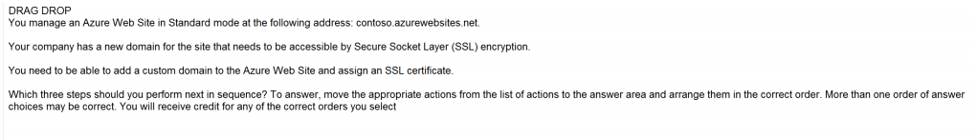
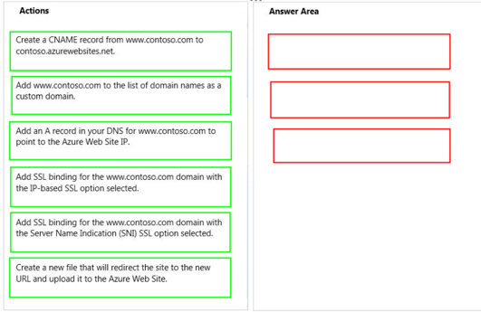
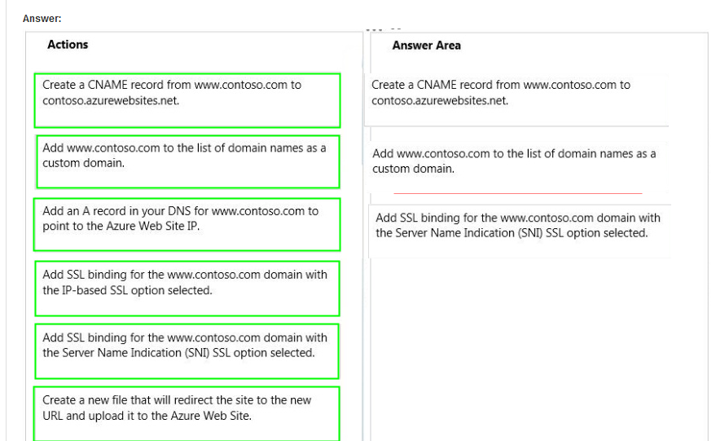
Ans =

Slide 22
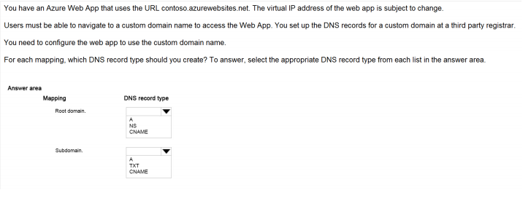
Ans – A and CNAME What to Explain Show Step by Step Domain Mapping

Slide 23
Diagnostic

Slide 24
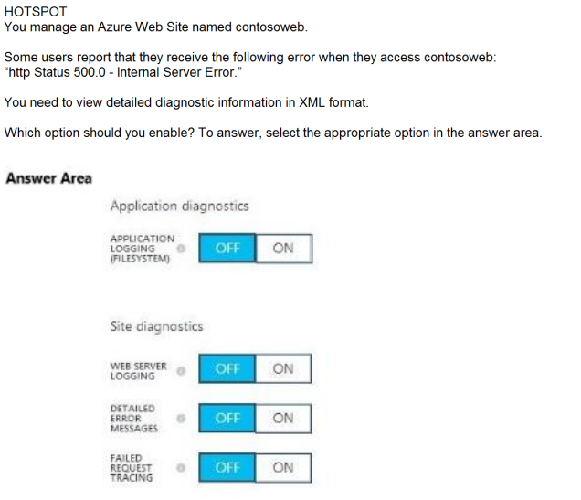
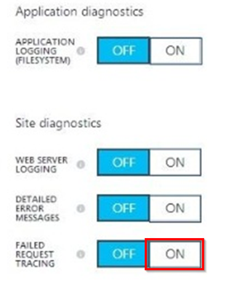
Ans = A

Slide 25
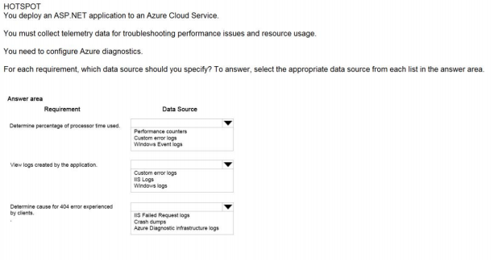
Ans – Performance Counters – Custom error logs - IIS Failed Request Logs What to Explain Azure Diagnostics

Slide 26
Analyse

Slide 27
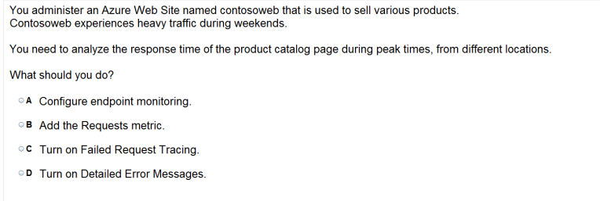
Ans – A

Slide 28
Monitoring

Slide 29
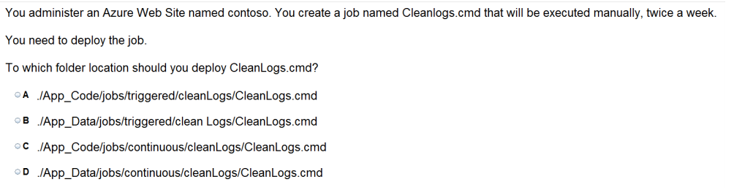
Ans =B

Slide 30
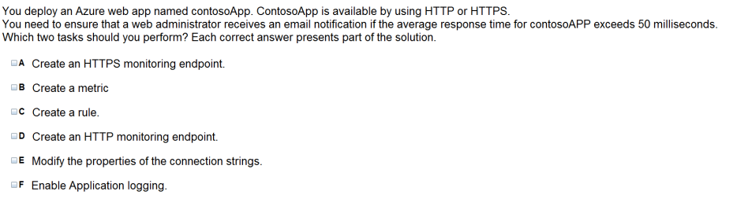
Ans = C & D

Slide 31
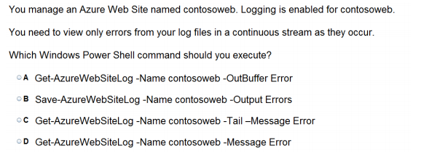
Ans = C

Slide 32
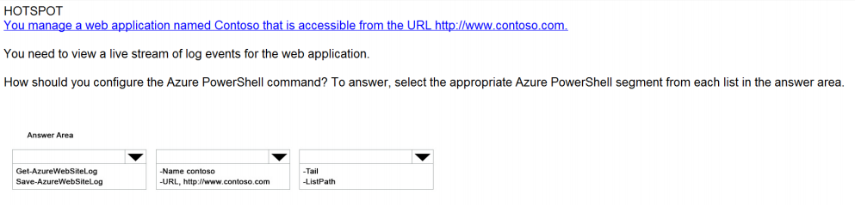
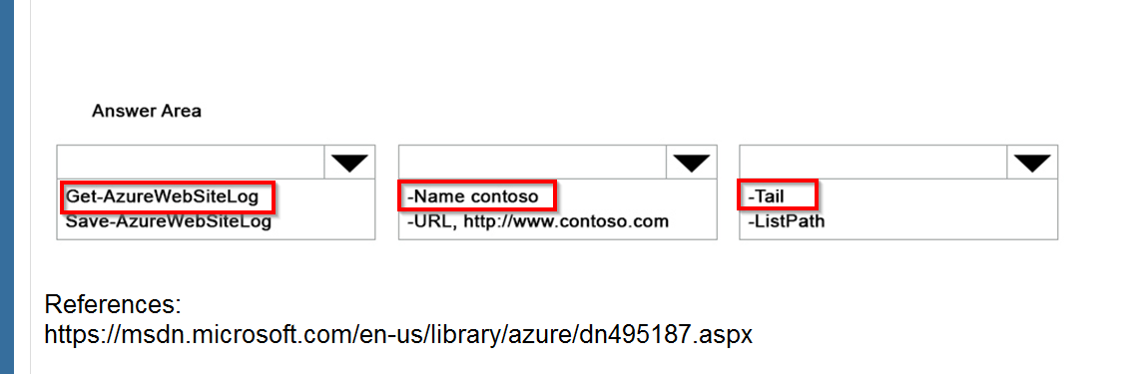
Ans =

Slide 33
Deployment Slot

Slide 34

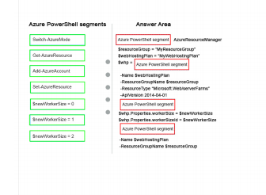
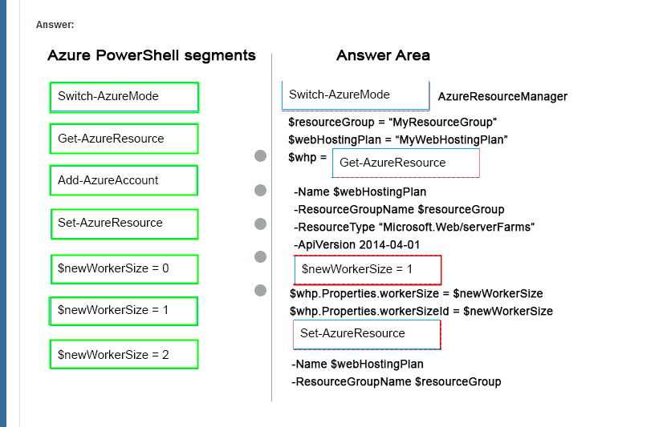
Ans =

Slide 35
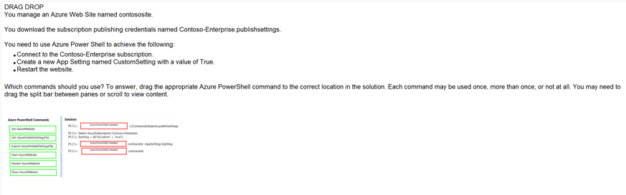
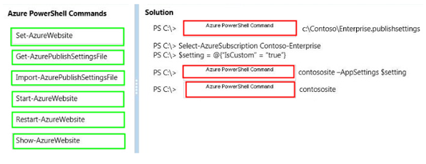
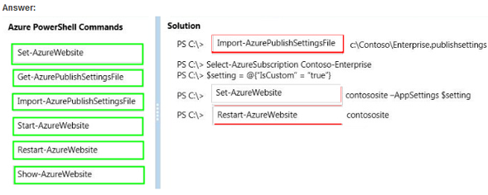
Ans =

Slide 36
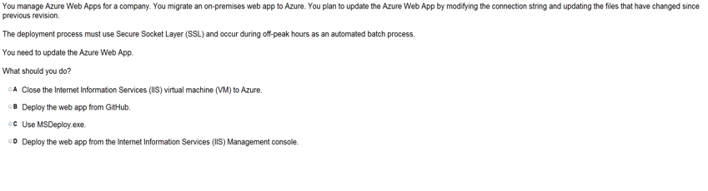
Ans = B

Slide 37
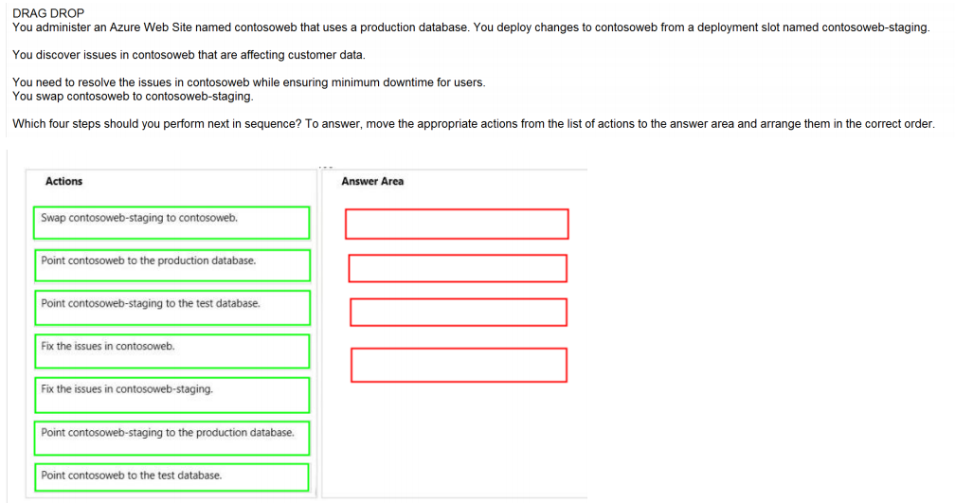
Ans =

Slide 38
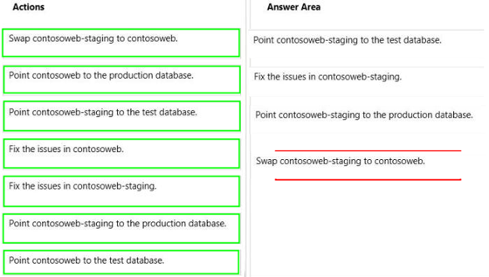

Slide 39
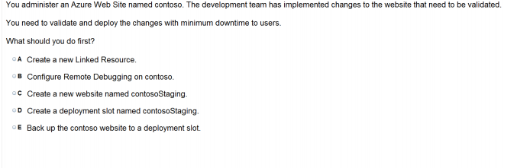
Ans – D Step by Step Deployment Slots

Slide 40
Cross Platform CLI tool ( Command line Interface)

Slide 41
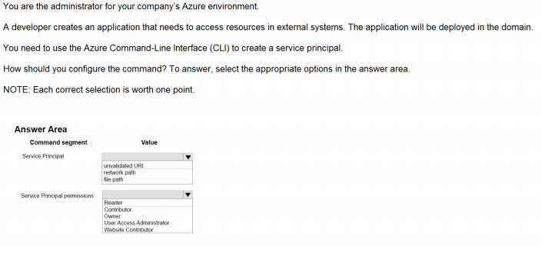
Ans = Service Principal – network path Service Pri. Permissions - Owner

Slide 42
App Service Autentication

Slide 43
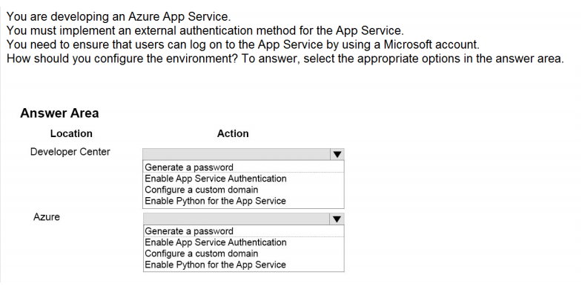
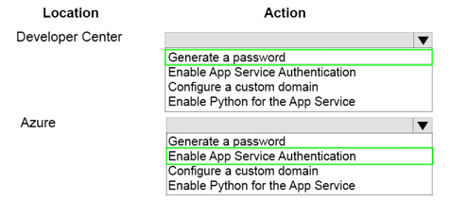
Ans =

Slide 44
Web Jobs

Slide 45
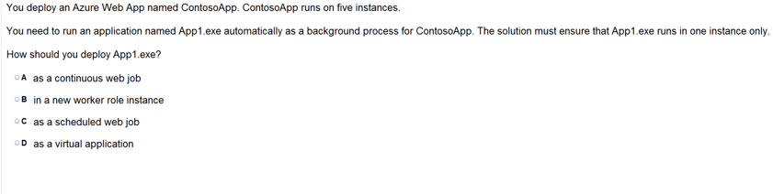
Ans = C

Slide 46
https://www.proprofs.com/quiz-school/story.php?title=mtg1mjywna99ud

