Slide 1
70-533 : Implementing Microsoft Azure Infrastructure Solutions

Slide 2
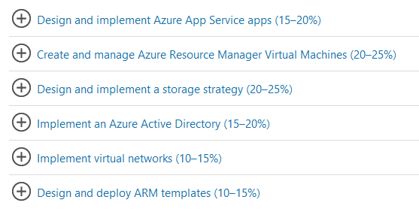
70-533 : Implementing Microsoft Azure Infrastructure Solutions

Slide 3
Configure VN

Slide 4

Ans = E
Network information is stored in the cscfg file

Slide 5

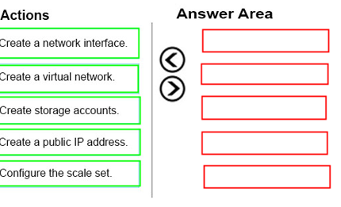
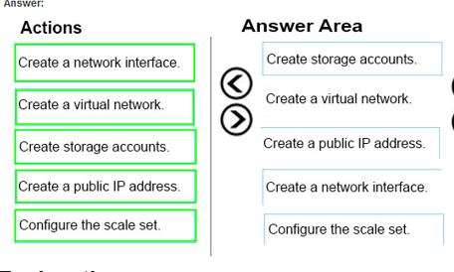
Ans =

Slide 6

Ans =A & D
New-AzureQuickVM
Creates and provisions a new Azure virtual machine.
the virtual machine. You can create a new Azure service for the virtual machine by specifying either the Location or AffinityGroup parameters, or deploy the new virtual machine into an existing service

Slide 7
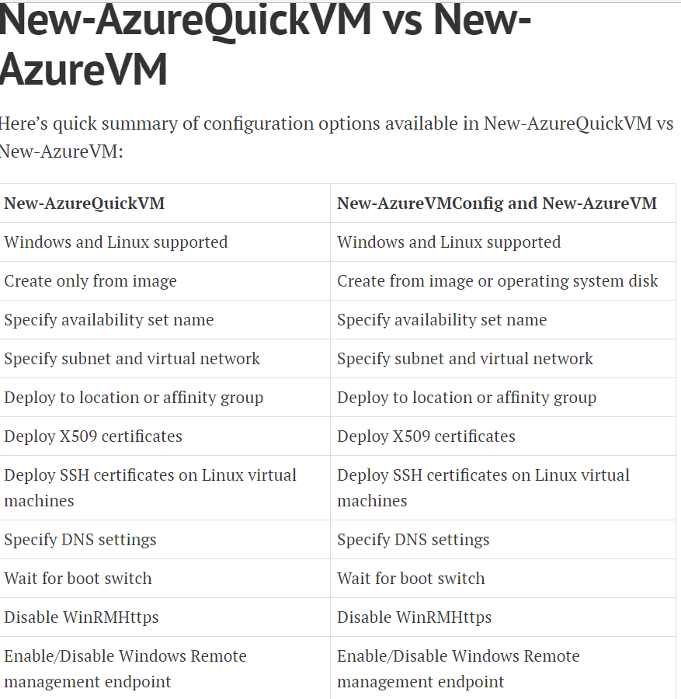

Slide 8
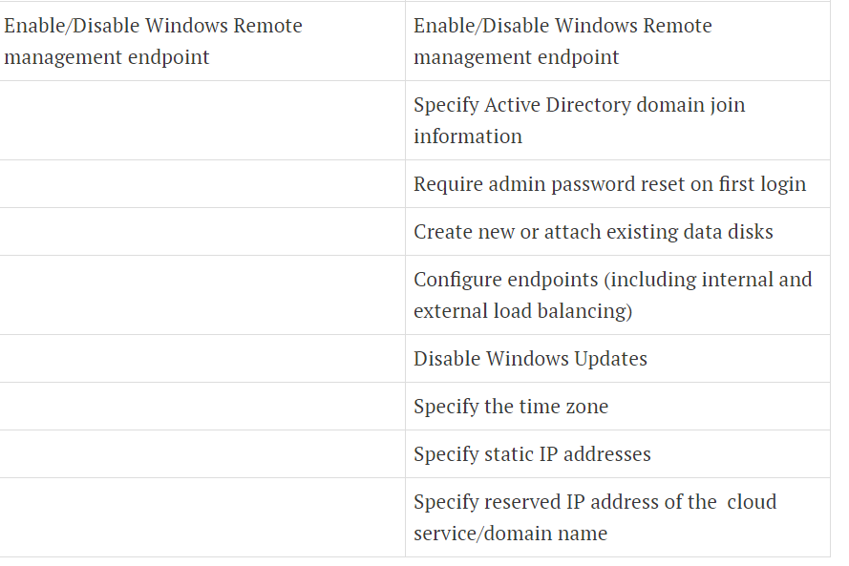

Slide 9
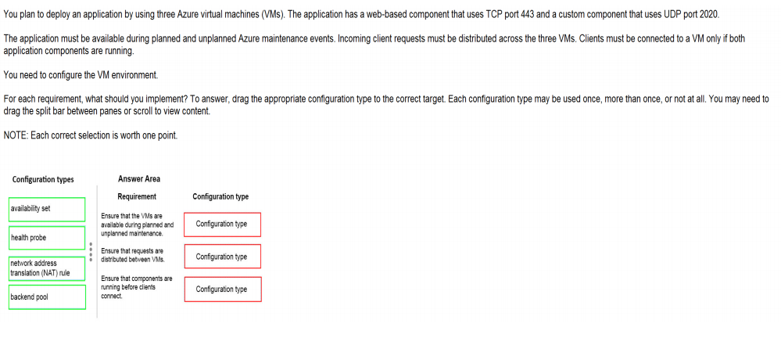
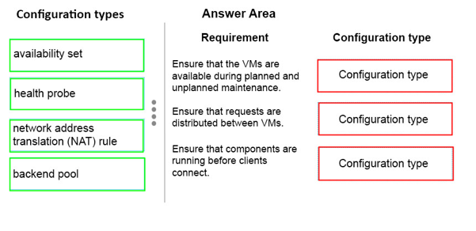
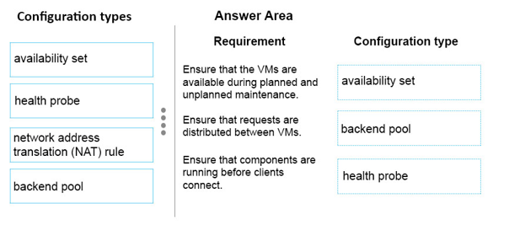
Ans =

Slide 10
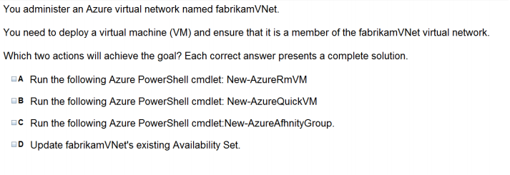
Ans = A & b The New-AzureQuickVM cmdlet sets the configuration for a new virtual machine and creates the virtual machine. You can create a new Azure service for the virtual machine by specifying either the Location or AffinityGroup parameters, or deploy the new virtual machine into an existing service.

Slide 11
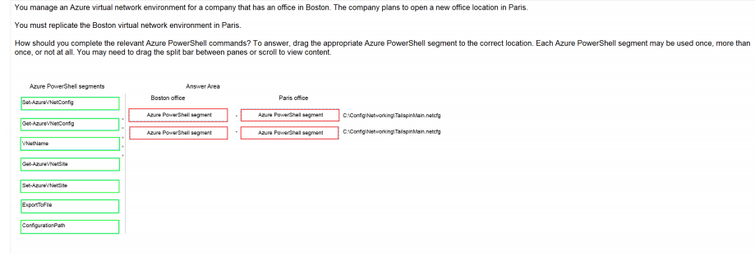
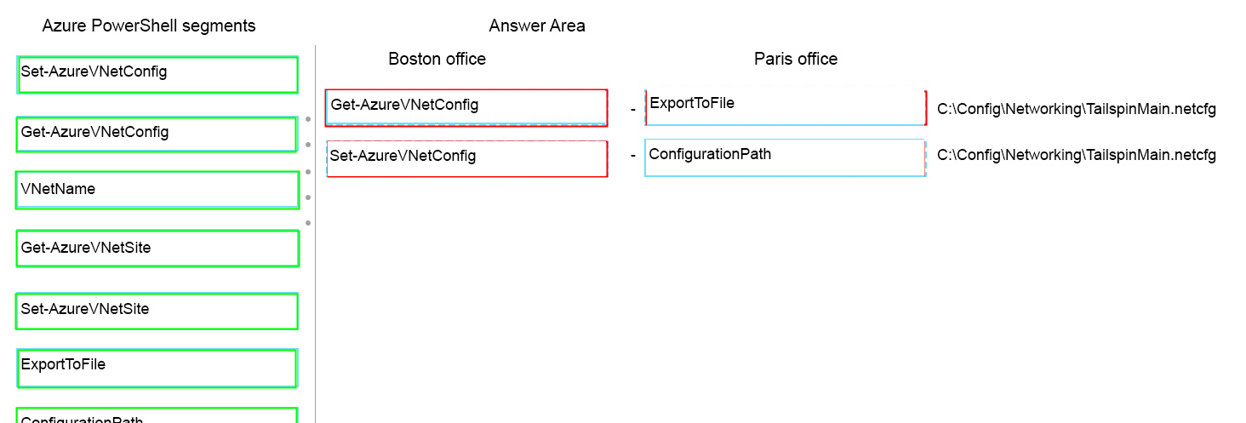
Ans =

Slide 12
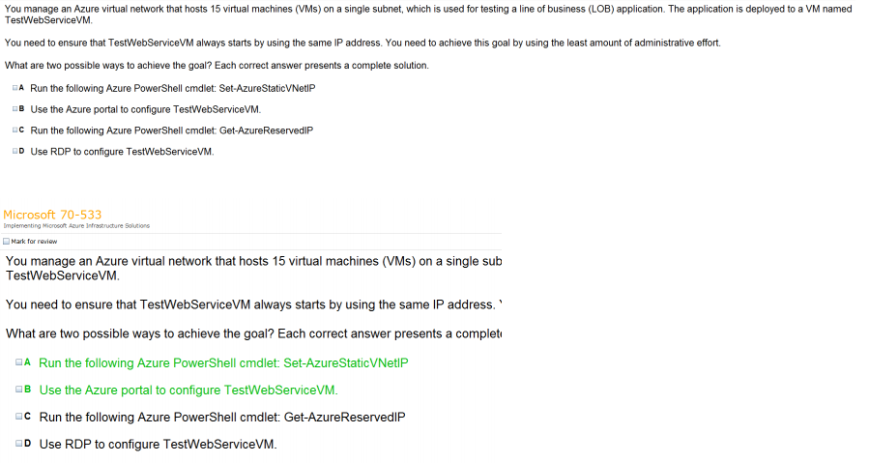
Ans =

Slide 13

Ans = B

Slide 14
Modify Virtual Network

Slide 15
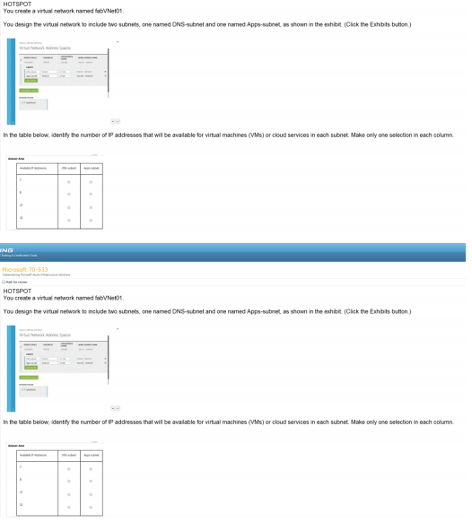
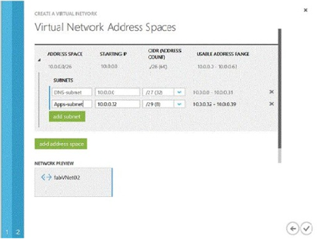
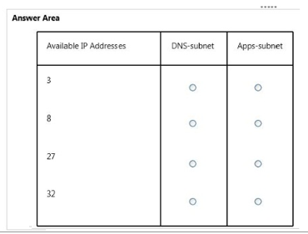
Ans – DNS – 27 & Apps Subnet - 3

Slide 16
Design & Implement Multi Site and Hybrid Network

Slide 17
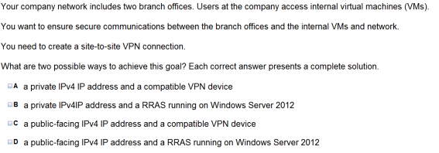

Ans = C & D Video Vnet to Vnet and Point to Site

Slide 18

Ans – B What to Explain Point to Site Video Steps

Slide 19
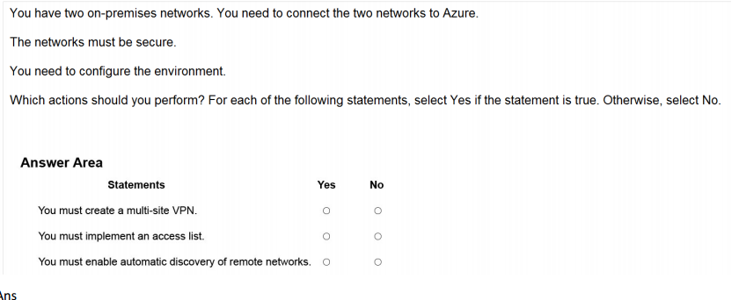

Ans =

Slide 20
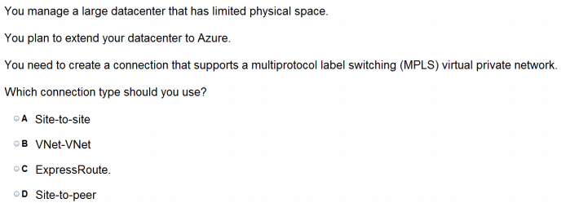
Ans = C

Slide 21
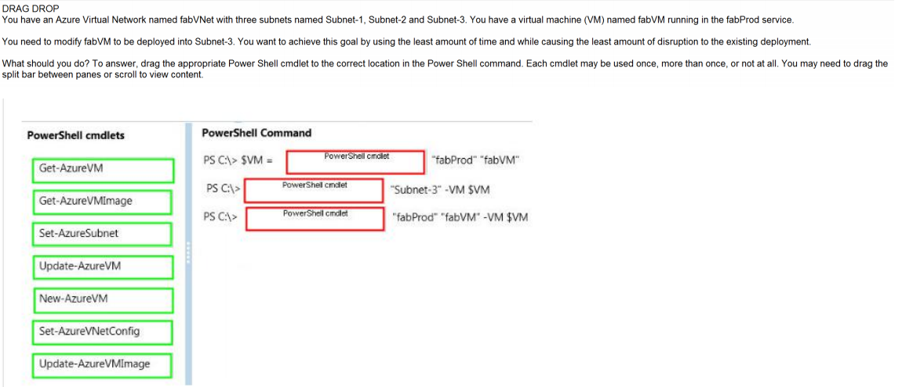
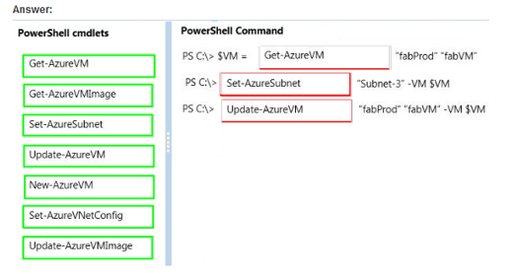
Ans =

Slide 22
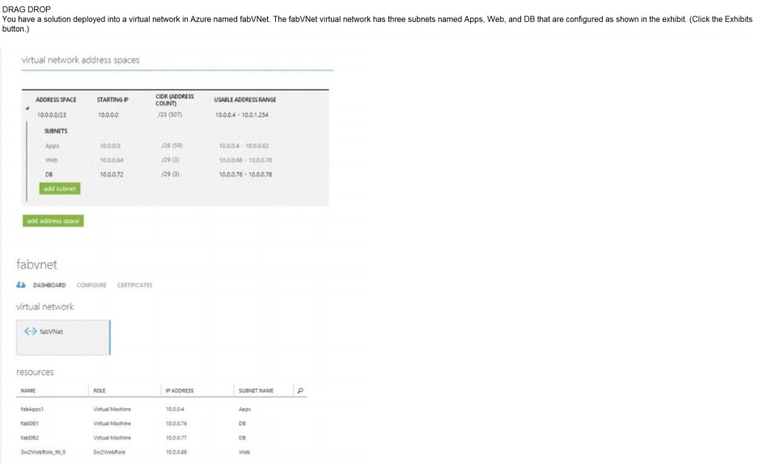
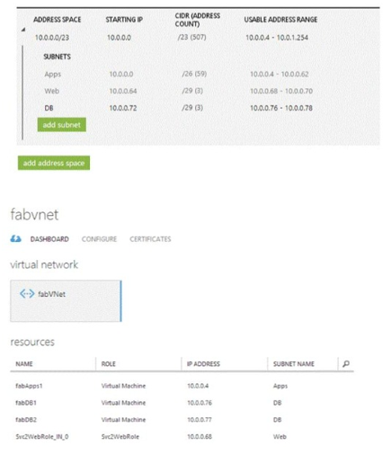
Ans =

Slide 23


Slide 24
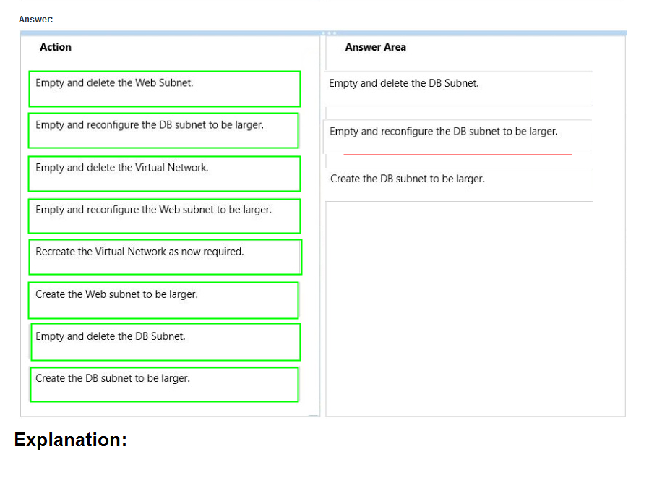
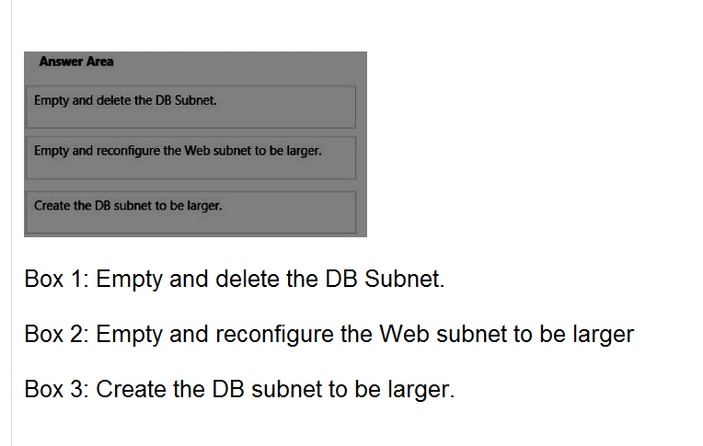

Slide 25

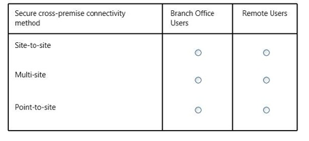
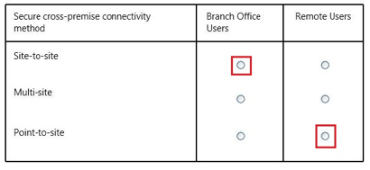
Ans =

Slide 26
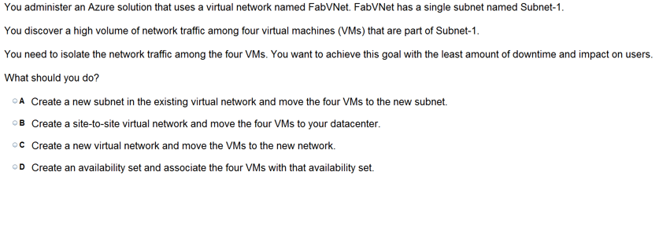
Ans =C

Slide 27

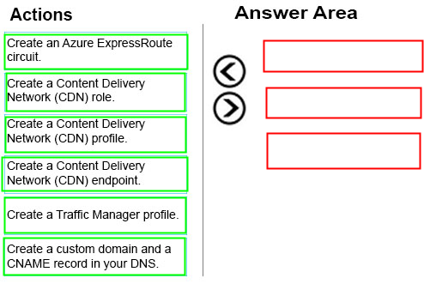
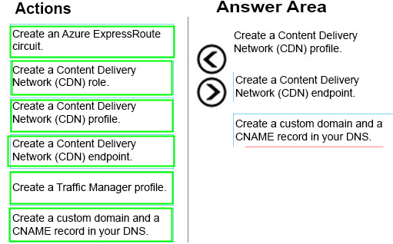
Ans =

Slide 28
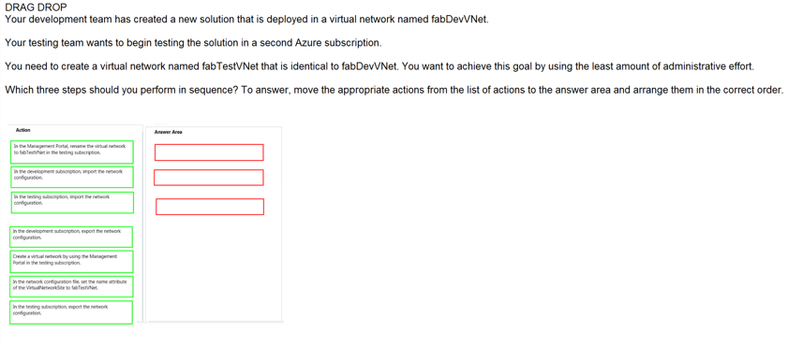
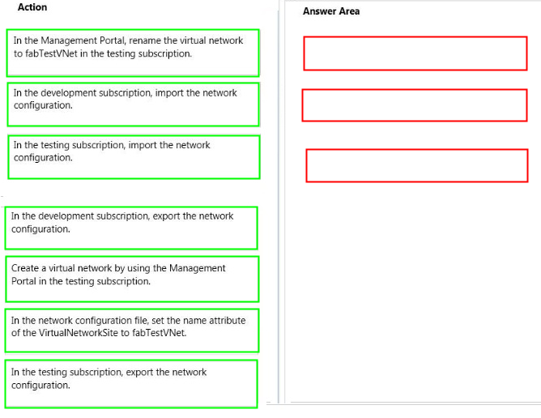
Ans =

Slide 29
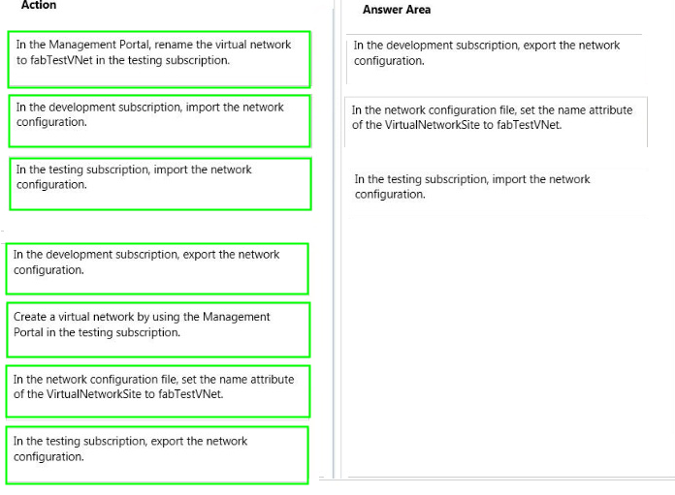

Slide 30

Ans =A

Slide 31

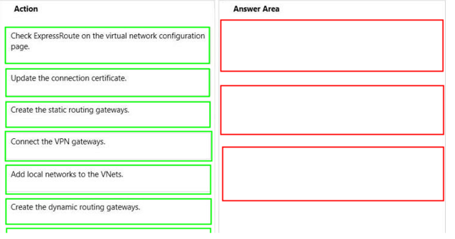
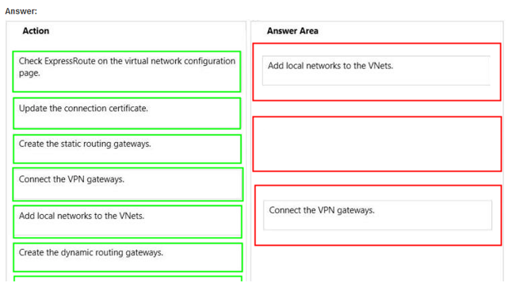
Ans =

Slide 32


