Slide 1
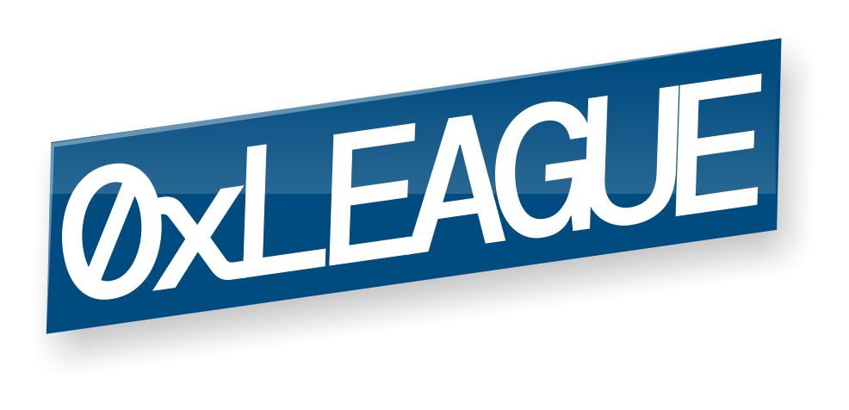
Decentralized Audit Marketplace

Slide 2
Problems with smart-contract auditing
Difficult to find auditors
Difficult to evaluate & compare auditors
Long & opaque pricing process
Inconsistent NDAs
Notes:
For smart contract developers its notoriously difficult to find syutable auditors - where are they, how good are they or what is their price.
theres a long and opaque pricing process with zoom meetings
And on top of that the NDAs are often times inconsistent and not standard

Slide 3
Decentralized Audit Marketplace
Browse and filter auditors by score and availability
Get quotes and pay on-chain
Open and public process
Standard global pre-signed NDA
Bonus: receive security badge as NFT
Notes:
0xLeague is a decentralized audit marketplace that aims to solve these issues
Clients can browse and filter auditors by score and avil
Get quotes and pay on chain
And benefit from global standard NDA
Plus, all successful audits reveive a personalized security badge as NFT

Slide 4
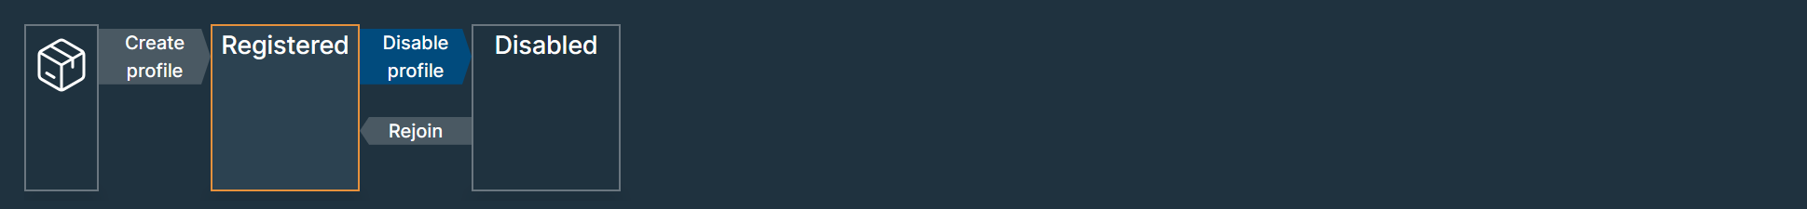
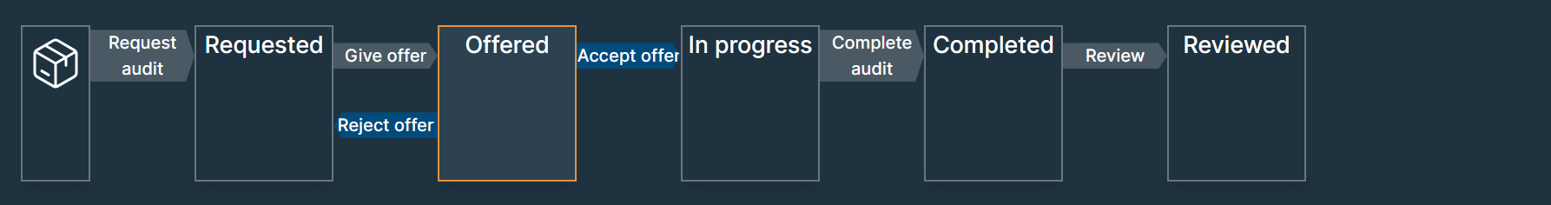
How was it built
Toolblox no-code platform
No-code smart contract & dApp builder
Auto-generated dashboard
2 smart contracts
Profile management
Audit management

Slide 5

Team
Silver Sepp
https://www.linkedin.com/in/silver-sepp-59413a5/

Slide 6
Thank you!

