Slide 1
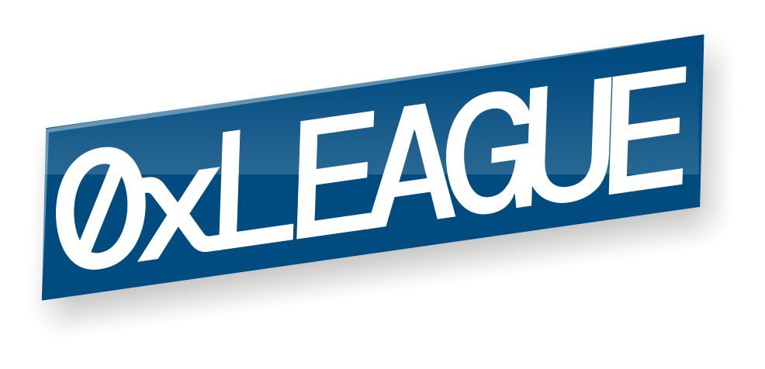
Decentralized Audit Marketplace

Slide 2
Problems with smart-contract auditing
Difficult to find auditors
Difficult to evaluate & compare auditors
Opaque pricing process
Inconsistent NDAs
Centralized audit marketplaces

Slide 3
Decentralized Audit Marketplace
Browse and filter auditors by score and availability
Get quotes and pay on-chain
Standard pre-signed NDA
Open decentralized platform
Bonus: receive audit security badge as NFT

