Slide 1


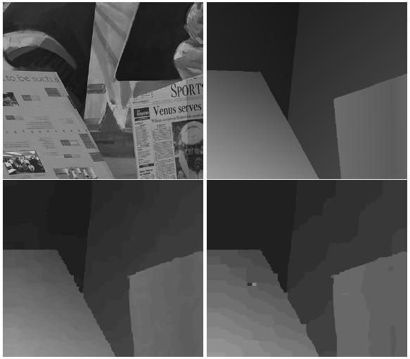
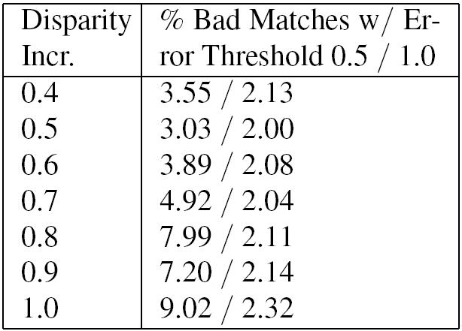
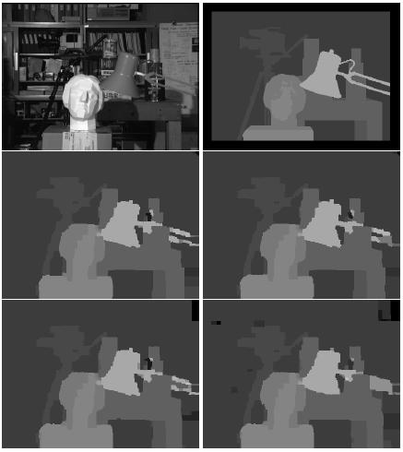
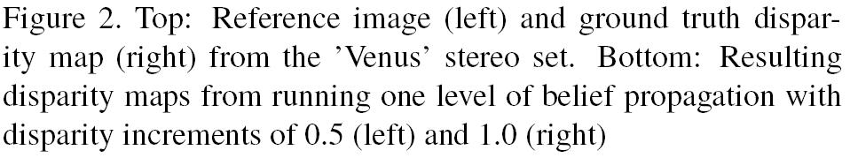
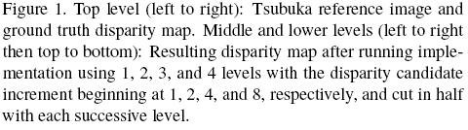
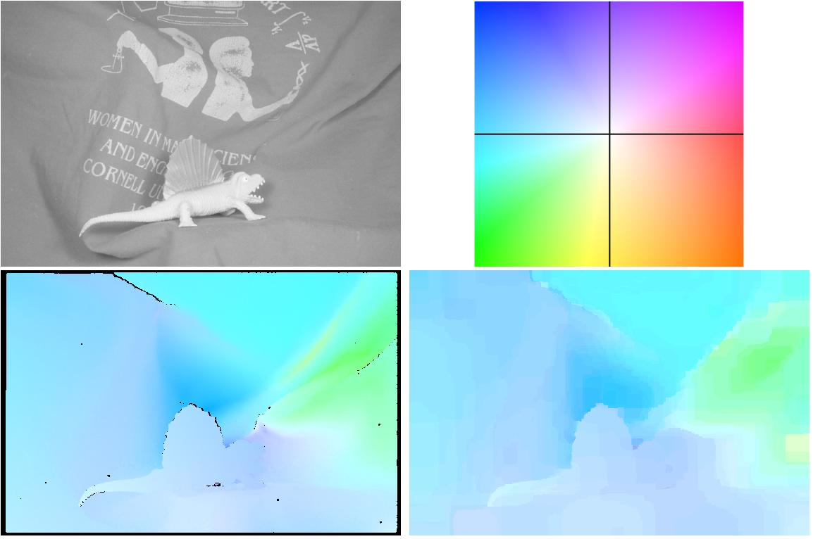
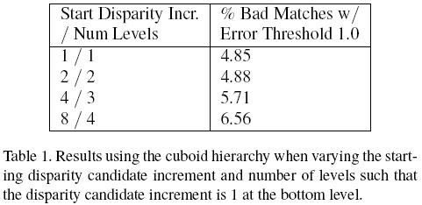
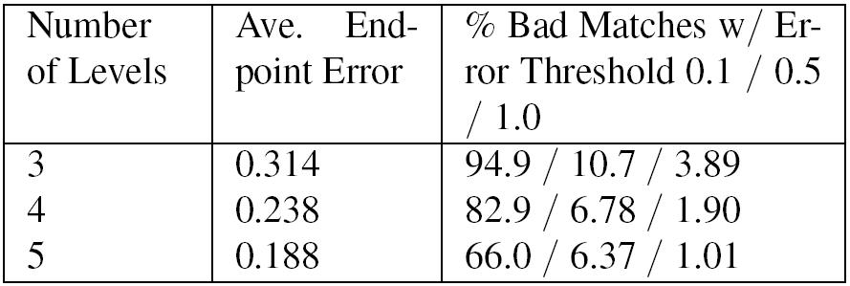
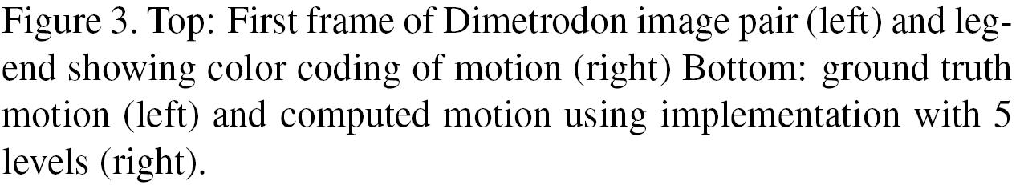
Hierarchical Belief Propagation To Reduce Search Space
Using CUDA for Stereo and Motion Estimation
Scott Grauer-Gray, Chandra Kambhamettu
Video/Image Modeling and Synthesis Lab (VIMS), Department of Computer and Information Sciences,
University of Delaware, Newark, DE 19716
Introduction
Belief propagation: known to produce accurate results for stereo processing/ motion estimation
High storage requirements limit the use of the algorithm in some situations
Belief propagation is an iterative algorithm which has been shown to produce accurate results for stereo processing and motion estimation via the use of a ‘data cost’ for each possible disparity / motion at each pixel and a ‘discontinuity cost’ between the results at each pair of neighboring pixels. The algorithm is used in 3 of the top 5 best-performing stereo algorithms according to the Middlebury benchmark.
In stereo processing / motion estimation, belief propagation operates via the utilization of the data costs together with four sets of frequently-updated message values for each possible disparity / motion vector at each pixel, necessitating storage space of O(5 * image height * image width * number of possible disparity values / motion vectors). This storage requirement limits the use of the algorithm in some situations, particularly in cases with a large range of possible output disparities or motion vectors, which may include results at the sub-pixel level.
Results On a Stereo Set with Integer Disparities
Results On a Stereo Set with Sub-Pixel Disparities
Conclusions and Future Work
We have presented a method to reduce the storage requirements of a stereo or motion estimation belief propagation implementation without sacrificing much in terms of the accuracy of the results, as well as how our GPU implementation can be used without modification to retrieve sub-pixel accuracy in the resulting disparity map or set of motion vectors. For image sets with a large disparity/motion range or with sub-pixel accuracy requirements, our implementation may be used where traditional belief propagation is not feasible due to overwhelming storage requirements.
Future work includes further tweaking of the parameters and algorithm details to retrieve the optimal balance of storage requirements and running time versus the accuracy of the results for various problems on a variety of hardware, as well as investigating how this implementation could fit into related work that prominently incorporates belief propagation, including some of the top-scoring algorithms in the Middlebury stereo evaluation.
Accuracy of resultant disparity map increases when non-integer disparity values are included in search space
Storage requirements reduced with minimal sacrifice of accuracy of resultant disparity maps
Next, we ran our implementation on the ‘Venus” stereo set with ground truth disparities ranging from 3.0 to 19.75 that are given at increments of one-eighth of a pixel. Our implementation takes advantage of the interpolation capabilities of the GPU, treating a non-integer disparity candidate the same way as an integer disparity candidate without any change in implementation via retrieval from texture memory on the hardware.
We ran our implementation on the stereo set at a single level using disparity increments ranging from 0.4 to 1.0 with a disparity candidate range from 0.0 to 20.0. The reference ‘Venus’ image, ground truth disparity map, and the resulting disparity maps using disparity increments of 0.5 and 1.0 are shown in figure 2 below, and the quantitative results showing the percentage of ‘bad’ pixels beyond an error threshold of 0.5 and 1.0 are shown in table 2 to the right of the figure.
We ran our implementation on the Tsukuba stereo set where all the ground-truth disparities are integer values, using a disparity range from 0 to 16. In our initial trial, we ran the implementation on a single level with a disparity increment of 1, resulting in a search space of 17 possible disparities values. In the next trial, we ran our implementation using 2 levels, where the increment in disparity candidates is set to 2 at the upper level and halved to 1 in the lower level, resulting in a search space of 9 possibly disparities at each level and nearly halving the storage requirements of the implementation as compared to the single-level trial. We continued to run our implementation on the Tsukuba set using 3 and 4 levels, with disparity candidate increments starting at 4 and 8 that are halved in each succeeding level, resulting in search spaces of 5 and 3 possible disparities and significantly lower storage requirements. The Tsukuba reference image, ground truth disparity map, and the resulting disparity maps from our trials are shown in figure 1 below, and we provide quantitative statistics regarding the accuracy of our implementation for each trial in table 1 below the figure. These results show that our implementation is capable of reducing the storage requirements of the belief propagation algorithm without severely sacrificing the accuracy of the results in this image set.
Hierarchical Belief Propagation:
Reduces the storage requirements of the algorithm
Hierarchical belief propagation as presented by Felzenswalb and Huttenlocher [1] has been used to decrease the number of iterations needed for message value convergence and therefore speed up various implementations of belief propagation. However, this method does not reduce the search space or the storage requirements of the implementation. In our implementation, we use ‘rough’ results computed at the higher levels of the hierarchy to initialize the search space at the lower levels, eliminating the need to consider every possible result at each level in the hierarchy.
Results On a Set of Sequential Images Containing 2D Motion
Literature Cited on Poster
[1] P. F. Felzenszwalb and D. P. Huttenlocher. Efficient belief propagation for early vision. Int. J. Comput. Vision, 70(1):41-54, 2006.
[2] S. Grauer-Gray, C. Kambhamettu, and K. Palaniappan. GPU implementation of belief propagation using cuda for cloud tracking and reconstruction. In 2008 IAPR Workshop on Pattern Recognition in Remote Sensing (PRRS 2008), pages 1-4, 2008.
See paper for additional citations.
Motion estimation using belief propagation more feasible via lower storage requirements
Belief propagation has been shown to give accurate results for motion estimation as well as stereo, but the presence of a two dimensional motion search space which is often combined with a need for sub-pixel accuracy can lead to large and possibly infeasible storage requirements when attempting traditional belief propagation for motion estimation. Our hierarchical implementation can make motion estimation via belief propagation feasible by reducing the storage requirements.
We ran our implementation on the Dimetrodon image pair using a motion range from -5.0 to 5.0 on the x and y axis and with a motion increment of 2.5 at the top level. The motion increment is halved with each succeeding level of the hierarchy. The first frame of the image pair, the legend showing color coding of motion, the ground truth motion, and the computed motion using our implementation with 5 levels are shown in figure 3 below. The table to the right of the figure displays quantitative results showing the accuracy of our implementation using 3, 4, and 5 levels as compared to the ground truth motion.
CUDA Implementation:
Leverages the parallel processing and interpolation capabilities of the graphics processing unit (GPU)
Our belief propagation implementation builds on our previous work in [2] which used the graphics processing unit (GPU) and the CUDA technology available from nVidia; the results in that work showed that the architecture can be used to speed up an implementation of the algorithm without losing accuracy, largely due to the natural parallelism of many steps of the algorithm.
In addition, our implementation takes advantage of the interpolation capabilities of the GPU to retrieve sub-pixel disparities without making changes to the general implementation.
Acknowledgments
This work was partially supported by a U.S. National Aeronautics and Space Administration award NASA NNX08AD80G under the ROSES Applied Information Systems Research program
Notes:
This poster template is from http://www.swarthmore.edu/NatSci/cpurrin1/posteradvice.htm. It is free, free, free for non-commercial use. But if you really like it, I’m always thrilled to get postcards from wherever you happen to be presenting your poster. Or, send me cookies! My kids made me put that last sentence in. Have fun. Sincerely, Colin Purrington, Department of Biology, Swarthmore College, Swarthmore, PA 19081, USA. Email: cpurrin1@swarthmore.edu

