Slide 1

Office 365 Email Migration and Tenant Merging
Brad Christ / Scott Green

Slide 2
The Problems of having two Office 365 tenants
Different user experiences for Students / Staff
Managing and maintaining “Alumni” accounts for life creates an ever expanding user base. We aren’t Google/Microsoft.
2 > 1 because Maths

Slide 3
Pre-Migration EWU User Creation Flow

Slide 4
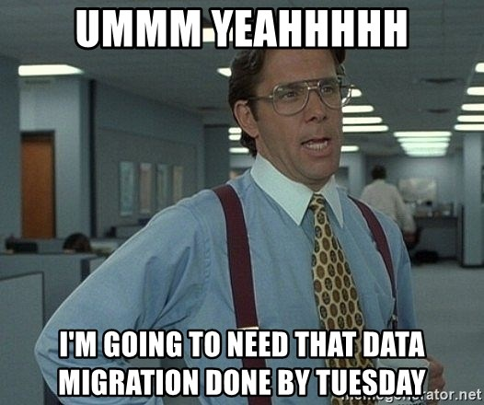

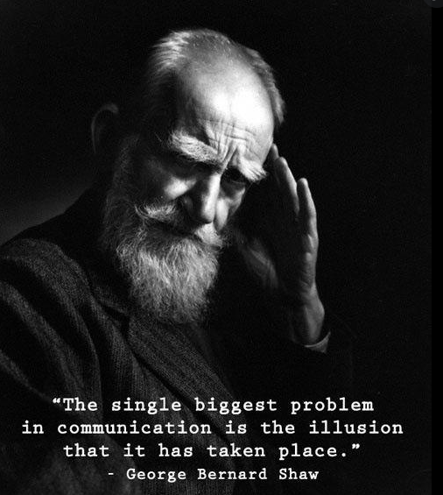
Internal Planning and Communication and Reasoning
Why did we do it this way? Because vendors are expensive and budgets are a thing.
We’re not DOT, there was an opportunity with Covid to take advantage of down enrollment.
People will want it done fast

Slide 5
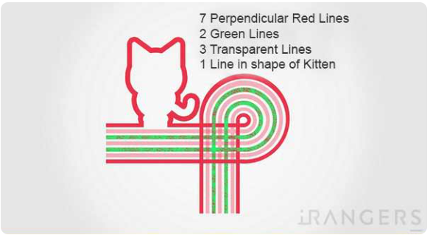

Preparing The Tenants
Its going to sound really confusing
But it’s not

Slide 6
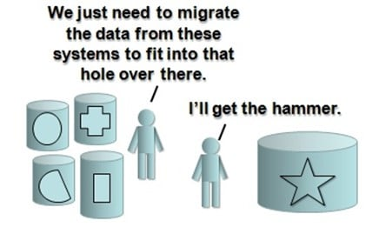
Migration Steps and Notes (Finally)
You thought the last part was the complicated step?

Slide 7
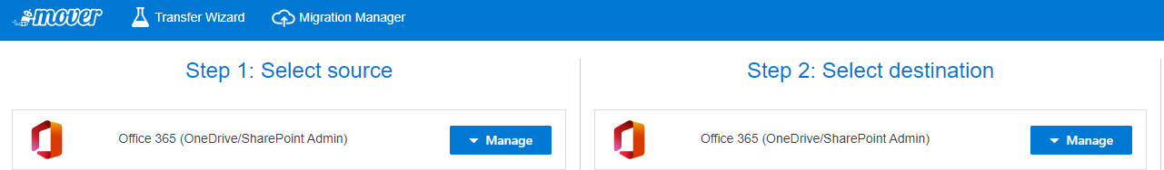
OneDrive Migrations
https://app.mover.io/
Connect and Authorize both Office Tenants
This is painful when moving Office 365 → Office 365 because Mover makes the Source/Destination look exactly the same.
Follow the steps for creating CSV files using the UPNs from the Source/Destination tenants.
Download the SAMPLE.CSV from Mover, and fill it in. It changes just often enough to be painful

Slide 8

User Experiences Post Migration
No matter how much you communicate people will get errors and inevitably panic. Train your staff to respond accordingly:

Slide 9
Post Migration EWU User Creation Flow
Office 365 Ewu.edu

Slide 10

Lessons Learned
Our opinions of the migration, and everyone else’s opinion of the migration may vary.

Slide 11
Questions? Comments? Complaints?

