Slide 1

Machine learning and lotto numbers
By Susy, Reyna, Danny and John

Slide 2

lottery fun Facts (google search)
A lottery is a form of gambling that involves the drawing of numbers at random for a prize
Lotteries are operated at the state level in the U.S.; 44 states and 3 territories operate state lotteries. In states where gambling is illegal but lottery is fine, they claim that the lotto is a form of entertainment.
People are more likely to do the following that win the lottery:
Die from an asteroid strike: 1 in 74,817,414
Become a movie star: 1 in 1,505,000
Get struck by lightning: 1 in 1,101,000
Bowl a 300 game: 1 in 11,500

Slide 3
California lottery www.calottery.com
Many people ask us “Where does the money go?” Well, first of all, we should clarify that the California Lottery does not receive General Fund or taxpayer dollars. Everything we have, we raise from Lottery ticket sales. Most importantly, we’re proud to say that 95% of all funds actually go right back into the community in the form of prize payments, retailer commissions and bonuses and, of course, our contributions to education.
Besides offering you entertaining games, the California Lottery’s sole mandate is to raise supplemental funds for all California public schools. Since FY 2000-01, we’ve been lucky. We’ve sent more than $1 billion a year to public education. That means K-12, Community Colleges, CSU and UC campuses and several specialized schools. Don’t misunderstand us, the Lottery’s supplemental funding to schools will not solve education’s budgetary problems. In fact, our contributions amount to less than 1.5% of public education’s overall needs. It’s really modest when you come down to it, but parents, teachers and administrators tell us that every little bit helps.

Slide 4
Machine Learning (google search)
“Machine Learning is the science of getting computers to learn and act like humans do, and improve their learning over time in autonomous fashion, by feeding them data and information in the form of observations and real-world interactions.”
Sequence prediction is a popular data mining/machine learning task, which consist of predicting the next symbol of a sequence of symbols.

Slide 5
Project Intro
Use machine learning models be used to predict the next lotto numbers
Lottery Game: Predict the numbers in the California Daily 3 game (less numbers than MegaMillions or Powerball)
Machine Learning:
Sklearn regression models
Keras sequential model

Slide 6
requirements
Objective:
Use trained ML models to predict numbers
Train and predict new ML models
Add actual winning numbers to data source used in #1 & #2
Show historical winning numbers
Visualize historical winning numbers
Tools & libraries :
Web framework: Flask, HTML, Javascript,
Formatting: CSS, Bootstrap
Visualization: Matplotlib, Seaborn
Machine Learning: keras, tensorflow
Code building: jupyter notebook
Data storage: csv

Slide 7
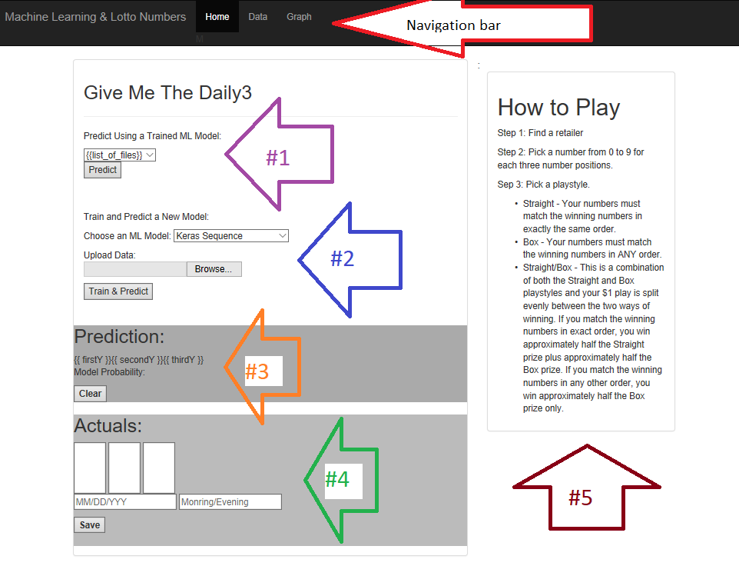
Wireframing
#1: User to select a trained model and click on predict button. Predictions will show in #3
#2: User to select the ML model to train with new data chosen in the ‘Upload Data’ and click the Train & Predict button. New trained model will be added to #1 list. Predicted numbers will show in #3
#3: User to click on clear button to clear the predicted numbers
#4: User to enter actual winning numbers. Data will be added to data used in #1 &2. “Data” page will render will historical winning numbers.
#5: Info on how to play
Navigation bar: Graph – visualization of hot numbers.

Slide 8
Demo time But first…

Slide 9
A gentle reminder from the California state lottery
PLEASE
PLAY
RESPONSIBLY

Slide 10
Questions?

