Slide 1
On the creation of a pronunciation dictionary for Hungarian
Stephen Grimes
stgrimes@indiana.edu
Midwest Computational Linguistics Colloquium
UIUC, May 20-21, 2006

Slide 2
Pronunciation Dictionary?
Consider the word szabadság ‘liberty; freedom’
The ‘d’ is pronounced [t] due to voicing assimilation.
The ‘ds’ consonant cluster is actually pronounced [čč] due to affrication.
‘sz’ is a digraph
‘á’ uses a diacritic; there are character encoding issues

Slide 3
Outline for today:
Motivation for a pronunciation dictionary
A strange kind of phonology? The relationship between spoken and written Hungarian
Error identification, deliberate omissions, and future additions
Applications of a pronunciation dictionary in cross-linguistic study and within Hungarian linguistics

Slide 4
Motivation: what is it used for?
Studying properties of the “mental lexicon”, phonological neighborhoods, Neighborhood Activation Model
Phonological complexity
Phonotactics, phonostatistics
Statistical models of sonority
Establishing a markedness hierarchy
Used in acoustic model for speech recognition
Interesting when viewed as a phonology problem
What it’s not used for!
For native speakers or foreigners seeking such as resource, the “Magyar kiejtési szótár” already exists (Fekete, 1995).

Slide 5
Why Hungarian?
Agglutinative language with high morpheme::word ratio.
More inflectional morphemes than English.
Several computational tools are already available (Kornai, 1986; Halácsy et al, 2004)
Relatively close relationship between writing and pronunciation allows for this.
Studying Hungarian is fun!

Slide 6
The Hoosier Mental Lexicon
HML (Nusbaum et al., 1984): developed at the Psychology Department at Indiana University
For ~20,000 English words, HML gives written form, a broad phonetic transcription, and the corpus frequency of the word.
Additionally, the HML contains data on word familiarity ratings, judged by subjects on a scale of one to seven.

Slide 7
Goals for Hungarian dictionary
Correct the majority of sound/symbol discrepancies.
One-to-one mapping of sound to symbol
Use ASCII-based alphabet for portability
Phonetic forms should represent the idealized standard dialect, present day...
Large vocabulary: 67,000 words
Include word frequencies

Slide 8
Orthography | OGOB7 (Szigetvári)
cs | C
ch | H
dzs | D
dz | F
gy | G
ly | L
ny | N
sz | S
ty | T
zs | Z
á | A
é | E
í | I
ó | O
ú | U
ö | w
ő | W
ü | y
ű | Y

Slide 9
Outline for today:
Motivation for a pronunciation dictionary
A strange kind of phonology? The relationship between spoken and written Hungarian
Error identification, deliberate omissions, and future additions
Applications of a pronunciation dictionary in cross-linguistic study and within Hungarian linguistics

Slide 10
Changes needed to create dictionary
historical spelling variants
digraphs and trigraphs
phonological rules
  vowel, consonant length alternations
  several types of assimilation
  glide insertion
morphophonological rules
  imperative forms

Slide 11
digraphs and trigraphs
Fortunately digraph ambiguity occurs only in compound words.
[zs]
rézsűn ‘on the slope’ (rézsű ’slope’, uncommon)
rézsün ‘copper hedgehog’ (réz ‘copper’, sün ‘hedgehog’)
[szs]
sertészsír ‘pork grease’ (sertés ’pig’, zsír ‘grease’)
kertészsír ‘gardener’s grave’ (kertész ’gardener’,
sír ’grave’)
[cs]
lécsín ‘liquid beauty’ or ‘slat track’
[tty]
hattyúk ‘six hens’ or ‘swans’
Are such examples widespread or isolated???

Slide 12
Phonology: assimilation
Voicing assimilation
Palatalization
Affrication
Nasal place assimilation
NB. Some types of assimilation are marked in the orthography.
/ember + vel/ -> [emberrel]

Slide 13
Phonology: regressive voicing assimilation
The voicing feature for a consonant must agree with the voicing feature of a following consonant
Exceptions:
1. do not undergo assimilation: h, j, m, n, ny, r
2. do not cause assimilation: v

Slide 14
Phonology: regressive voicing assimilation
Written Form | Pronounced Form | Gloss
abszolút | apszolút | ’absolute’
joghurt | jokhurt | ’jogurt’
olvasd el | olvazsd el | ’read it’
népdal | nébdal | ’folksong’
kútban | kúdban | ‘in the well’
húsdaráló | húzsdaráló | ‘meatgrinder’
kerékgyártó | keréggyártó | ’wheelmaker’

Slide 15
Phonology: nasal place assimilation
A nasal consonant must agree with the place of articulation feature of a following consonant.
Written Form | Pronounced Form | Gloss
szénpor | szémpor | ’coal dust’
különben | külömben | ’otherwise’
szenved | szemved | ’suffer’
mondja | monygya | ’she says’

Slide 16
Phonology: palatalization
A coronal stop is palatalized, often in imperative or 3rd singular forms.
{t, d, n} + j -> {tty, ggy, nny}
Written Form | Pronounced Form | Gloss
látja | láttya | ‘he sees it’
adjuk | aggyuk | ‘we give it’
menjen | mennyen | ‘he should go’

Slide 17
Phonology: affrication
A plosive and a following sibilant coalesce into an affricate of the appropriate place of articulation. The resulting affricate is usually a long consonant, unless reduced due to being adjacent to another consonant.
{t, ty} + s -> ccs {t, ty} + sz -> cc
Written Form | Pronounced Form | Gloss
váltson | válcson | ‘it should change’
szabadság | szabaccság | ‘freedom’
egyszer | eccer | ‘once’
maradsz | maracc | ‘you stay’

Slide 18
Phonology: glide insertion
A glide consonant [j] is inserted to interrupt hiatus between two vowels
whenever one of the vowels is i, í, e, or é.
Written Form | Pronounced Form | Gloss
tea | teja | ’tea’
szia | szija | ’hello’
hiába | hijába | ‘in vain’
nénié | nénijé | ‘the aunt’s’
dió | dijó [gyó]? | ‘walnut’
kiöl | kijöl | ‘extinguish’

Slide 19
Consonant length alternations
Shortening – Long consonants are produced short before or after consonants
  orrhang [orhang] ‘nasal’
Lengthening (treat these as exceptions?)
  egy [eggy], egyet [eggyet]
  lesz [lessz]
  edz [eddz], bridzs [briddzs] (affects all dz, dzs in coda position)
Deletion in triconsonantal clusters
  -middle consonant in tri-consonantal sequence can be elided
  -t and d are particularly susceptible to this
  mindnyájan [minnyájan], kezdhetjük [keszhettyük] / [keszthettyük]

Slide 20
Vowel length alternations
Written Form | Pronounced Form | Gloss
őrs | örs | patrol
gyűjt | gyüjt | collect
ródli | ródli | sled
csúzli | csúzli | slingshot

Slide 21
Vowel length phonotactics
Mid vowels in word-final position
  Typically marked in the orthography
  Exceptions are function words: no (well, [interjection]), ö ([ahh])
  Include phonotactic rule to apply to any foreign words
High vowels in word-final position
  High vowel exceptions (how are they pronounced)?
  Exceptions?:
    hamu, Pittyu, falu, kenu, kapu, daru, áru, anyu, apu, saru
    menü, eskü

Slide 22
Some implementation issues
Coding issues
  Each phoneme needs to be coded for articulatory features and sonority value
  Need morpheme boundaries
  Know word POS (function vs. content words)
Care must be taken to apply rules in order
Currently implemented in Perl using regular expressions

Slide 23
Outline for today:
Motivation for a pronunciation dictionary
A strange kind of phonology? The relationship between spoken and written Hungarian
Error identification, deliberate omissions, and future additions
Applications of a pronunciation dictionary in cross-linguistic study and within Hungarian linguistics

Slide 24
Omissions from current version
Correctly identifying compounds: rézsün, sertészsír [possibly not hard to correct]
Phonological rules applying only in presence or absence of a morpheme boundary or only to certain parts of speech
“Slang” pronunciations / truncations:
  asszem (azt hiszem) “I believe (that)”
  nemtom (nem tudom) “I don’t know”
  valszeg (valószínűleg) “probably”

Slide 25
Error assessment
Two types of errors
  Need to have some notion of precision and recall:
  due to overlooked cases; rules applied incorrectly
  variability in the language; lack of genuine language standard creates
How to assign value to correctness?
  random sample of words to two speakers, see how often they agree on correctness?
Find more crucial examples to check:
  Words containing digraphs, words edited by one of my phonological rules
  egyszer → eGSer → eTSer → eccer

Slide 26
Future developments
Will there be standards for phonological lexicons / pronunciation dictionaries??
Add age of acquisition information or familiarity ratings for each word
Include subsets of pronounced forms, such as only vowels or only consonants and examine bigrams of these structures
Include syllable boundaries, CV skeletal structure
Support for some types of dialectical variation
Perceptual information: confusion matrices

Slide 27
Outline for today:
Motivation for a pronunciation dictionary
A strange kind of phonology? The relationship between spoken and written Hungarian
Error identification, deliberate omissions, and future additions
Applications of a pronunciation dictionary in cross-linguistic study and within Hungarian linguistics

Slide 28
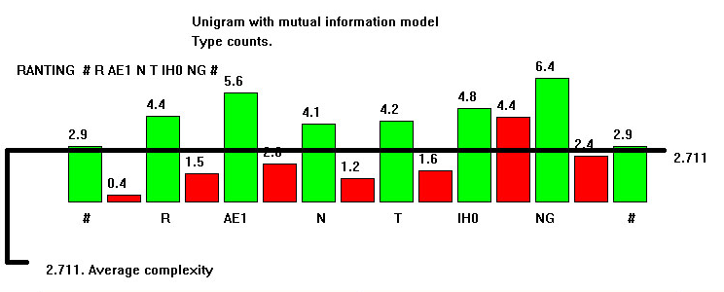
Phonotactics and probability
Phonological Complexity (Goldsmith, 2002)

Slide 29
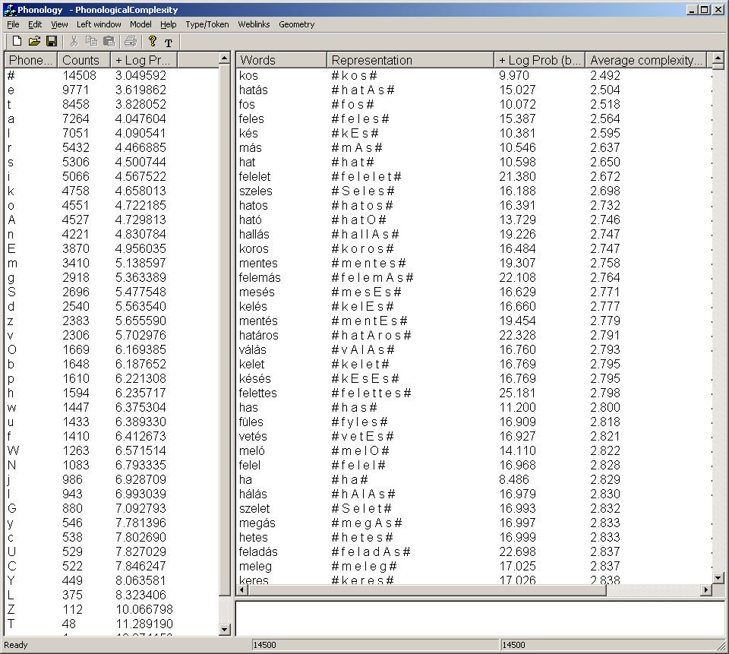

Slide 30
Phonological lexicon?
Neighborhood Activation Model (Luce, 1986; Luce and Pisoni, 1998; Barlow, 2000)
Probabilistic phonotactics (Vitevitch and Luce, 1999)
Developing accurate models of phonological similarity (e.g. Kapatsinski, to appear)

Slide 31
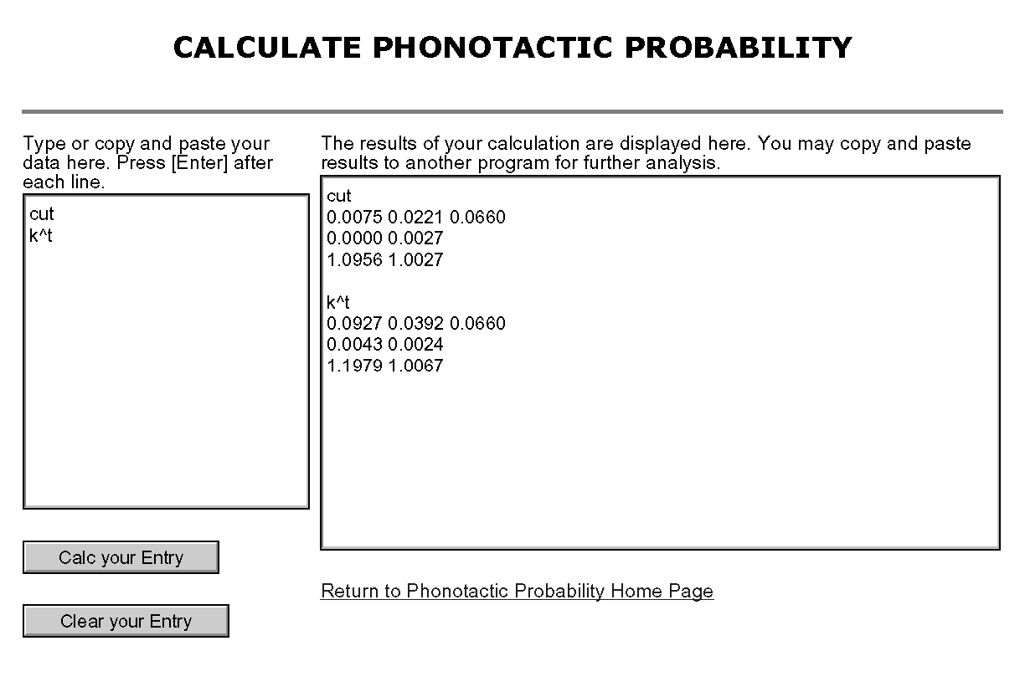

Slide 32
The Mental Lexicon as a Graph
Work by Mike Vitevitch (unpublished) and Gruenenfelder and Pisoni (to appear)
Each (phonetically distinct) word is a node
A link is placed between two words if they differ by exactly one phoneme
  Deletion, addition, or substitution
  Neighbor, as defined by Luce and Pisoni, Landauer and Streeter, Greenberg and Jenkins
What are the properties of this graph?

Slide 33
Modeling the Lexicon as a Graph
Peak
Speed
Spook
Reach
Pea
Peak
Peach
Spike
Speech
Leech
Speak
Spoke
Seek

Slide 34
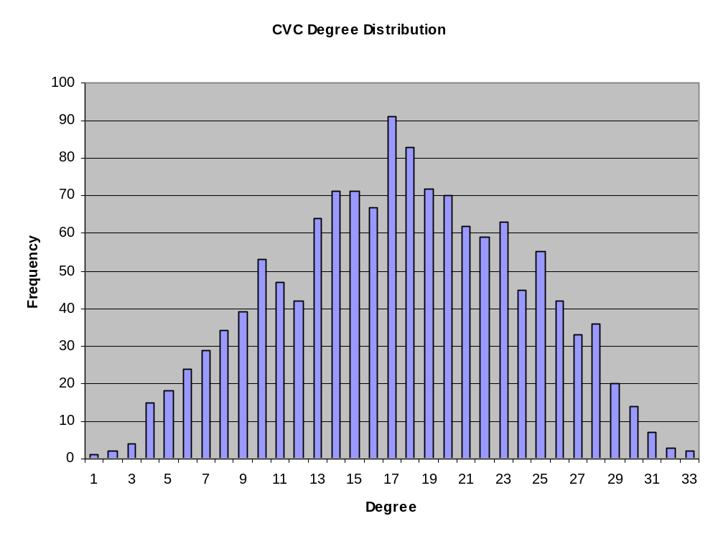
Degree Distribution for CVCs

Slide 35
A basis for further development of resources
Add further items related to phonological lexicon
Can serve as a basis for developing a morphologically annotated corpus of Hungarian
  Morphological parsers for Hungarian exist
  Using orthographic form, do alignment with the pronunciation dictionary to create a morphologically-annotated pronunciation dictionary.

Slide 36
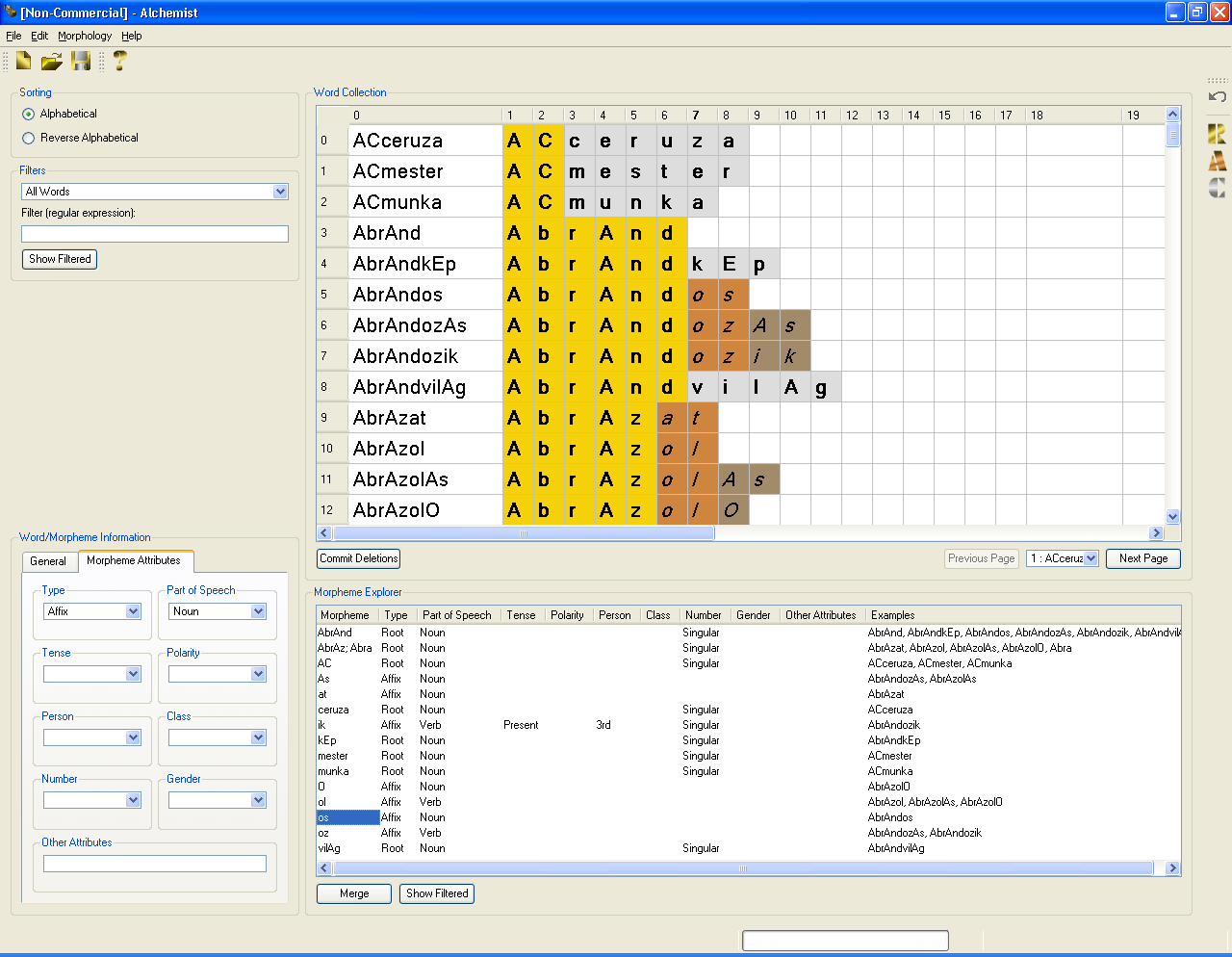

Slide 37
Applications to the study of Hungarian
Personal work: representation in phonology
  Double or single root node (Vago, 1992; Szigetvári, 2001)
  Complex onsets? (Törkenczy and Siptár, 1999)
  functional load of segments
  “Tiers” in language: vowel, consonant, syllable (weight, stress), sibilant projections (Hayes, pc)
Sonority Hierarchy (Kornai, 1990)
Vowel length in present Hungarian (Nádasdy and Siptár, 1998)
Vowel harmony, vacillation in vowel harmony

Slide 38
Acknowledgments
Thanks to Péter Szigetvári, Ádám Nádasdy, Péter Rebrus, Stuart Davis, Ken de Jong, and Damir Cavar.
The dictionary available for download for research purposes at
http://mypage.iu.edu/~stgrimes/dict/

