Slide 1
Introduction to web programming
Project by @sgrmshrsm7

Slide 2
E-commerce

Slide 3

Vivago

Slide 4
Overview
Have you ever searched for online hotels? If you have, then you must be knowing that different hotels give different prices and don’t give the features that you want in your hotel. Well, Vivago does the work for you and gives you our hotels at a very low price with great features. So, you can save money and time both by using Vivago Hotels to get your hotels at very less price with premium quality.

Slide 5
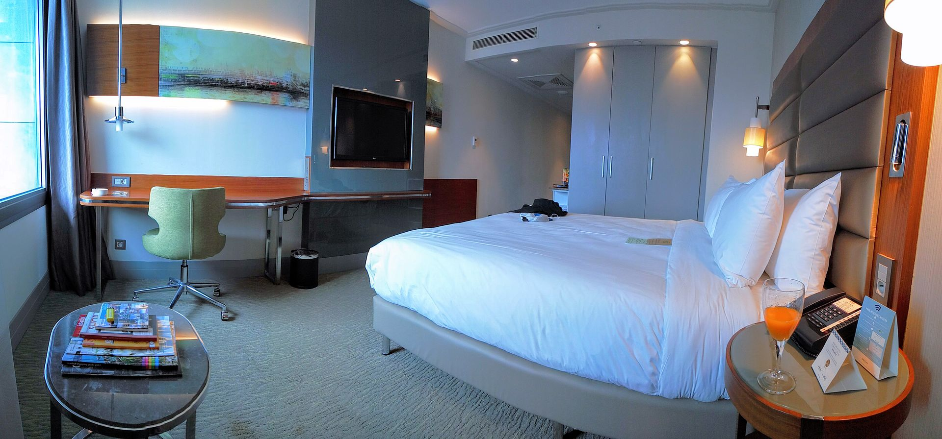

Sample Hotel Interiors

Slide 6
How to use?
Just go to Vivago website, type in where you want to go and with 2 clicks select your check in and check out dates and search, It’s that simple. Vivago will show you the best results according to your need. You can select price according to your budget, additional features(if you want), select number of stars and filter by average guest ratings to over 100 million reviews. Remember, Vivago will show you the different prices for different featured rooms. That’s how you can be sure to find your ideal hotel for the best price.

Slide 7
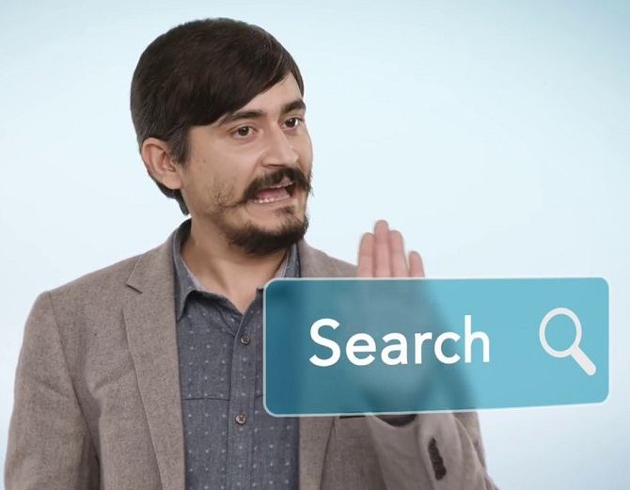

Slide 8
Key Features
Fast and easy pre-bookings.
Safe and Secure.
Filter according to various parameters like budget, reviews, additional features, distance and location.
User-friendly environment.
You can add additional features like gym, swimming pool, spa, massage etc.
Wide range of quality available for selection.
Exclusive offers for bookings through our platform.
Payments accepted via online mode and offline mode(on-spot bookings).

Slide 9
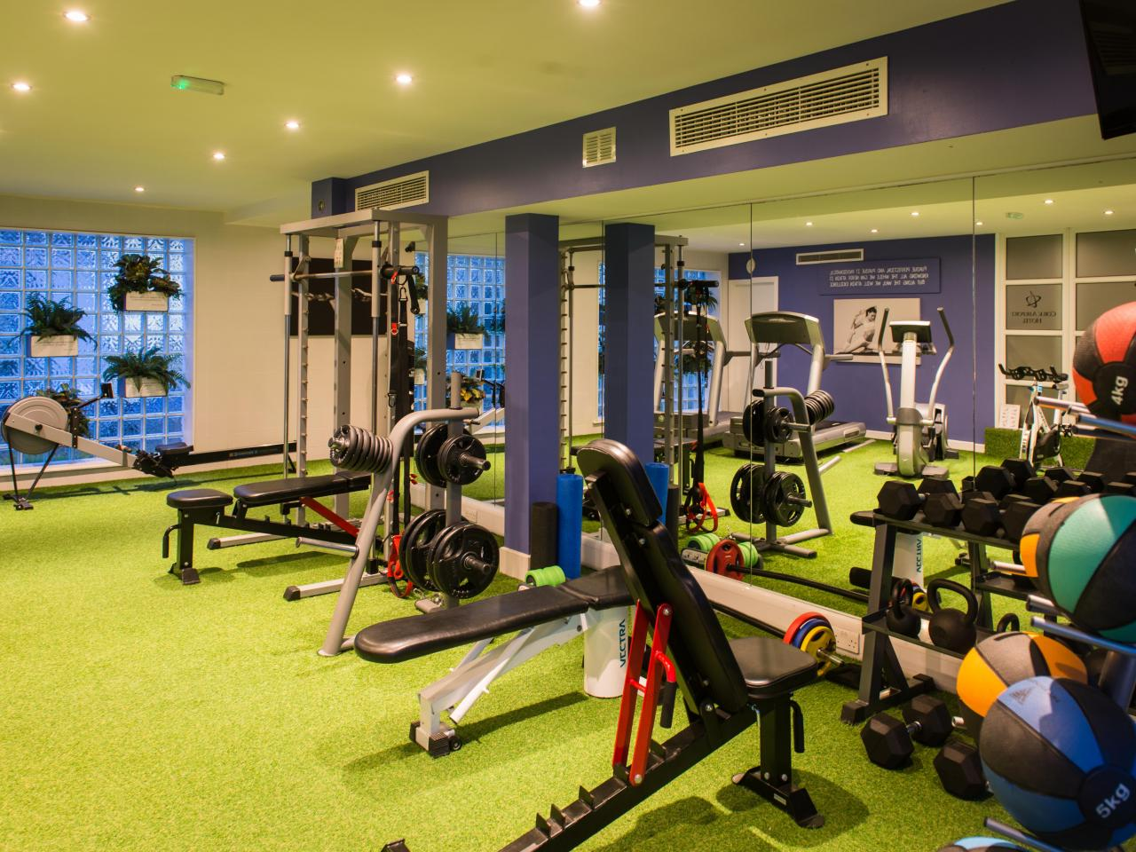

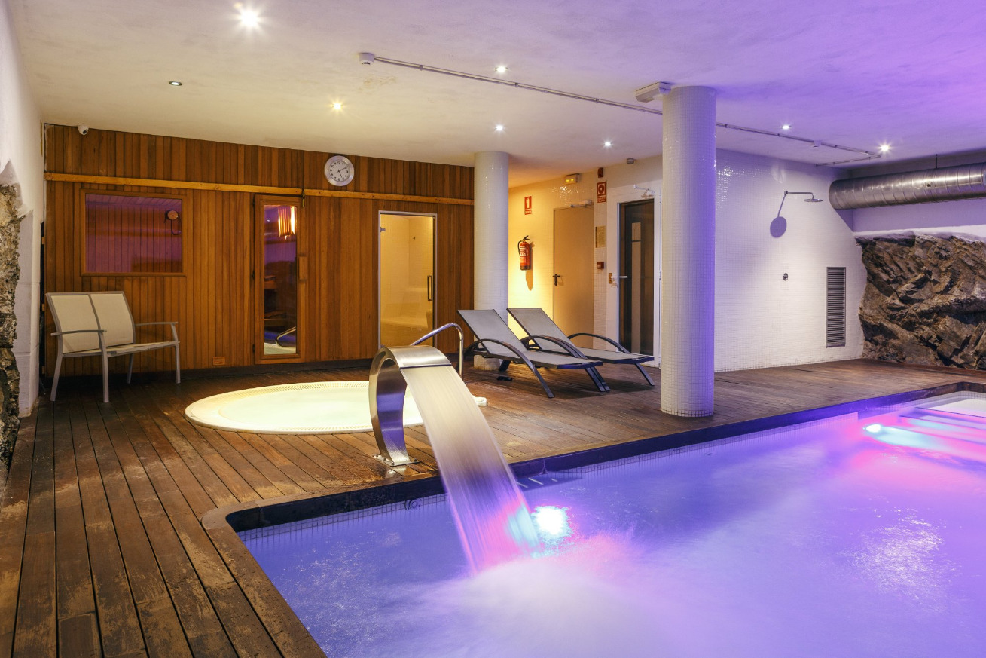

Special Features

Slide 10

Thank You

