Slide 1
Patterns of
D(archaic1, archaic2, modern human, ape)
stratified by B-allele frequency
in modern humans

Slide 2
Disclaimer:
    this is based on observations from real data, some simulations and discussions in meetings
    to my knowledge it has not been coherently
        formally written down
        explored with simulations
        (but see Supplement S9b, Figures S47-S66 from Prüfer et al. (2017).
        A high-coverage Neandertal genome from Vindija Cave in Croatia.
        which covers most of it)
    great future project! ;)

Slide 3
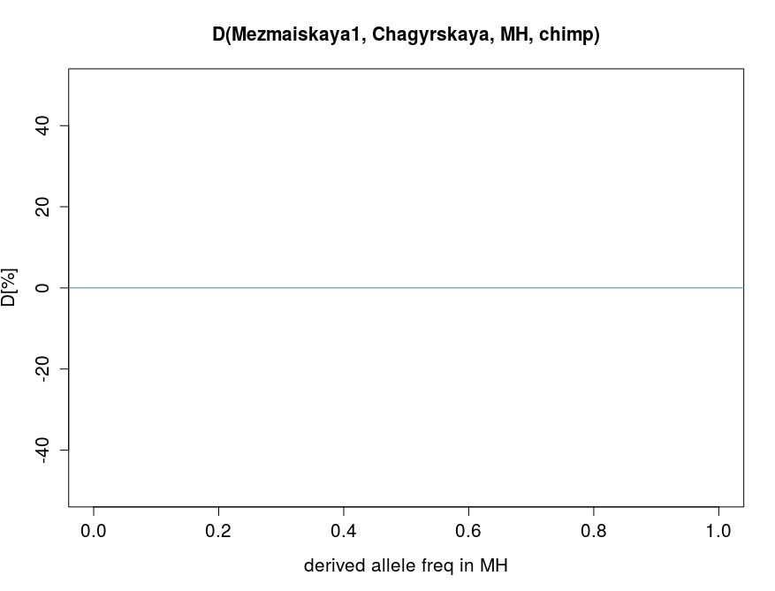
D(archaic1, archaic2, modern humans, ape)
Null-hypothesis:
modern humans are an outgroup to archaic1 and archaic2
no introgression
then:
numbers of ABBA and BABA
sites are equal
independent of modern human allele frequencies (?)
(effect of different Ne etc in archaics to be checked)
D = (BABA-ABBA) / (BABA+ABBA)
E(D) = 0
Arch1 Arch2 MH ape
A B B A
Arch1 Arch2 MH ape
B A B A
more BABA
D[%]
more ABBA
B-allele-frequency in MH

Slide 4
(1) effect of introgression
archaic → modern humans

Slide 5
example for introgression from archaic1
      effect 1: BAAA → BABA
      introgression of B allele
strongest at introgressed allele frequency
stronger the more diverged archaic1 and archaic2 are
more BABA
D[%]
more ABBA
B-allele-frequency in MH

Slide 6
example for introgression from archaic1
      effect 2: ABBA → ABAA
      introgression of A allele
strongest at introgressed allele frequency
    A-allele-frequency = 1 - B-allele-frequency
    ABBA sites get removed from fixed to high-frequency
more BABA
D[%]
more ABBA
B-allele-frequency in MH

Slide 7
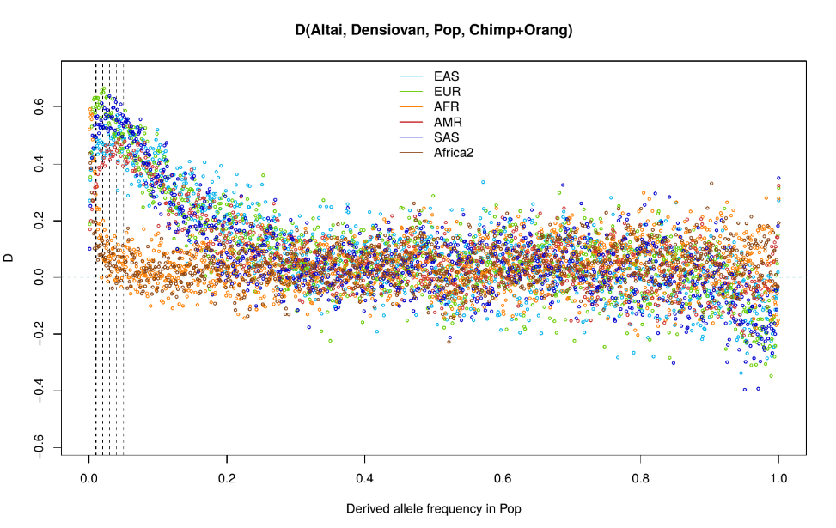
example for introgression with high-coverage genomes:
    Altai vs. Denisova → introgression from Neandertals
introgression:
more BABA
introgression signal
at lower frequency
for Africans
introgression
BAAA → BABA
introgression of ancestral allele
ABBA → ABAA:
fixed ABBA
gets converted to high-freq ABBA
more ABBA

Slide 8
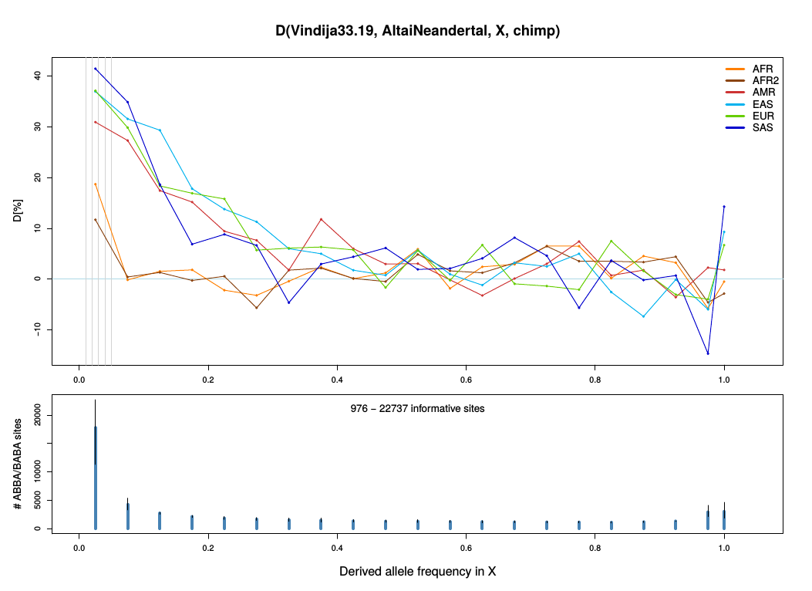
example for introgression with high-coverage genomes:
    Vindija vs. Altai → Vindija is closer to introgressing Neandertal
introgression:
more BABA
more ABBA
introgression
BAAA → BABA
introgression of ancestral allele
ABBA → ABAA:
fixed ABBA
gets converted to high-freq ABBA

Slide 9
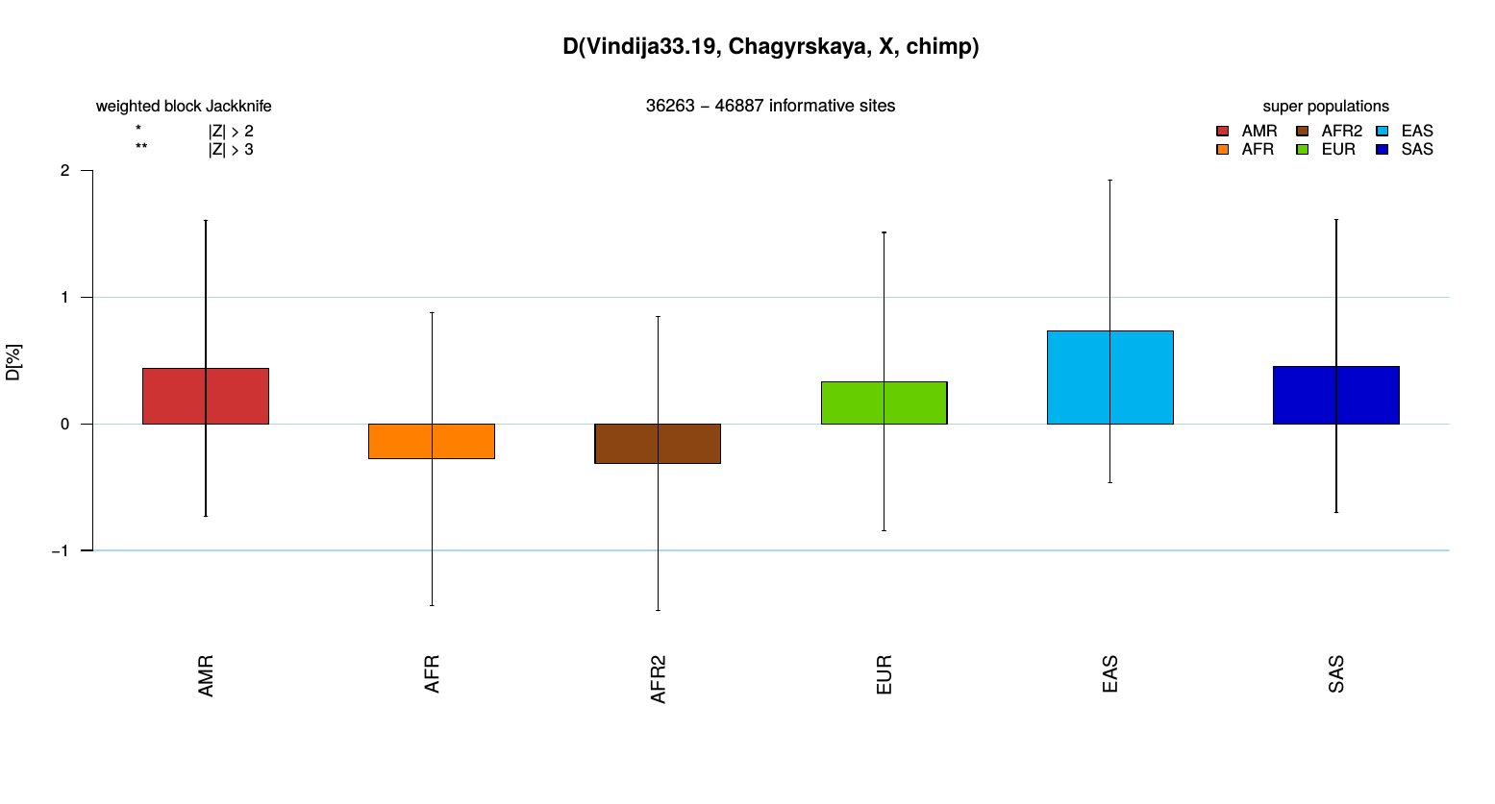
example for how stratified D-statistics can increase the power:
    regular D-statistics show no significant difference
    between Vindija and Chagyrskaya

Slide 10
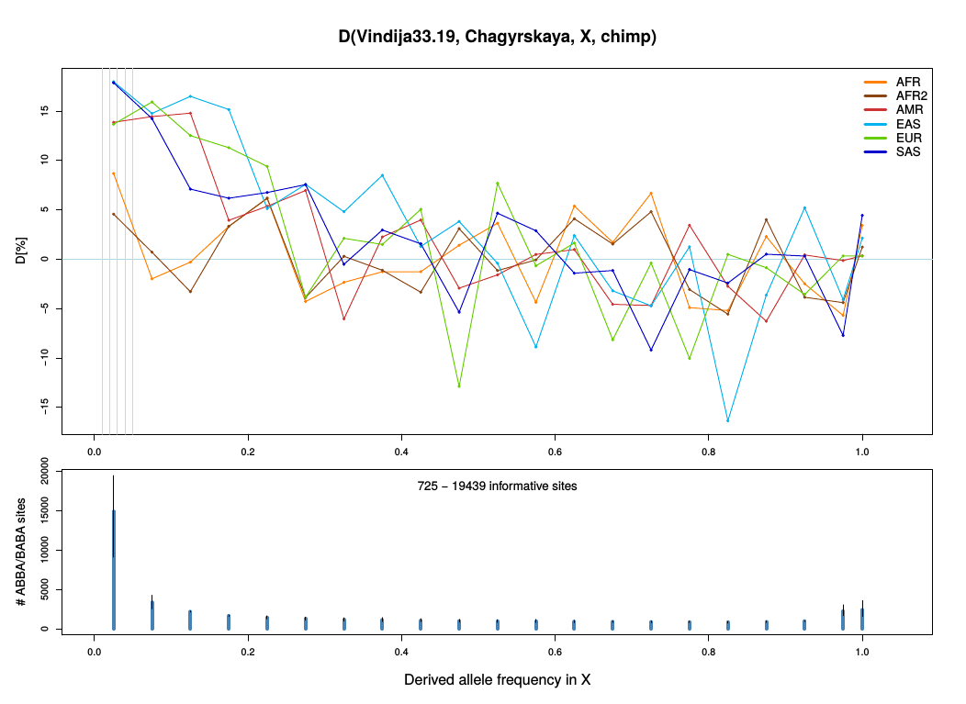
at low B-frequencies in modern humans Vindija shares more derived alleles with modern humans than Chagyrskaya
→ Vindija is closer to the introgressing Neandertal than Chayrskaya
more BABA
more ABBA

Slide 11
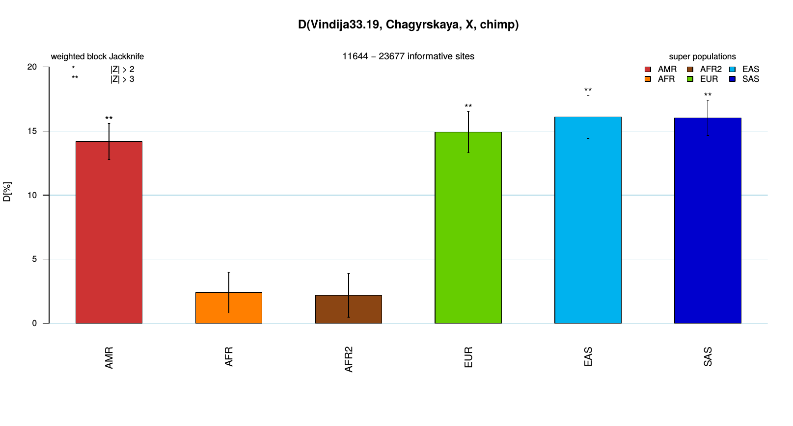
filter for B-frequency <= 10% in modern humans:
    signal for Vindija being closer to modern humans gets significant

Slide 12
(2) effect of contamination
(or MH → archaic introgression)

Slide 13
example for modern human contamination into archaic1
      effect 1: AABA → BABA
correlated with MH allele frequency
      contaminant more likely to share the B-allele with rising frequency of B
more BABA
D[%]
more ABBA
B-allele-frequency in MH

Slide 14
(3) effect of error

Slide 15
example for more errors in archaic1
      effect 1: BBBA → ABBA
most visible at fixed B in MH (most BBBA sites are fixed)
gets stronger with outgroup branch length (more BBBA sites)
more BABA
D[%]
more ABBA
B-allele-frequency in MH

Slide 16
example for more errors in archaic1
      effect 2: AABA → BABA
most visible at low B-frequency in MH (most AABA sites are low frequency)
more effect in Africans (more AABA sites)
more BABA
D[%]
more ABBA
B-allele-frequency in MH

Slide 17
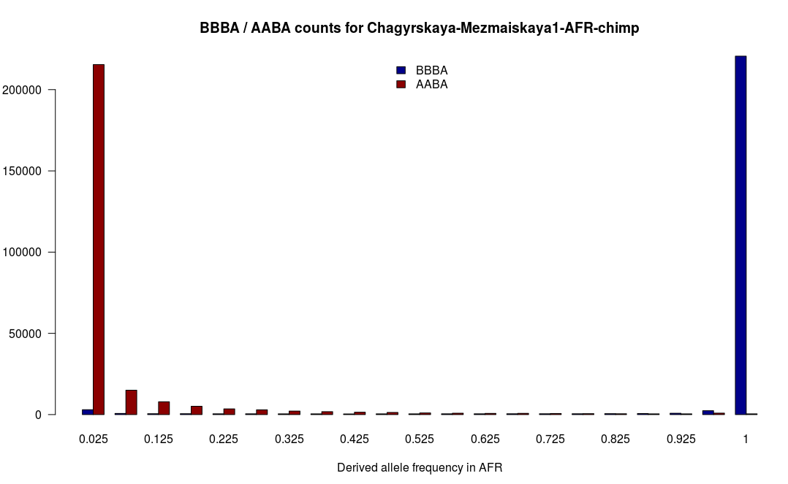
example of BBBA counts and ABAA counts per MH B-allele-frequency
starting point for effect 1 and effect 2 from errors in archaic1

Slide 18
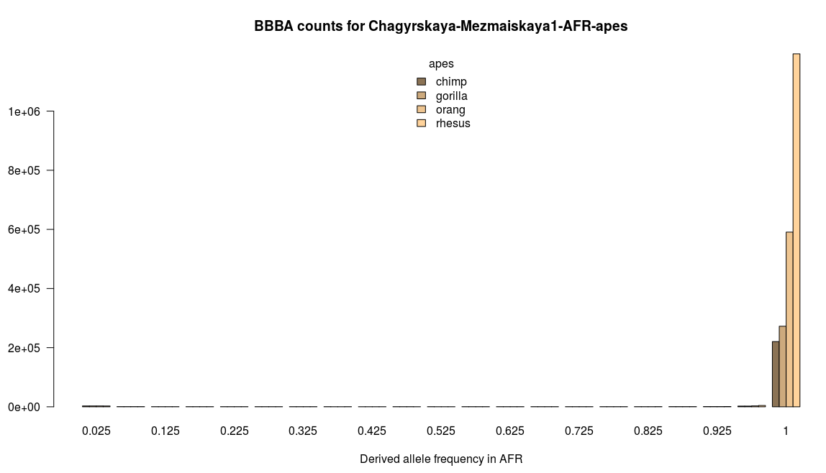
example of BBBA counts per MH B-allele frequency
for different outgroup branch lengths
starting point for effect 1 from errors in archaic1
chr1
hominins chimp gorilla orang rhesus

Slide 19
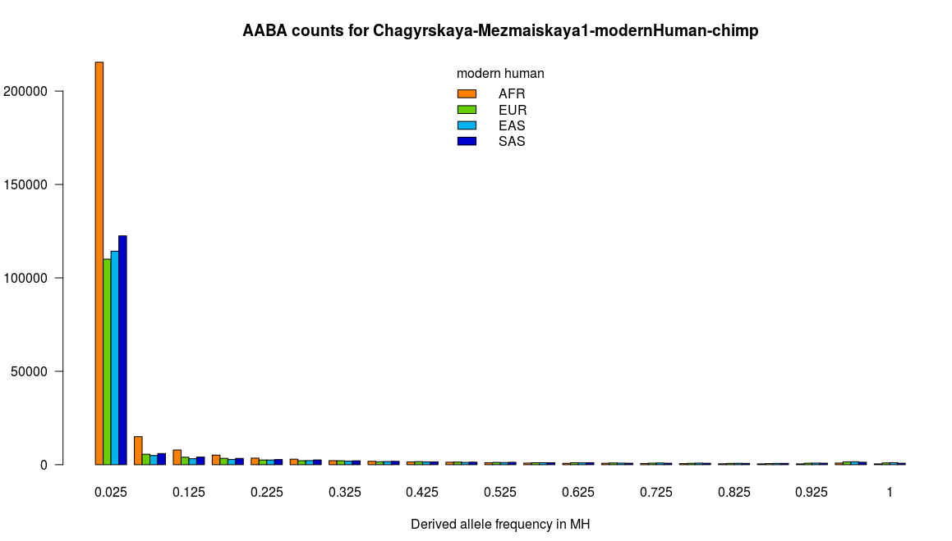
example of AABA counts per MH B-allele frequency
for different modern human populations
starting point for effect 2 from errors in archaic1

Slide 20
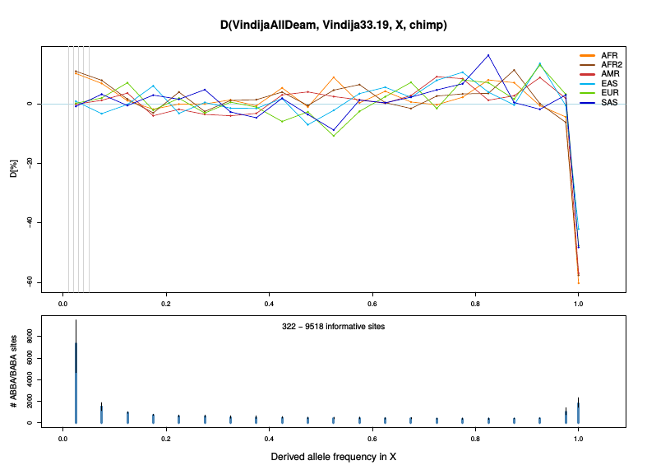
example for effect of errors:
    high-coverage Vindija33.19 genotypes vs. Vindija33.19 random reads
    same individual → 0-hypothesis of equidistance to introgressing Neandertal is true
more errors:

Slide 21
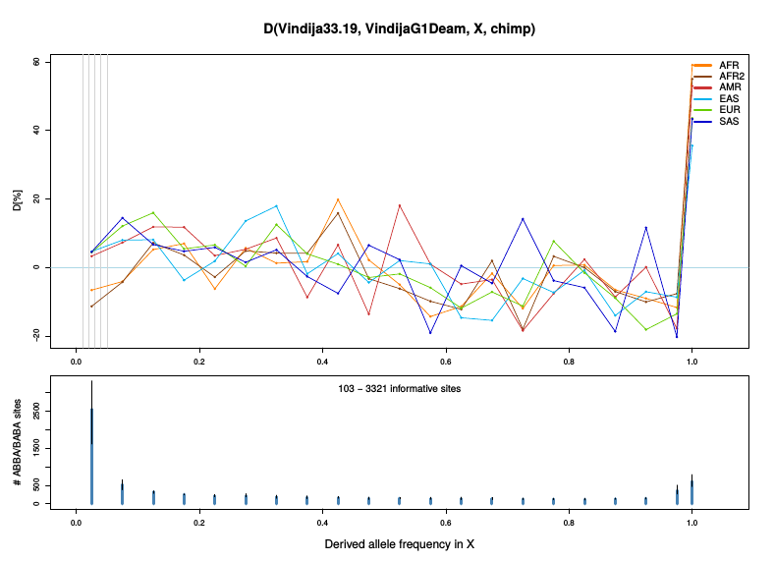
example for effect of errors + contamination:
    high-coverage Vindija33.19 genotypes vs. VindijaG1 random reads
    same individual → 0-hypothesis of equidistance to introgressing Neandertal is true
more errors:
contamination:

Slide 22
(4) effect of super-archaic introgression

Slide 23
example for super-archaic introgression into archaic1
      effect 1: BBBA → ABBA
most visible at fixed B in MH (most BBBA sites are fixed)
should not increase with outgroup branch length (unlike BBBA → ABBA error)
more BABA
D[%]
more ABBA
B-allele-frequency in MH

Slide 24
summary of patterns for B-allele-frequency-stratified D-statistics
introgression from archaic1:
    BAAA → BABA
    ABBA → ABAB
more errors in archaic1:
    BBBA → ABBA
    AABA → BABA
contamination in archaic1:
    AABA → BABA
more BABA
more ABBA
superarchaic into archaic1:
    BBBA → ABBA
more BABA
more ABBA

Slide 25
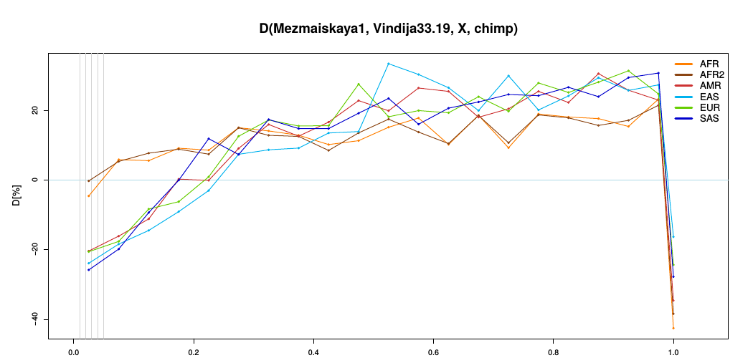
summary of patterns for B-allele-frequency-stratified D-statistics
introgression from archaic1:
    BAAA → BABA
    ABBA → ABAB
more errors in archaic1:
    BBBA → ABBA
    AABA → BABA
contamination in archaic1:
    AABA → BABA
more BABA
more ABBA
superarchaic into archaic1:
    BBBA → ABBA
more BABA
more ABBA

Slide 26
(4) effect of errors and outgroup branch length

Slide 27
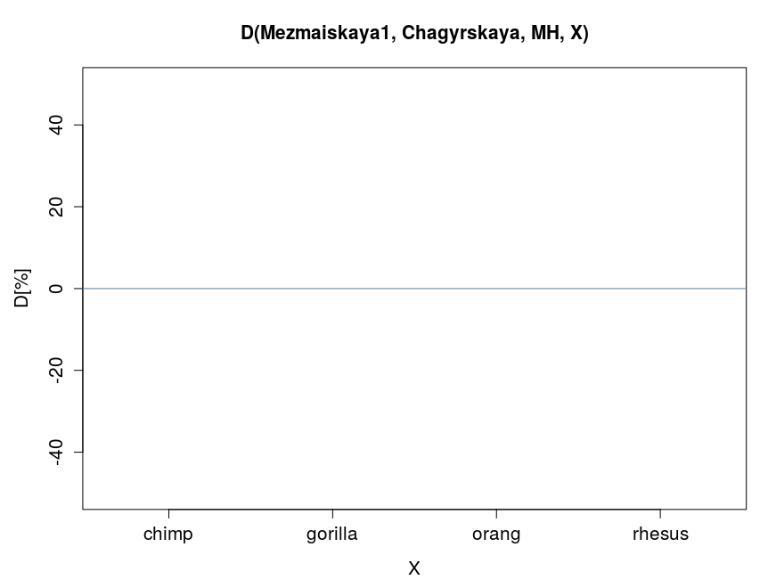
example for error in archaic1
      → bias genomewide D towards
      Chagyrskaya
      effect 1: BBBA → ABBA
expectation if Mezmaiskaya1 and Chagyrskaya are equally close to introgressing Neandertal:
with same quality:
with more errors in Mez1:
more BABA
more ABBA

Slide 28
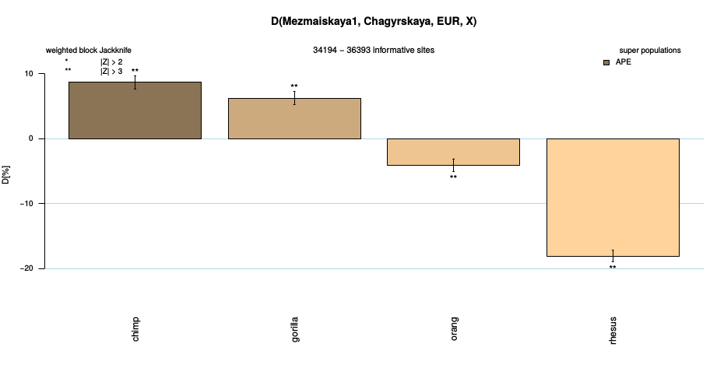
check for the effect of long branch attraction using different outgroups
1) for D using all sites the expected effect is very strong
all B-frequencies
more BABA
MH contam. in Mezmais
AABA → BABA
errors in Mezmais
BBBA → ABBA
more ABBA
increasing amount of BBBA sites

Slide 29
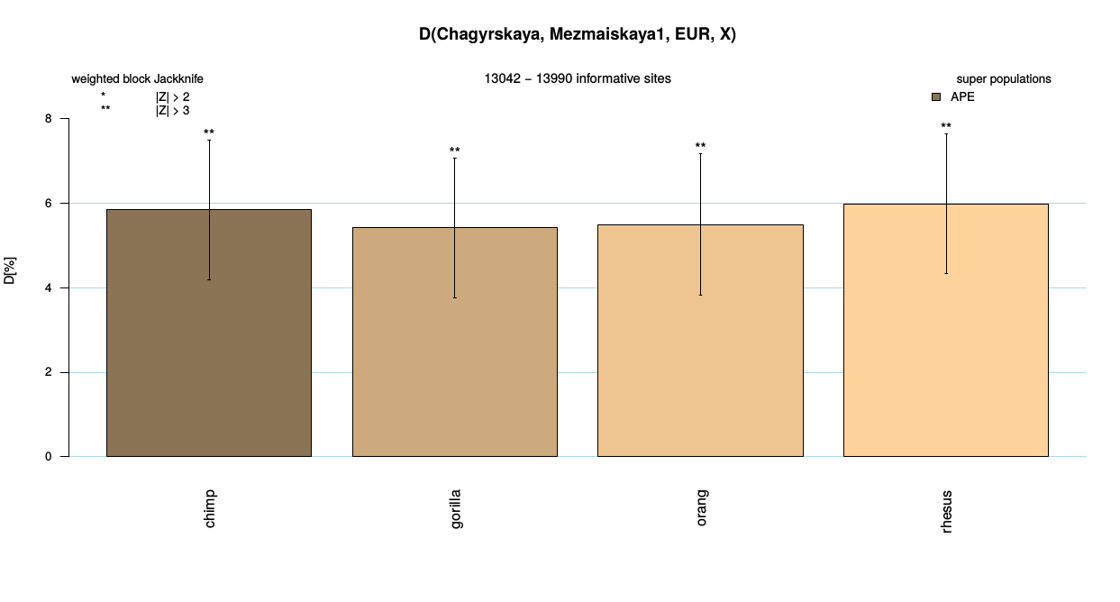
2) for D using only sites with B-freq <= 10% however long branch attraction is not observed at all
    because most BBBA sites are fixed B in modern humans
        errors affect mostly fixed B (also see freq-stratified D above)
        for low frequency B in modern humans there are
        few BBBA sites that can be converted to ABBA sites
B <= 10% in EUR
introgression Cha → EUR
BAAA → BABA
more BABA
more ABBA

Slide 30
also note:
stratifying by B-allele-frequency in
pop1 or pop2
makes no sense

Slide 31
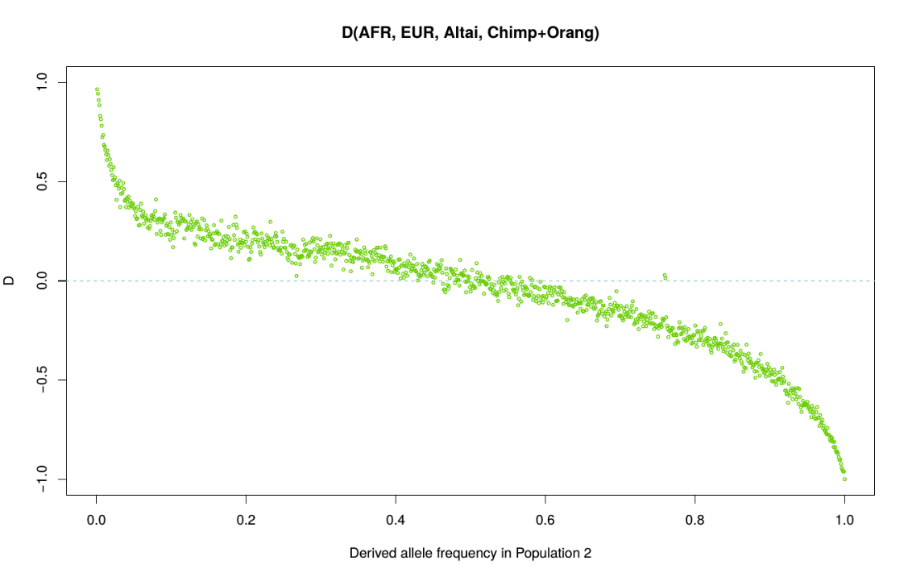
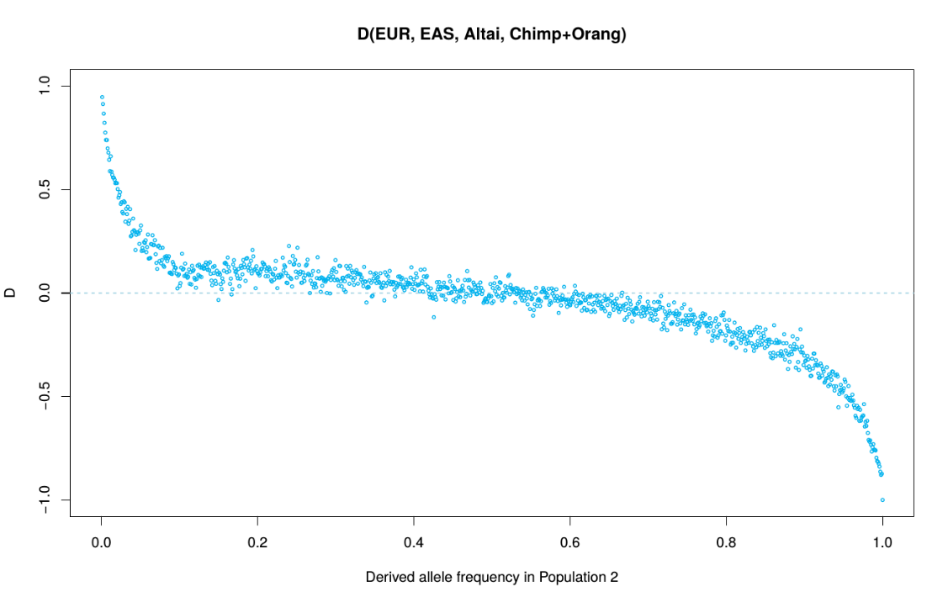
high B-freq in pop2:
  low A-freq in pop2
  more ABBA
low B-freq in pop2:
  high A-freq in pop2
  more BABA
this was also confusing Bill Amos, who claimed D(Afr, Eur, Nean, out) should have a stronger introgression signal at low B-frequencies in Europeans. But in fact he observed the opposite and interpreted that as evidence against introgression theory.
In fact one will always observe a pattern like on the right, independent of which MH pops are used
more BABA
more ABBA
more BABA
more ABBA
B-allele-frequency in population 2

