Slide 1
OPTIMIZING WIND ENERGY DISTRIBUTION IN NEW YORK STATE
PROBLEM STATEMENT
What is the best way to add 5000 3MW wind turbines (i.e., a total of 15000MW) to the existing power grid in New York state?
The best way is that which maximizes how much wind power we can consume, accounting for a complex network of factors:
West, East and Downstate NY grids
Existing power generation
Electricity demand
Transmission corridors
Power imports
Potential wind farm sites
Wind speeds and generation potentials
Maximum wind generation capacity

Slide 2
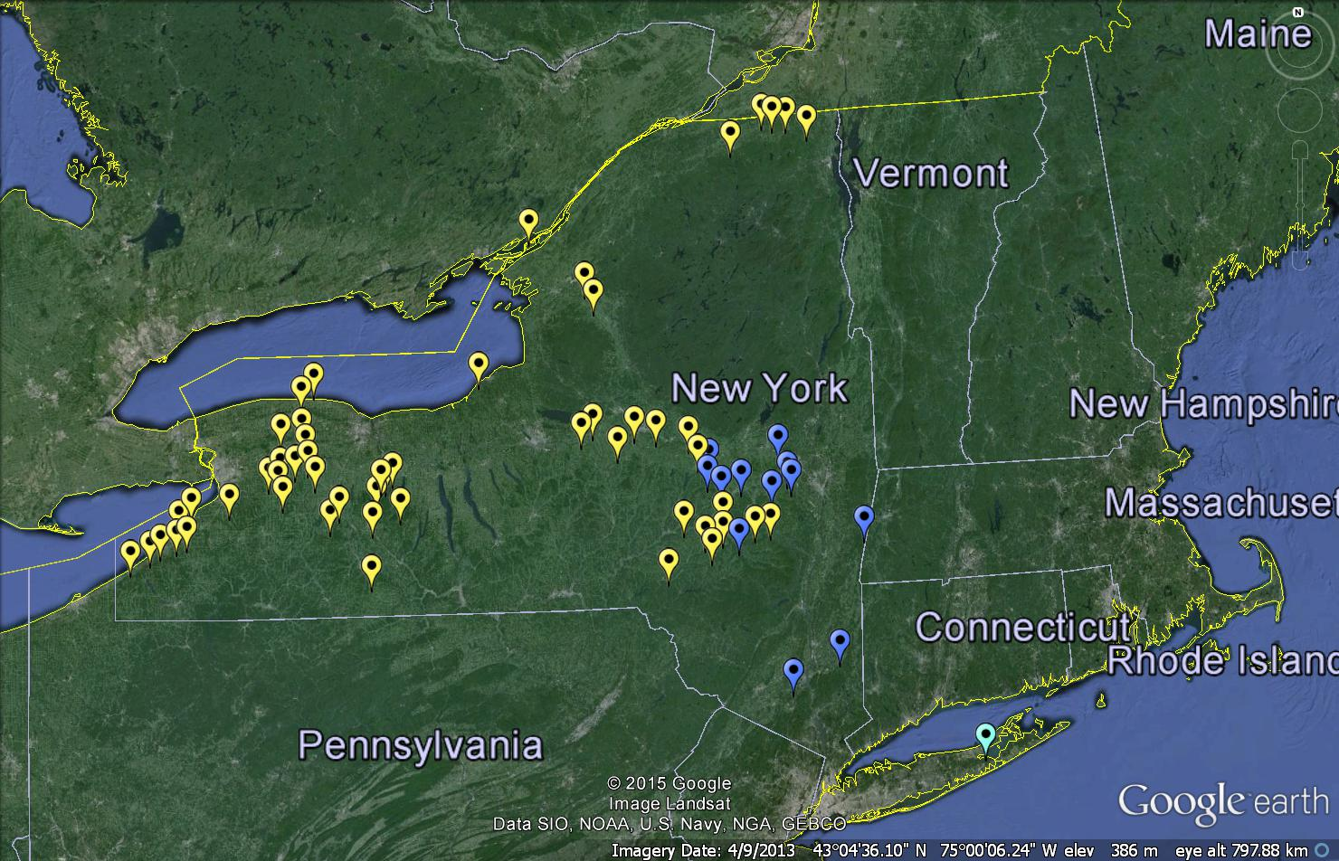










Windsites
Imports
Transmission
Lines
Power Gen.;
Coal/
Nuclear/
Hydro
Demand
(by size)

Slide 3
DATA
Demand
Hourly resolution
For each zone
Windsite
Zone and capacity of each site
66 x 2
Wind Resource
Max. Wind generation possible per turbine in kWh
Hourly resolution
Demand in kWh
For each site
Generation
Annual generation in GWh
Transmission
Baseload coal, nuclear, hydro and other peak gen.
For each zone
3 x 4
8760 x 66
8760 x 3
Transmission limits between zones in MW
2 x 1
Imports
Import limits from neighbouring states in MW
Four importers
For each zone
3 x 4
NREL & The Earth Institute

Slide 4
CASE 1: CONSTRAINTS ON DATA
Energy Balance in the West zone (8760 constraints)
Energy Balance in the East zone (8760)
$$\sum_{i∈w}{{gen.per.turb}_{i,h}×{n.t}_{i}+{other.gen.w}_{h}−{trans.w.e}_{h}≥{demand.w}_{h}−{base.gen.w}_{h}}$$
∑10_(𝑖∈𝑤)▒〖〖𝑔𝑒𝑛.𝑝𝑒𝑟.𝑡𝑢𝑟𝑏〗_(𝑖,ℎ)×〖𝑛.𝑡〗_𝑖+〖𝑜𝑡ℎ𝑒𝑟.𝑔𝑒𝑛.𝑤〗_ℎ−〖𝑡𝑟𝑎𝑛𝑠.𝑤.𝑒〗_ℎ≥〖𝑑𝑒𝑚𝑎𝑛𝑑.𝑤〗_ℎ−〖𝑏𝑎𝑠𝑒.𝑔𝑒𝑛.𝑤〗_ℎ 〗
$$\sum_{i∈e}{{gen.per.turb}_{i,h}×{n.t}_{i}+{other.gen.e}_{h}+{trans.w.e}_{h}−{trans.e.d}_{h}≥{demand.e}_{h}−{base.gen.e}_{h}}$$
∑2_(𝑖∈𝑒)▒〖〖𝑔𝑒𝑛.𝑝𝑒𝑟.𝑡𝑢𝑟𝑏〗_(𝑖,ℎ)×〖𝑛.𝑡〗_𝑖+〖𝑜𝑡ℎ𝑒𝑟.𝑔𝑒𝑛.𝑒〗_ℎ+〖𝑡𝑟𝑎𝑛𝑠.𝑤.𝑒〗_ℎ−〖𝑡𝑟𝑎𝑛𝑠.𝑒.𝑑〗_ℎ≥〖𝑑𝑒𝑚𝑎𝑛𝑑.𝑒〗_ℎ−〖𝑏𝑎𝑠𝑒.𝑔𝑒𝑛.𝑒〗_ℎ 〗
Energy Balance in the Downstate zone (8760)
$$\sum_{i∈d}{{gen.per.turb}_{i,h}×{n.t}_{i}+{other.gen.d}_{h}+{trans.e.d}_{h}≥{demand.d}_{h}−{base.gen.}_{h}}$$
∑2_(𝑖∈𝑑)▒〖〖𝑔𝑒𝑛.𝑝𝑒𝑟.𝑡𝑢𝑟𝑏〗_(𝑖,ℎ)×〖𝑛.𝑡〗_𝑖+〖𝑜𝑡ℎ𝑒𝑟.𝑔𝑒𝑛.𝑑〗_ℎ+〖𝑡𝑟𝑎𝑛𝑠.𝑒.𝑑〗_ℎ≥〖𝑑𝑒𝑚𝑎𝑛𝑑.𝑑〗_ℎ−〖𝑏𝑎𝑠𝑒.𝑔𝑒𝑛.〗_ℎ 〗
Total number of turbines (1)
$$\sum_{i∈NY}{{n.t}_{i}}=5000$$
∑2_(𝑖∈𝑁𝑌)▒〖𝑛.𝑡〗_𝑖 =5000
i – site
h – hour
gen.per.turb – generation per turbine
n.t – number of turbines
other.gen – non-baseload generation or imports
trans.a.b – transmission from a to b
demand – demand
base.gen – baseload generation

Slide 5
CASE 1: VARIABLES TO FIND
Number of turbines at a site (66 variables)
Non-baseload generation + imports in the West zone (8760)
$$0≤{n.t}_{i}≤{n.t.max}_{i}$$
0≤〖𝑛.𝑡〗_𝑖≤〖𝑛.𝑡.𝑚𝑎𝑥〗_𝑖
$$0≤{other.gen.w}_{h}≤{{other.gen.w.max}_{h}}_{}$$
0≤〖𝑜𝑡ℎ𝑒𝑟.𝑔𝑒𝑛.𝑤〗_ℎ≤〖〖𝑜𝑡ℎ𝑒𝑟.𝑔𝑒𝑛.𝑤.𝑚𝑎𝑥〗_ℎ〗_
Non-baseload generation + imports in the East zone (8760)
$$0≤{other.gen.e}_{h}≤{{other.gen.e.max}_{h}}_{}$$
0≤〖𝑜𝑡ℎ𝑒𝑟.𝑔𝑒𝑛.𝑒〗_ℎ≤〖〖𝑜𝑡ℎ𝑒𝑟.𝑔𝑒𝑛.𝑒.𝑚𝑎𝑥〗_ℎ〗_
Non-baseload generation + imports in the Downstate zone (8760)
$$0≤{other.gen.d}_{h}≤{{other.gen.d.max}_{h}}_{}$$
0≤〖𝑜𝑡ℎ𝑒𝑟.𝑔𝑒𝑛.𝑑〗_ℎ≤〖〖𝑜𝑡ℎ𝑒𝑟.𝑔𝑒𝑛.𝑑.𝑚𝑎𝑥〗_ℎ〗_
Transmission between West and East zones (8760)
$$0≤{trans.w.e}_{h}≤{{trans.w.e.max}_{h}}_{}$$
0≤〖𝑡𝑟𝑎𝑛𝑠.𝑤.𝑒〗_ℎ≤〖〖𝑡𝑟𝑎𝑛𝑠.𝑤.𝑒.𝑚𝑎𝑥〗_ℎ〗_
Transmission between East and Downstate zones (8760)
$$0≤{trans.e.d}_{h}≤{{trans.e.d.max}_{h}}_{}$$
0≤〖𝑡𝑟𝑎𝑛𝑠.𝑒.𝑑〗_ℎ≤〖〖𝑡𝑟𝑎𝑛𝑠.𝑒.𝑑.𝑚𝑎𝑥〗_ℎ〗_

Slide 6
CASE 1: OPTIMIZING
We want to minimize non-baseload power and imports
$$Min \sum_{h=1}^{8760}{{other.gen.w}_{h}+{other.gen.e}_{h}+{other.gen.d}_{h}}$$
𝑀𝑖𝑛 ∑24_(ℎ=1)^8760▒〖〖𝑜𝑡ℎ𝑒𝑟.𝑔𝑒𝑛.𝑤〗_ℎ+〖𝑜𝑡ℎ𝑒𝑟.𝑔𝑒𝑛.𝑒〗_ℎ+〖𝑜𝑡ℎ𝑒𝑟.𝑔𝑒𝑛.𝑑〗_ℎ 〗
Therefore, we have formulated a Mixed Integer Linear Programming (MILP) problem, with:
26281 constraints
43866 variables
We can solve this problem using the lpSolveAPI package in R (or lpsolve in Python, etc.) to obtain optimum values for our variables, which tells us:
The optimal distribution of 5000 turbines across 66 sites
A schedule for generators and importers in the three zones
A schedule for transmission between the three zones
while maximizing our utilization of wind power.

Slide 7
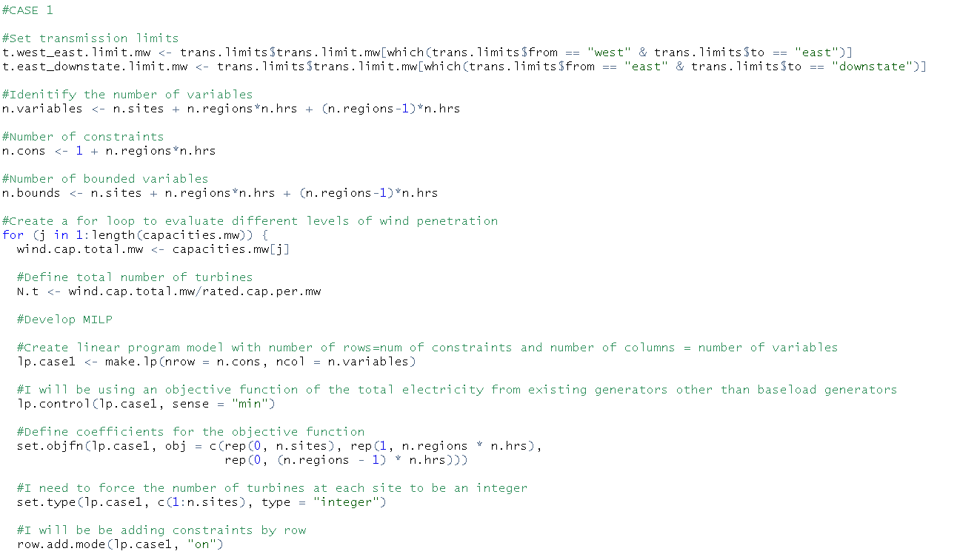
CASE 1: IMPLEMENTING IN lpSolveAPI

Slide 8
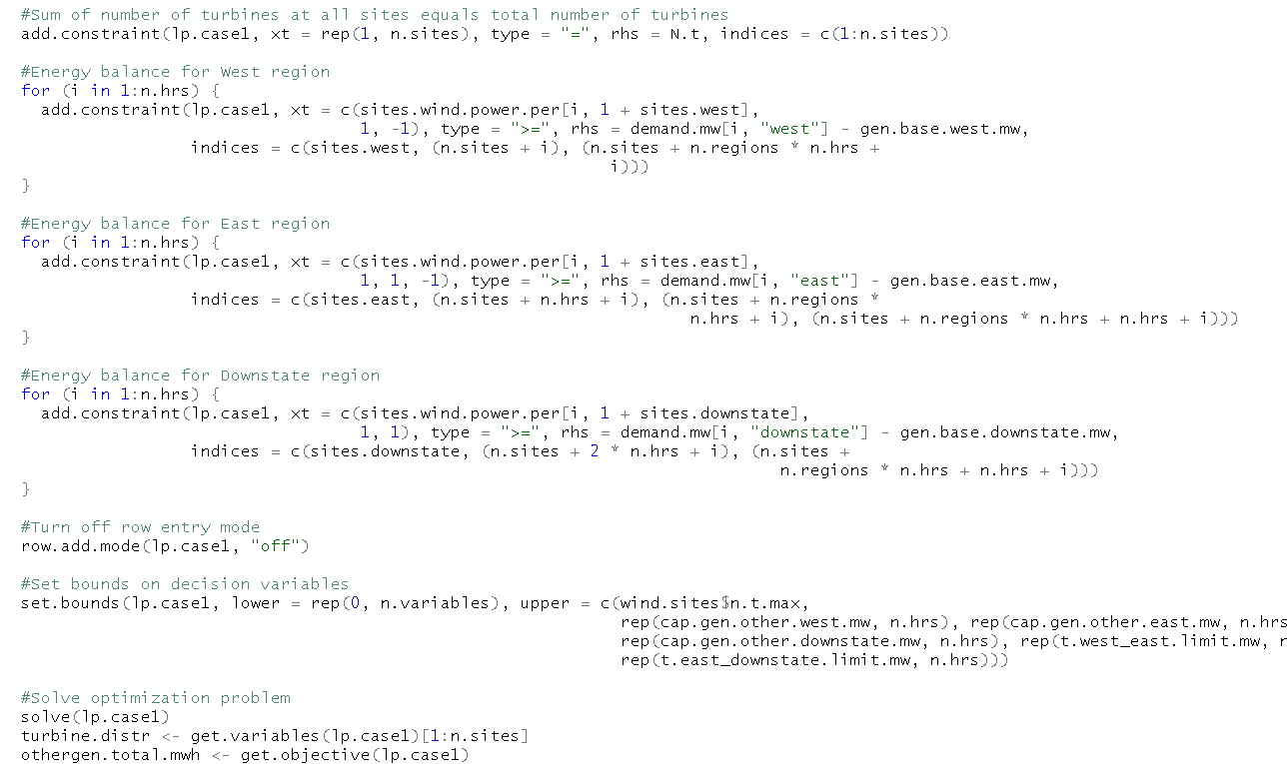
CASE 1: IMPLEMENTING IN lpSolveAPI

Slide 9
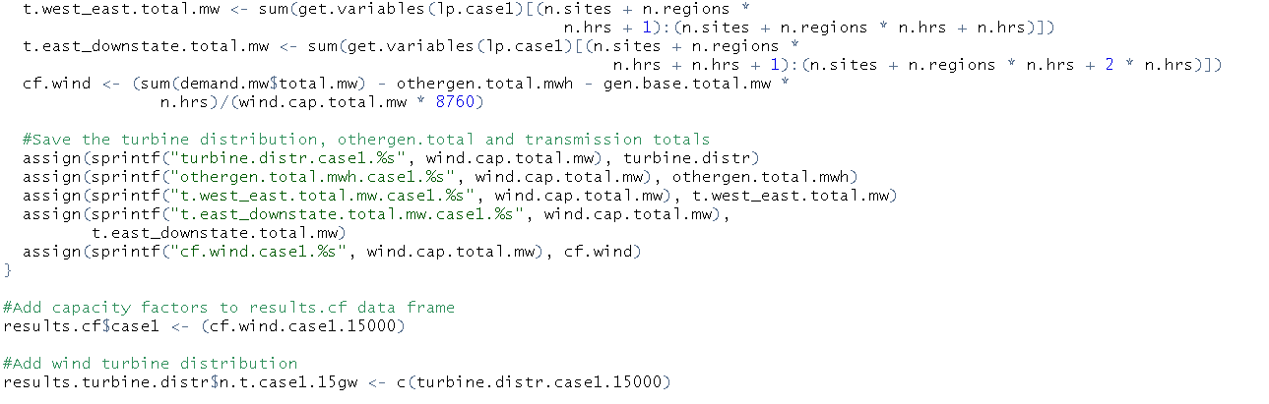
CASE 1: IMPLEMENTING IN lpSolveAPI

Slide 10
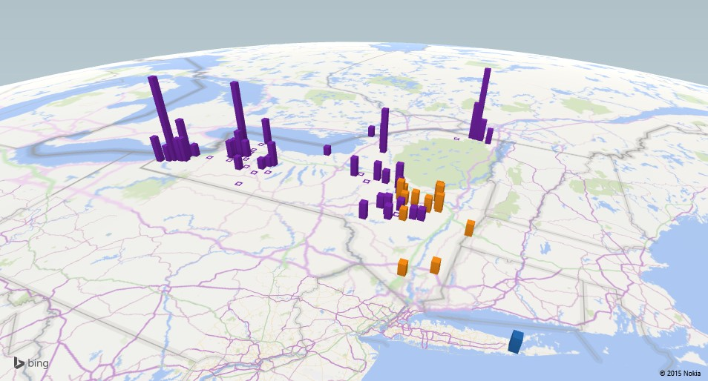
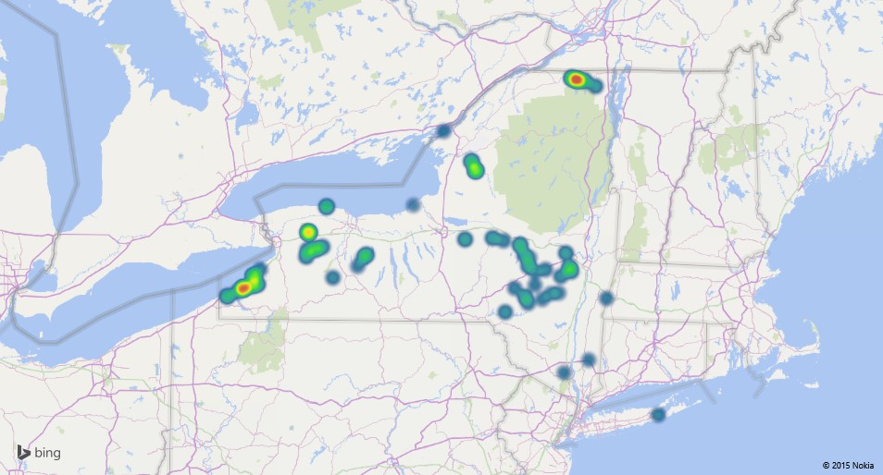
CASE 1: SOLUTION
The optimal distribution of 5000 turbines
This yields a Capacity Factor of
26.79%
This means that, with this optimal distribution, NY State will utilize 26.79% of its installed wind power capacity (15000MW).
This is good for large-scale deployment, but can it be better?

Slide 11
CASE 2: IMPROVEMENTS
Improvements can be obtained in the Capacity Factor if new transmission lines are added:
400MW/line
$1M/line/mi
West-East ~ 200mi, East-Downstate ~ 150mi
We want this addition of new lines to pay for itself, i.e., it should have zero net cost.
$${Total cost per MWh}_{Case 1}≥{Total cost per MWh}_{Case 2}$$
$${\frac{Annual cost of windE}{Annual generation of windE}}_{Case 1}≥{\frac{Ann. cost of windE+Ann. cost of trans. W.E+Ann. cost of trans.E.D}{Ann. generation of windE}}_{Case 2}$$

Slide 12
CASE 2: NEW CONSTRAINTS
Cost (1 constraint)
Transmission between West and East zones (8760)
$$\sum_{h=1}^{8760}{\begin{aligned}other.gen+\frac{8760×{CF}_{Case1}×Ann.cost.per.line.w.e}{Ann.cost.wind.per.mw}×n.l.w.e+\frac{8760×{CF}_{Case1}×Ann.cost.per.line.w.e}{Ann.cost.wind.per.mw}×n.l.w.e \\ \end{aligned}}$$
∑24_(ℎ=1)^8760▒█(𝑜𝑡ℎ𝑒𝑟.𝑔𝑒𝑛+(8760×〖𝐶𝐹〗_𝐶𝑎𝑠𝑒1×𝐴𝑛𝑛.𝑐𝑜𝑠𝑡.𝑝𝑒𝑟.𝑙𝑖𝑛𝑒.𝑤.𝑒)/(𝐴𝑛𝑛.𝑐𝑜𝑠𝑡.𝑤𝑖𝑛𝑑.𝑝𝑒𝑟.𝑚𝑤)×𝑛.𝑙.𝑤.𝑒+(8760×〖𝐶𝐹〗_𝐶𝑎𝑠𝑒1×𝐴𝑛𝑛.𝑐𝑜𝑠𝑡.𝑝𝑒𝑟.𝑙𝑖𝑛𝑒.𝑤.𝑒)/(𝐴𝑛𝑛.𝑐𝑜𝑠𝑡.𝑤𝑖𝑛𝑑.𝑝𝑒𝑟.𝑚𝑤)×𝑛.𝑙.𝑤.𝑒@)
$$≤\sum_{h=1}^{8760}{demand−8760×base.gen−8760×{CF}_{Case1}×total.capacity}$$
≤∑24_(ℎ=1)^8760▒〖𝑑𝑒𝑚𝑎𝑛𝑑−8760×𝑏𝑎𝑠𝑒.𝑔𝑒𝑛−8760×〖𝐶𝐹〗_𝐶𝑎𝑠𝑒1×𝑡𝑜𝑡𝑎𝑙.𝑐𝑎𝑝𝑎𝑐𝑖𝑡𝑦〗
$${trans.w.e}_{h}−line.capacity×n.l.w.e≤{trans.w.e.max}_{h}$$
〖𝑡𝑟𝑎𝑛𝑠.𝑤.𝑒〗_ℎ−𝑙𝑖𝑛𝑒.𝑐𝑎𝑝𝑎𝑐𝑖𝑡𝑦×𝑛.𝑙.𝑤.𝑒≤〖𝑡𝑟𝑎𝑛𝑠.𝑤.𝑒.𝑚𝑎𝑥〗_ℎ
Transmission between East and Downstate zones (8760)
$${trans.e.d}_{h}−line.capacity×n.l.e.d≤{trans.e.d.max}_{h}$$
〖𝑡𝑟𝑎𝑛𝑠.𝑒.𝑑〗_ℎ−𝑙𝑖𝑛𝑒.𝑐𝑎𝑝𝑎𝑐𝑖𝑡𝑦×𝑛.𝑙.𝑒.𝑑≤〖𝑡𝑟𝑎𝑛𝑠.𝑒.𝑑.𝑚𝑎𝑥〗_ℎ
Ann.cost.per.line.w.e/e.d = capital cost per mile * length * recovery factor
Ann.cost.wind.per.mw = capital cost per MW * recovery factor
n.l.w.e – number of new lines from West to East
n.l.e.d – number of new lines from East to Downstate

Slide 13
CASE 2: OPTIMIZING
As before, we want to minimize non-baseload power and imports
$$Min \sum_{h=1}^{8760}{{other.gen.w}_{h}+{other.gen.e}_{h}+{other.gen.d}_{h}}$$
𝑀𝑖𝑛 ∑24_(ℎ=1)^8760▒〖〖𝑜𝑡ℎ𝑒𝑟.𝑔𝑒𝑛.𝑤〗_ℎ+〖𝑜𝑡ℎ𝑒𝑟.𝑔𝑒𝑛.𝑒〗_ℎ+〖𝑜𝑡ℎ𝑒𝑟.𝑔𝑒𝑛.𝑑〗_ℎ 〗
We have now obtained a more complex Mixed Integer Linear Programming (MILP) problem, with:
43802 constraints
43868 variables
Again, we solve this using the lpSolveAPI package in R (or lpsolve in Python, etc.) to obtain optimum values for our variables, which tells us:
The optimal distribution of 5000 turbines across 66 sites
Number of new transmission lines between zones at zero net cost
A schedule for generators and importers in the three zones
A schedule for transmission between the three zones
while maximizing our utilization of wind power.

Slide 14
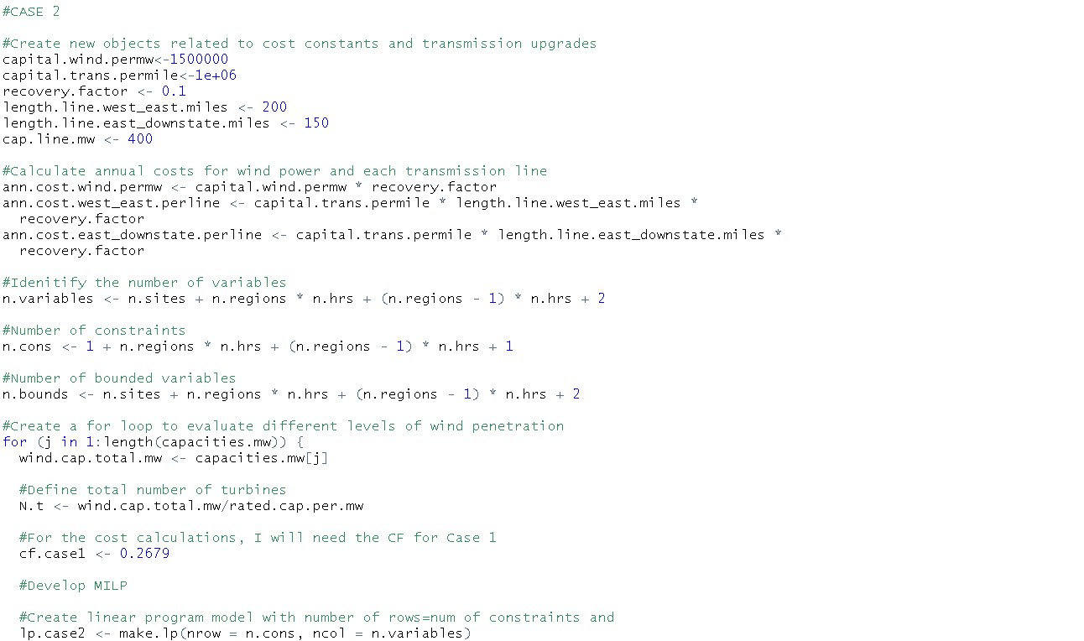
CASE 2: IMPLEMENTING IN lpSolveAPI

Slide 15
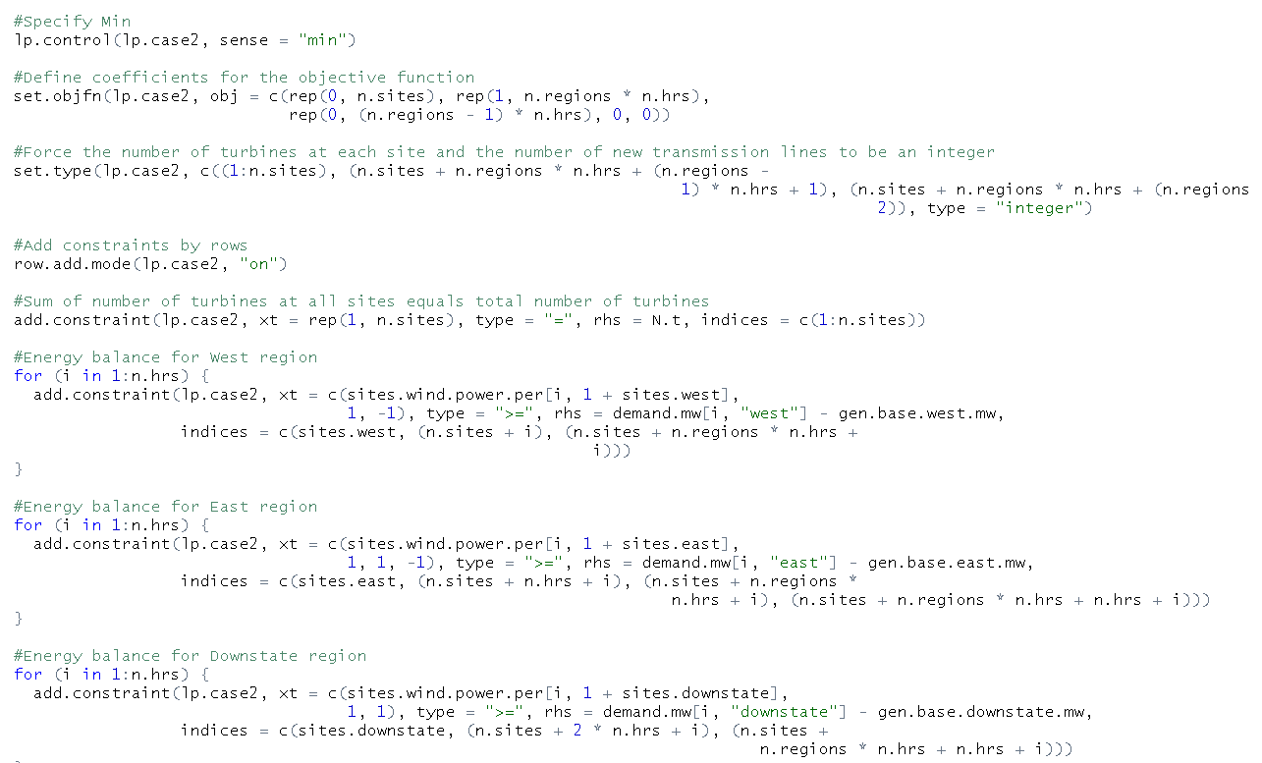
CASE 2: IMPLEMENTING IN lpSolveAPI

Slide 16
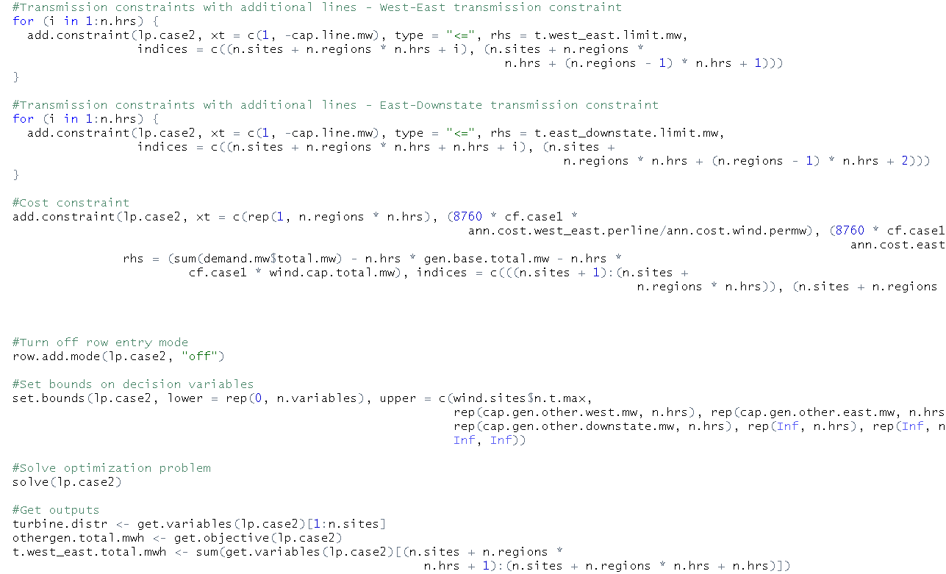
CASE 2: IMPLEMENTING IN lpSolveAPI

Slide 17
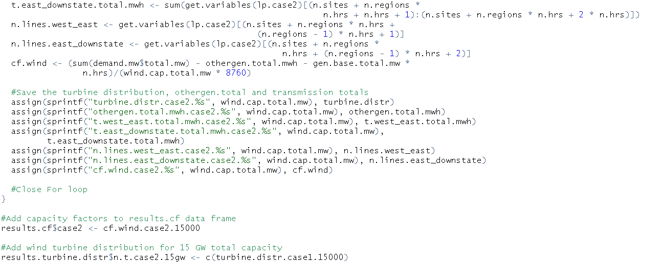
CASE 2: IMPLEMENTING IN lpSolveAPI

Slide 18
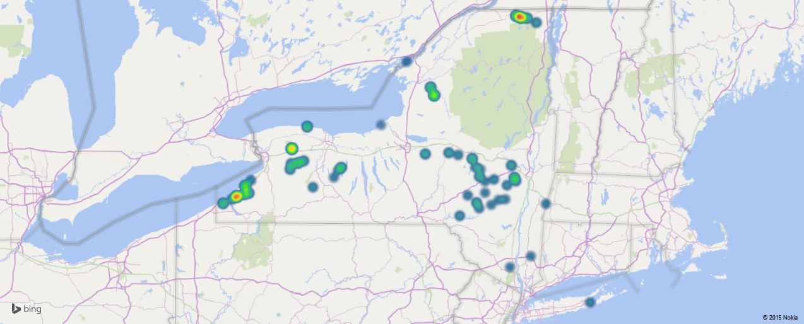
CASE 2: SOLUTION
This yields a Capacity Factor of
New lines between West and East grids
New lines between East and Downstate grids
29.48%
5
8
(2000MW)
(3200MW)

