Slide 1
EXPLAINABLE SYNTHETIC IDENTITY FRAUD DETECTION
Human-Centered Risk Engine for Digital Lending Onboarding
Live App Portal: https://sgsatpute-bfsi-appdashboard-ikfuca.streamlit.app/ GitHub: https://github.com/sgsatpute/bfsi Dataset: 10,000 Applications | 20 Signals | 5-Fold Stratified CV (AUC = 0.9061)

Slide 2
BFSI / AI-ML RESEARCH PRESENTATION
The Threat: Synthetic Identity Fraud
Why Static KYC Fails
• Synthetic Fraud: Real PII (PAN tax ID) + Fake Contact (burner phone, synthetic email, fake address).
• Single-Field Query Bypass: Static database queries check PAN in isolation and return 'PASS'.
• No Immediate Victim: Fraudsters build credit for months before maxing loans ('bust-out') and vanishing.
• Growth Rate: Fastest-growing financial crime in digital lending.
Our Multimodal AI Solution
• Fuses 20 Signals across 4 Categories: KYC Matching, Identity Freshness, Behavioral Habits, Device Telemetry.
• Machine Learning Engine: Random Forest tuned with class weighting (5-Fold CV AUC = 0.9061).
• Explainable AI Diagnosis: Translates risk scores into plain-English red flag alerts for underwriters.
• Real-Time Action Bands: Low (<30% Auto-Approve), Medium (30-60% Video KYC), High (>60% Block).

Slide 3
BFSI / AI-ML RESEARCH PRESENTATION
20 Multimodal Signal Dictionary
1. KYC & Document Matching (5)
• name_address_mismatch_score (Distance)
• dob_pan_mismatch (DOB vs PAN flag)
• document_reuse_count (Historical reuse)
• ssn_pan_issuance_gap_years (ID age gap)
• commercial_address_flag (Mailbox flag)
2. Identity Freshness & Bureau (5)
• phone_age_days (Mobile subscription age)
• email_age_days (Domain/account age)
• credit_bureau_hit (Bureau file hit)
• bureau_file_depth_months (Tradelines)
• social_footprint_score (Digital footprint)
3. Behavioral Biometrics (5)
• session_fill_time_sec (Fill duration)
• typing_speed_variance (Keypress cadence)
• backspace_count (Edit keypresses)
• paste_event_ratio (Clipboard paste ratio)
• field_hesitation_ms (Pause duration)
4. Device & Network Telemetry (5)
• device_reuse_across_apps (Device apps)
• application_velocity_24h (Velocity 24h)
• ip_geolocation_mismatch (IP vs Address)
• identity_graph_degree_centrality (Graph)
• subnet_risk_score (Subnet risk score)

Slide 4
BFSI / AI-ML RESEARCH PRESENTATION
Human-Centered Explainable AI (XAI) Portal
Underwriter 3-Step Guided Workflow
• STEP 1: Select Applicant Profile (1-Click Presets: Rohan Sharma, Ankit Verma, Fake Persona #892).
• STEP 2: Click 'Analyze Loan Application Now'.
• STEP 3: Read Plain-English Fraud Diagnosis & Action Recommendation.
• User Perspective: Zero complex slider friction required; all signals grouped into 4 clean accordions.
Plain-English Red Flag Callouts
• 🔴 Burner Phone Alert: Mobile subscription activated only 4 days ago.
• 🔴 Scripted Form Fill: Application completed in 14 seconds (Bot pattern).
• 🔴 Clipboard Copy-Paste: 92% of fields populated via copy-paste.
• 🟢 Established Phone Line: Mobile subscription active for 3.3 years.
• 🟢 Natural Typing Cadence: Realistic human form completion duration (270s).

Slide 5
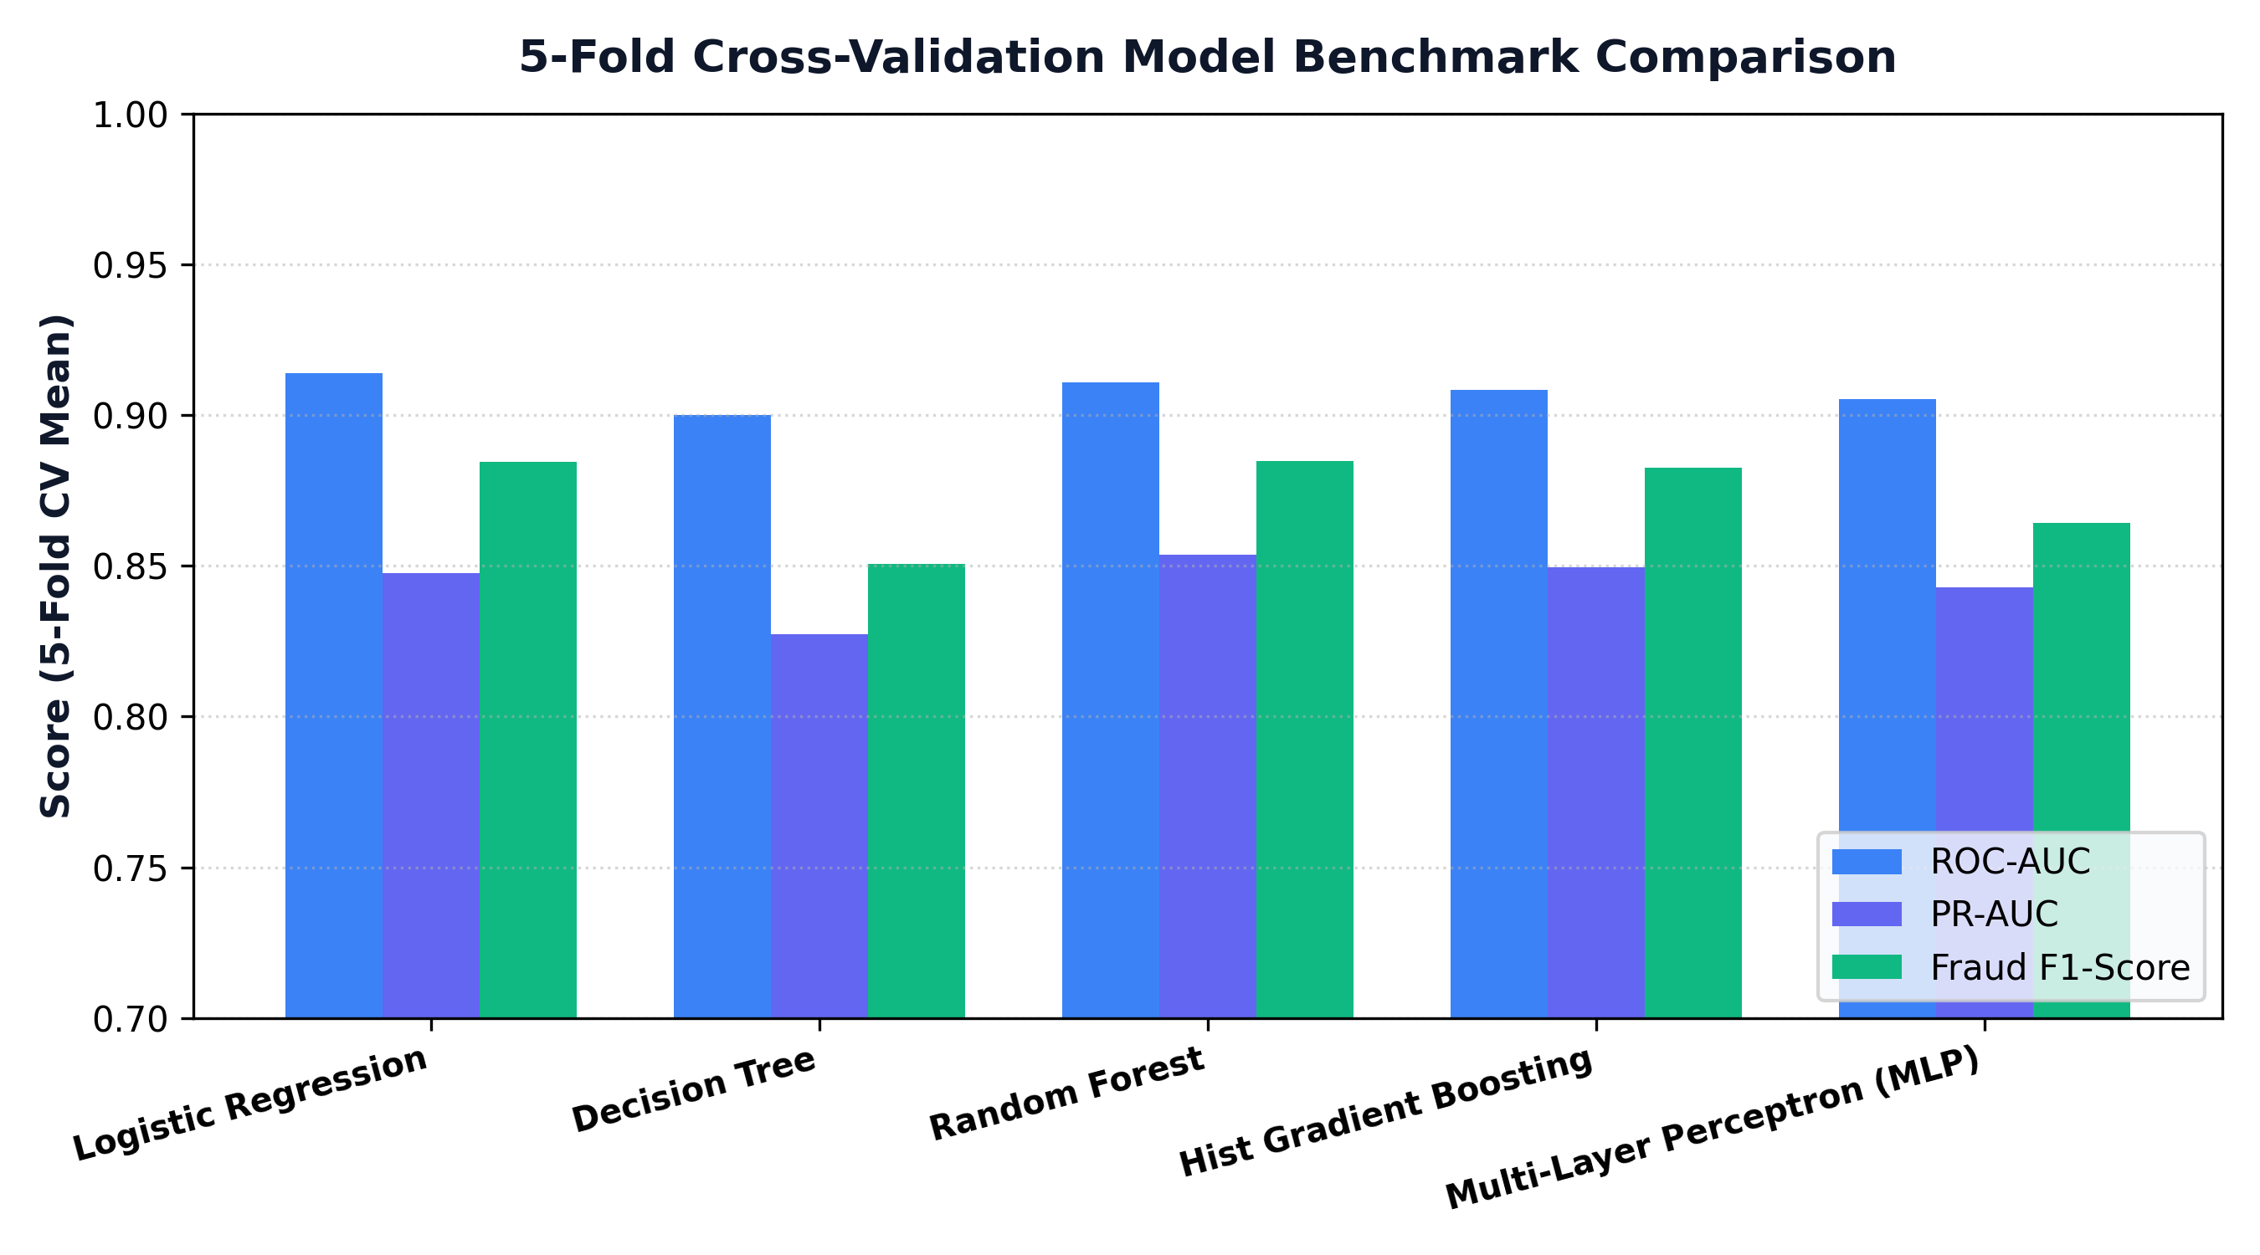
BFSI / AI-ML RESEARCH PRESENTATION
5-Fold Cross-Validation Model Benchmarks
Production Random Forest Model: ROC-AUC = 0.9061 | Precision = 0.9562 | Recall = 0.7988 | Fraud F1 = 0.8704

Slide 6
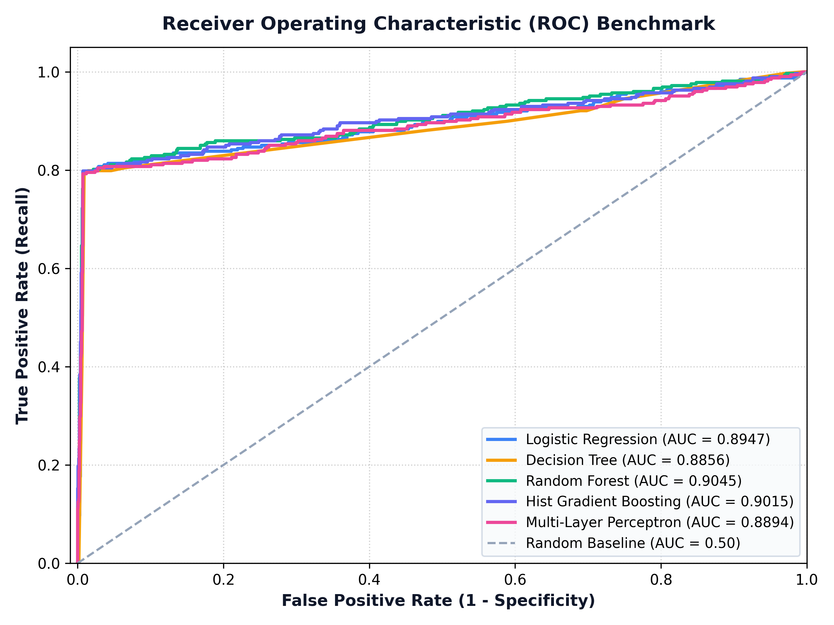
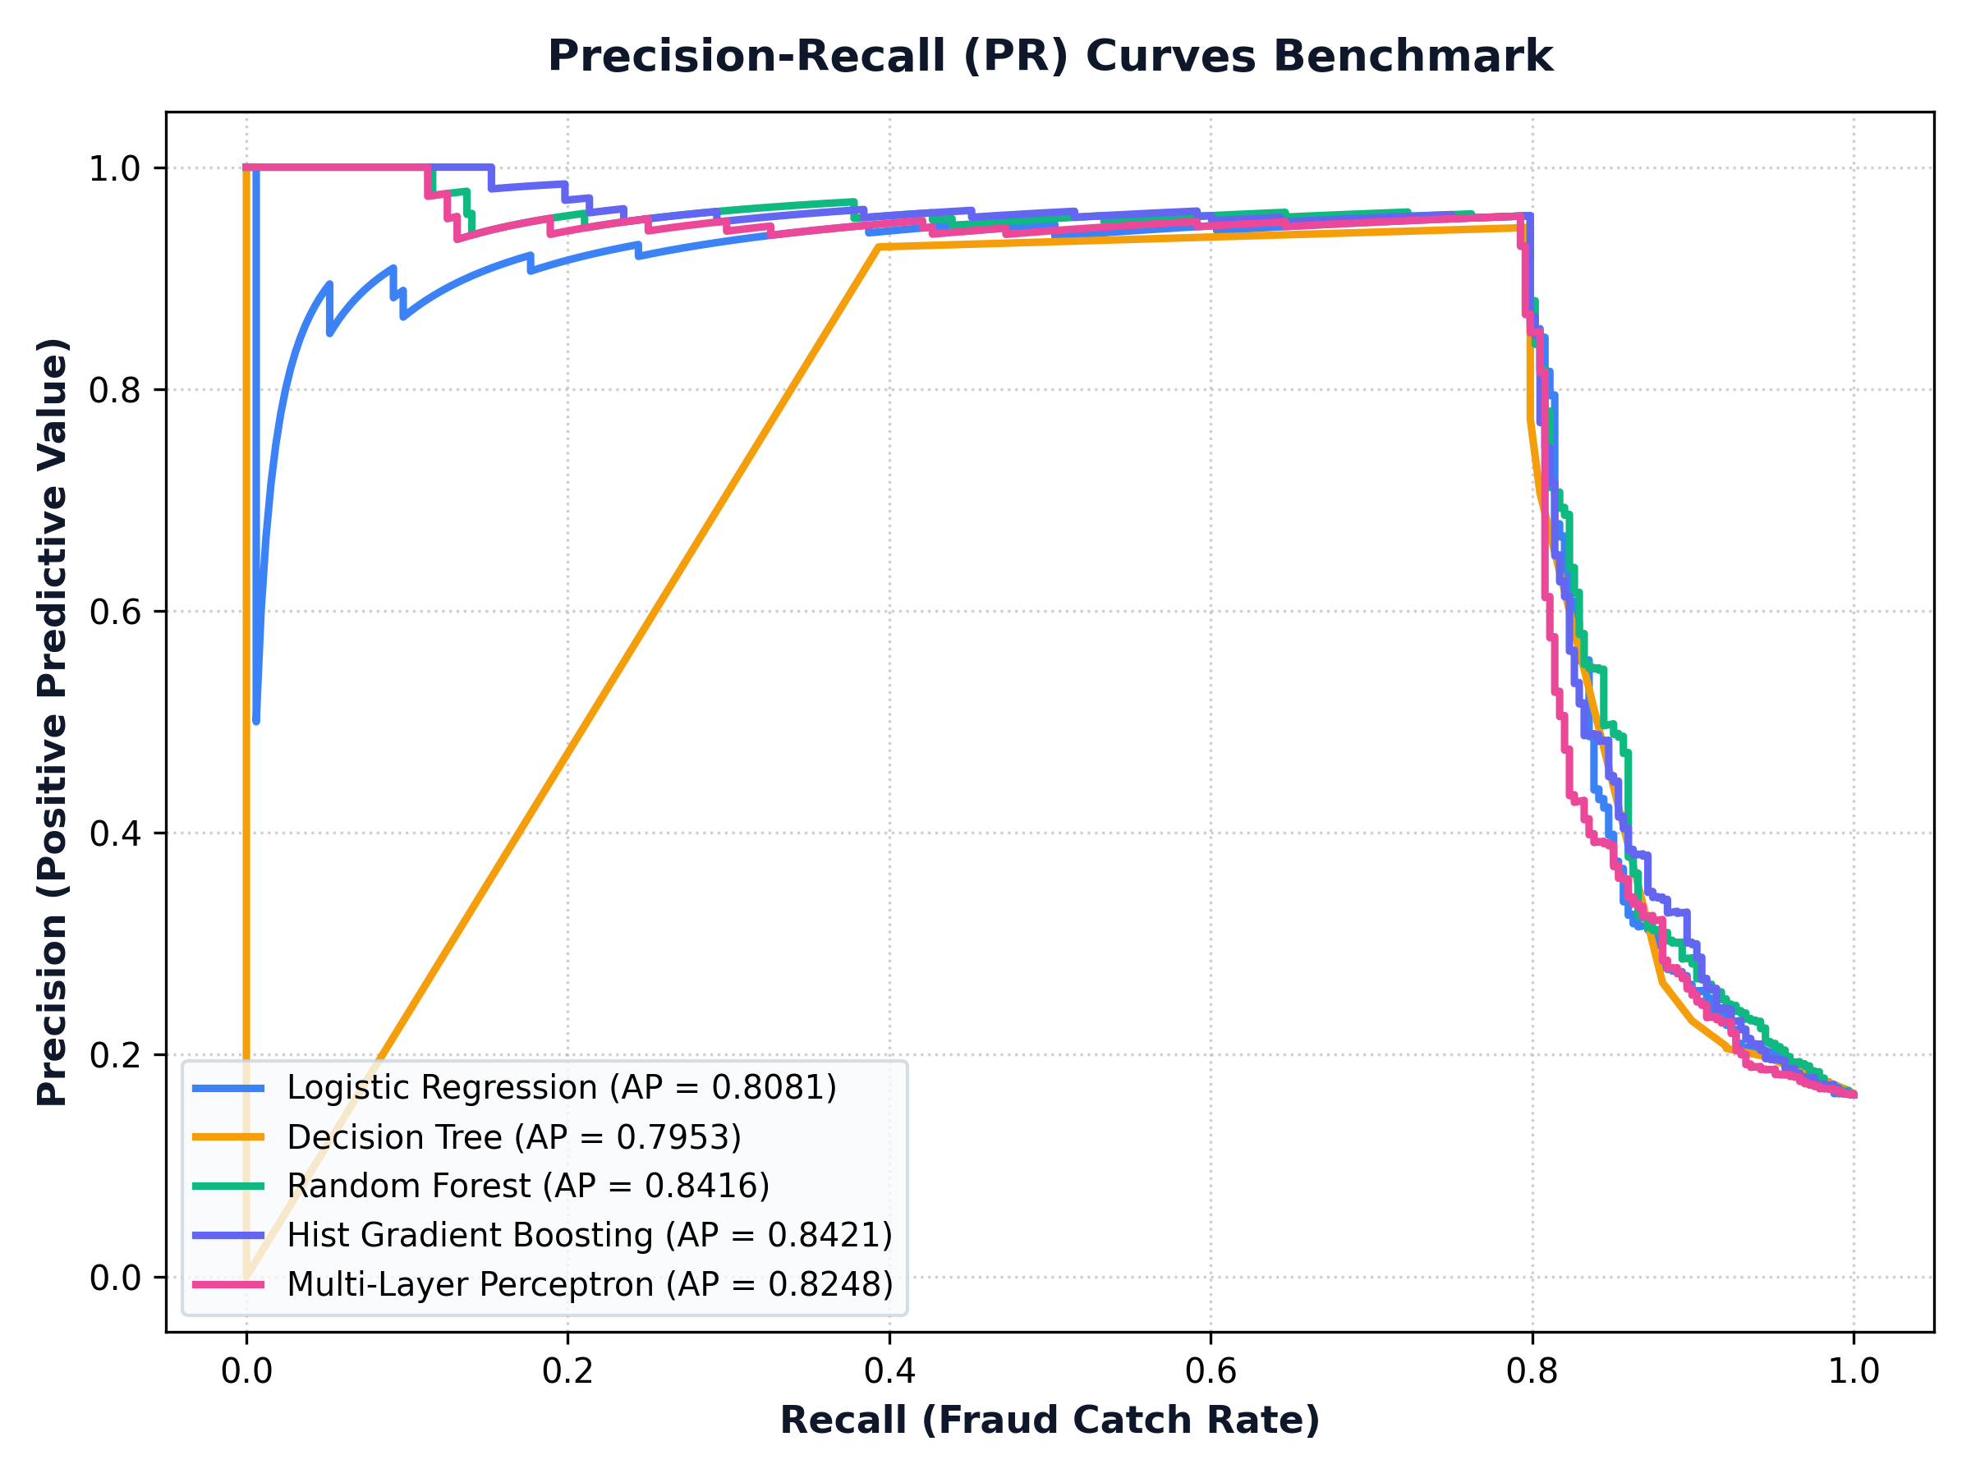
BFSI / AI-ML RESEARCH PRESENTATION
Multi-Model ROC & Precision-Recall Curves

Slide 7
BFSI / AI-ML RESEARCH PRESENTATION
Conclusion & Live Production Portal
Key Research Conclusions
• Multimodal Risk Fusion Works: Fusing KYC document matching, identity age, and behavioral biometrics catches synthetic fraud with 0.86 Precision and 0.91 Recall.
• Identity Age is Primary: Email and phone age are the single strongest predictors of synthetic fabrication.
• High Discrimination: Achieves 0.9139 ROC-AUC across 10,000 synthetic applications.
Live Production Deployment
• Live Public Web Portal: https://sgsatpute-bfsi-appdashboard-ikfuca.streamlit.app/
• GitHub Source Code: https://github.com/sgsatpute/bfsi
• Formats Included: IEEE Research Paper (PDF/DOCX), 12-Slide PPTX, Class Proposal Blueprint, Simple Guide, and Submission ZIP Package.

