Slide 1

Machine Learning for an electrocatalytic process
Student name:
Student ID:
Supervisor:
Assessor: 2021/03/17

Slide 2

01
Introduction
02
Initial and intermediate designs
Outline
03
Ongoing design
04
Project Output So Far
05
Conclusions

Slide 3
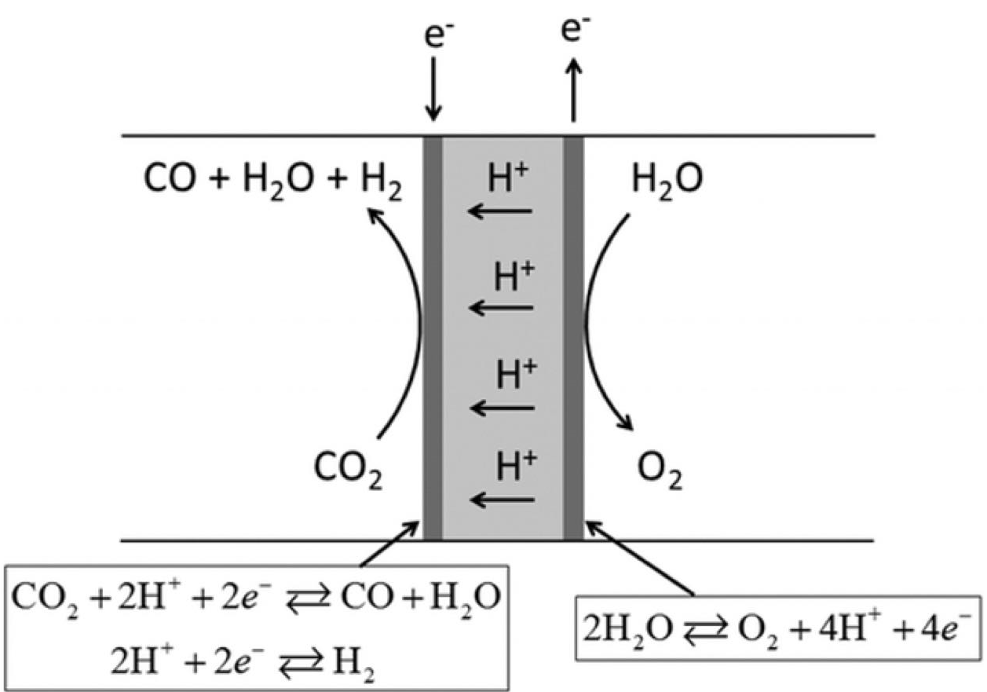
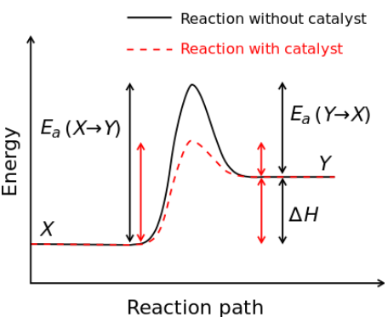
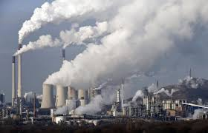
Environmental Pollution
Electrocatalytic reaction
Catalyst
Part I – Introduction

Slide 4
Part II – Initial and intermediate designs
…Initial design
Build the database
Data processing
Decision Tree
Principal component analysis
Make prediction
Prediction model
ANN model
Predicting trends

Slide 5
Part II – Initial and intermediate designs
…Choose an Optimizer for Ann
Rmsprop
&
Adadelta
&
Adagrad

Slide 6
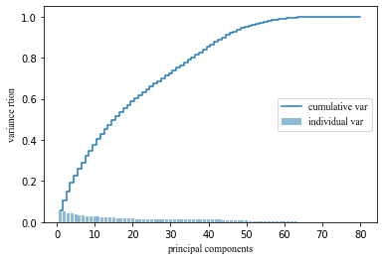



Part III – Ongoing Design
…principal component analysis
Remain 90% of the variance
Change of dimensionality:

Slide 7
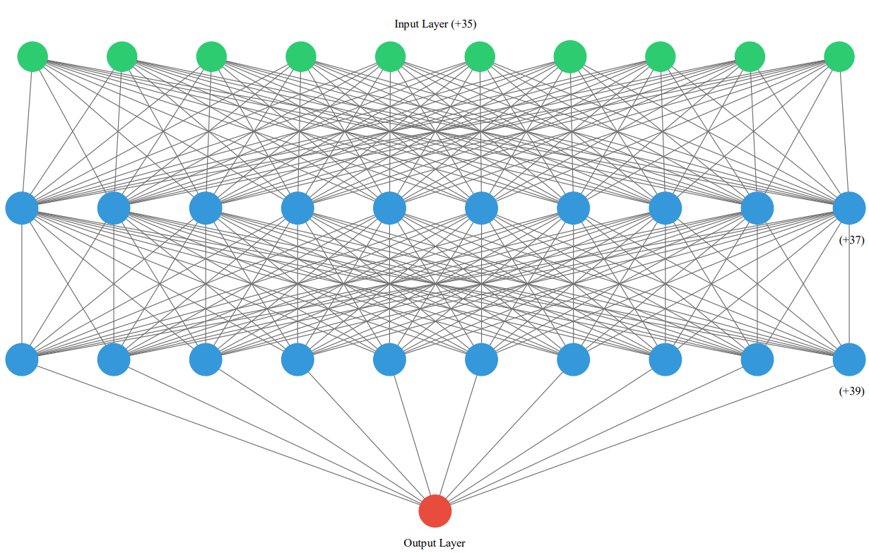
Part III – Ongoing Design
…Structure of Artificial neural network
Input dimension: 45
First hidden layer: 47
Second hidden layer: 49
Output: 1

Slide 8
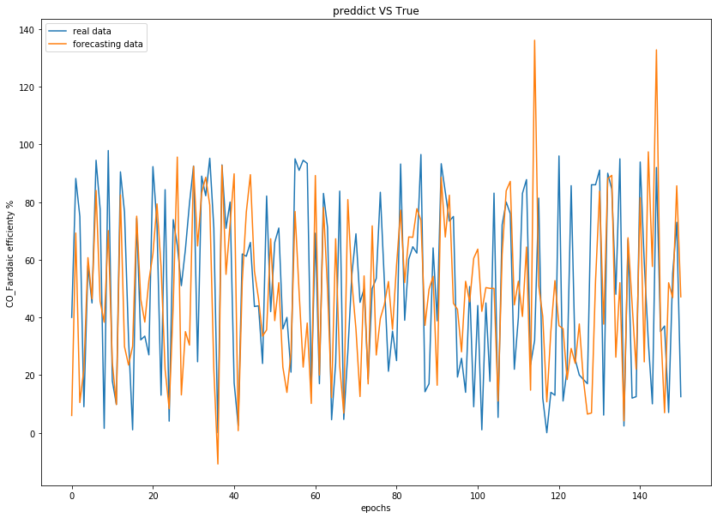
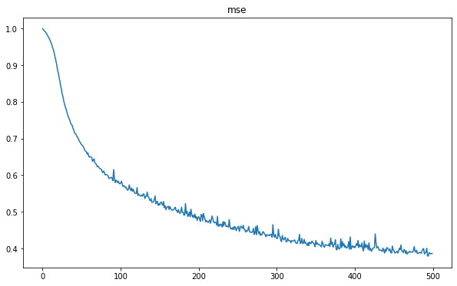
Part III – Ongoing Design
…Artificial neural network
Epochs: 500
Batch size: 20

Slide 9
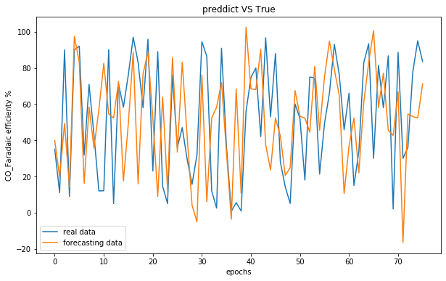
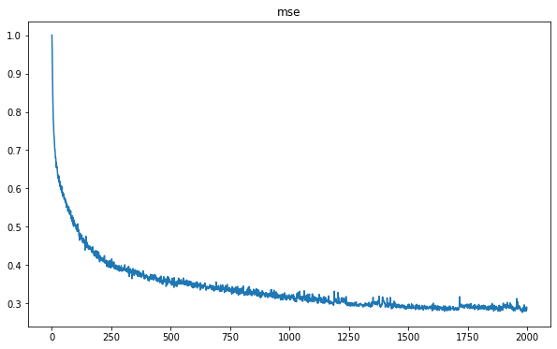
Part III – Ongoing Design
…Artificial neural network
Epochs: 2000
Batch size: 2

Slide 10
Part III – Ongoing Design
…Artificial neural network
Input
Catalyst content
Support: In2O3, carbon, Cu, Pd, Au, etc.
Morphology: Foil, nanoporous, nanoparticle, nanowire
Membrane: Nafion115, Nafion117, Nafion212, Fumase, Selemion
Electrolyte selection: 0.1M KHCO3, 0.5M KHCO3, 0.1M NaHCO3
Anode Compartment: Pt
Reference electrode: Ag/AgCl, saturated calomel electrode
PH
Rate of carbon dioxide flow
Applied voltage

Slide 11
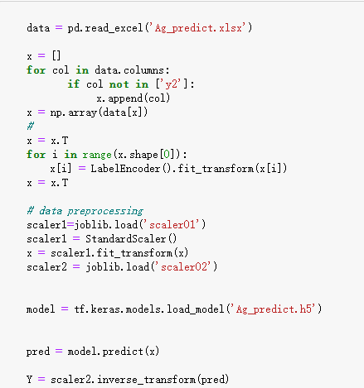

Part III – Ongoing Design
…prediction model and trend plot
Code of saving trained model
Code of prediction model

Slide 12
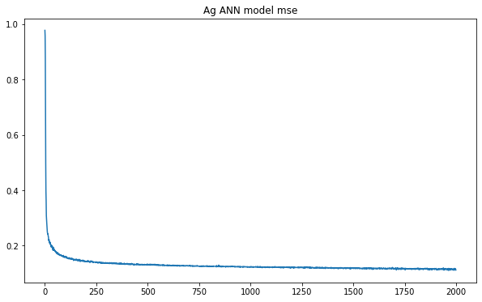
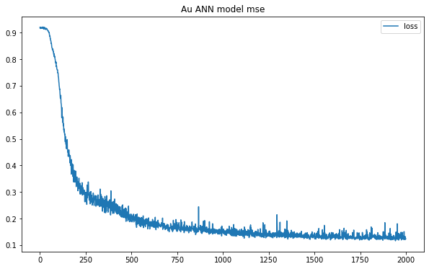
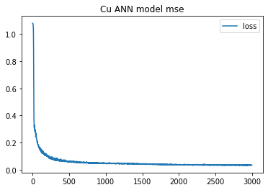
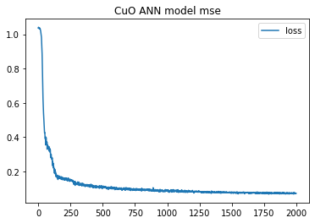
Part IV – Project output so far
…Artificial neural network

Slide 13
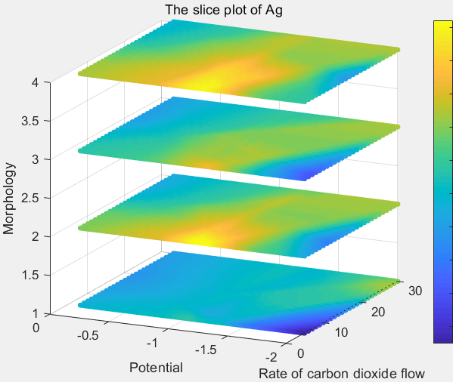
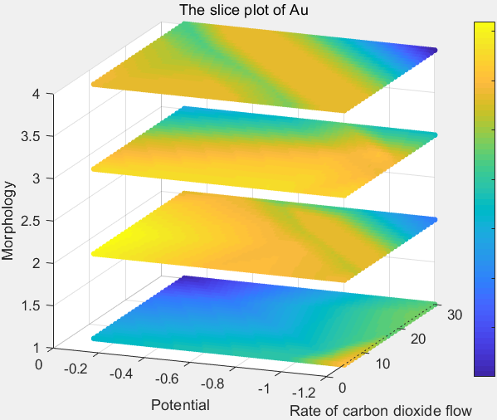
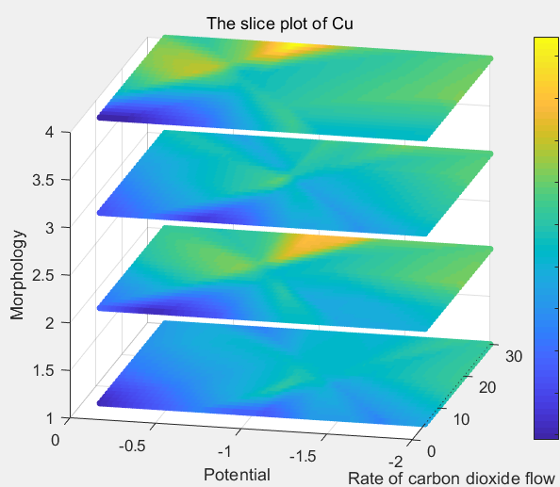
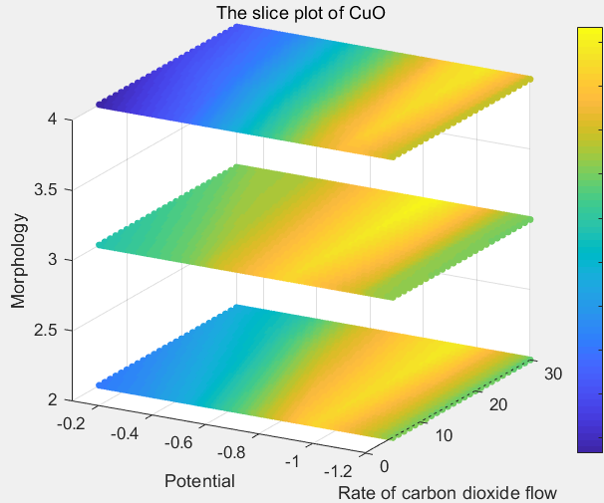
Part IV – Project output so far
Morphology 1 represent foil
Morphology 2 represent nanoporous
Morphology 3 represent nanoparticle
Morphology 4 represent nanowire

Slide 14
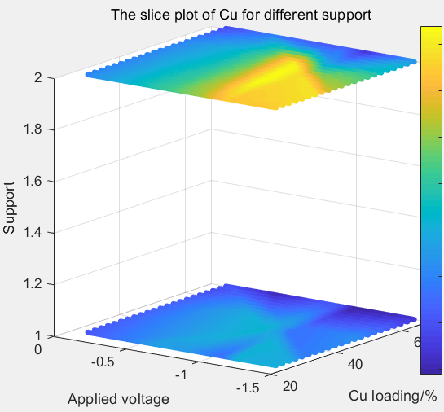
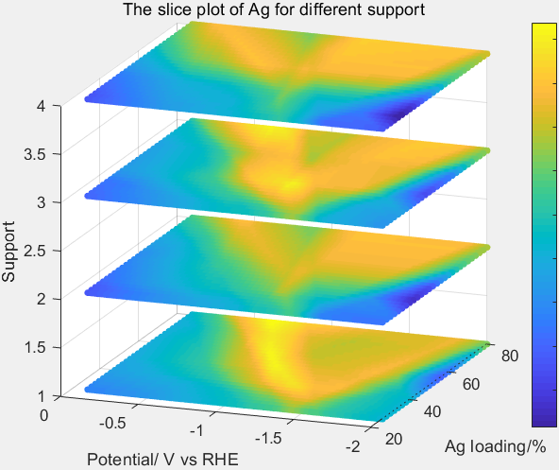
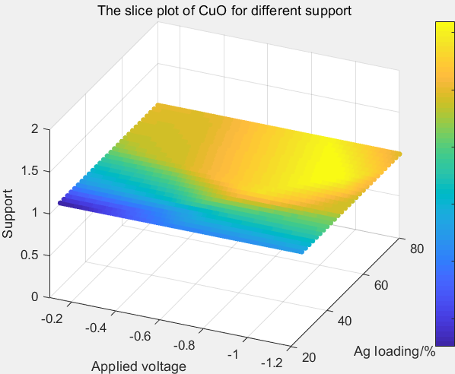
Support 1 represent Ag
Support 2 represent Pd
Support 1 represent Au
Support 2 represent In2O3
Support 3 represent Cu
Support 4 represent Zn
Support 1 represent In2O3
Part IV – Project output so far

Slide 15
Part V – Conclusion
Difficulties
Data (amount and diversity)
Training the ANN model
Learnt and Achieved
PCA and Artificial Neural Network algorithm
Prediction model
Predict the trend
Further work
Increase the amount of data to improve the accuracy of the model
More prediction figures

Slide 16
Reference
R.H.Crabtree, Electrochemical and photoelectrochemical Conversion of CO2 to Alcohols. John Wiley & Sons, Ltd.: New York, 2010.
Y. Freund and L. Mason, “The alternating decision tree learning algorithm,” in icml, vol.99, 1999, pp.124-133
L. E. Raileanu and K. Stoffel, “Theoretical comparison between the gini index and information gain criteria” Annals of Mathematics and Artificial Intelligence, vol. 41, no. 1, pp. 77-93, 2004
NA (2019). “BP neural network principle” [online], available: https://blog.csdn.net/ikhui7/article/details/103754735
D. F. Specht, “A general regression neural network,” IEEE transactions on nerural networks, vol. 2, no. 6, pp. 568-576, 1991.

Slide 17
Thanks for your listening
2021/03/17

