Slide 1
Modern Model Risk Management
Managing VLMs in regulated industries
Modelography | Responsible AI Governance
Presenter Name | Date

Slide 2
Modelography
1
Unmanaged AI has limited value in critical applications
• First self driving car was tested in 1995 (Pittsburgh to San Diego)
  Self driving cars are still being developed thirty years later.
• AI largely failed during Covid-19
  Only 2 of 232 general diagnostic models rated as promising (BMJ 2020;369:m1328 )
  0 of 62 models effective in using radiographs or CT scans
  (Nature Machine Intelligence volume 3, pages199–217(2021)
$800bn is to be invested in AI; how will we create the return that is needed?
  Impossible if critical applications are out of bounds

Slide 3
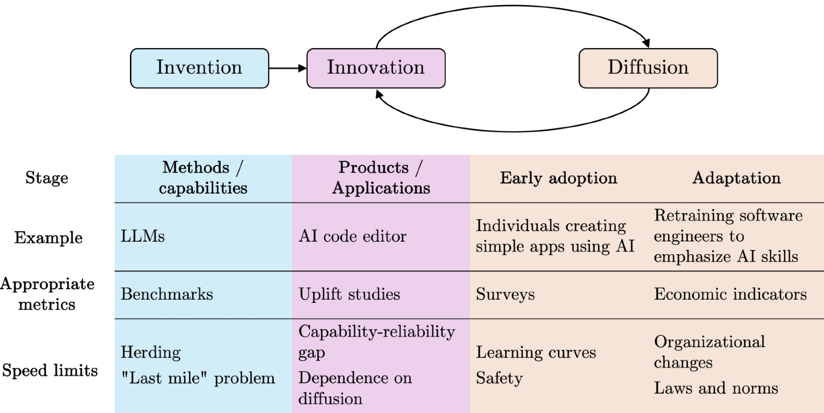
Modelography
1
adoption
adaptation
https://knightcolumbia.org/content/ai-as-normal-technology

Slide 4
Modelography
1
Opportunity
• MRM designed for VLMs
• Tools that support proper characterisation of VLM behaviour
• Process automation and autonomy that minimises risk

Slide 5
Modelography
1
Market
• Life Sciences
• Financial Services (~£300bn UK)
  SS1/23 and SR11-7 mandate model risk practice
  PRA is pushing for adoption across all FS inc. insurance

Slide 6
Modelography
1
Offer
• Jen’s introspection tool
• Output quantification tools (Simon’s paper)
• Agentic model risk platform

Slide 7
Modelography
1
Ask
Is there someone in your network struggling with LLM compliance issues?
Or… is there someone who should be struggling but is currently unaware of the risk?

Slide 8
Thank You
Questions & Discussion
contact@vlm-metrics.com
www.vlm-metrics.com
VLM-Metrics | Responsible AI Governance

Slide 9
01
Section Name
VLM-Metrics

