Slide 1
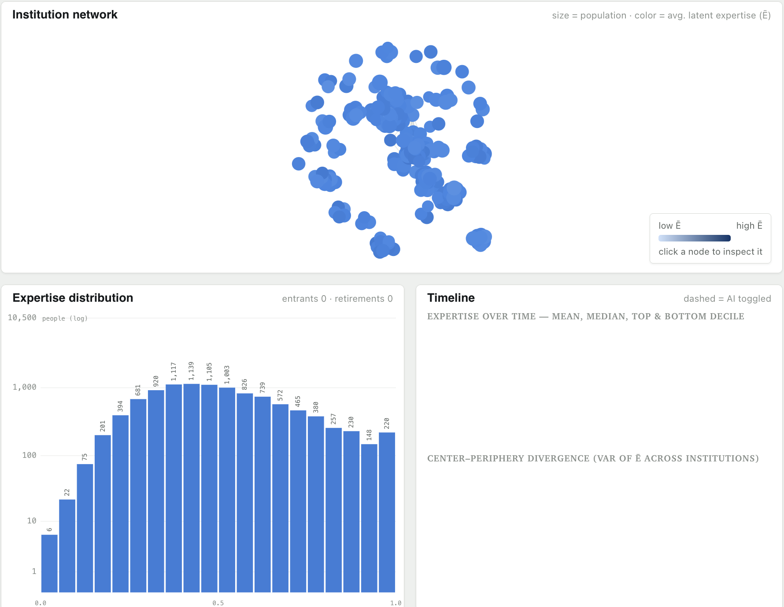
Start state

Slide 2
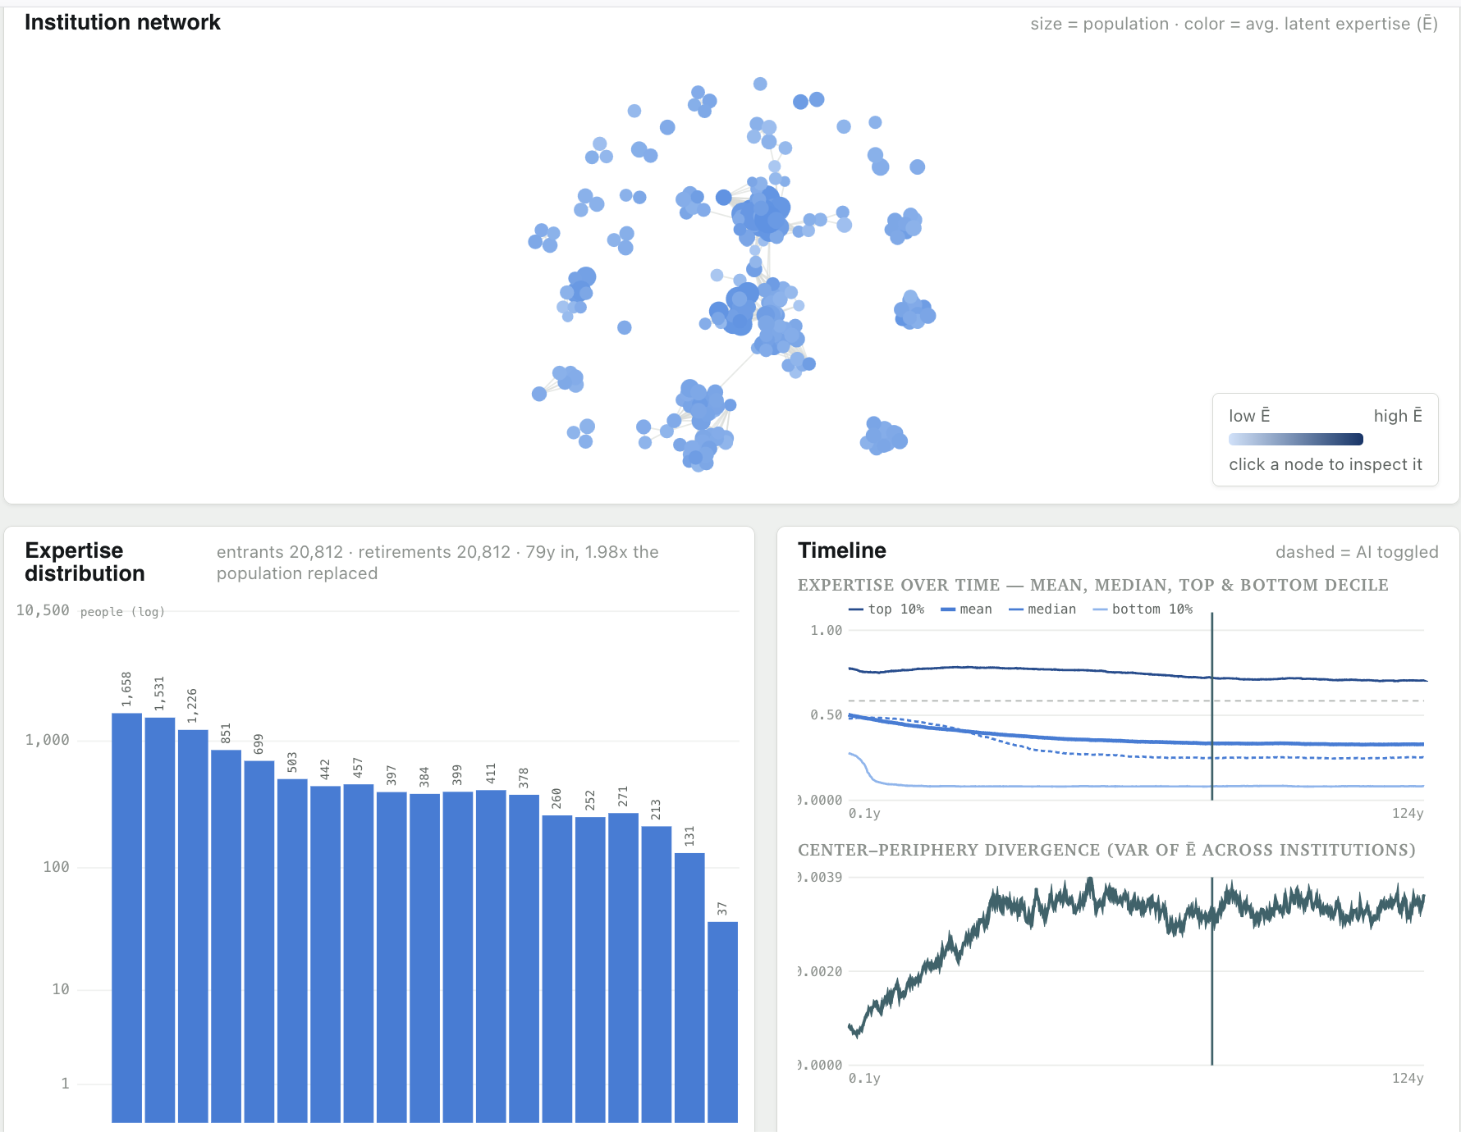
Your bank on AI
: strong damping on junior learning

Slide 3
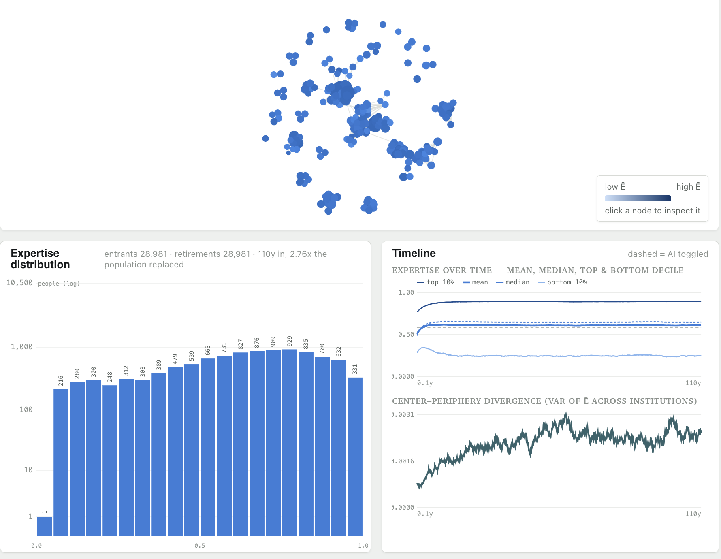
No AI

