Slide 1
Batting!
A program to calculate your batting average.
Created by Jordan Salm

Slide 2



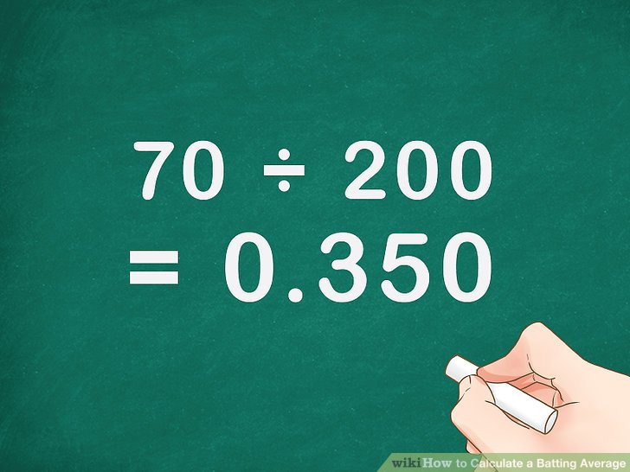
This is how a batting average is calculated.
Batting average is calculated by taking the number of hits divided by the number of at bats, then rounding the number to the third decimal point.

Slide 3
Goals and Process Of The Program
This program will calculate the batting average over a user entered amount of games played
The user will then enter the amount of at bats and hits in each game
Once all the hits and the at bats are added, then it will be calculated.

Slide 4
How Its Made
First, the program stored the number of games played.
Next, the program will store user entered numbers for at bats and hits per game
Then, the program will calculate the batting average based on the two numbers entered.

Slide 5
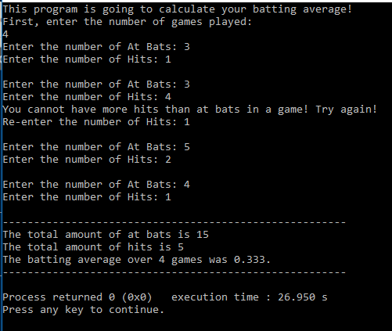
Screenshot of Program Running
z

Slide 6
Program Scalability
This program was built to be scalable
If there are more stats that are interested in being calculated, the program is made to handle those and be able to calculate those.
Examples of stats include, a batter’s on-base percentage (OBP) or their batting average with runners in scoring position (RISP).

