Slide 1
AI in GitLab CI without personal certificates
Briefing for leaders and engineers
Status 2026-11-06: design approved, probe not yet run on our GitLab, nothing else built
Notes:
Purpose: agree a small pilot and two decisions that sit outside the team. The main deck is for everyone. The appendix holds engineering detail for peers.

Slide 2

We can bring AI to CI without exposing user keys
1
The problem
Our AI provider requires each user's personal mTLS certificate. Putting that on a shared runner exposes the key to CI jobs.
What this is not
2
The proposal
Attribution, not cryptographic non-repudiation.
GitLab vouches for the user, and the user's private key signs nothing. The accreditor must accept this in writing before production.
A token service and gateway let a job use AI as the person who started it. No personal key or password on runners or in new services.
3
The ask
Approve a small pilot on non-sensitive test projects, and sponsor the accreditor review and an instance runner request.
Notes:
Lead with the ask. Say the attribution point out loud: the original goal mentioned non-repudiation, and this design does not provide it. GitLab vouches for the user; the private key signs nothing.

Slide 3
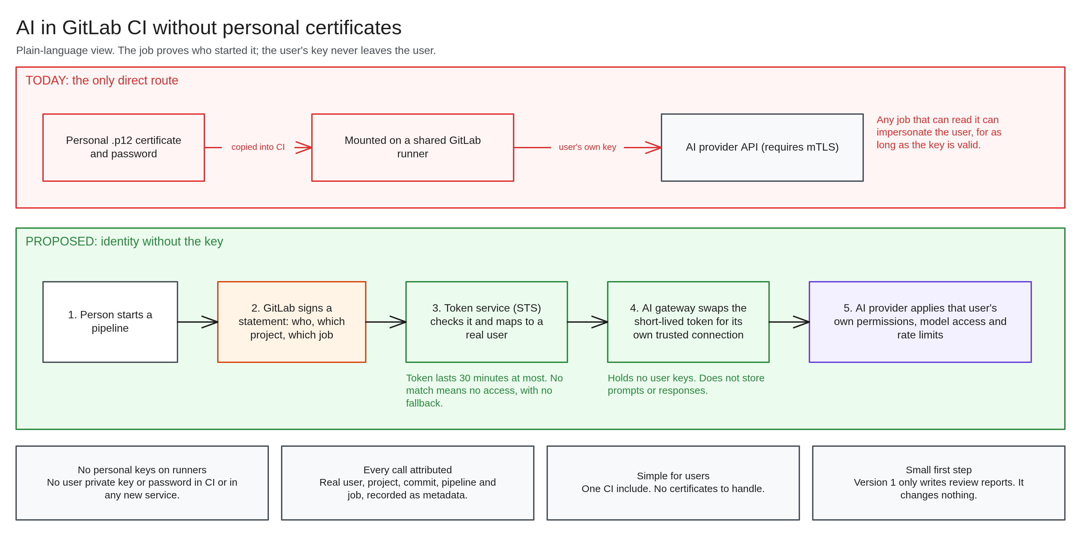
Identity travels, the key does not
Notes:
Walk left to right. The job proves who started it with a token GitLab signs. STS checks it and maps to a real directory user. The gateway calls the provider with its own trusted certificate and names the user. The provider applies that user's permissions, as it does today.

Slide 4






What teams and the organization get
Automated code review
Scheduled automation
No personal keys in CI
Static findings on merge requests. The largest expected benefit.
For users with nowhere else to run scheduled tasks.
No user private key or password on runners or in new services.
Every call attributed
Existing limits still apply
Simple for users
Real user, project, commit, pipeline and job, as metadata.
Provider keeps each user's permissions, models and rate limits.
One CI include, and no certificates to handle.
Notes:
Code review is the largest expected benefit. Scheduled automation helps users with nowhere to run cron. Bulk work stays on the batch service. No benefit figures yet: the pilot will measure latency, load and false failures.

Slide 5
Five risks we would be accepting
1
Identity follows the trigger, not the author
A malicious commit can act as whoever runs it, for up to 30 minutes.
What limits them
Version 1 jobs hold no write credential, and only write reports
Tokens last 30 minutes at most
Only listed runners get a token
Runner network denies everything except five destinations
Pilot uses non-sensitive test projects until written sign-off
2
GitLab admins are in the trust boundary
They sit outside our team, and can likely act as other users.
3
Two very powerful secrets
The gateway certificate and STS signing key could each claim to be any user.
4
No content screening
Prompt injection is limited only by restricting what jobs can do.
5
Audit shows who, when and where, not what
Deliberate, given the data involved. After an incident, nobody can show what was sent.
Notes:
State these plainly, as they are what the accreditor must sign off. All five come from the design. Nothing here is hidden behind the templates, because templates are convenience and not a boundary. Node-level admin exposure is outside this list: the owner states engineers and admins with node access have incidental exposure protection.

Slide 6
Three ways for jobs to reach the runners
 | 1. Instance runner | 2. Group runners | 3. Central template
Best for | Production, all users | Pilot and fallback | High-risk projects
Reach | All projects | Onboarded groups only | Users granted access
Outside help | One GitLab admin action | Each group Owner, once | None for runner; access setup per user or project
Who controls job YAML | Each user | Each user | Us
Trust added beyond admins | None | Each group Owner | Central project Maintainers
Who can run code on cluster | Any GitLab user | Onboarded group members | Protected-branch code only
Report on the MR | Native | Native | Likely not. Needs testing
Identity | Signed claim, being tested | Same as option 1 | Unverified. Must be tested
Notes:
STS, gateway and provider are identical in all three. The options differ in how a job reaches the runner, and who controls what it runs. Options can run together. Full comparison is in design section 8.1.

Slide 7
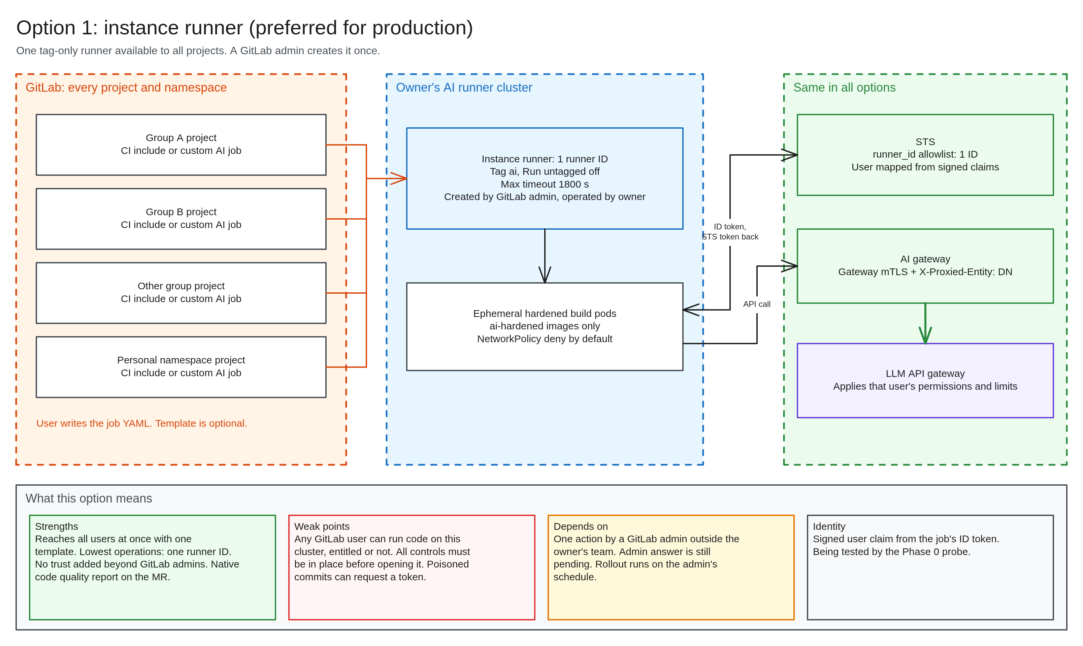
Option 1: instance runner
Use when
Going to production for all users. One GitLab admin action, and the lowest upkeep.
Main catch
Any GitLab user can run code on this cluster, so every control must be in place before it opens. Admin answer is pending.
Notes:
Preferred for production because it best fits any user. No trust added beyond GitLab admins. Controls must be complete first, because entitlement does not limit who can run a job.

Slide 8
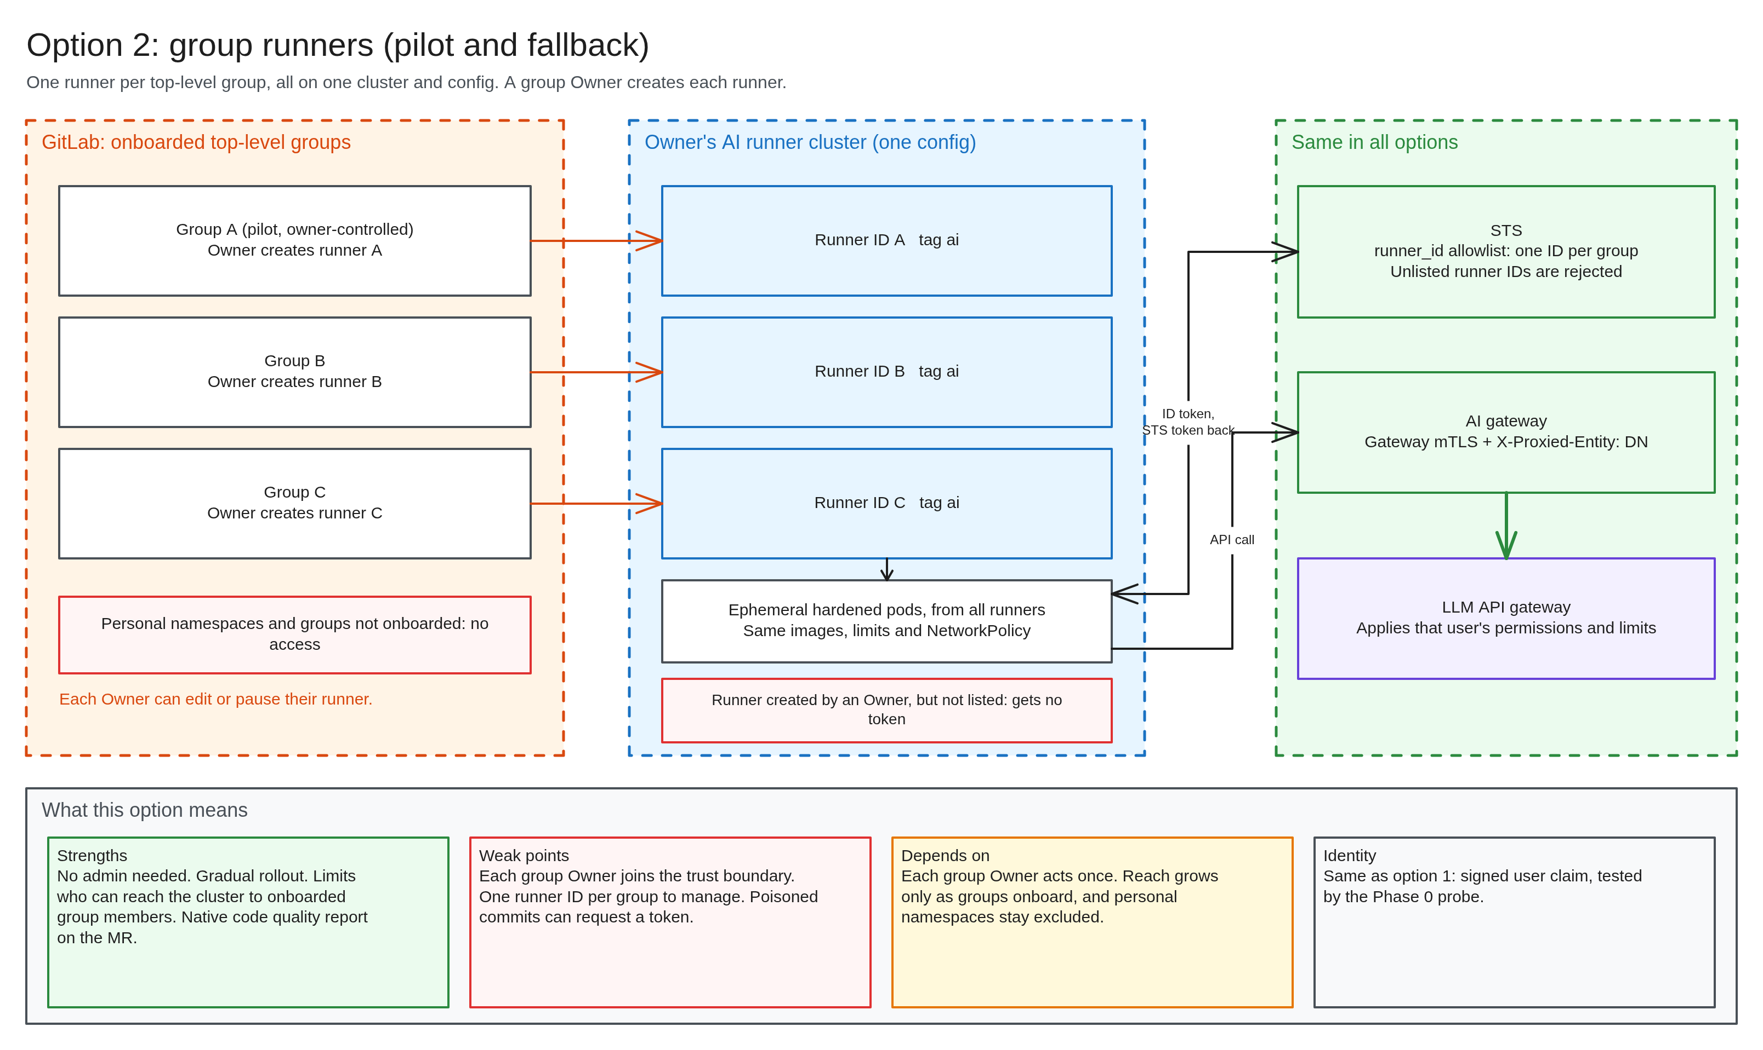
Option 2: group runners
Use when
Piloting in a group we own, or if the instance runner is refused.
Main catch
Each group Owner joins the trust boundary and must act once. Personal namespaces stay excluded.
Notes:
The pilot uses this in a group we control. STS rejects any runner ID not on its list, so a rogue runner created by an Owner gets no token.

Slide 9
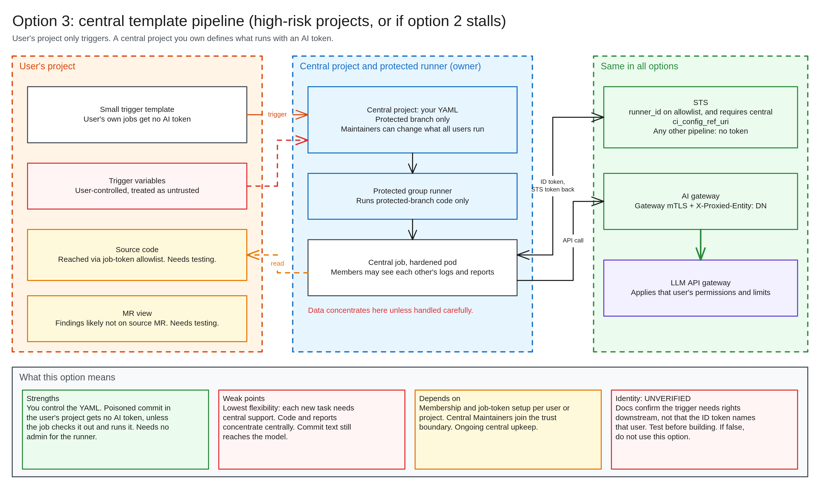
Option 3: central template pipeline
Use when
Users must not control job YAML, such as a high-risk project, or if option 2 stalls.
Main catch
Identity is unverified. Code and reports concentrate centrally, and findings likely miss the source MR.
Notes:
Build only if a case arises, and only after the identity test passes: docs confirm the trigger needs rights downstream, not that the ID token names that user. If it does not, do not use this option for that purpose.

Slide 10
Recommended: pilot small, then widen
1
2
3
4
Pilot on option 2
Request option 1
If refused, roll out option 2
Option 3 where needed
In a group we own, on non-sensitive test projects. Needs no outside approval.
For production. Best fit for any user, with the lowest upkeep.
Group by group, with each Owner acting once.
High-risk projects, or if option 2 stalls, after its identity test passes.
Rejected
Project runners: anyone who can edit one from an enabled project changes it for all
Existing shared runners: remove our image, network and isolation controls
Mounting personal certificates: exposes the keys this project exists to protect
Central key storage: a service holding every key could have made any signature
Notes:
The order is a recommendation and open to challenge. Step 1 needs nobody else's approval. Rejected: project runners, because of shared-edit behaviour; existing shared runners, because they remove our controls; mounting certificates; and central key storage, because a service holding every key could have made any signature.

Slide 11
SWOT: the overall approach
Strengths
Weaknesses
No user keys on runners or in new services
Every call attributed to user, project, commit and job
Per-user permissions and rate limits still apply
One CI include; standard API clients work
Version 1 only writes reports
Attribution, not cryptographic non-repudiation
Gateway certificate and STS key can claim any user
No content screening
Audit shows who, when and where, never what
Identity follows trigger, not author
Opportunities
Threats
Other internal services could reuse STS, after review
Automation for users with nowhere to run schedules
Code review is the largest expected benefit
MR comments and agent fixes on the same identity base
Usage visibility through audit metadata
Accreditor refusal blocks production
No usable identity mapping blocks the build
GitLab admins sit outside the team, inside the boundary
Poisoned code runs as whoever triggers it
Bulk demand on a service not designed for it
Notes:
Strengths and weaknesses come from the design. Some opportunities and threats are the author's judgment and open to challenge.

Slide 12
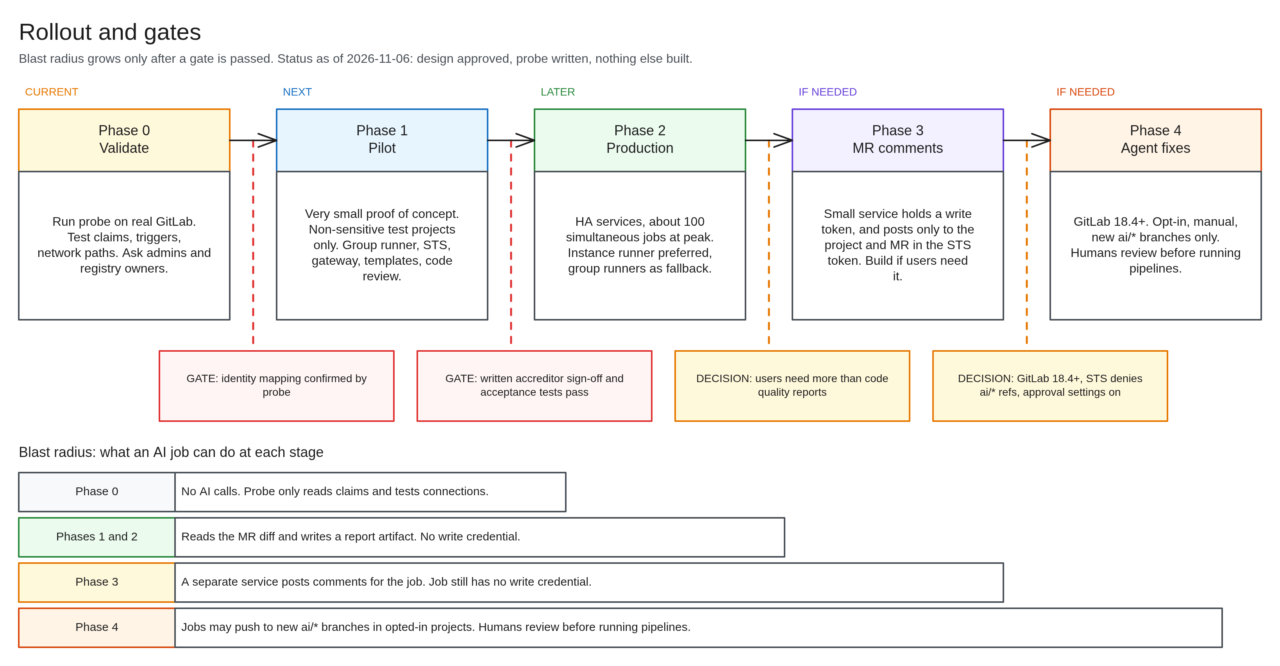
Blast radius grows only after a gate
Notes:
We are in Phase 0. The build waits for identity mapping. Production waits for written accreditor sign-off and the acceptance tests. Phases 3 and 4 are built only if needed. If the accreditor refuses, high-risk projects need signed user delegation.

Slide 13
Four decisions we need
# | Decision | Who | Why now
1 | Approve the pilot on non-sensitive test projects | Leadership | Starts once the probe passes
2 | Sponsor the accreditor review | Leadership, accreditor | Sign-off is pending, and blocks production
3 | Sponsor an instance runner request | Leadership, GitLab admins | Best route to all users. Answer pending, and fallbacks exist
4 | Commit platform team capacity for the token service and gateway | Platform lead | Production needs both highly available
Notes:
Decision 1 starts once the probe passes. Replace role names with real names before presenting. Cost, staffing and schedule are not estimated yet.

Slide 14
Next: the probe decides whether we build
Run the probe on our GitLab. Confirm identity mapping. Then build the pilot.
Still unknown: cost, staffing, schedule and the accreditor's position.
Notes:
Close on the ask. Nothing beyond the probe gets built until identity mapping is confirmed on real GitLab. Pilot load data will inform sizing and cost.

Slide 15
Appendix: engineering detail
For peers reviewing the design. The written design is the authority.
Notes:
Ask reviewers for ways to get a token for another user or bypass STS, assumptions that may not hold on our GitLab version, gaps in acceptance tests, and whether an existing reverse proxy would be better than building the gateway.

Slide 16
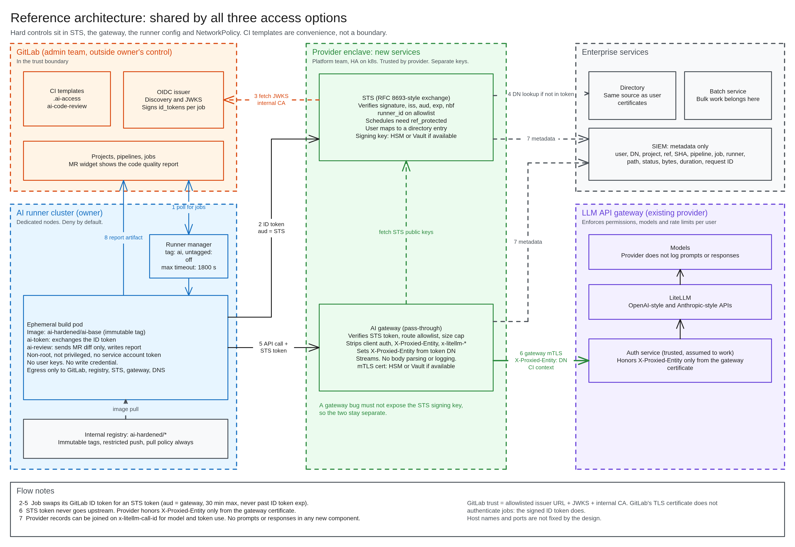
Reference architecture
Notes:
GitLab trust is one relationship: issuer URL, JWKS and the internal CA. GitLab's TLS certificate does not authenticate jobs; the signed ID token does.

Slide 17
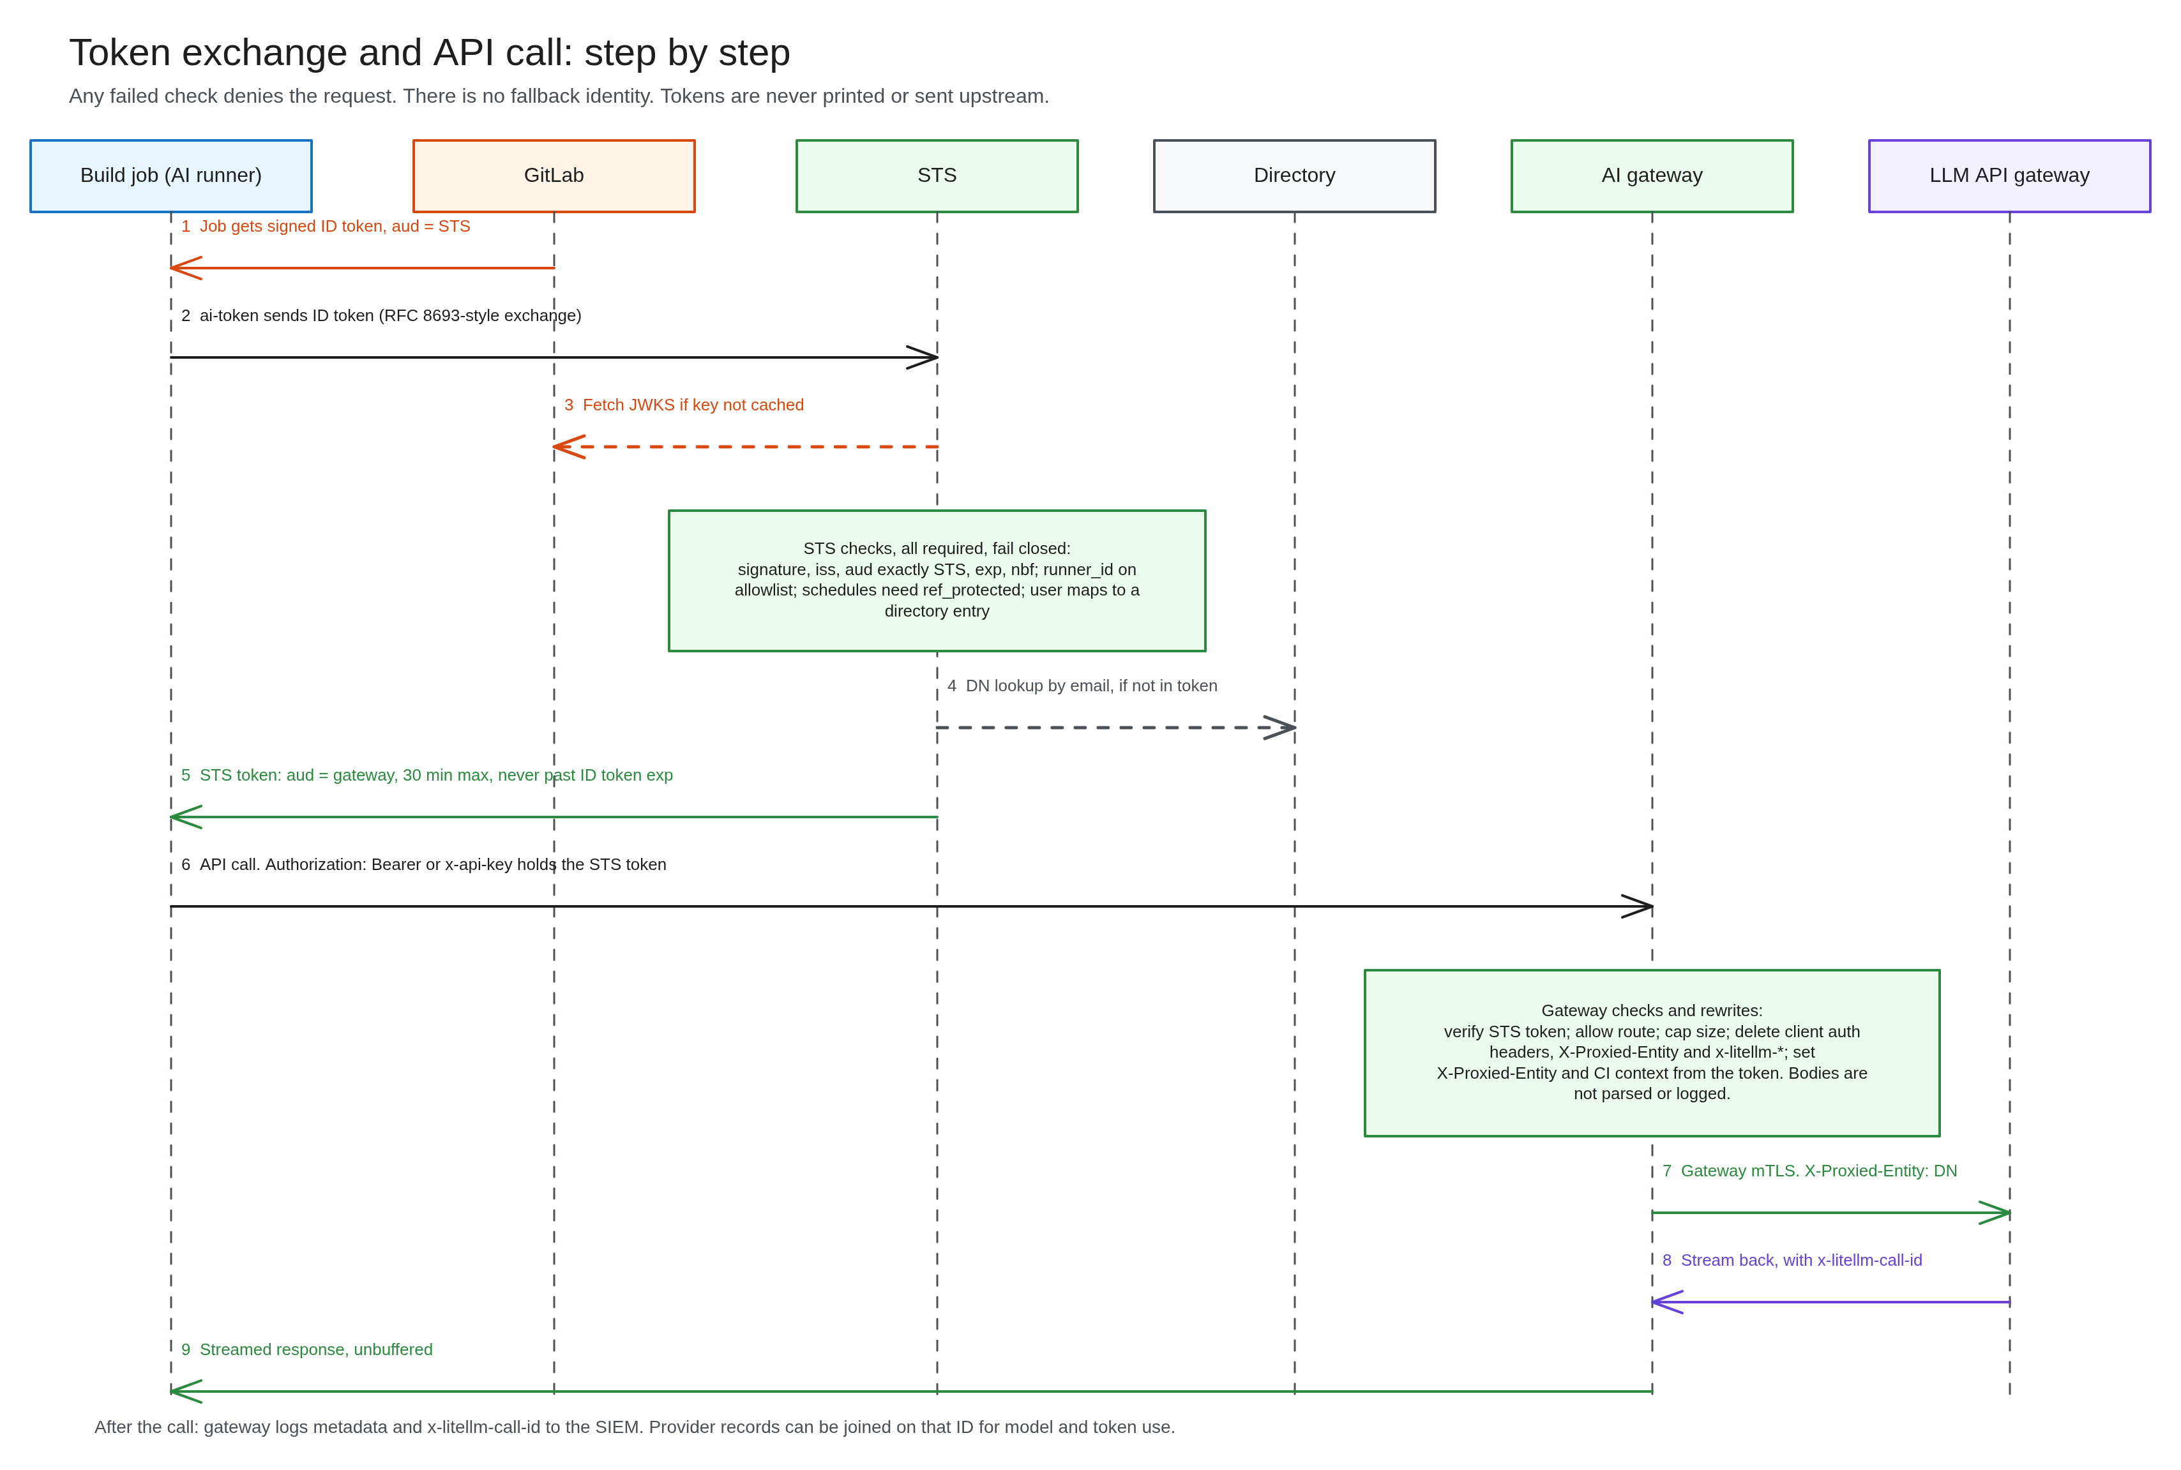
Token exchange, step by step
Notes:
Any failed check denies. STS token never goes upstream. Model and token use comes from provider records joined on x-litellm-call-id.

Slide 18
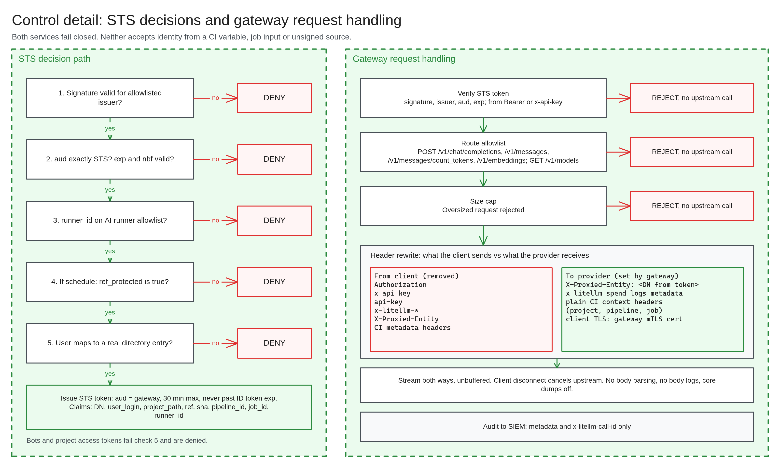
STS decisions and gateway handling
Notes:
Bots and project access tokens fail mapping. Gateway removes client auth and x-litellm headers, then sets identity from the token.

Slide 19
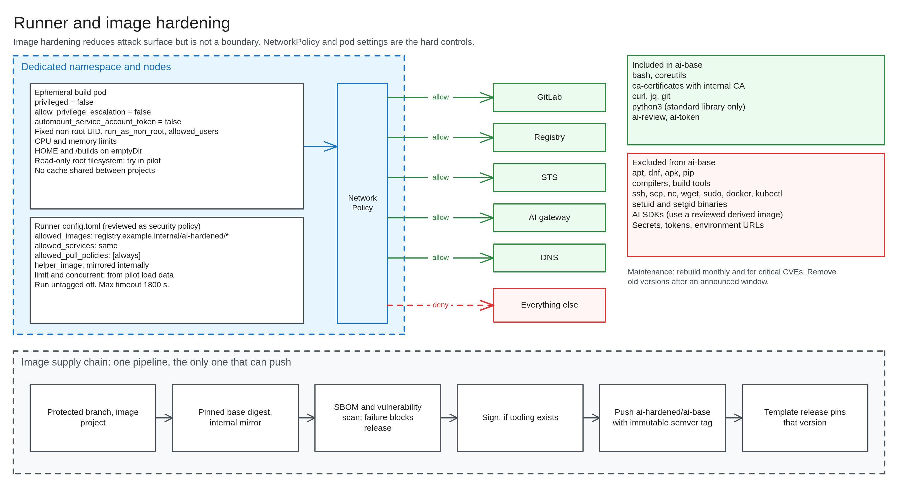
Runner and image hardening
Notes:
Image hardening is not a boundary, as a job can run what is in its checkout. NetworkPolicy and pod settings are the hard controls.

Slide 20
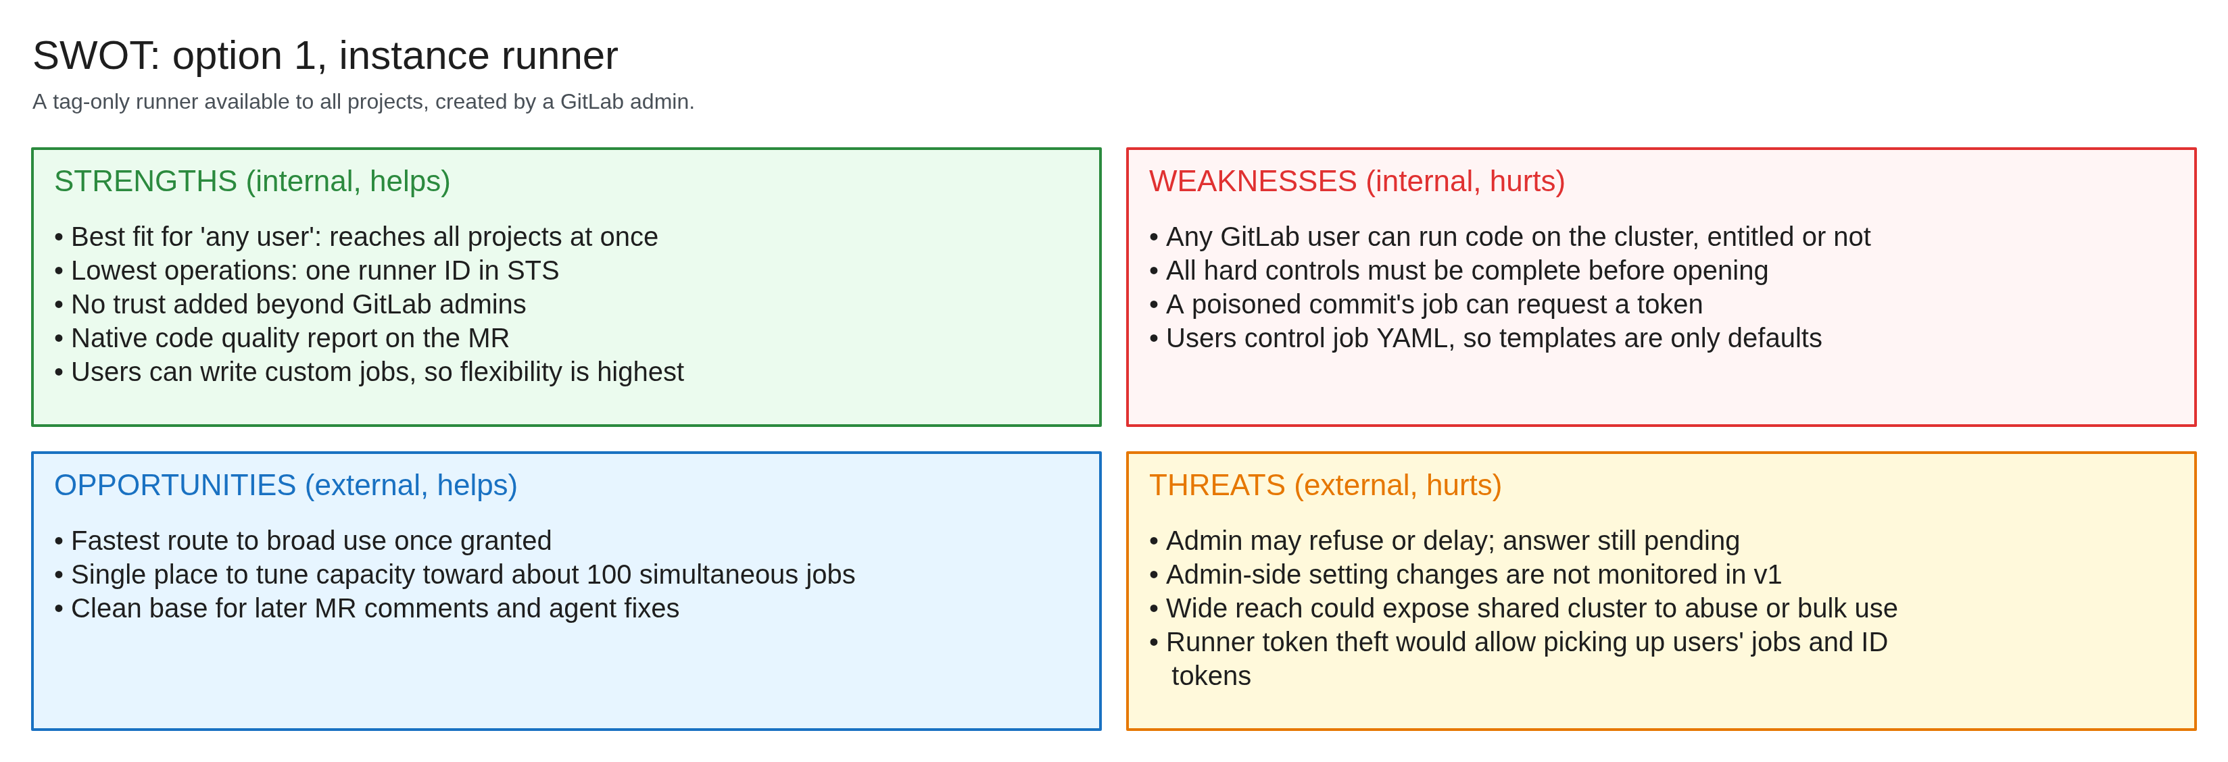
SWOT: option 1, instance runner
Notes:
Some opportunities and threats are the author's judgment and open to challenge.

Slide 21
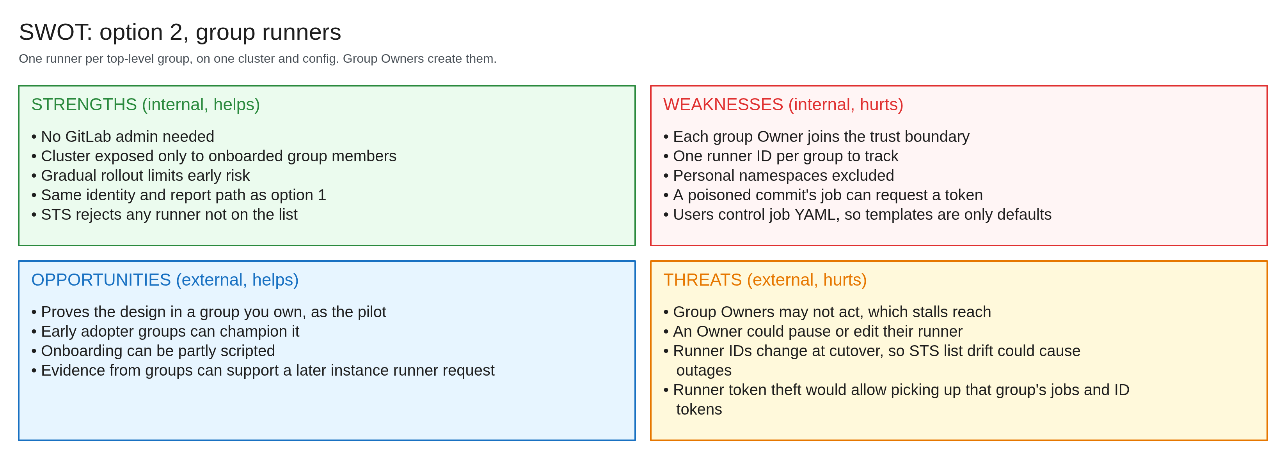
SWOT: option 2, group runners
Notes:
Some opportunities and threats are the author's judgment and open to challenge.

Slide 22
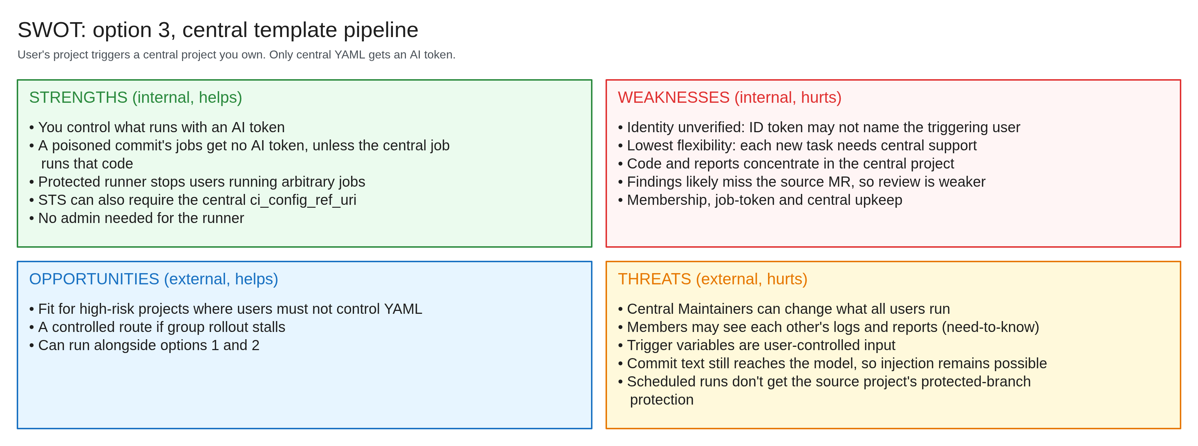
SWOT: option 3, central template
Notes:
Some opportunities and threats are the author's judgment and open to challenge.

