Slide 1

SMART INDIA HACKATHON 2026
TITLE PAGE
CryptoDrishti
An evidence-driven tool for discovering enterprise cryptography, assessing quantum exposure and planning post-quantum migration.
Problem Statement ID – SIH26164
Problem Statement Title – Enterprise Cryptographic Discovery & Analysis Tool (ECDAT)
Theme – 26164
PS Category – Software
Team ID – 146876
Team Name – Zero-Day

Slide 2
CryptoDrishti | PROPOSED SOLUTION
Zero-Day
The problem
Cryptographic assets are spread across application code, third-party libraries, configuration, certificates, compiled binaries and container images. Each records cryptography differently, and none of them is a list. Without a reliable inventory, an organisation cannot say which assets need quantum-safe migration, or in what order.
What CryptoDrishti does
CryptoDrishti discovers cryptographic evidence across those surfaces, normalises it into one inventory, assesses each asset's quantum exposure, and produces evidence-backed migration recommendations and a CycloneDX Cryptography Bill of Materials.
Why it is different
Finding RSA in a library is not observing RSA signing at a call site — capability, declaration, use and observation stay apart.
WHERE THE EVIDENCE COMES FROM
Source code
Python AST + rule packs
Dependencies
13 manifest formats
Binaries
ELF symbols, constants
Configuration
nginx · sshd · OpenSSL
Certificates
X.509 · PEM/DER
Containers
OCI · docker save
CRYPTODRISHTI
normalise → correlate → classify → score
INVENTORY
distinct assets
RISK
Mosca exposure
MIGRATION
named target
CBOM
CycloneDX 1.6/1.7
A seventh sensor completes a live TLS handshake — only against an endpoint the operator names, and only after the destination policy vets every resolved address.

Slide 3
TECHNICAL APPROACH
Zero-Day
How a finding is processed
ONE ALGORITHM · THREE PURPOSE STATES · THREE DECISIONS
Every scanner can tell you RSA is present. What decides the migration is what it is being used for.
Scanner evidence
file, line, symbol, technique, confidence
Case 1 — RSA signing
Normalisation
hits become one distinct asset
svc-payments/signing.py:15 · source · used
RSA-PSS padding signs
ML-DSA-65
Purpose + assurance
what it is for; how strong the proof is
Case 2 — RSA key establishment
Risk assessment
Mosca X + Y > Z, per purpose
svc-gateway/transport.py:16 · source · used
RSA-OAEP padding wraps a key
X25519MLKEM768
Migration decision
a named target — or none
Case 3 — RSA, unresolved
legacy/nginx.conf:5 · config · declared
CBOM
CycloneDX, schema-validated
a cipher list permits RSA, purpose unstated
Purpose must be resolved first
BUILT WITH
Python 3.11+ · FastAPI
SQLite (WAL)
Vanilla JS console
60 rules · 8 languages
ELF symbol parsing
CycloneDX 1.6 / 1.7

Slide 4
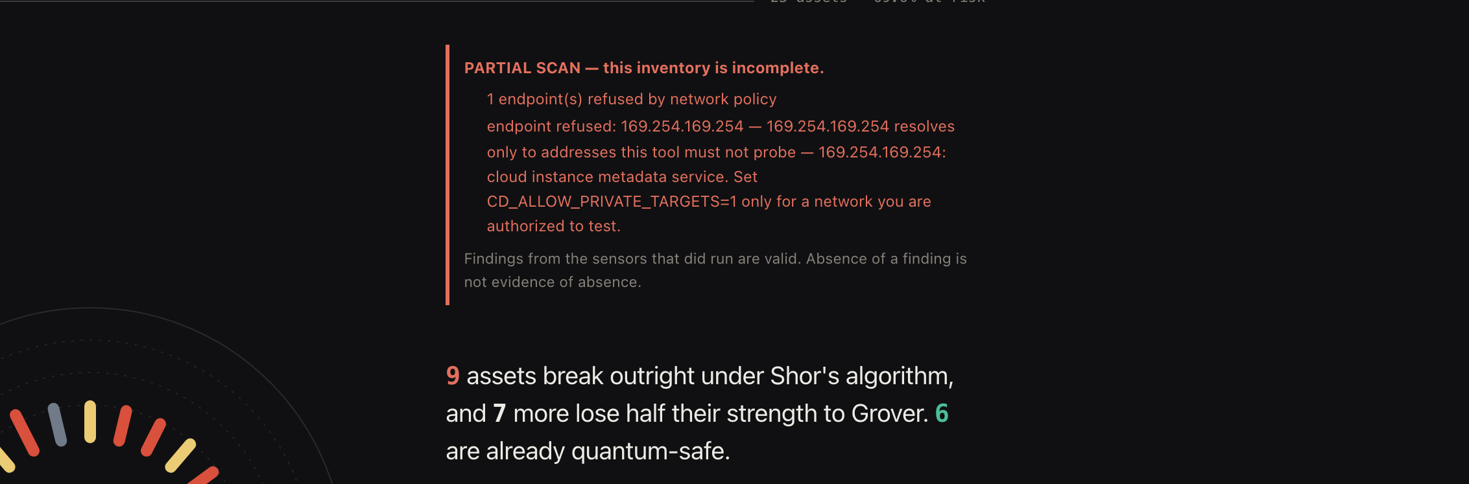
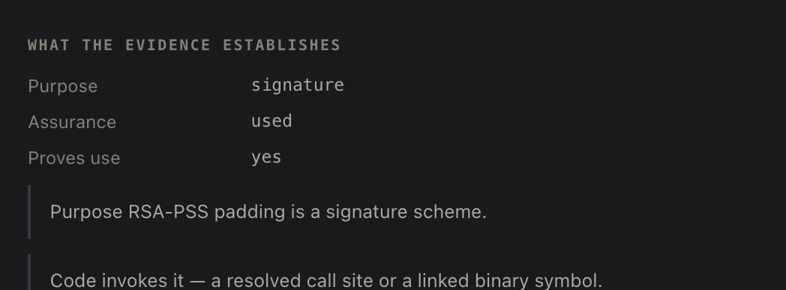
FEASIBILITY AND VIABILITY
Zero-Day
Implemented
Seven scanning surfaces, each returning evidence with a location, a technique and a confidence
An inventory of distinct assets, carrying purpose and assurance on every one
A quantum-risk model taking operator-supplied shelf life, criticality and constraints, saved per asset and surviving a rescan
Validated
664 automated tests — on Python 3.11, 3.12 and 3.13 in CI
Official schema validation — every CBOM checked offline against the CycloneDX schemas at pinned commit 0bd48c8; CI fails on a violation
Hand-labelled benchmark — 116 findings over six scanners, labelled from the fixtures, not from the tool's output
Feasible to deploy
The tool is local-first: one machine, loopback by default, no cloud service, and it validates its own output offline. Committed demo fixtures reproduce every figure in this deck with one command.
Assessment — the scan states its own completeness first: one endpoint refused, so the inventory is marked PARTIAL.
Limits — Full AST analysis is Python only; seven further languages use rule packs, and Rust and Swift are recognised but effectively uncovered. Binary parsing is ELF only. No KMS, HSM, cloud or Kubernetes integration. A working prototype, not a deployed product.
Evidence drawer — purpose, assurance and the exposure arithmetic behind one finding's score.

Slide 5
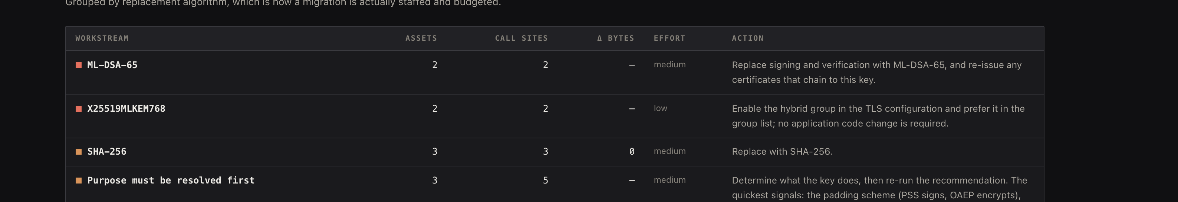
IMPACT AND BENEFITS
Zero-Day
What a migration team does with the output
DISCOVER
Inventory the cryptographic assets that are actually present.
UNDERSTAND
Algorithm, purpose, evidence strength and exact location.
PRIORITISE
Quantum exposure with documented, operator-set assumptions.
PLAN
A purpose-matched target — or a request for more evidence.
EXPORT
A schema-validated CBOM and a traceable report.
Who this is for
Measured on a labelled corpus
Intended for security engineering teams, cryptographic inventory and migration-planning teams, and infrastructure operators. These are intended users; the tool has not been deployed in production.
Like-for-like, same corpus, before → after
F1 0.941 → 0.983
79/5/5 → 84 TP · 3 FP · 0 FN
What changes for them
“We think we use RSA somewhere” becomes a per-asset list with file, line, purpose, evidence strength and a named replacement.
What an estate runs is separated from what it merely has installed, so the plan is not padded with libraries nobody calls.
A partial scan is labelled partial, so nobody signs off an estate on an inventory that silently missed half of it.
An expanded synthetic corpus of 116 findings across six scanners scores 1.000 — a separate, non-comparable experiment. Both corpora were written by this project's developers and measure those corpora only; real-world enterprise accuracy has not been measured.
Remediation programme — grouped by the replacement each asset needs, which is how the work is staffed.

Slide 6
RESEARCH AND REFERENCES
Zero-Day
Cryptography standards informing classification and migration
FIPS 203 — Module-Lattice-Based Key-Encapsulation Mechanism (ML-KEM). NIST, 2024. doi.org/10.6028/NIST.FIPS.203
FIPS 204 — Module-Lattice-Based Digital Signature Standard (ML-DSA). NIST, 2024. doi.org/10.6028/NIST.FIPS.204
FIPS 205 — Stateless Hash-Based Digital Signature Standard (SLH-DSA). NIST, 2024. doi.org/10.6028/NIST.FIPS.205
NIST IR 8547 (initial public draft) — Transition to Post-Quantum Cryptography Standards. NIST, 2024.
Problem statement and repository
Smart India Hackathon 2026, Problem Statement SIH26164 — Enterprise Cryptographic Discovery & Analysis Tool (ECDAT), National Technical Research Organisation (NTRO).
Source, 664 tests, the labelled benchmark corpus and its committed results, and the vendored schemas: github.com/sgtsujith141-wq/cryptodrishti
CBOM and container formats
CycloneDX v1.6, standardised as ECMA-424 (1st edition, June 2024) — cyclonedx.org/specification/overview
CycloneDX v1.7 JSON Schema. Both schemas vendored in this repository at pinned commit 0bd48c8 and checksummed.
OCI Image Format Specification — image layout, manifests and layer whiteouts. github.com/opencontainers/image-spec
RFC 8996 — Deprecating TLS 1.0 and TLS 1.1. rfc-editor.org/rfc/rfc8996
Risk methodology
M. Mosca, “Cybersecurity in an Era with Quantum Computers: Will We Be Ready?”, IEEE Security & Privacy, vol. 16, no. 5, 2018 — the source of the X + Y > Z inequality used by the risk model.
P. W. Shor, “Polynomial-Time Algorithms for Prime Factorization and Discrete Logarithms on a Quantum Computer”, SIAM J. Computing, 1997.
L. K. Grover, “A fast quantum mechanical algorithm for database search”, STOC 1996.
WHICH STANDARD GOVERNS WHICH PART OF THE PRODUCT
FIPS 203 / 204 / 205
the migration targets it names
NIST IR 8547
how it classifies what is at risk
CycloneDX 1.6 / 1.7
the CBOM it exports and validates
OCI image spec
how it reads container layers
Mosca X + Y > Z
how it scores exposure
Scope — CryptoDrishti discovers, classifies, assesses and recommends cryptography. It does not implement the post-quantum primitives above; it uses them as the standards that inform classification and migration targets.

