Slide 1

SMART INDIA HACKATHON 2026
TITLE PAGE
Problem Statement ID – SIH26159
Problem Statement Title – SecureMailScope: AI-Assisted Cryptographic Security Posture Assessment for Secure Email Communications
Organisation – National Technical Research Organisation (NTRO)
Theme – [UNRESOLVED: theme]
PS Category – Software
Team ID – [UNRESOLVED: team id]
Team Name (Registered on portal) – Zero-Day

Slide 2
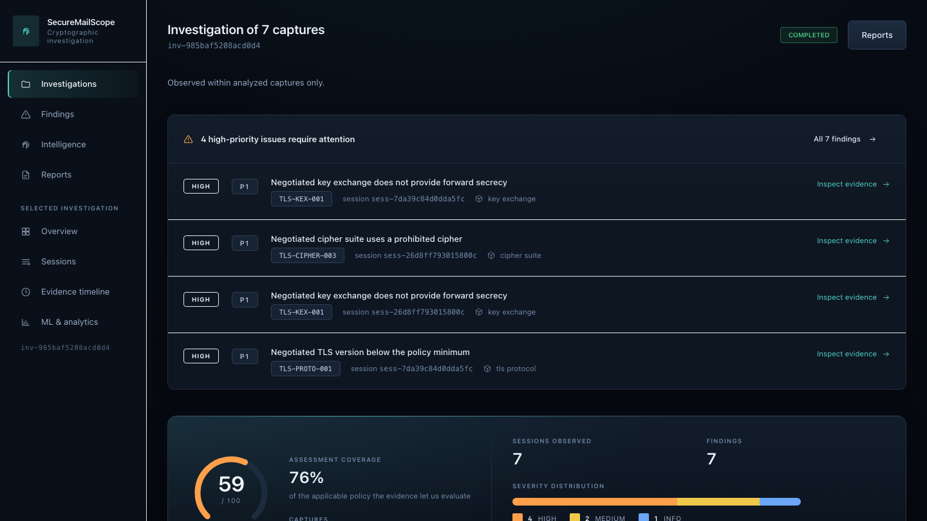
IDEA TITLE
Zero-Day
SecureMailScope turns passive email packet captures into evidence-backed cryptographic investigations.
Every conclusion is traceable to the packets that establish it — and where a capture cannot show something, it says so.
PCAP
TCP
reconstruction
SMTP / IMAP
POP3
STARTTLS
TLS
Cryptographic
evidence
Risk +
remediation
What it does
Reads authorized PCAP/PCAPNG, reconstructs TCP sessions, identifies the email protocol from the dialogue rather than the port, reconstructs the TLS handshake, extracts certificate evidence where it is observable, applies 25 policy rules and scores the result.
How it addresses SIH26159
The organisation already holds the captures. No probe, no scan, no credential and no change to a production mail server — which also means an authorised investigator with no access to the host can still assess how it protected traffic.
What makes it different
Packet-level provenance on every finding · cryptographic DNA and drift across captures · cross-session correlation · explainable scoring with the arithmetic shown · fully local and offline · stated limits instead of silent gaps
The investigation overview, on seven synthetic captures. Actual product output.

Slide 3
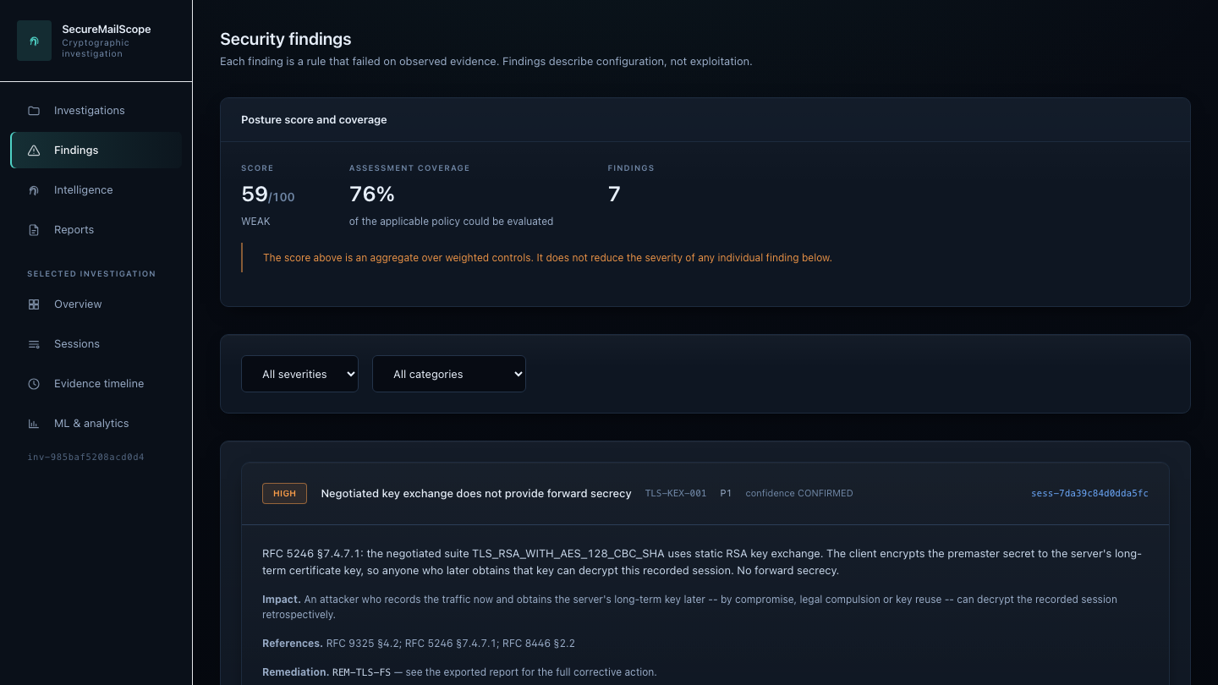
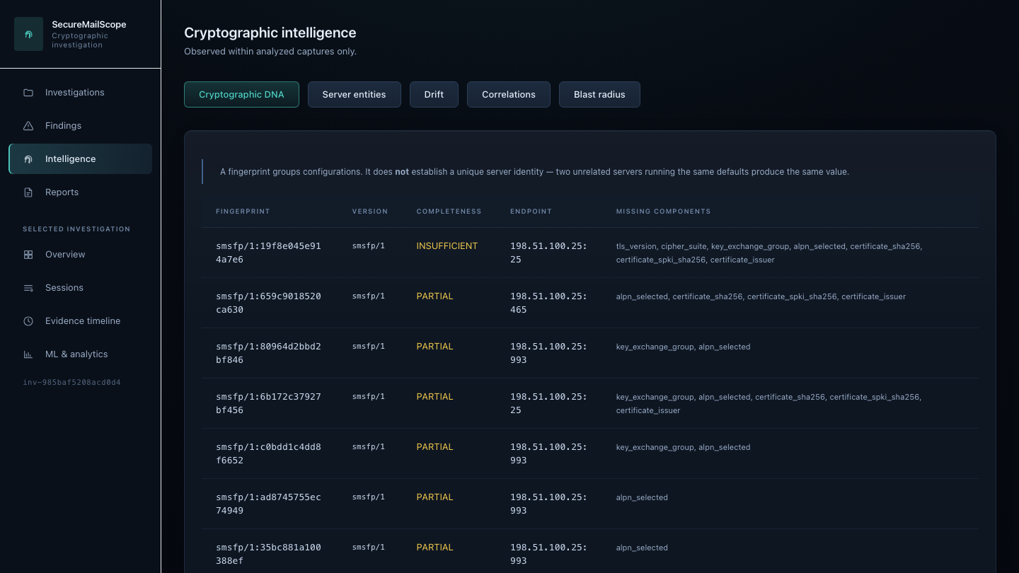
TECHNICAL APPROACH
Zero-Day
Each stage reads only what the previous one produced. Line counts are actual.
PCAP / PCAPNG — untrusted input, 8 hard limits
PASSIVE ONLY
LOCAL FIRST
EVIDENCE LINKED
Safe ingestion — 1,166 loc — format from content, never the extension
TCP reconstruction — ~900 loc — reorder · retransmit · gaps · overlap conflicts
SMTP / IMAP / POP3 — 3,406 loc — real state machines; port is only a hint
STARTTLS / STLS — advertised · requested · outcome · exact upgrade packet
TLS handshake + crypto — 3,042 loc — version from supported_versions, KX from key_share
Finding → packets
Cryptographic DNA
Technologies
Python 3.12 · Scapy 2.7 (dissection only) · cryptography 50 · Pydantic 2.9 · FastAPI · SQLite · SQLAlchemy
React 18 · TypeScript strict · Vite 8 · Tailwind · scikit-learn 1.5 · ReportLab · Jinja2
Verification: pytest · hypothesis · Playwright · Vitest · TShark used as an independent dissector
X.509 intelligence — 861 loc — RFC 5280 path, dates, hostname, key, signature
Security rules + scoring — 3,416 loc — 25 rules · versioned policy · explainable score
Correlation · drift · anomaly — 5,471 loc — fingerprints · entities · blast radius · ML
FastAPI + SQLite — 2,756 loc — loopback only · token · 3 explicit migrations
React forensic dashboard — 4,400 loc — TypeScript strict · evidence-linked throughout
JSON · HTML · PDF — 1,582 loc — one canonical model, parity-tested

Slide 4
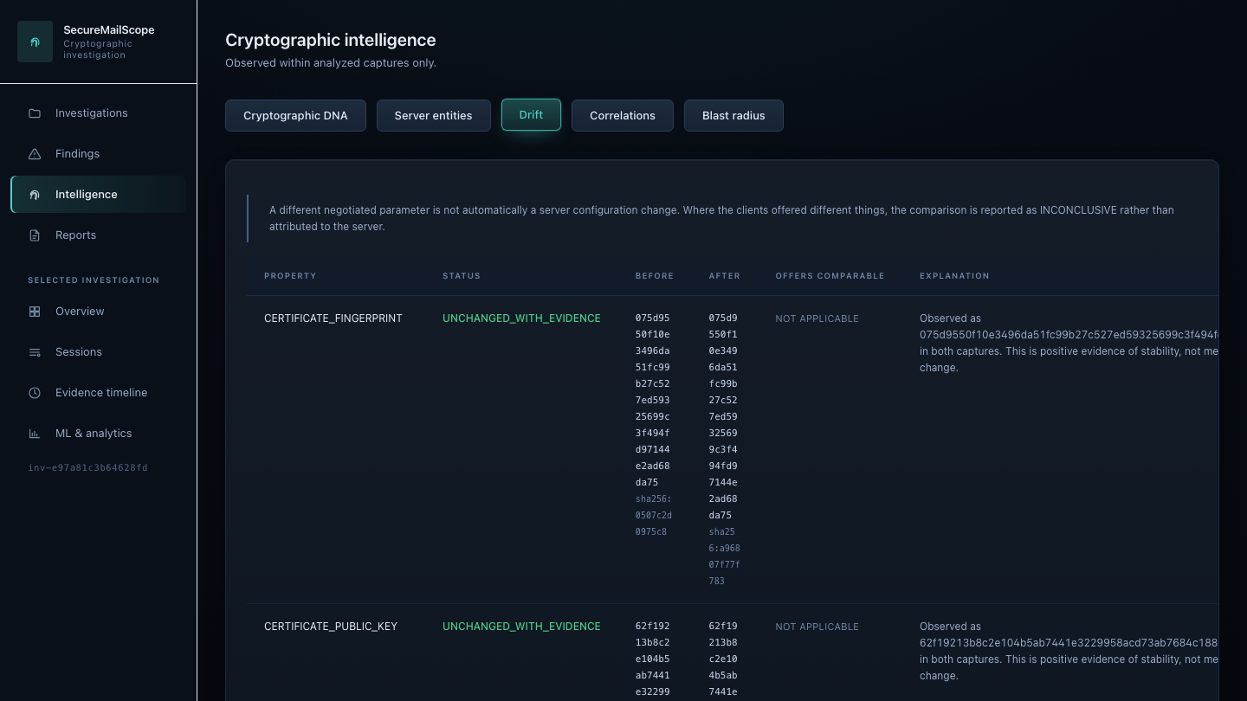
FEASIBILITY AND VIABILITY
Zero-Day
Feasible because it is built and measured. Every figure is from the release commit, re-run — not an estimate.
Implemented and verified
Full PCAP → report workflow, end to end
TCP reconstruction handles reordering, retransmission, gaps, overlap conflicts and tuple reuse
SMTP / IMAP / POP3 state machines with STARTTLS and STLS; protocol from the dialogue, not the port
TLS 1.2 and TLS 1.3 handled with separate semantics
X.509 analysis wherever the evidence permits
25 deterministic rules, versioned policy, explainable score
Cross-capture drift and correlation
Verification
1,354 backend tests pass; 1,364 with the TShark cross-check enabled
Ten cross-checks compare our dissection against Wireshark's, so a bug in our own parser cannot validate itself
88 frontend tests · 5 browser end-to-end specs against the real backend, nothing mocked
ruff and mypy clean over 153 files
Expectations are hand-derived and committed as manifests; the captures are generated, so a test cannot confirm itself
0 known dependency vulnerabilities (pip-audit, npm audit); hash-pinned lock; CycloneDX SBOM
Cryptographic drift across two captures. Actual product output.
Challenges and limits — stated, not hidden
TLS 1.3 encrypts the Certificate message. A passive capture without decryption material cannot expose what is not on the wire. Reported NOT_AVAILABLE with the reason, never blank and never guessed. TLS 1.2 certificates are read and verified in full: dates, chain, hostname, key size, signature algorithm.
The supervised classifier is NOT VALIDATED for real-world deployment. It is trained and measured on controlled synthetic servers (macro-F1 0.5624). Synthetic evaluation does not establish real-world accuracy, the interface says so on screen, and the classifier drives no finding and no score. The anomaly detector actually in use is a deterministic rarity baseline, not a machine-learning model — a trained Isolation Forest was measured, lost, and is shipped labelled as experimental.
Handshake completion is not verifiable and revocation is never checked. A capture carries no traffic keys, and an OCSP or CRL request would break the passive rule. Three constants are asserted false or zero in every report by the test suite.
Deployment. Memory binds before speed — about 76 KB peak resident per packet — and no benchmark has been run on the assumed 4-core/8 GB minimum, which is recorded NOT VERIFIED. Analysis cannot be cancelled, and a test asserts the absence so it cannot be mistaken for a broken control.

Slide 5
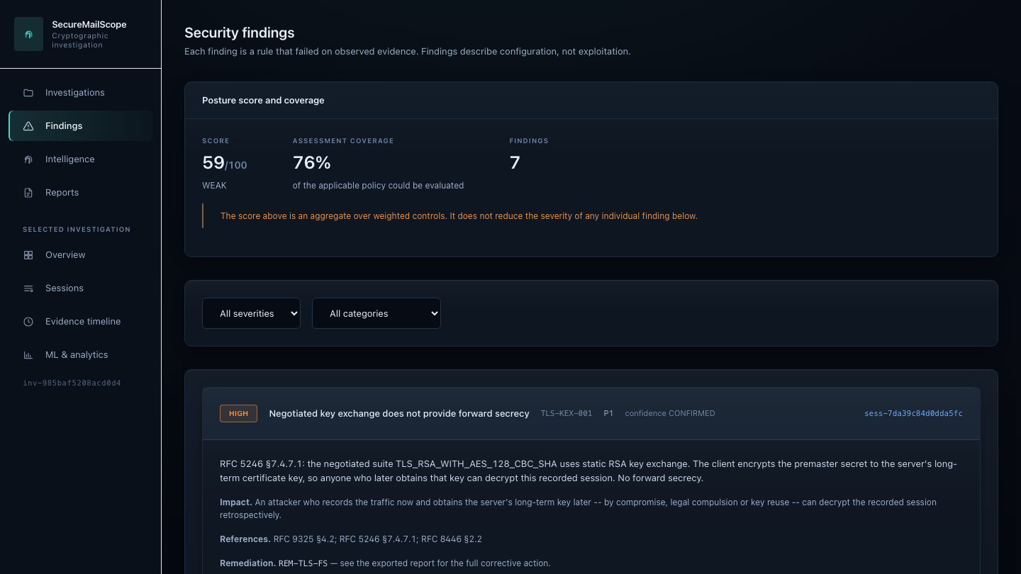
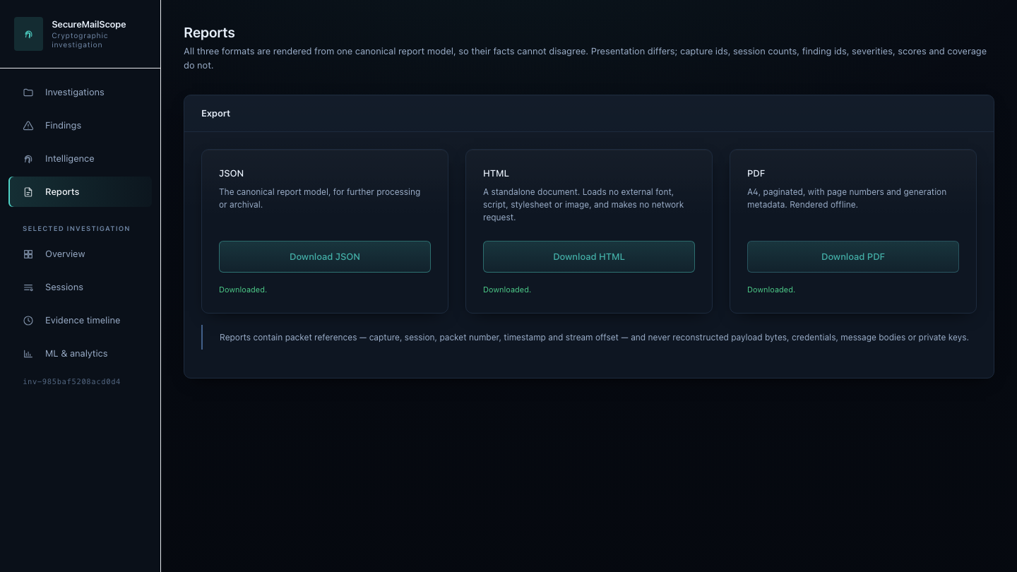
IMPACT AND BENEFITS
Zero-Day
For authorised email-security investigation. These are potential benefits: the tool is demonstrated on synthetic captures and has no deployments, no users and no measured real-world outcomes.
DISCOVER
Identify the cryptographic configurations actually negotiated — versions, cipher suites, key exchanges and certificates — from traffic the organisation already holds, without touching the host.
EXPLAIN
Link every finding to the packets that establish it, with the RFC it applies and the limitation it carries. An analyst can open the same packet in Wireshark and check.
PRIORITIZE
Rank weaknesses by a severity and confidence matrix, each with a named remediation and its expected security effect, so 'what do I fix first' has an answer with a reason.
TRACK
Detect cryptographic drift across captures: when the same observed service changes what it negotiates, and whether the change is attributable to the server or merely to a different client.
A finding, with its rule, severity and remediation.
Configuration drift between two captures.
JSON, offline HTML and PDF export.
Captured enterprise traffic stays local by default — nothing is uploaded, and no host in a capture is ever contacted. · No financial saving, adoption figure, deployment or real-world detection rate is claimed: none has been measured.

Slide 6
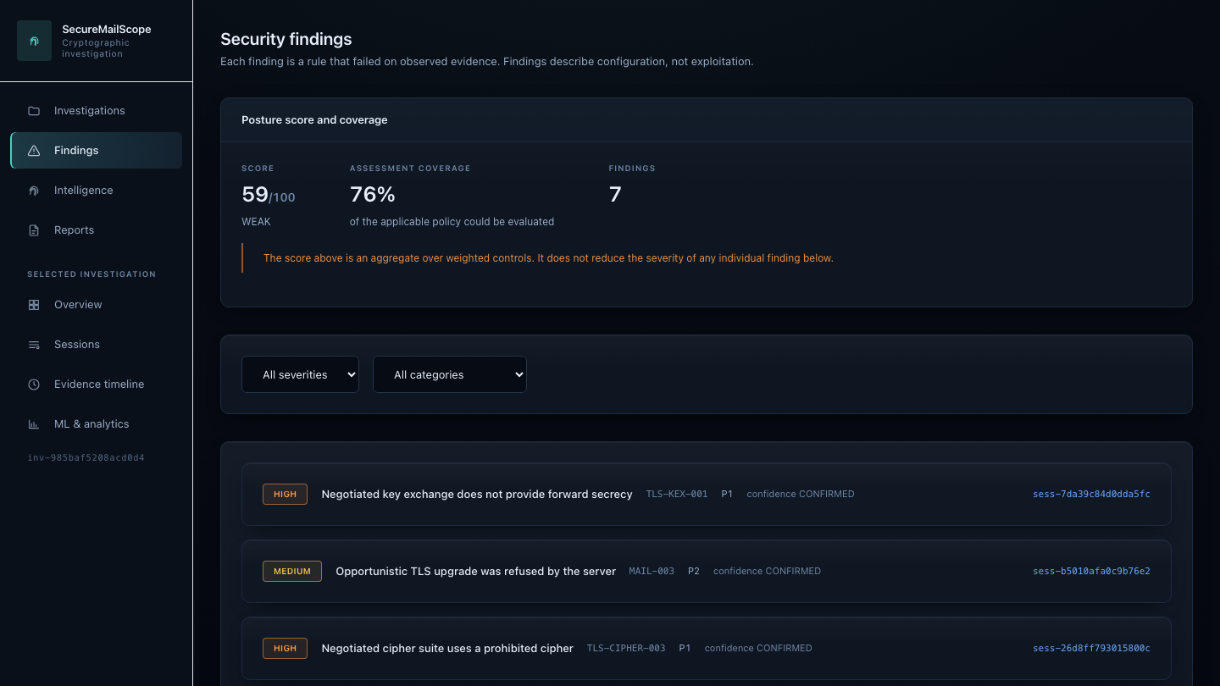
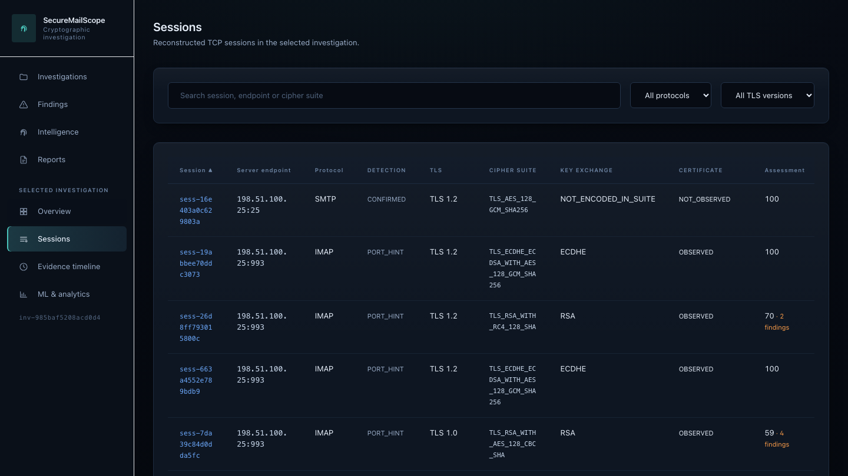
RESEARCH AND REFERENCES
Zero-Day
Standards the rules cite and the parsers implement. Every rule names the clause it applies.
TLS and certificates
[1] RFC 8446 — TLS 1.3
[2] RFC 5246 — TLS 1.2
[3] RFC 9325 — Recommendations for secure use of TLS (2022)
[4] RFC 8996 — Deprecating TLS 1.0 and 1.1
[5] RFC 7457 — Known attacks on TLS and DTLS
[6] RFC 4492 — ECC cipher suites for TLS
[7] RFC 5280 — X.509 certificate and CRL profile
[8] RFC 6125 — Verifying application service identity
[9] NIST SP 800-52 Rev. 2 — TLS implementation guidelines
[10] IANA TLS Parameters registry
Email transport
[11] RFC 5321 — Simple Mail Transfer Protocol
[12] RFC 3207 — SMTP over TLS (STARTTLS)
[13] RFC 9051 — IMAP version 4rev2
[14] RFC 1939 — Post Office Protocol version 3
[15] RFC 2595 — Using TLS with IMAP, POP3 and ACAP
[16] RFC 2606 — Reserved DNS names (.invalid, used by every synthetic fixture)
Libraries
[17] Scapy · [18] python-cryptography · [19] FastAPI
[20] scikit-learn · [21] React · [22] Wireshark / TShark
Verification methodology
Deterministic synthetic fixtures. Every capture is generated from a fixed seed, so the same bytes are produced on every machine and in CI.
Known-answer manifests. Expectations are hand-derived and committed; the captures themselves are gitignored. A test cannot confirm its own output.
Independent TShark cross-checks. Ten comparisons against Wireshark's dissector, so a shared bug in our parser cannot validate itself.
Browser end-to-end tests. Five Playwright specs drive the real backend over the real engine, including a restart to prove persistence.
Report-parity verification. One canonical model feeds JSON, HTML and PDF, and their facts are asserted equal.
Project research
evidence-model · scoring-methodology · limitations · threat-model · security-audit
ml-methodology · ml-evaluation · ml-model-card · performance-benchmarks
REQUIREMENT-COVERAGE.md — all 35 SIH26159 capabilities with status and evidence
Findings triage
Session inventory

