Slide 1

SMART INDIA HACKATHON 2026
TITLE PAGE
Problem Statement ID – SIH26159
Problem Statement Title – SecureMailScope: AI-Assisted Cryptographic Security Posture Assessment for Secure Email Communications
Organisation – National Technical Research Organisation (NTRO)
Theme – Blockchain & Cybersecurity
PS Category – Software
Team ID – 146876
Team Name (Registered on portal) – Zero-Day

Slide 2
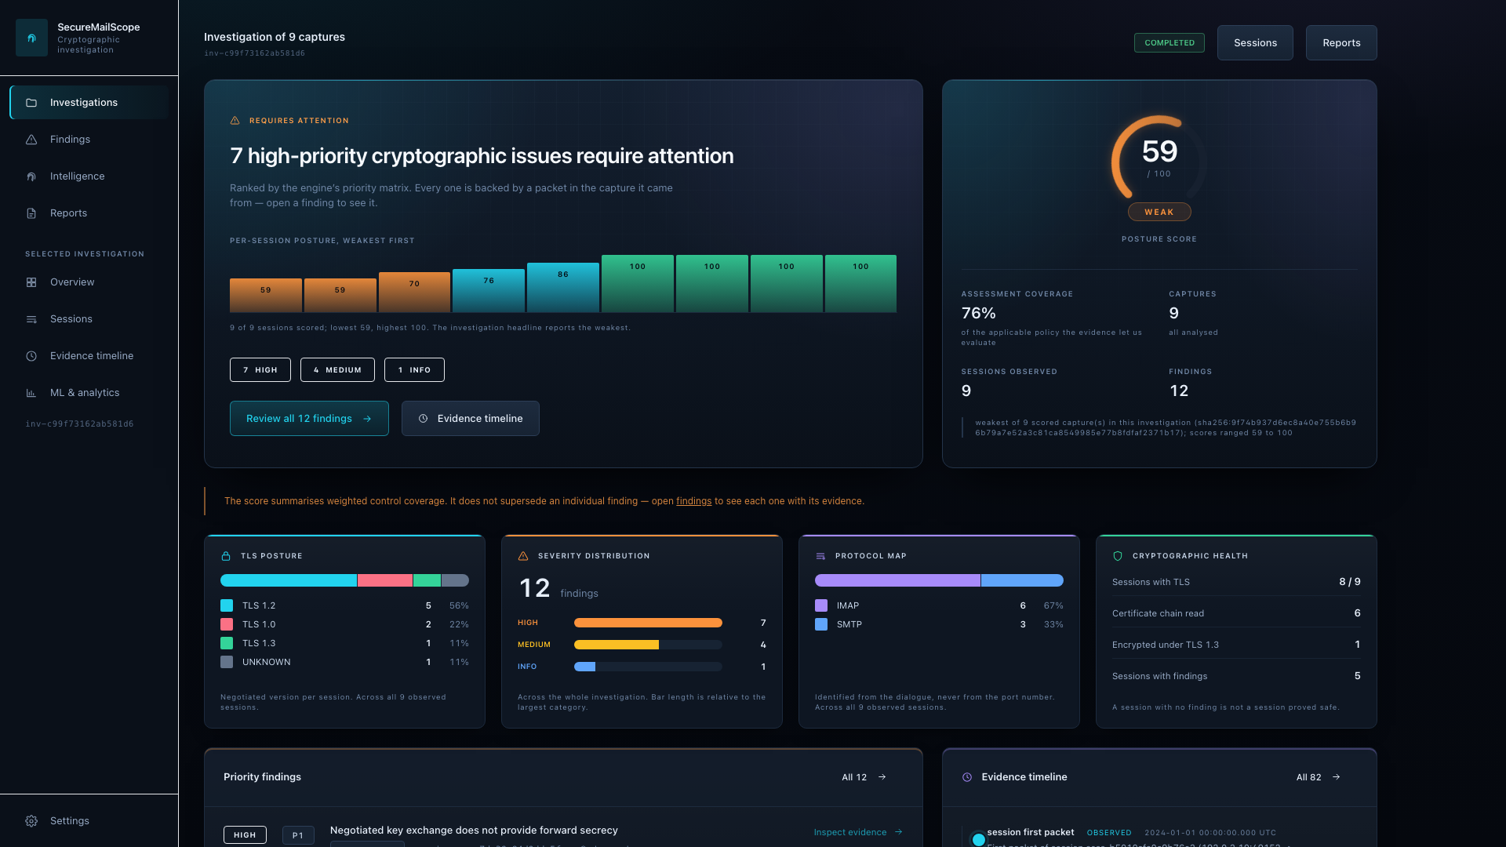
IDEA TITLE
Zero-Day
SecureMailScope turns passive email packet captures into evidence-backed cryptographic investigations.
Every conclusion is traceable to the packets that establish it — and where a capture cannot show something, it says so.
PCAP
TCP
reconstruction
SMTP / IMAP
POP3
STARTTLS
TLS
Cryptographic
evidence
Risk +
remediation
What it does
Reads authorized PCAP/PCAPNG, reconstructs TCP sessions, identifies the email protocol from the dialogue rather than the port, reconstructs the TLS handshake, extracts certificate evidence where it is observable, applies 25 policy rules and scores the result.
How it addresses SIH26159
The organisation already holds the captures. No probe, no scan, no credential and no change to a production mail server — which also means an authorised investigator with no access to the host can still assess how it protected traffic.
What makes it different
Packet-level provenance on every finding · cryptographic DNA and drift across captures · cross-session correlation · explainable scoring with the arithmetic shown · fully local and offline · stated limits instead of silent gaps
The investigation overview, on 9 synthetic captures. Actual product output.

Slide 3
TECHNICAL APPROACH
Zero-Day
One direction of flow. Each stage reads only what the previous one produced, and attaches the packets it read it from.
INPUT
RECONSTRUCTION
ASSESSMENT
OUTPUT
PCAP / PCAPNG
untrusted file
TCP reassembly
reorder · retransmit · gaps
SMTP · IMAP · POP3
state machines, not ports
25 policy rules
versioned, fingerprinted
One canonical report model
schema 1.4.0
Safe ingestion
format from the bytes
8 hard limits
STARTTLS / STLS
advertised · requested · outcome
TLS handshake
version, suite, key exchange
Score · coverage · priority
arithmetic shown, not asserted
JSON · offline HTML · PDF
parity-tested against each other
Packet decode
X.509 certificate analysis — chain, dates, identity, key, signature
Fingerprints · drift · correlation · ML (advisory)
Local API → React dashboard
EVIDENCE PROVENANCE — every stage attaches the capture, session, packet number, timestamp and stream offset it read from, and marks each value OBSERVED, INFERRED, UNKNOWN or NOT AVAILABLE
PASSIVE BY CONSTRUCTION — no stage opens a socket. Scapy's neighbour resolver is replaced with one that raises, and the whole pipeline is run through stubbed socket constructors by the test suite
Engine
Python 3.12 · Scapy (dissection only) · cryptography · Pydantic · scikit-learn
Interface and API
FastAPI · SQLite · SQLAlchemy · React 18 · TypeScript strict · Vite · Tailwind
Verification
pytest · hypothesis · Vitest · Playwright · TShark as an independent dissector

Slide 4
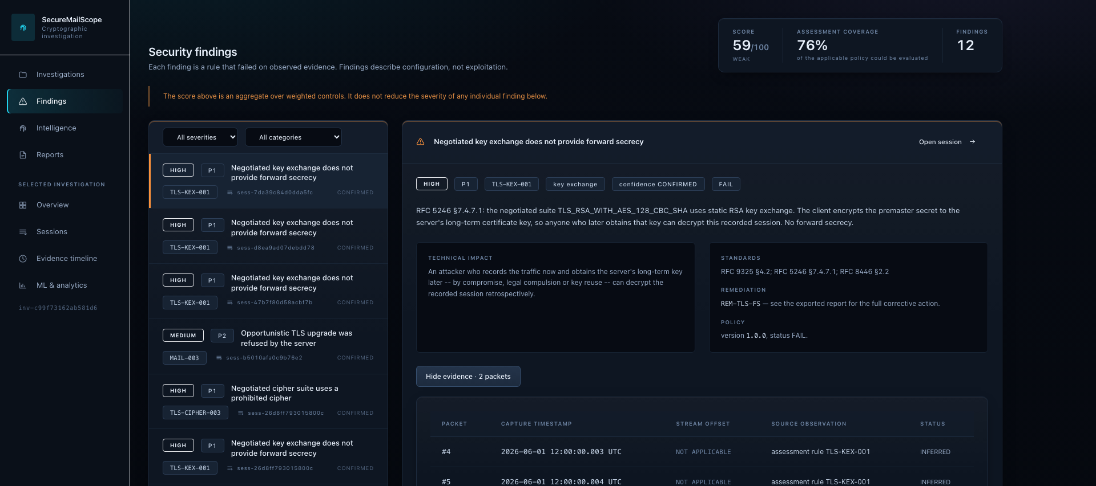
FEASIBILITY AND VIABILITY
Zero-Day
Feasible because it is built and measured. Every figure below is from the release commit, re-run — not an estimate.
1,357
backend tests pass
1,367
with the TShark cross-check
89
frontend tests
5
browser end-to-end specs
156
files ruff + mypy clean
0
known dependency vulnerabilities
How a finding is proved
1. A rule fails on a reconstructed observation — here, static RSA key exchange, so no forward secrecy.
2. The engine attaches the packets it evaluated: #4 and #5, with their capture timestamps and stream offsets.
3. The capture and session ids are printed beside them, so an analyst can open the same packets in Wireshark and check.
4. Packet metadata only. Reconstructed payload bytes are never included in a report or shown in the interface.
Expectations are hand-derived and committed as manifests while the captures are generated, so a test cannot confirm its own output; ten TShark cross-checks compare our dissection against Wireshark's, so a bug in our parser cannot validate itself.
The finding, and the packets it was evaluated against. Actual product output.
Limits, stated not hidden
TLS 1.3 encrypts the Certificate message, so a passive capture cannot expose it — reported NOT_AVAILABLE with the reason, never blank and never guessed. TLS 1.2 chains are read and verified in full.
The supervised classifier is NOT VALIDATED for real-world use: it was measured on synthetic servers only, it drives no finding and no score, and the interface says so on screen.

Slide 5
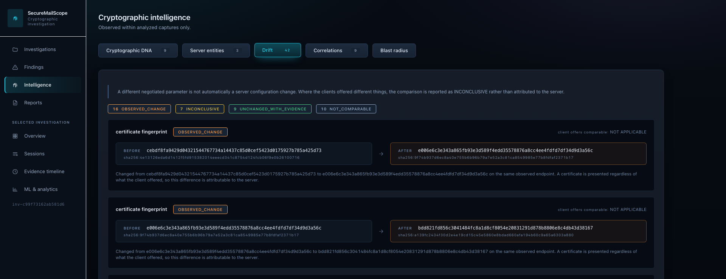
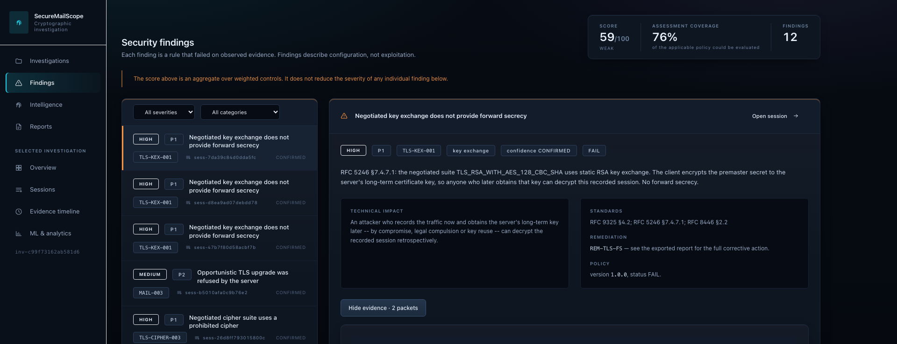
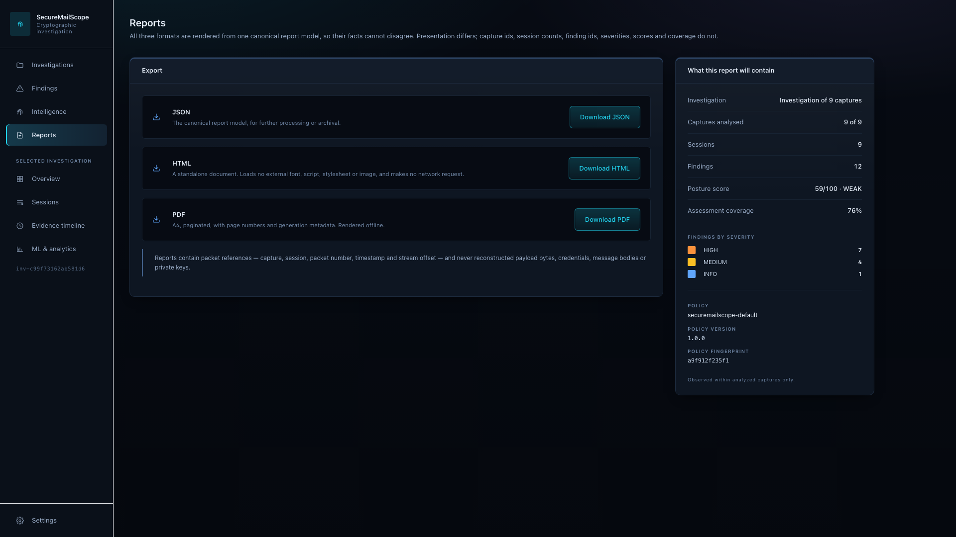
IMPACT AND BENEFITS
Zero-Day
For authorised email-security investigation. Each visual below is the product output that supports the benefit beside it.
TRACK
Drift compares one endpoint across captures. Where the clients asked different questions the comparison is reported INCONCLUSIVE rather than blamed on the server.
DISCOVER
The cryptographic configuration actually negotiated — version, cipher suite, key exchange, certificate — read from traffic the organisation already holds, without touching the host.
EXPLAIN
Every finding names the rule it failed, the RFC clause it applies and the packets that establish it, so the conclusion can be checked rather than believed.
PRIORITIZE
Severity and confidence produce a ranked priority with a named remediation, so 'what do I fix first' has an answer and a reason.
Configuration drift, before and after.
REPORT
One canonical model produces JSON, a self-contained offline HTML document and a PDF, so their facts cannot disagree.
One finding, its rule, its remediation and the packets behind it.
Export, in three formats.
Benefits are demonstrated on synthetic captures. No deployment, adoption figure or real-world detection rate is claimed.

Slide 6
RESEARCH AND REFERENCES
Zero-Day
The standards the rules cite and the parsers implement, and how every claim in this deck is checked.
Core TLS and PKI
RFC 8446 — TLS 1.3
RFC 5246 — TLS 1.2
RFC 9325 — secure use of TLS (2022)
RFC 8996 — deprecating TLS 1.0 and 1.1
RFC 7457 — known attacks on TLS
RFC 4492 — ECC cipher suites
RFC 5280 — X.509 certificate and CRL profile
RFC 6125 — service identity verification
NIST SP 800-52 Rev. 2 · IANA TLS registry
Email protocols
RFC 5321 — SMTP
RFC 3207 — SMTP over TLS (STARTTLS)
RFC 9051 — IMAP 4rev2
RFC 1939 — POP3
RFC 2595 — TLS with IMAP, POP3 and ACAP
RFC 2606 — reserved names (.invalid, used by every fixture)
Validation tools
Wireshark / TShark — independent dissection
pytest · hypothesis — property and regression tests
Playwright · Vitest — browser and unit tests
pip-audit · npm audit · CycloneDX — supply chain
ruff · mypy — lint and strict typing
HOW EVERY CLAIM IN THIS DECK IS CHECKED
Deterministic fixtures
generated from a fixed seed; identical bytes on every machine
Hand-derived manifests
expectations written by hand and committed, not read back
Engine under test
1,357 tests; the captures themselves stay out of git
Independent dissector
ten TShark cross-checks against Wireshark's own parse
Real browser, real backend
five Playwright specs, including a restart for persistence
Report parity
JSON, HTML and PDF asserted to agree, field by field
Repository and demonstration
Repository https://github.com/sgtsujith141-wq/securemailscope
Demonstration Demo video included in submission package.

