Slide 1
EmporiUm
Sales Territory Analysis
Texas | New Jersey — Cross-Region Comparison
Analyst: Sharleen Guerrero
Period: January 2022 – December 2025 | 48 Months | 335,129 Transactions
Tools: Python · Pandas · NumPy · Matplotlib

Slide 2
Analysis Workflow
Preview
LOAD DATA
CLEAN
ANALYZE
VISUALIZE
RECOMMenD
pd.read_csv() 5 CSV files
.info() Sep=‘|’
.head()
pd.to_datetime()
.dt.to_period(‘M’)
0 duplicates
0 anomalies
.groupby()
.merge()
.agg()
pd.pivot_table
Line Chart + Regression
Horizontal Bar
Grouped Bar
Q6 Product Strategies
Customer Retention
Store Audits
335k
48
Q1-q5
4
Q1 2026
Rows
Months
Key Insights
Charts
First Quarter Focus

Slide 3
Q1 — TERRITORY
Territory Overview and Findings
★ TEXAS — South Region
◆ NEW JERSEY — Northeast Region
Territory Manager: Jeff "Howdy" Richards
Total Stores: 11 stores (Store IDs 901–911)
Store Locations: Arlington, Austin, Bacliff, Baytown, Beaumont, Cedar Park, Dallas, Denton, Desoto, Fort Worth, Georgetown
Region: South
Territory Manager: Miami Vue
Total Stores: 16 stores (Store IDs 824-839)
Store Locations: Atlantic City, Bayonne, Cape May, Clifton, East Orange, Hackensack, Hoboken, Jersey City, Montclair, Morristown, New Brunswick, Newark, Passaic, Paterson, Trenton, Vineland
Region: Northeast
Getting Results:
Filtered store_details using .isin(['Texas', 'New Jersey’]) to isolate assigned territories, then extracted territory managers and store information from rows where the condition was true.
Findings:
New Jersey operates 5 more stores than Texas, a cross-region difference that will be a recurring factor throughout the revenue and performance analysis

Slide 4
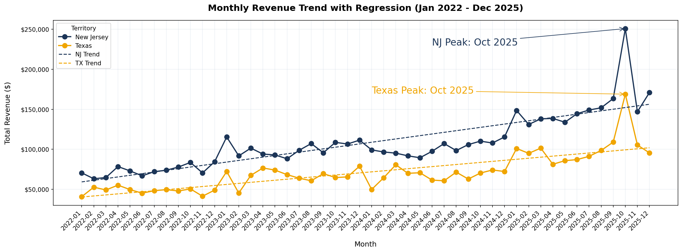
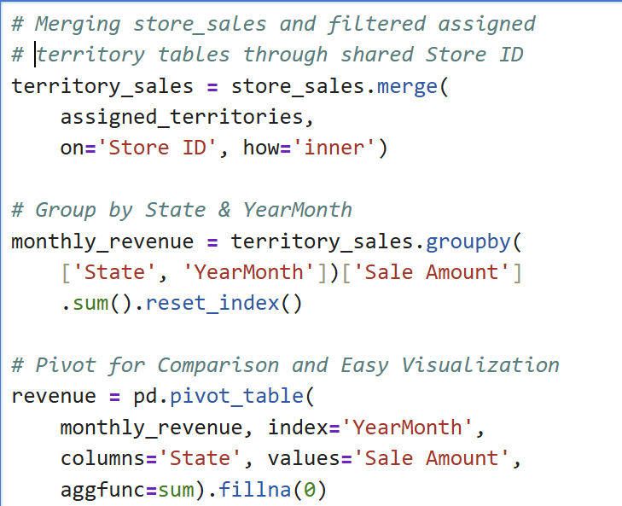
Q2 — Revenue
Monthly Territory Revenue Performance and Findings
Getting Results: Merged store_sales with assigned territories on Store ID, grouped by State and YearMonth, then pivoted for side-by-side territory comparison.
Findings: New Jersey consistently outperformed Texas across all 48 months. Both territories show an upward trend confirmed by regression lines, with a synchronized peak in October 2025 with NJ at $250,830 and TX at $168,956. Recurring dips during winter months suggest a student consumer base. NJ's regression slope is steeper than Texas, projecting stronger revenue momentum into 2026.

Slide 5
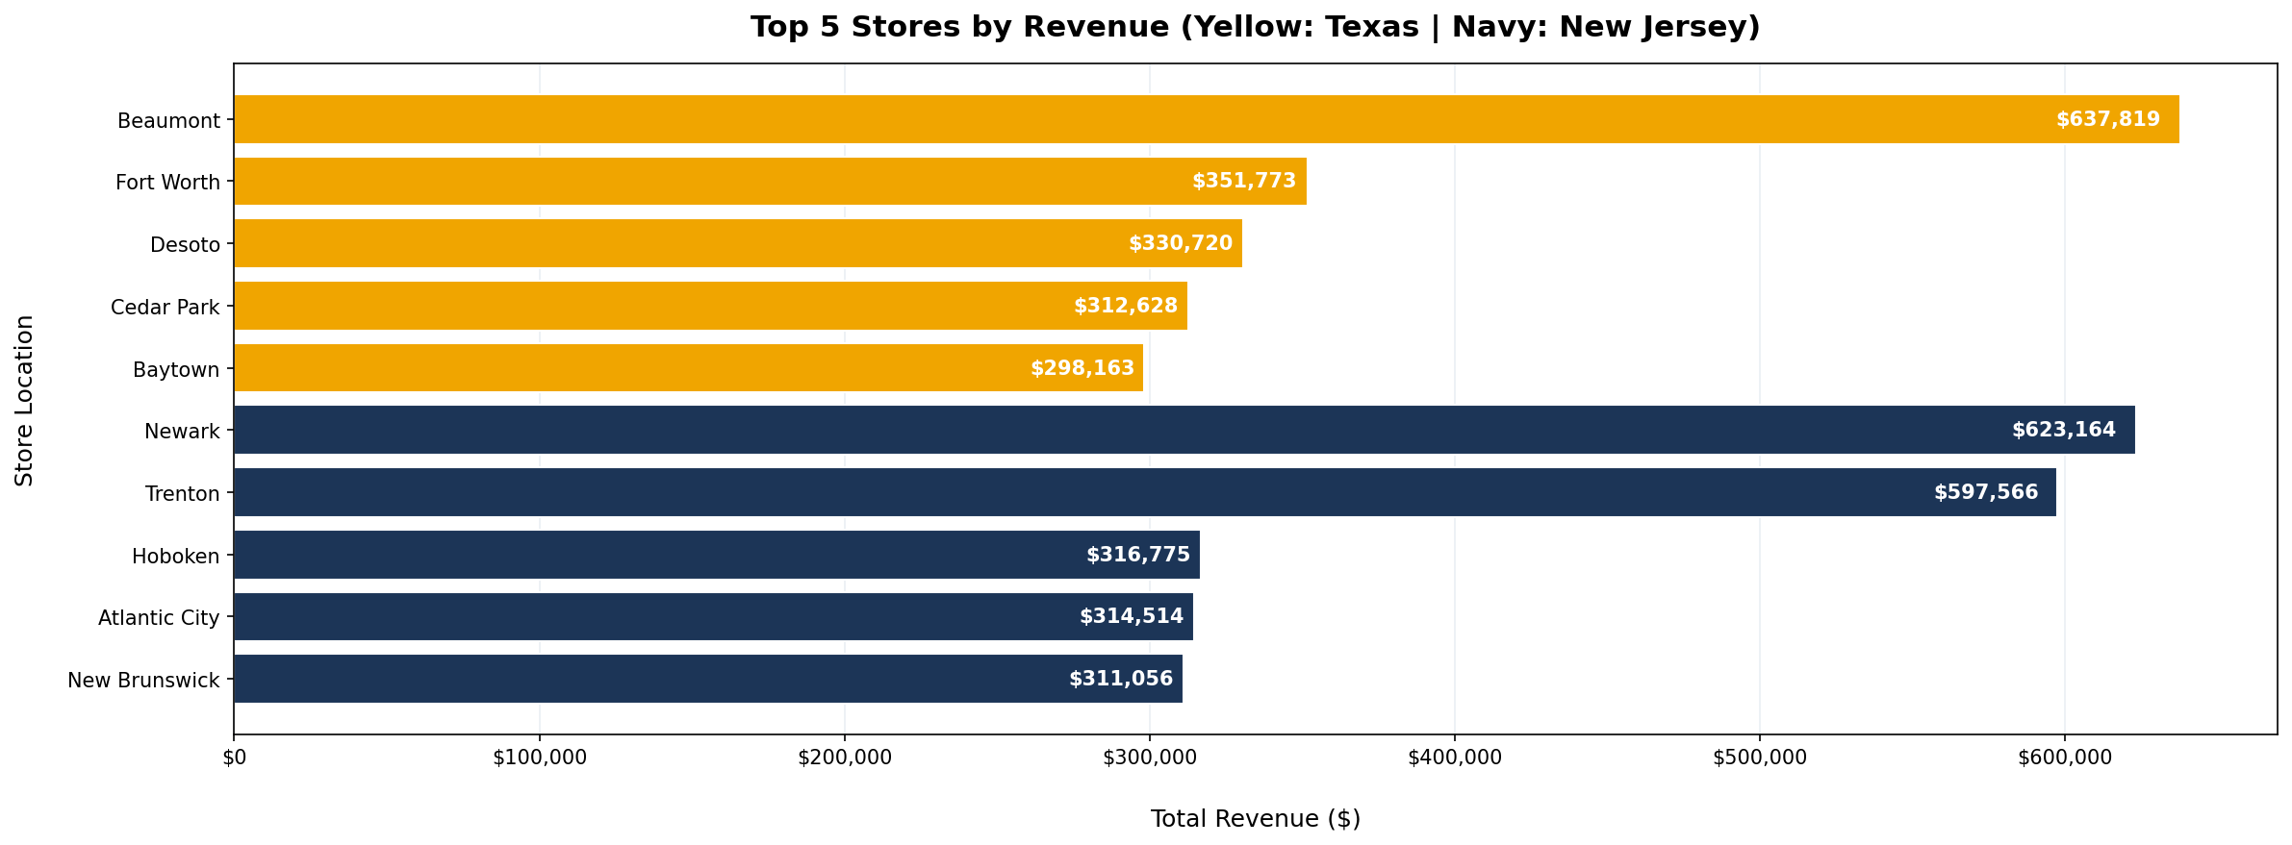
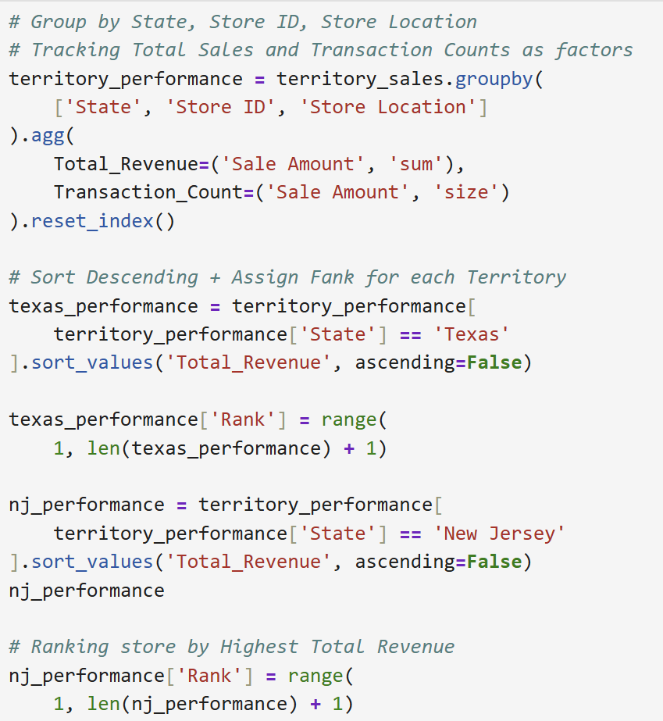
Q3 — Store Rankings
Store Rankings by Territory Sales and Findings
Getting Results: Grouped territory_sales by State, Store ID, and Store Location using .agg() to calculate both total revenue and transaction count simultaneously and add them as new columns. Then filtered by state and total revenue and sorted descending with assigned ranks.
Findings: Beaumont (TX) ranks #1 overall at $637,819 across both territories. Newark (NJ) leads New Jersey at $623,164. Most stores cluster between $285K–$355K, confirming NJ's revenue dominance is driven by store count rather than individual store quality. Dallas (TX) and Paterson (NJ) are notable outliers warranting store quality audits and targeted local marketing campaigns.

Slide 6
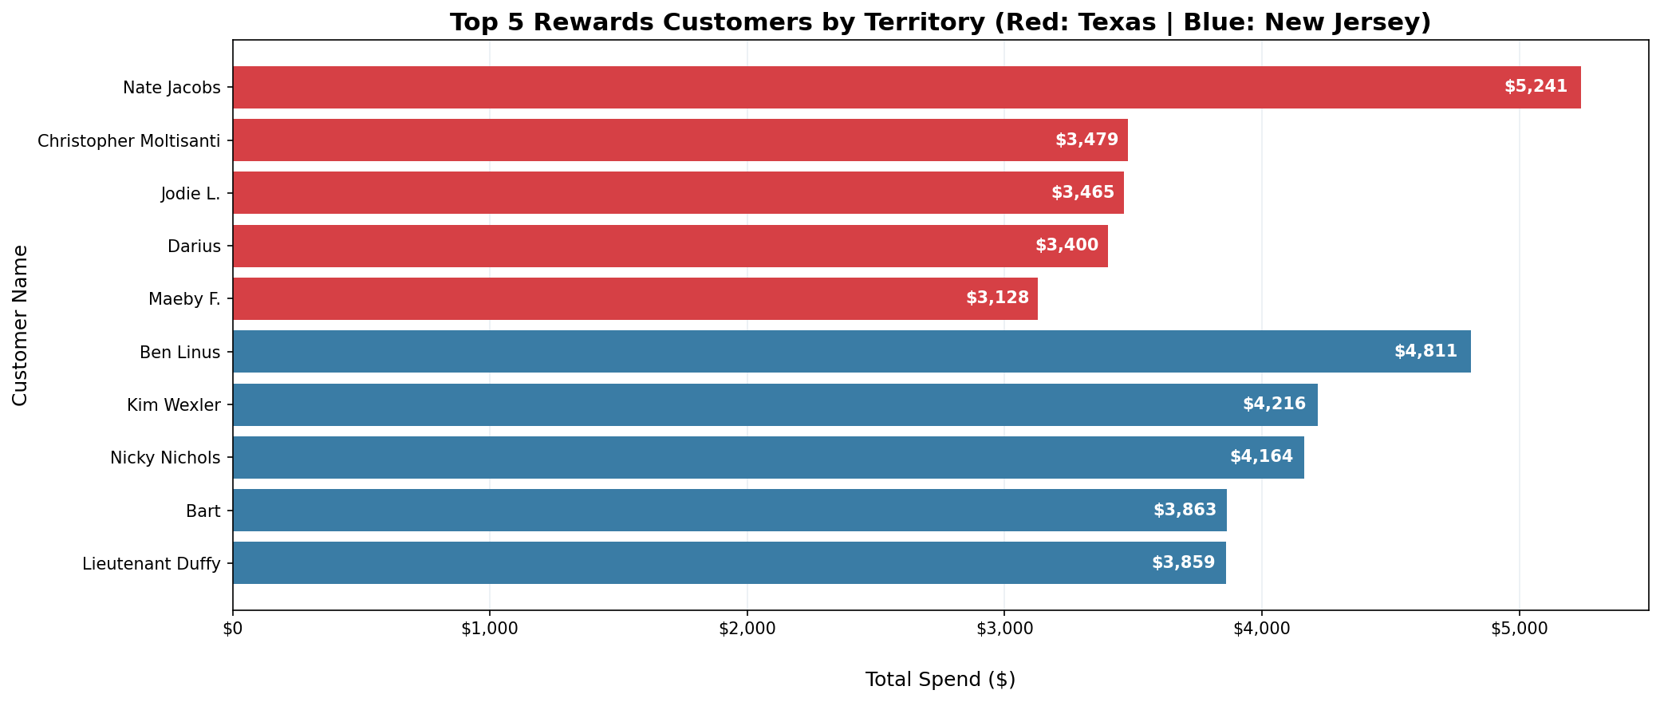
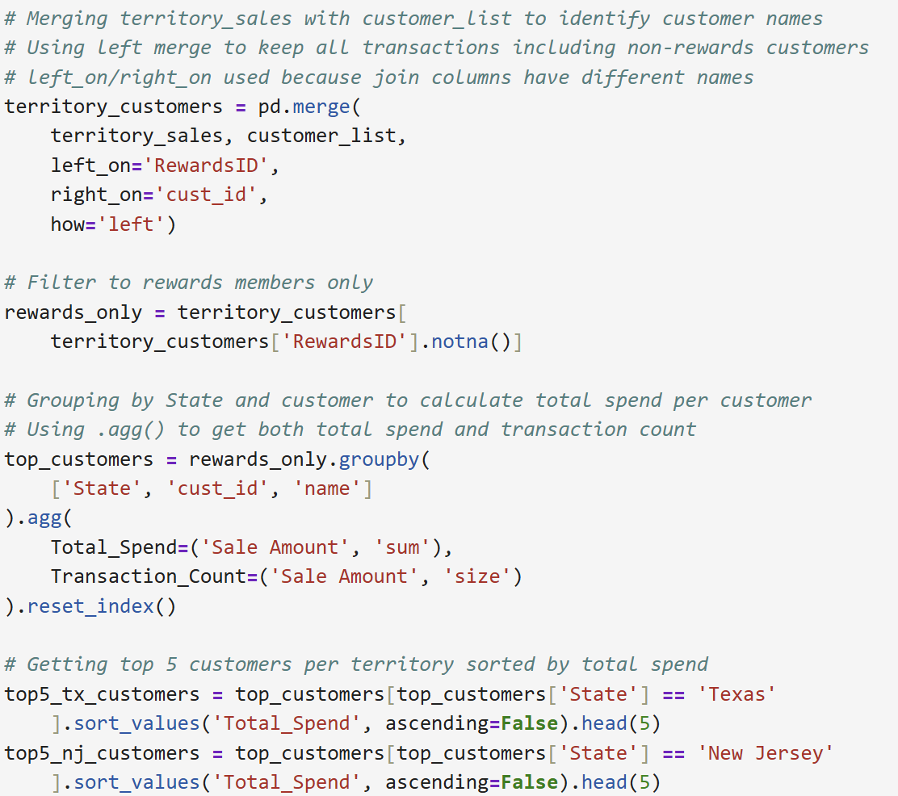
Q4 — Top Customers
Top Rewards Customers by Territory and Findings
Getting Results: Left merged territory_sales with customer_list on RewardsID and cust_id — different column names requiring left_on/right_on. Filtered to rewards members only using .notna(), then grouped by customer to calculate total spend and transaction count.
Findings: Texas' top rewards customer is Nate Jacobs at $5,241 across 10 transactions ($524 avg). New Jersey's top spender is Ben Linus at $4,811 across 8 transactions ($601 avg). Despite NJ's overall revenue dominance, Texas claims the top individual rewards spender. A critical data gap exists because the other non-rewards transactions cannot be individually tracked. This gap suggests that email-based rewards expansion may be a more inclusive tracking system.

Slide 7
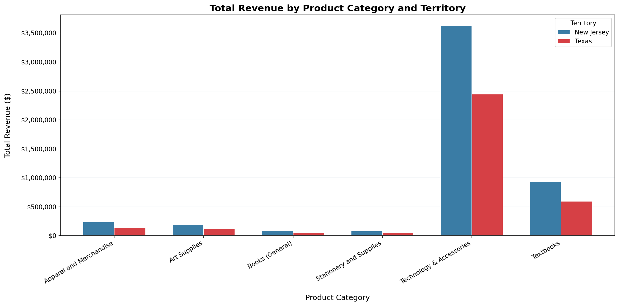
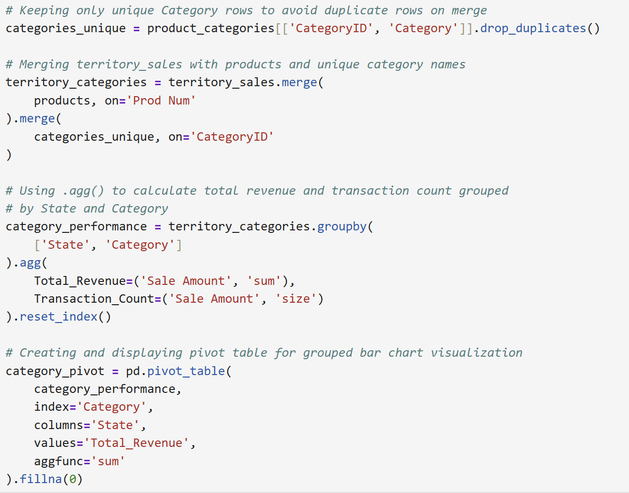
Q5 — Product Categories
Product Category Performance by Territory and Findings
Getting Results: Used drop_duplicates() on ProductCategories before merging to prevent duplicates. Chained two merges: territory_sales to products on shared Prod Num, and then on categories through shared CategoryID. Grouped by State and Category using .agg(), then pivoted for the grouped bar chart visualization.
Findings: Technology & Accessories dominates both territories generating approximately $3.6M in NJ and $2.4M in TX — far exceeding every other category. Stationery and Supplies ranks highest in transaction count but generates disproportionately low revenue, suggesting customers purchase frequently but spend minimally per visit, presenting a strong bundle opportunity. Books (General) shows the lowest revenue and transaction count across both territories.

Slide 8
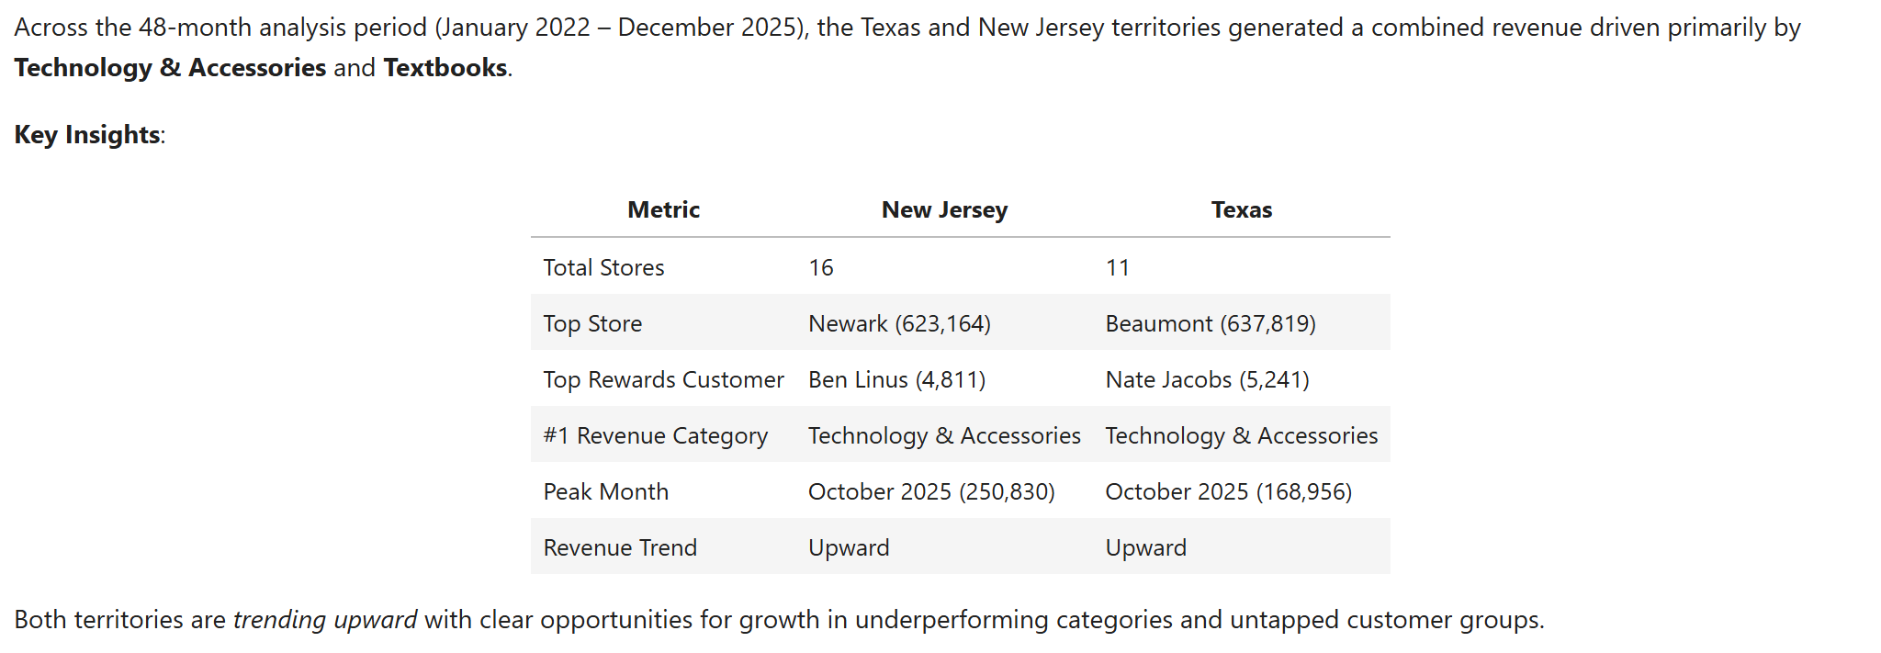
Executive Summary
Key Metrics for Both Territories

Slide 9
Marketing Focus Recommendations - Quarter 1 2026
Primary Focus: Technology & Accessories
1
Technology & Accessories is the clear revenue driver across both territories generating over $6M combined. Marketing efforts should prioritize promoting technology products, especially in Texas where the gap with New Jersey is largest. Leveraging Texas customer loyalty by offering care packages or accessories bundles with technology purchases could incentivize both existing and new customers to increase their spend in this category.
Secondary Focus: Stationery Bundle Strategy
2
Introducing bundle promotions pairing Stationery with Books or Art Supplies as back-to-school or premium studying packages would simultaneously lift revenue across three low-performing categories while targeting what the seasonal data suggests is a predominantly student consumer base.
Customer Retention: VIP Rewards + Email Tracking
3
A points-based VIP rewards expansion targeting high spenders could increase transaction frequency and drive enrollment among non-rewards customers who currently cannot be tracked. Since every transaction is already tied to an email address, implementing a lightweight email-based tracking system would provide full visibility into customer behavior across both territories, not just rewards members.
Store Performance Disparity: Address Outliers
4
Dallas' underperformance is surprising given its metropolitan population of approximately 1.3 million according to the U.S. Census Bureau, suggesting location alone is not the issue. Jeff Richards and Miami Vue should conduct store quality audits examining foot traffic, product placement, and staff engagement. Replicating successful tactics from top-performing stores Beaumont (TX) and Newark (NJ) is a practical first step before investing in larger external campaigns.

Slide 10

GitHub Repository
Thank You!
https://github.com/sguerrero777/Capstone_2.git
sguerrero@my.yearupunited.org

